Slide 1
DFT – Tight-binding
Maurits W. Haverkort
Institute for theoretical physics – Heidelberg University
M.W.Haverkort@thphys.uni-heidelberg.de

Slide 2
Three examples
MgO
NiO
Alkali metals

Slide 4
MgO – rocksalt structure
O
Mg

Slide 5
MgO – band-structure
Mg-3s character
O-2p character

Slide 6
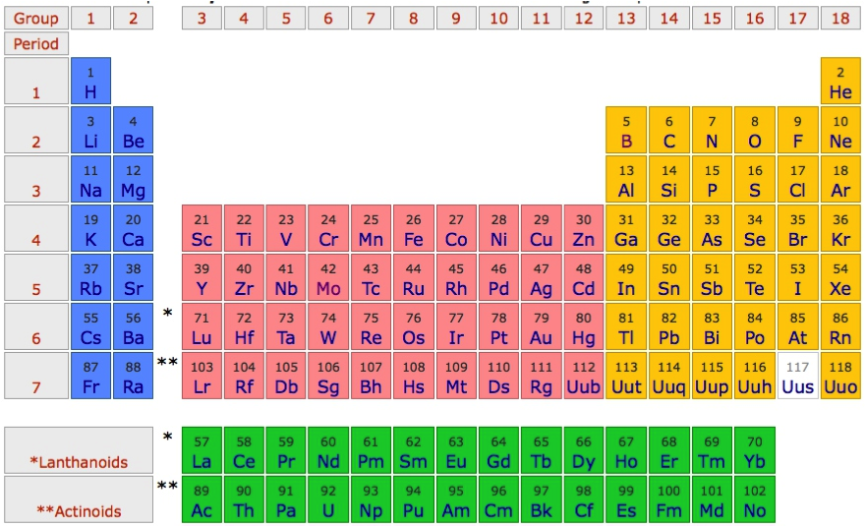
MgO – band-structure

Slide 7
MgO – band-structure
1s²2s²2p⁴
1s²2s²2p⁶3s²

Slide 8
MgO – band-structure
1s²2s²2p⁶
1s²2s²2p⁶3s⁰

Slide 9
MgO – band-structure
Mg-3s character
O-2p character

Slide 10
MgO – band-structure – minimal basis O-p and Mg-s

Slide 11
MgO – atomic orbitals
Mg-3s

Slide 12
MgO – atomic orbitals
O-2p

Slide 13
MgO – atomic orbitals
Mg-3s
O-2p

Slide 14
MgO – wannier orbitals
Mg-3s
atomic
Mg-3s
Wannier

Slide 15
MgO – wannier orbitals
O-2p
atomic
O-2p
Wannier

Slide 16
MgO – wannier orbitals

Slide 17
MgO – wannier orbitals
Mg-3s
Wannier
O-2p
Wannier
Mg-3s
atomic
O-2p
atomic

Slide 18
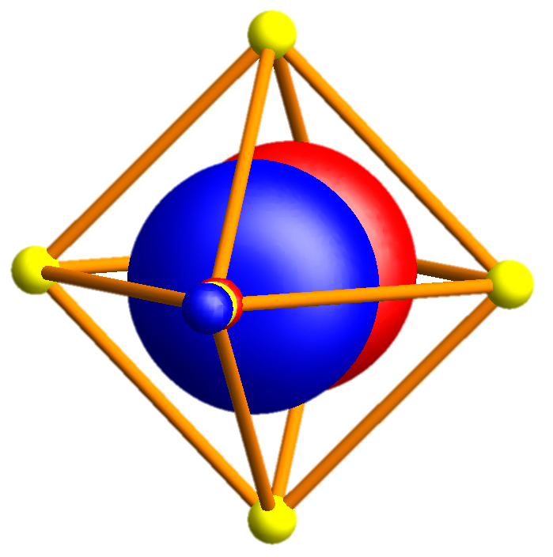
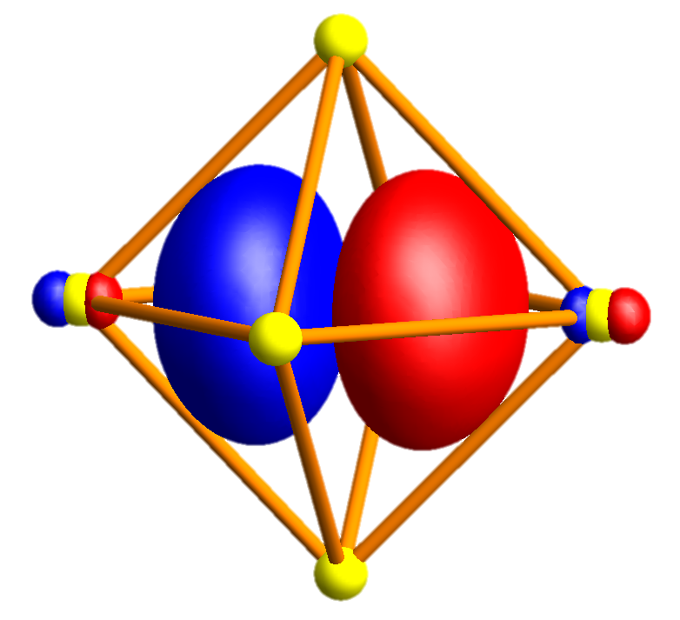
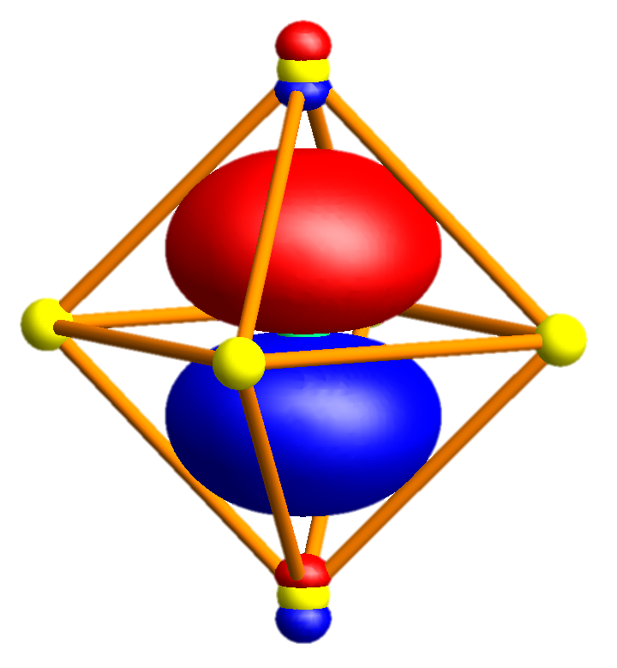
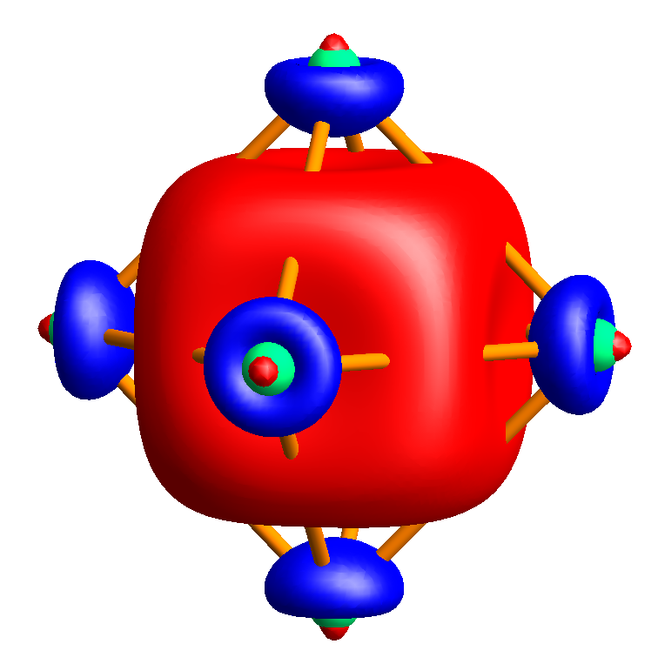
MgO – wannier orbitals

Slide 19
MgO – band-structure
Mg-3s character
O-2p character

Slide 20
MgO – band-structure – minimal basis O-p and Mg-s

Slide 21
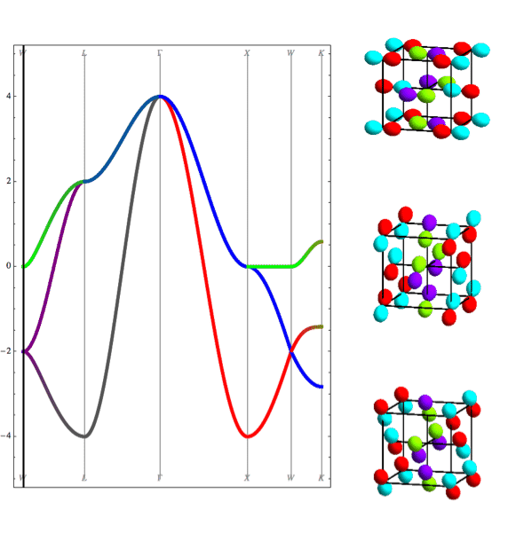
MgO – band-structure
Nearest neighbor tight binding
Full DFT calculation
L
Γ
X
W

Slide 22
MgO – band-structure – minimal basis O-p and Mg-s
Mg 3s
O 2p
O 2s
Mg 2p

Slide 23
MgO – band-structure – minimal basis O-p and Mg-s
Mg 3s
O 2p
O 2s
Mg 2p

Slide 24
MgO – band-structure – minimal basis O-p and Mg-s
Mg 3s
Mg 3s
O 2p
O 2p
O 2s
Mg 2p

Slide 25
MgO – band-structure – minimal basis O-p and Mg-s
Mg 3s
Mg 3s
O 2p
O 2p
O 2s
Mg 2p

Slide 26
NiO – rocksalt structure
O
Ni

Slide 27

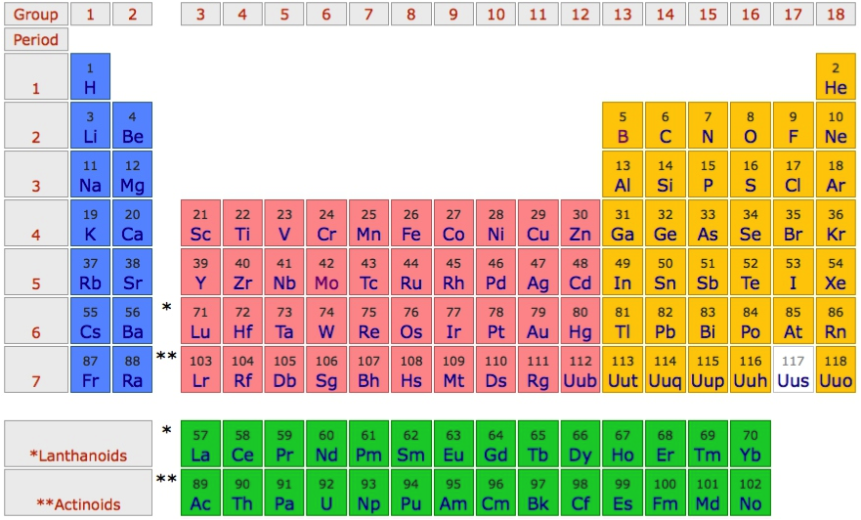
Use NiO as an example material
O²⁻ - 2p⁶
Ni²⁺ - 4s⁰ 3d⁸

Slide 28
“Downfold” the DFT results to obtain basis of choice

Slide 29
Pick a basis of “TM-d” and “O-p” Wannier orbitals
e_{g} σ bond
t_{2g} π bond

Slide 30
The TM-d Wannier orbitals are very close to atomic orbitals

Slide 31
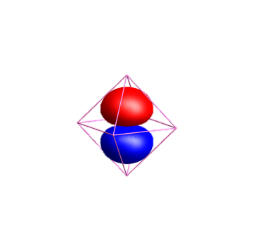
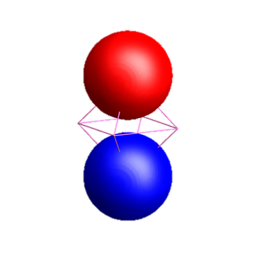
The O-p Wannier orbitals have tails!!!
O-2p
Ni-4s

Slide 32
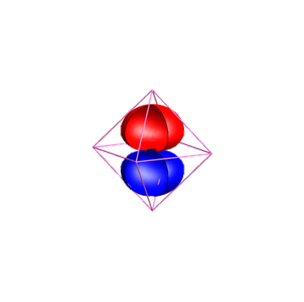
The O-p Wannier orbitals have tails!!!
O-2p
Ni-4s

Slide 33
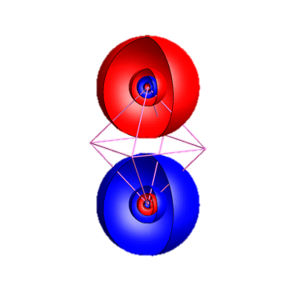
The O-p Wannier orbitals have tails!!!
O-2p
Ni-4s

Slide 34
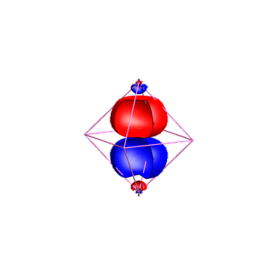
The O-p Wannier orbitals have tails!!!
Ni-4s
O-2p

Slide 35
Pick a basis of “TM-d” and “O-p” Wannier orbitals

Slide 36
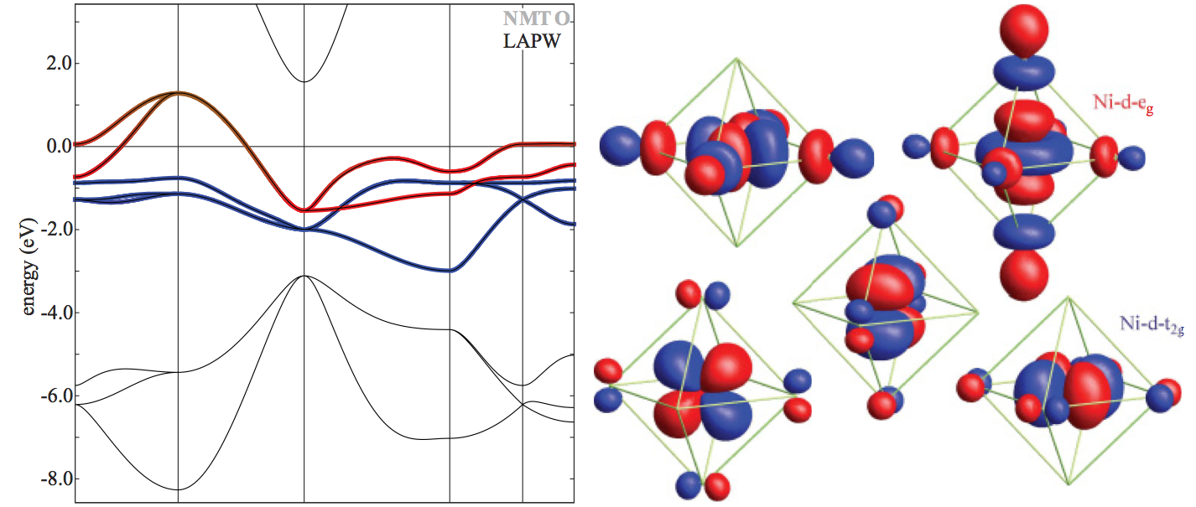
Pick a basis of “TM-d” Wannier orbitals

Slide 37
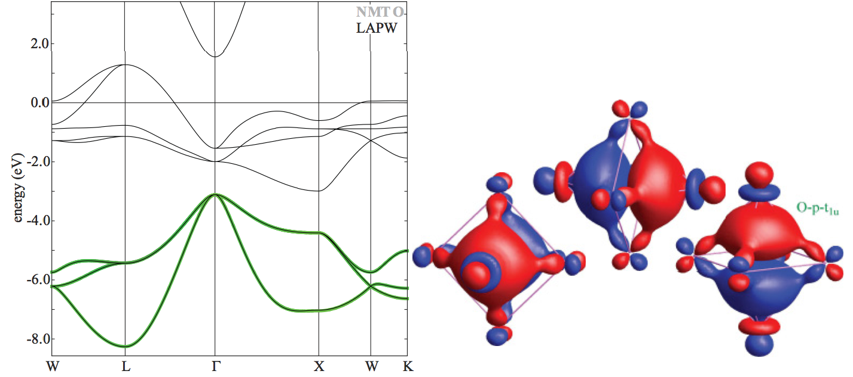
Pick a basis of “O-p” Wannier orbitals

Slide 38
NiO in a LDA band-structure picture

Slide 39
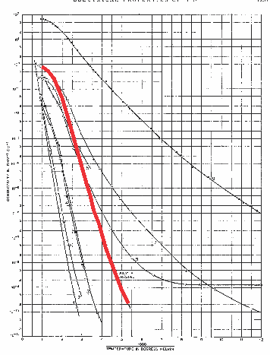
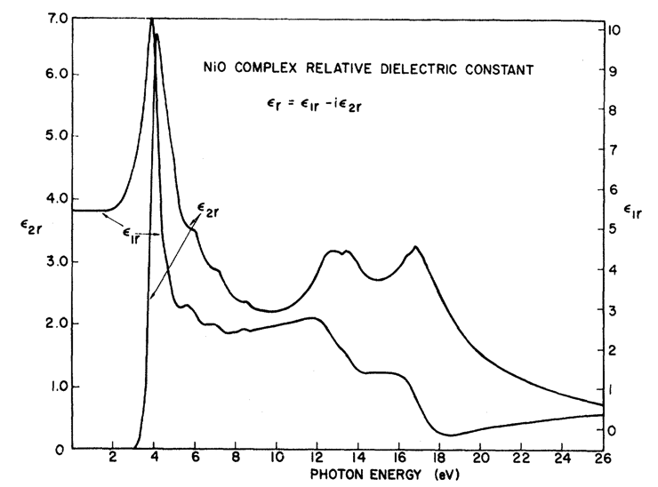
In LDA NiO is a metal: Experimentally it is a good insulator
F. J. Morin, Phys. Rev. 93, 1199 (1954)
R. Newman and R. M. Chrenko,
Phys. Rev 114 1507 (1959)
Room temperature
ρ~10⁵ Ο cm
Optical-gap
3.5 – 4.0 eV

Slide 40
“Downfold” the DFT results to obtain basis of choice

Slide 41
Orbital energy level diagram obtained from LDA

Slide 42
Orbital energy level diagram obtained from LDA

Slide 43
Orbital energy level diagram obtained from LDA

Slide 44
Orbital energy level diagram obtained from LDA

Slide 45
Orbital energy level diagram obtained from LDA

Slide 46
Create ligand orbitals from O-2p Wannier orbitals

Slide 47
Create ligand orbitals from O-2p Wannier orbitals

Slide 48
Create ligand orbitals from O-2p Wannier orbitals

Slide 49
Create ligand orbitals from O-2p Wannier orbitals

Slide 50
Create ligand orbitals from O-2p Wannier orbitals

Slide 51
Create ligand orbitals from O-2p Wannier orbitals

Slide 52
Create ligand orbitals from O-2p Wannier orbitals

Slide 53
Create ligand orbitals from O-2p Wannier orbitals

Slide 54
Create ligand orbitals from O-2p Wannier orbitals

Slide 55
Create ligand orbitals from O-2p Wannier orbitals

Slide 56
Create ligand orbitals from O-2p Wannier orbitals

Slide 57
Create ligand orbitals from O-2p Wannier orbitals

Slide 58
Create ligand orbitals from O-2p Wannier orbitals

Slide 59
Create ligand orbitals from O-2p Wannier orbitals

Slide 60
Orbital energy level diagram obtained from LDA

Slide 61
Tight binding description of Alkali metals
Alkali metals are close to free electron like

Slide 62
Free electron like description
Energy momentum relation of a free electron
Maximal velocity is given by the Fermi momentum

Slide 63
Free electron like description – Brillouin zone folding

Slide 64
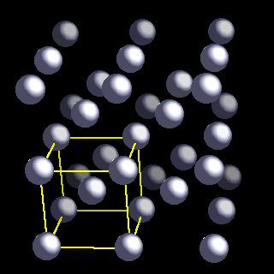
Brillion zone of Li (bcc)

Slide 65
Brillion zone of Li

Slide 66
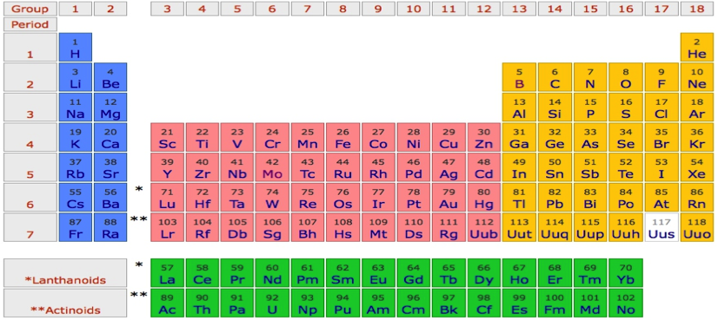
Li
P
Γ
P
H
P
Γ
P
H
P
Γ
P

Slide 67
Na
P
Γ
P
H
P
Γ
P
H
P
Γ
P

Slide 68
K
P
Γ
P
H
P
Γ
P
H
P
Γ
P

Slide 69
Rb
P
Γ
P
H
P
Γ
P
H
P
Γ
P

Slide 70
Cs
P
Γ
P
H
P
Γ
P
H
P
Γ
P

Slide 71
Fr
P
Γ
P
H
P
Γ
P
H
P
Γ
P

Slide 72
Li - Tigth binding description – “atomic” orbitals
φ_{2s}(r)
Li-atom
neighbor
Li-atom
neighbor
Li-atom

Slide 73
Li - Tigth binding description – “atomic” orbitals

Slide 74
Li - Tigth binding description – “atomic” orbitals
Non-orthogonal
Basis, but that is ok.

Slide 75
Li - Tigth binding description – “atomic” orbitals
Tight binding description of free electron like state

Slide 76
Li - Tigth binding description – “atomic” orbitals

Slide 77
Li - Tigth binding description – “atomic” orbitals

Slide 78
Li - Tigth binding description – “atomic” orbitals

Slide 79
Li - Tigth binding description – “atomic” orbitals

Slide 80
Li - Tigth binding description – “atomic” orbitals

Slide 81
Li - Tigth binding description – “atomic” orbitals

Slide 82
Li - Tigth binding description – “atomic” orbitals

Slide 83
Li - Tigth binding description – “atomic” orbitals

Slide 84
Li - Tigth binding description – “atomic” orbitals
p_{x}
s

Slide 85
Li - Tigth binding description – “atomic” orbitals
p_{z}
s
p_{x}
p_{y}

Slide 86
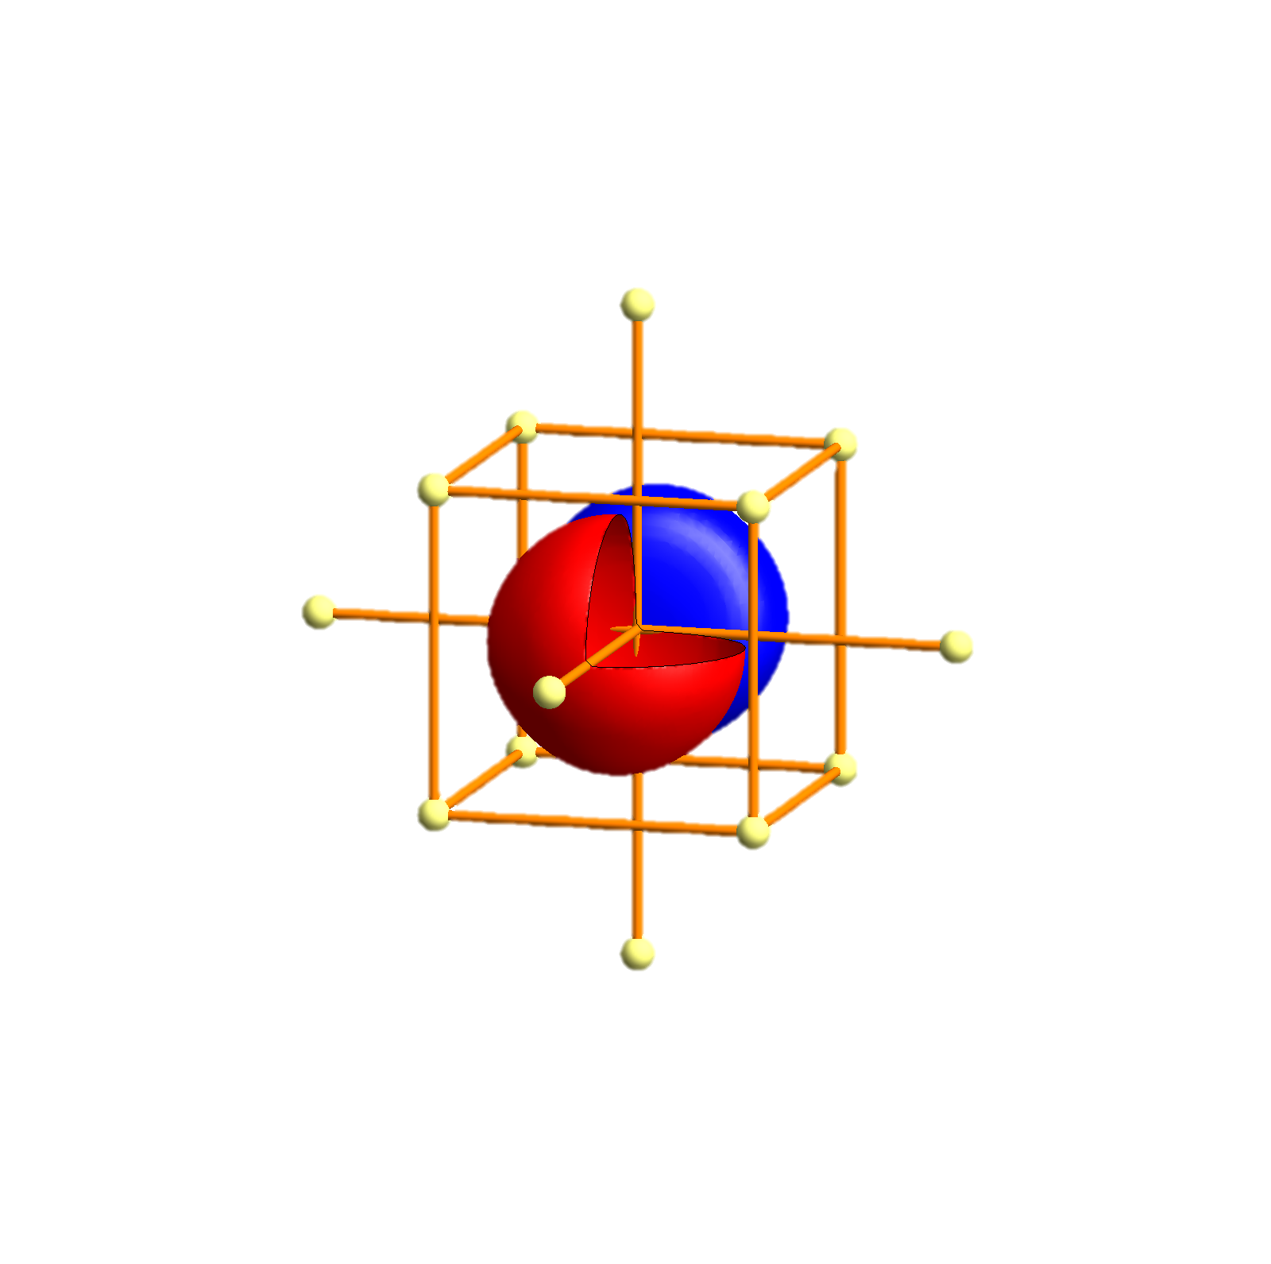
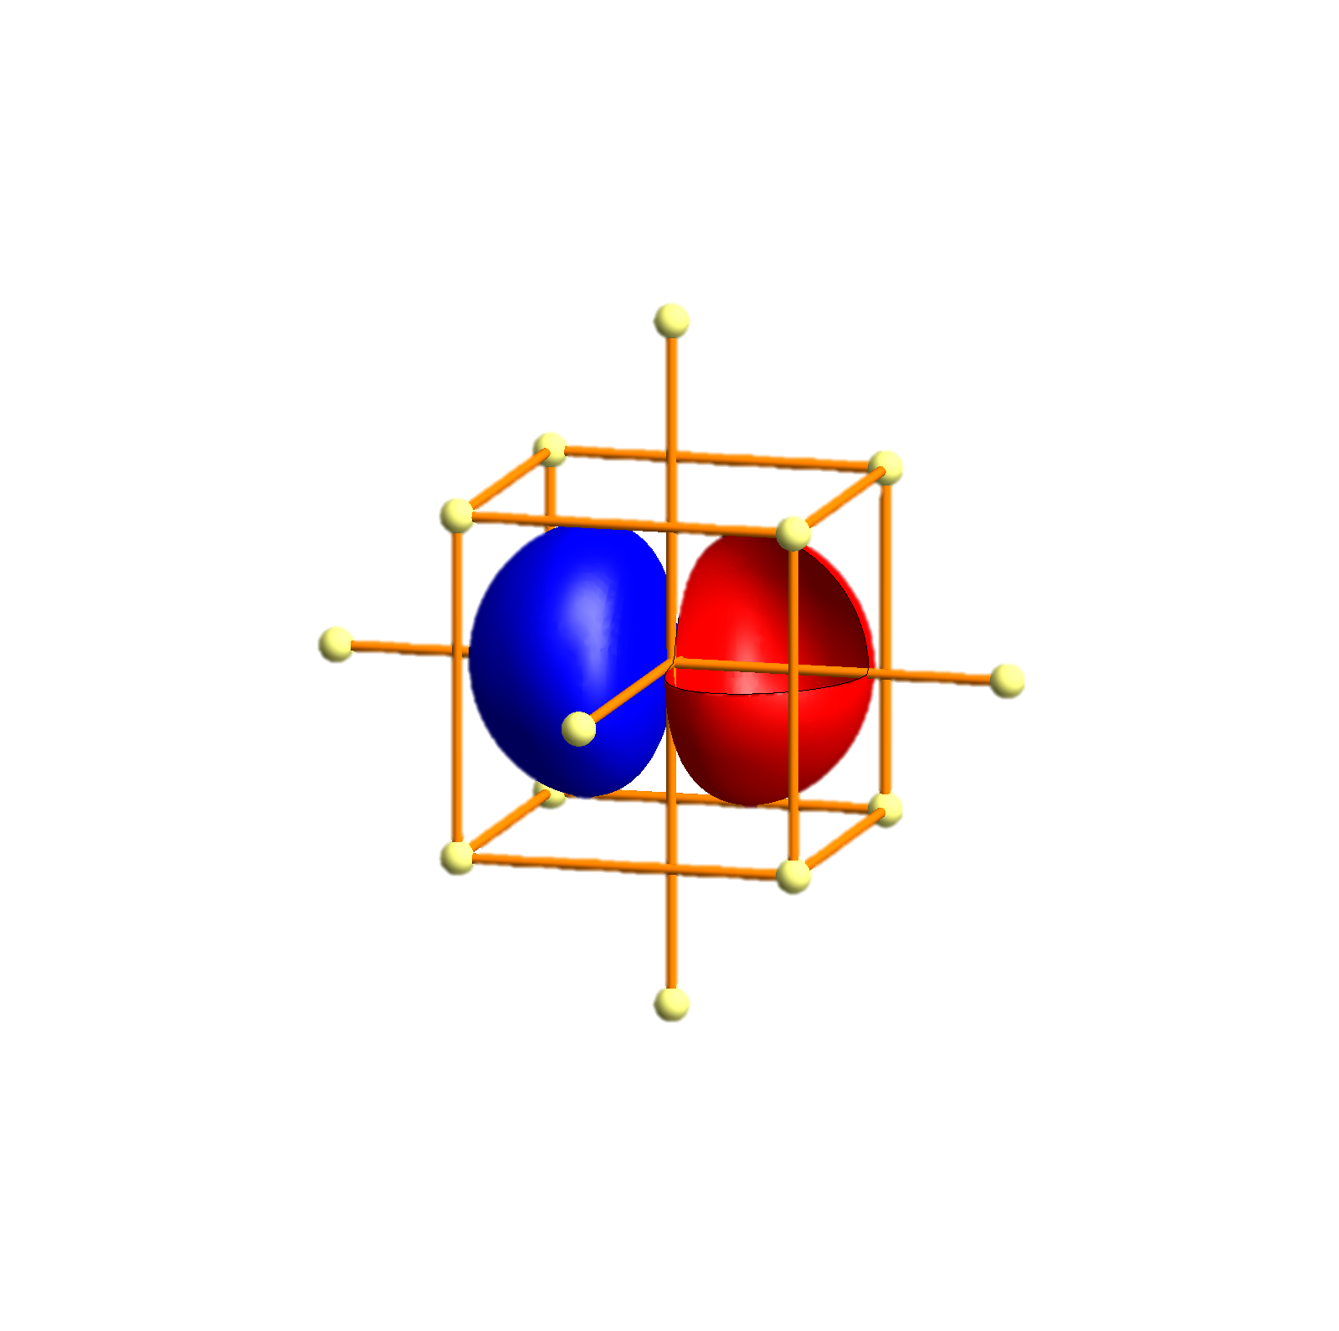
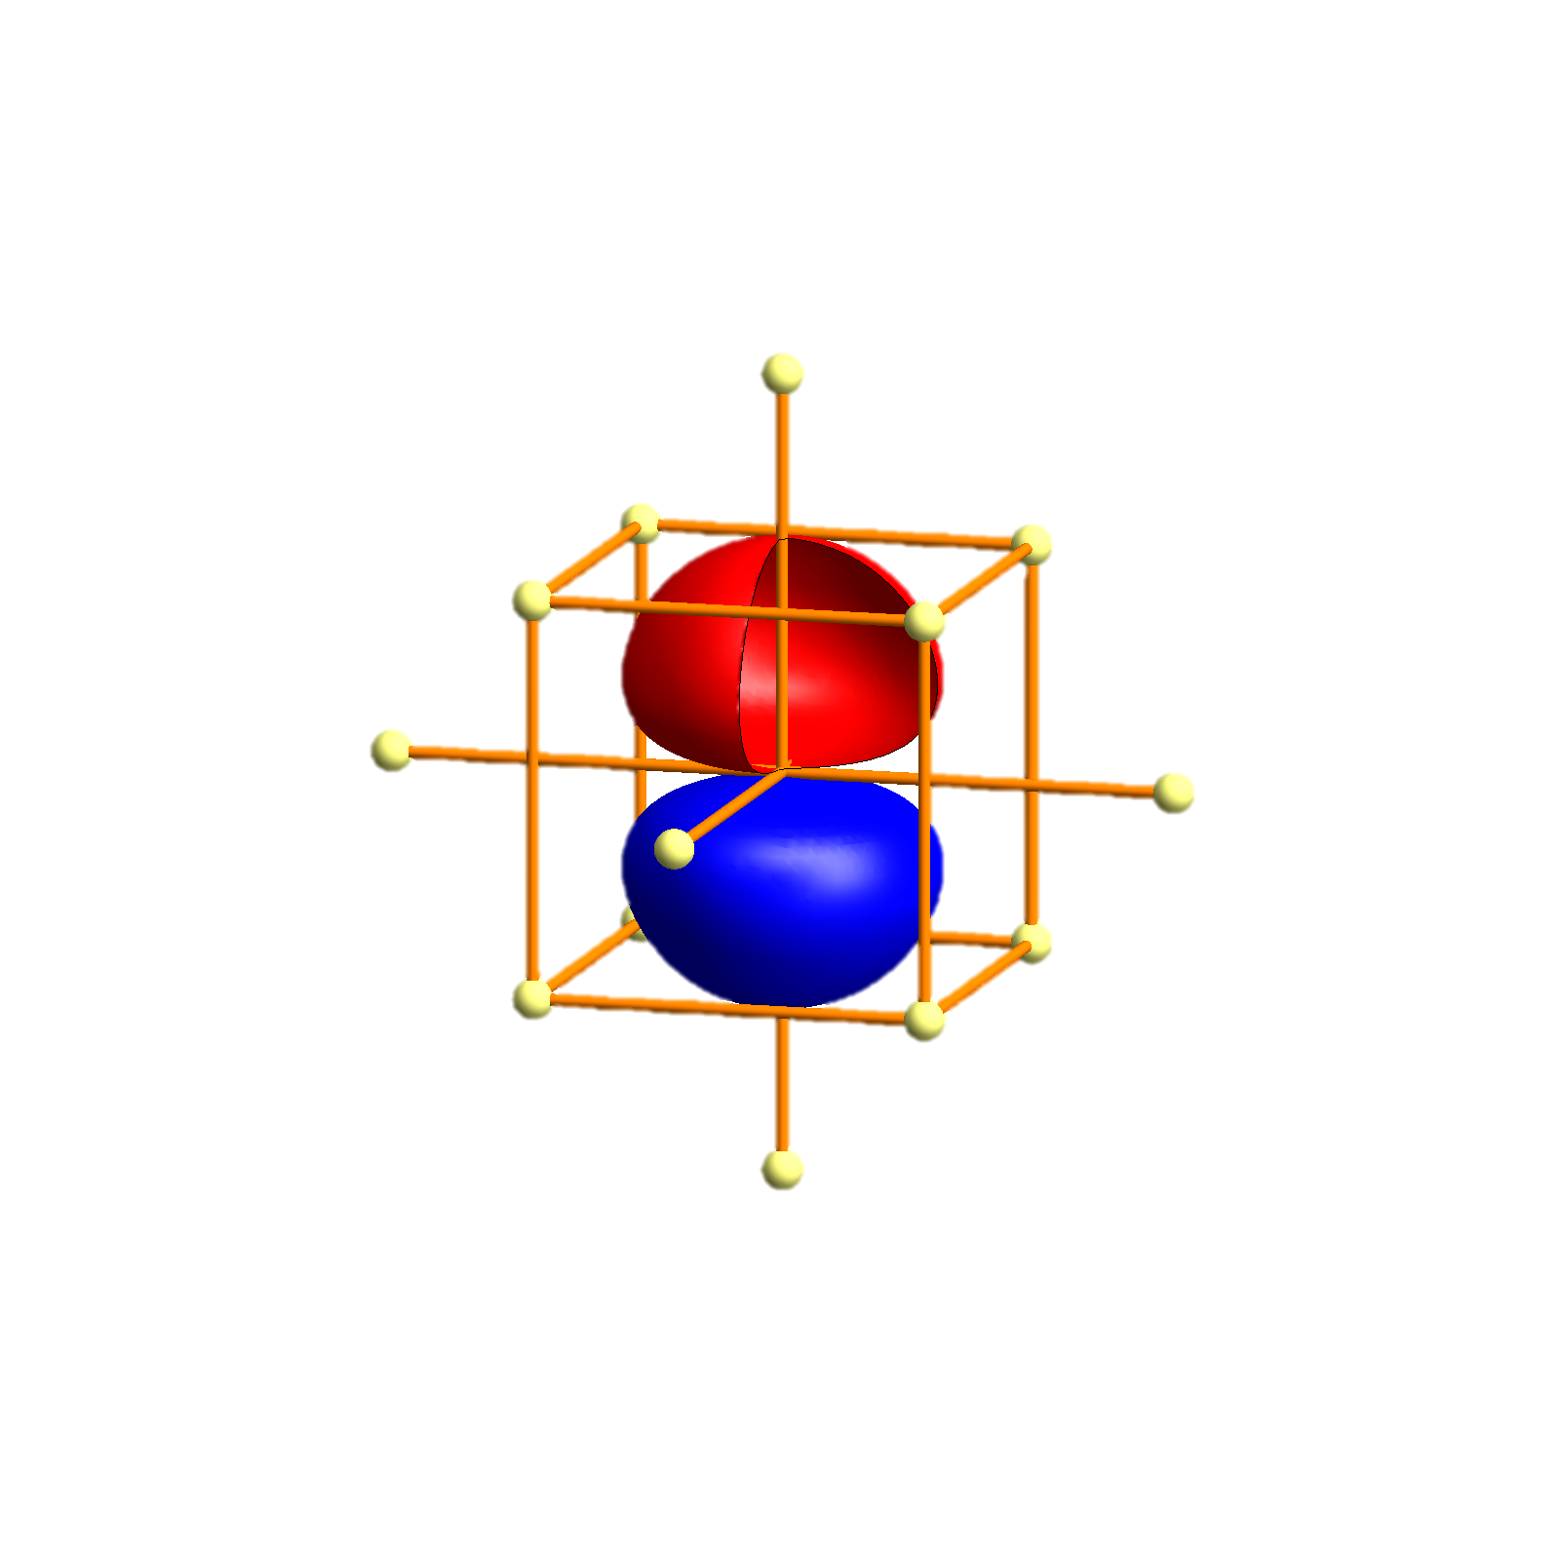
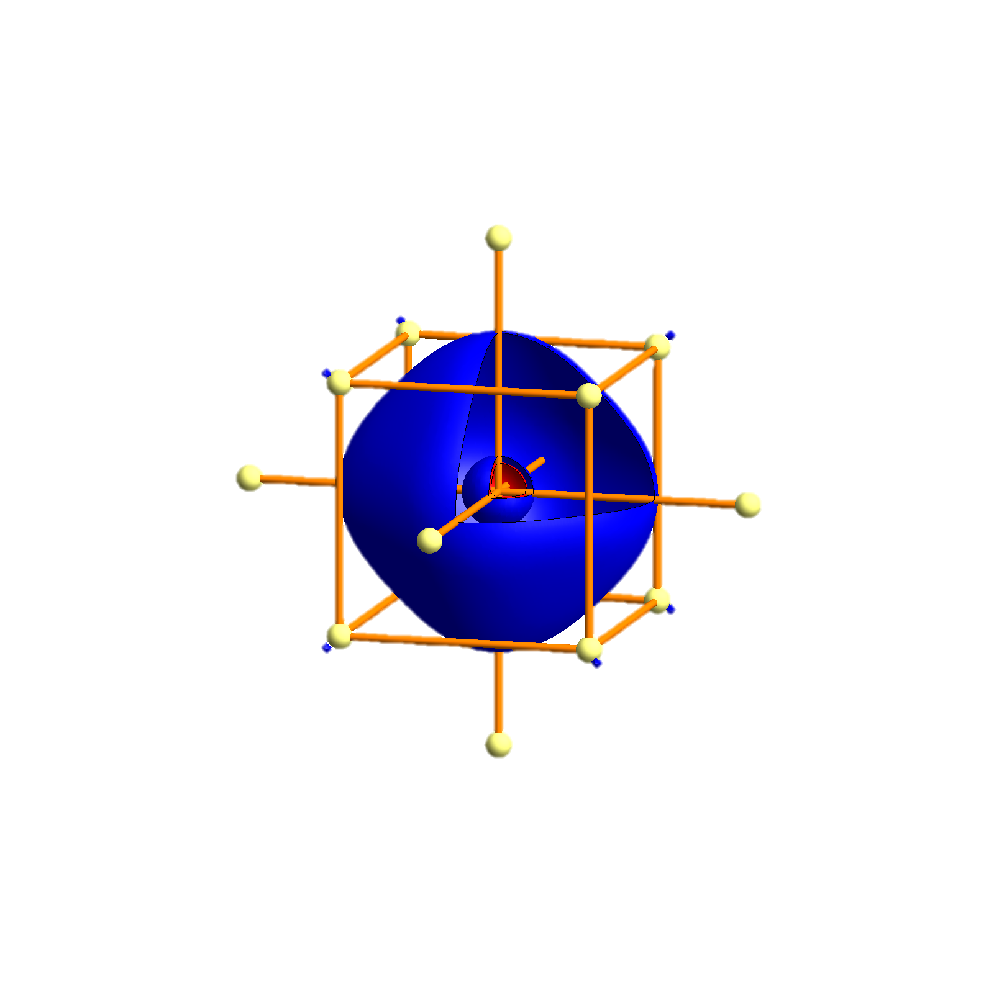
Li - Tigth binding description – atomic orbitals
p_{x}
p_{x}
p_{y}
p_{z}
s
s
P
Γ
P
H
P
Γ
P
H
P
Γ
P

Slide 87
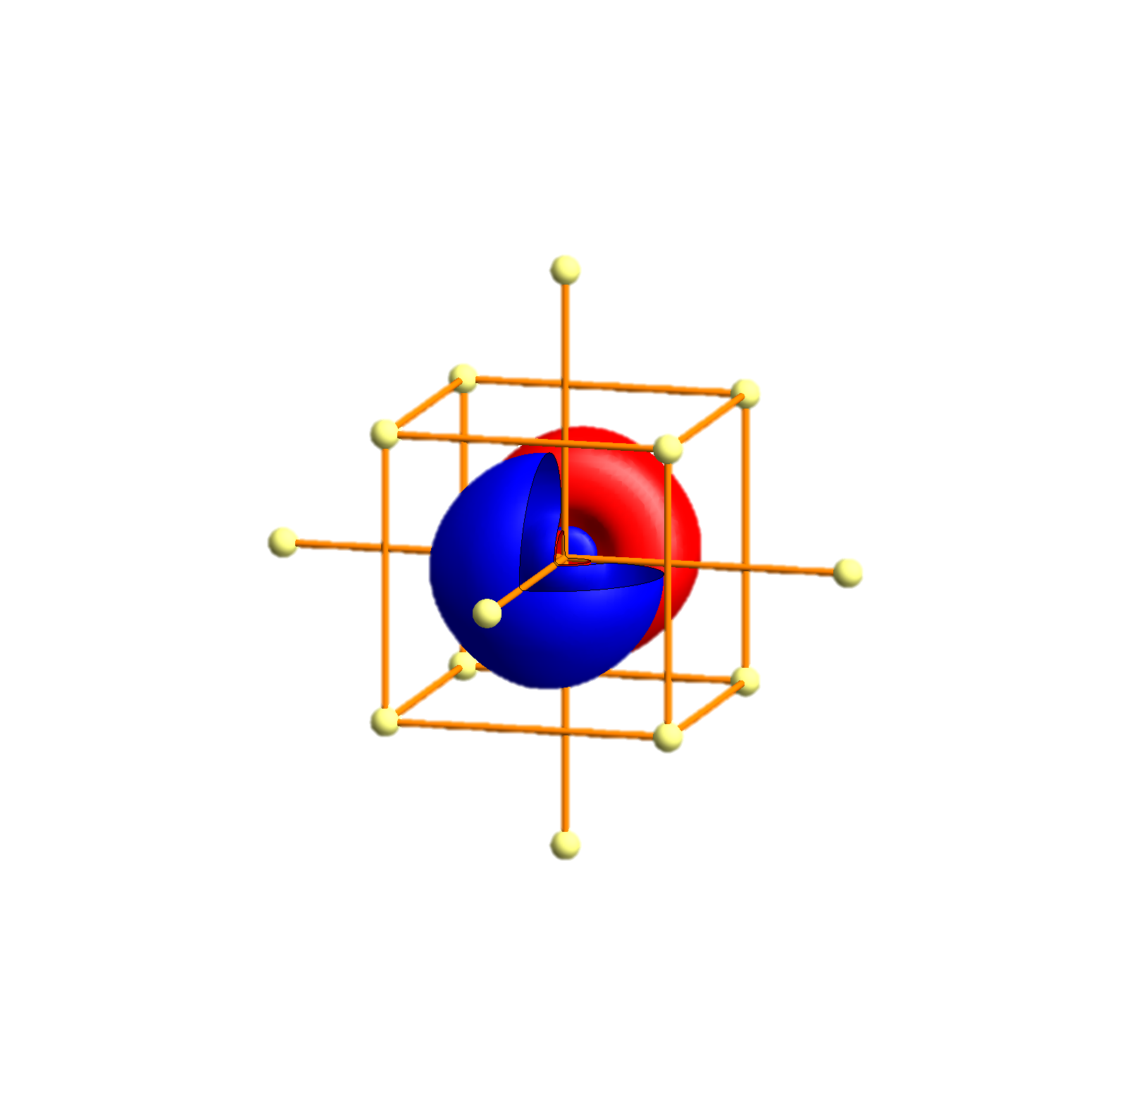
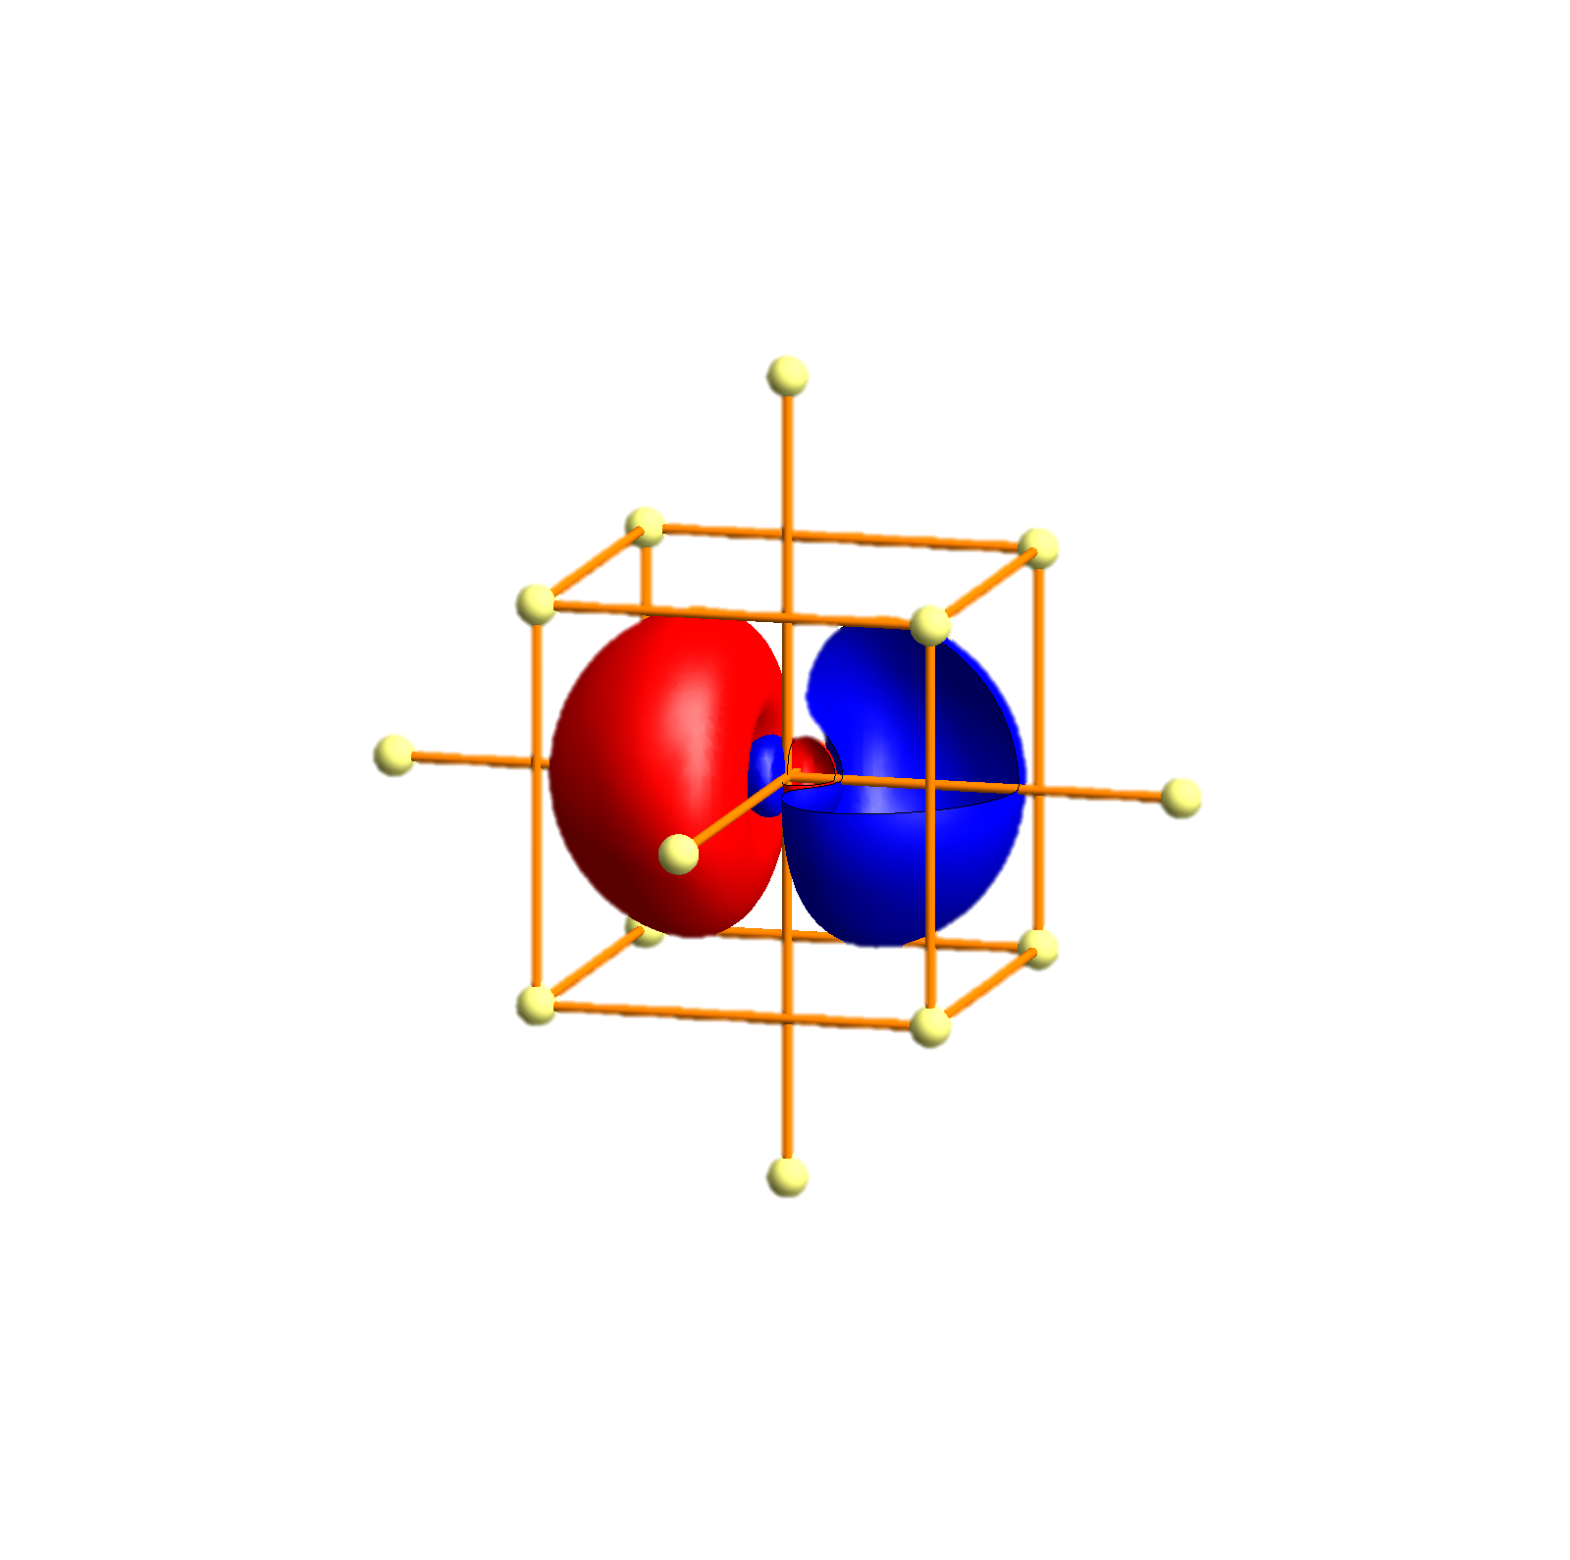
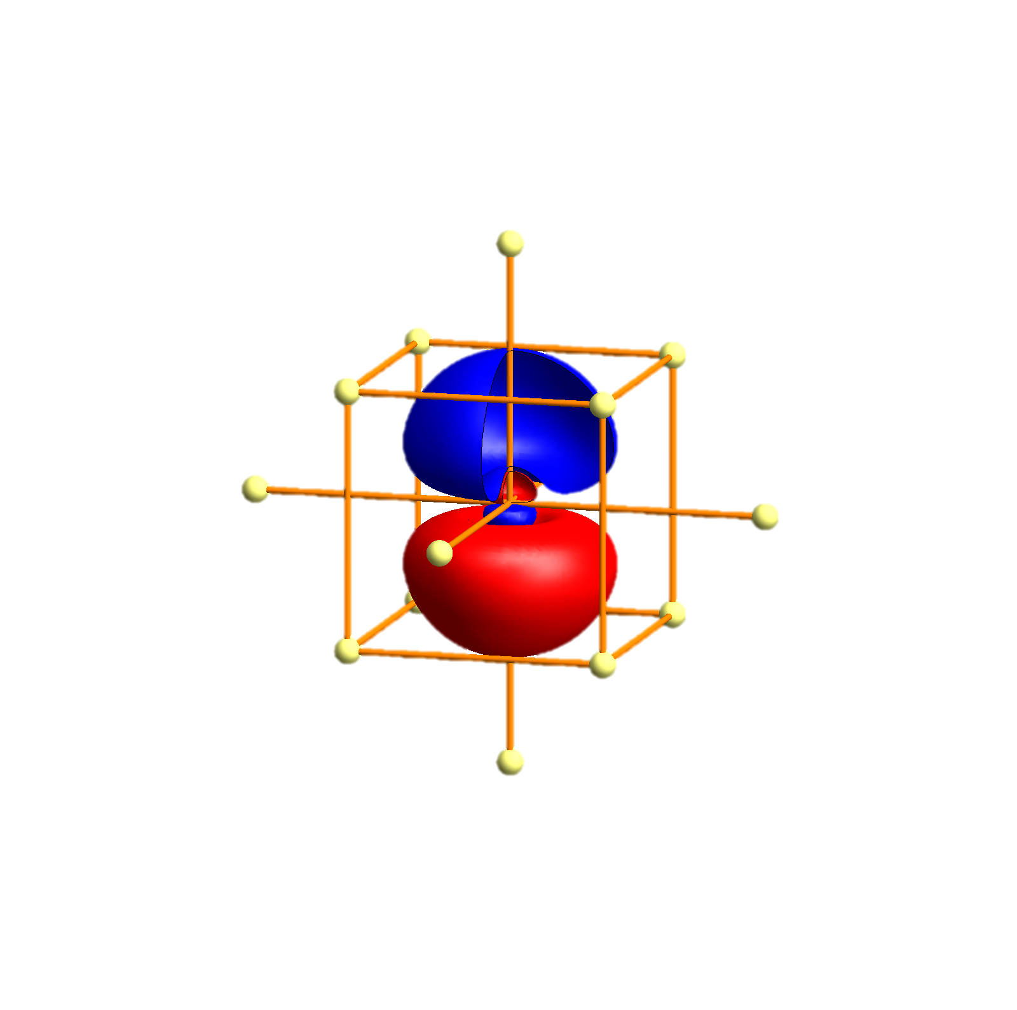
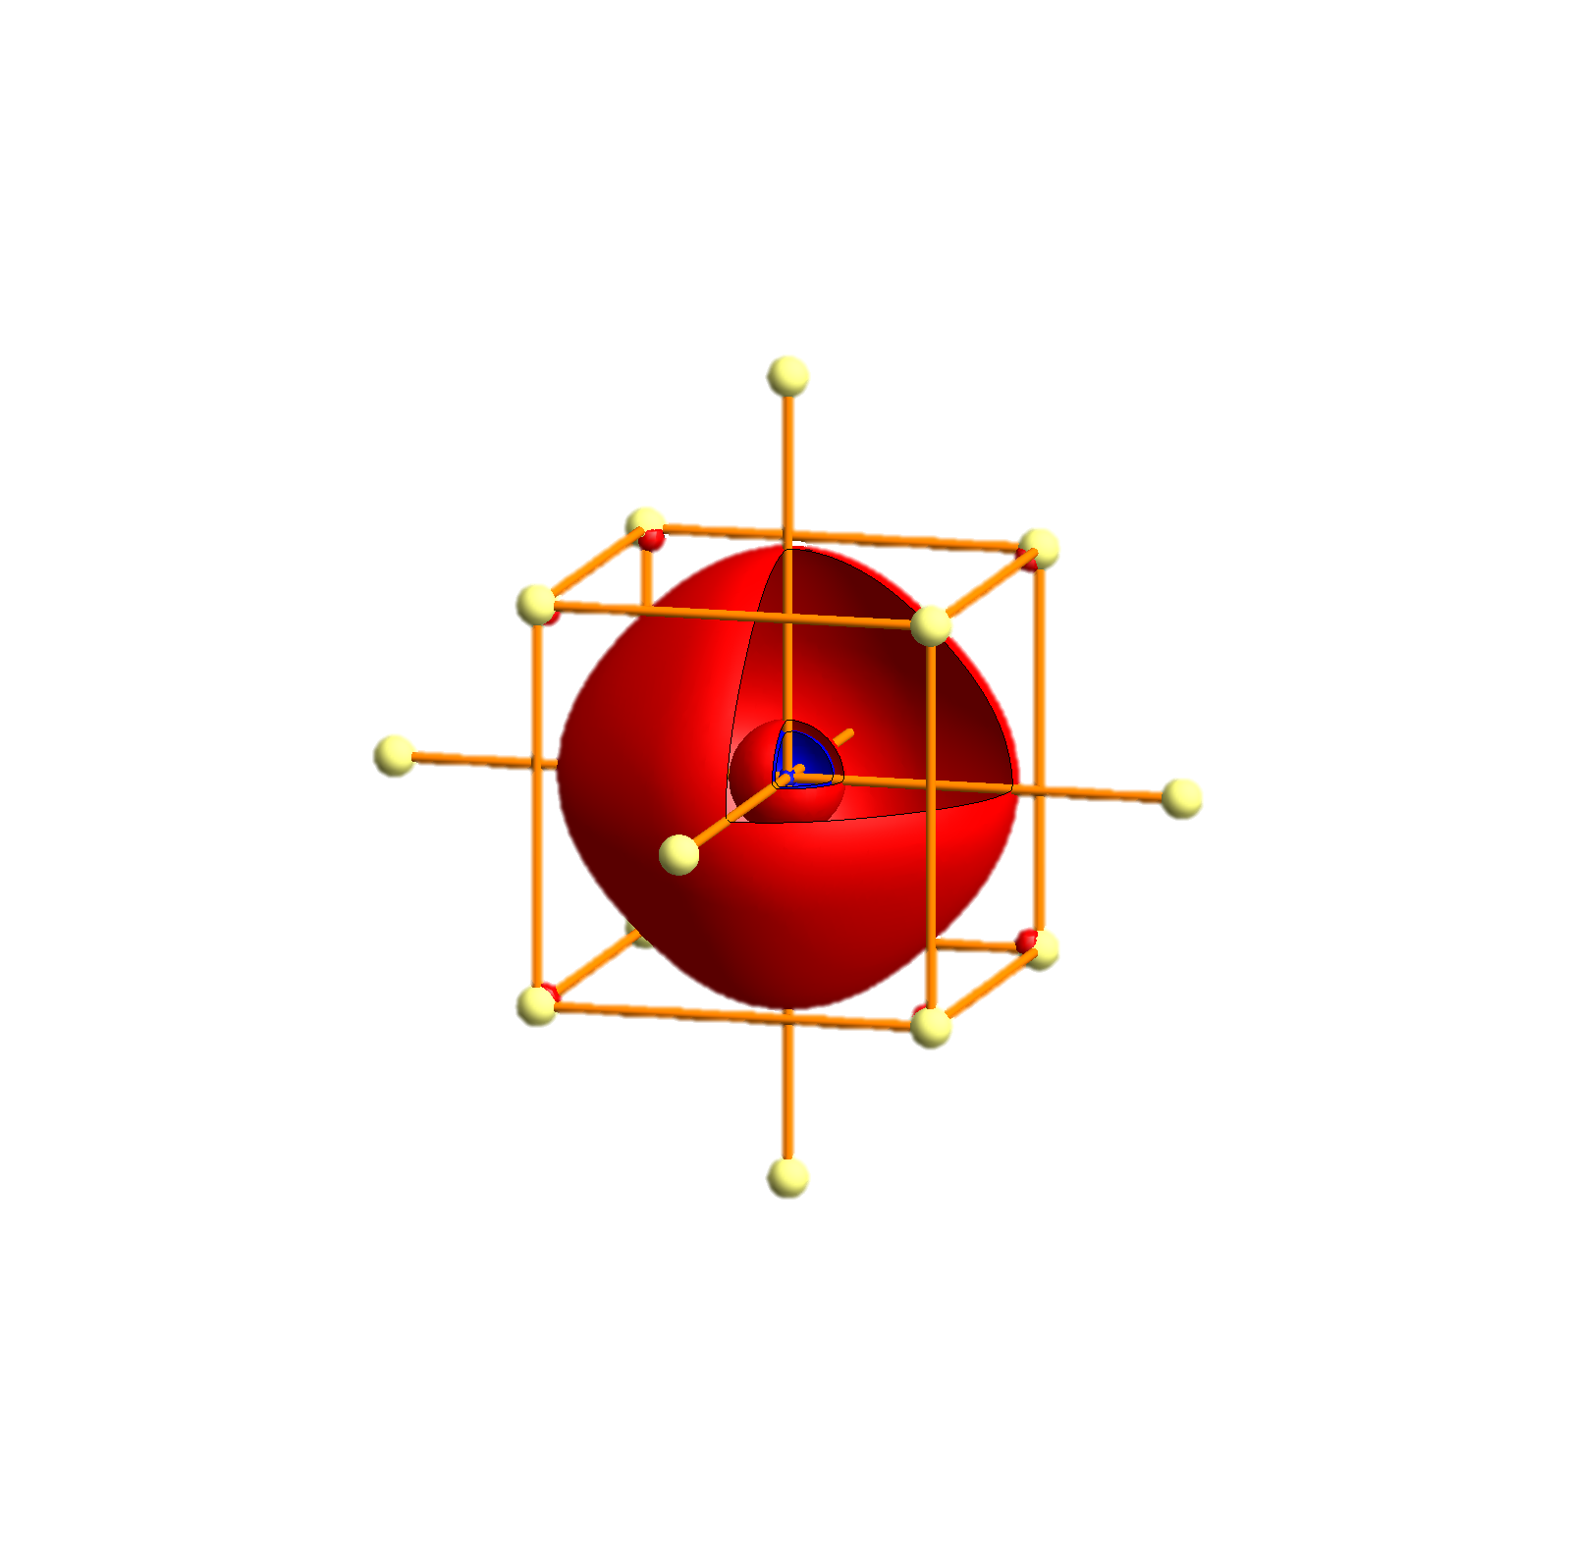
Na - Tigth binding description – atomic orbitals
p_{x}
p_{y}
p_{z}
s

Slide 88
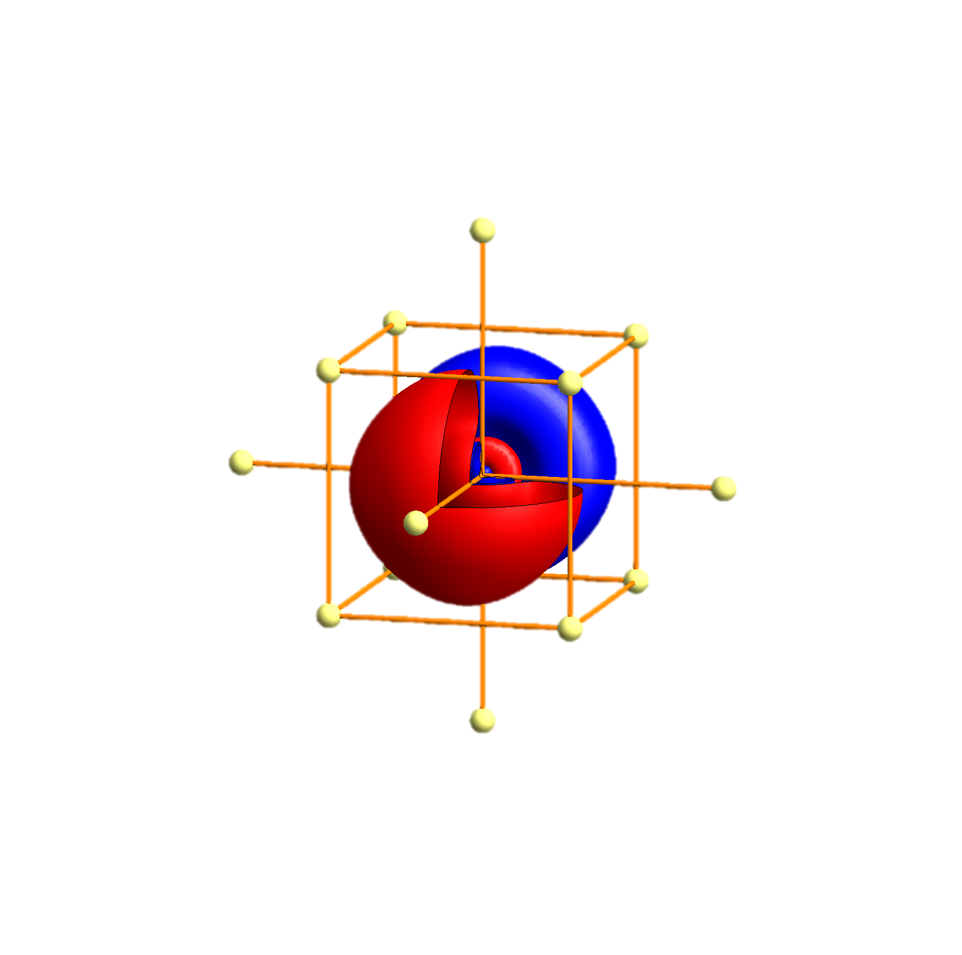
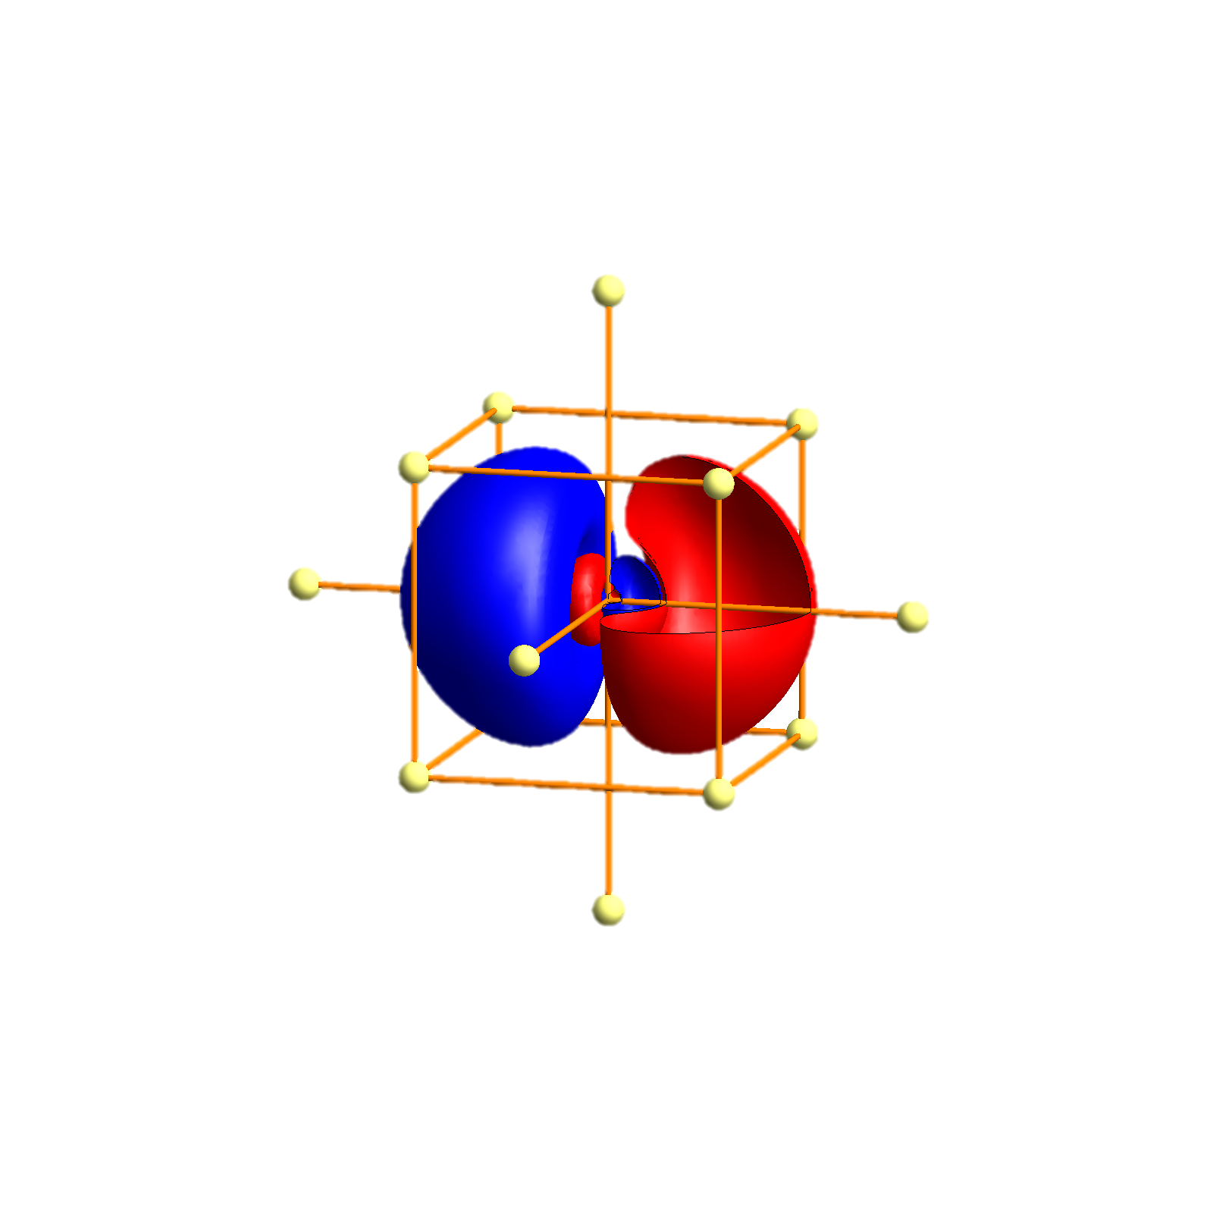
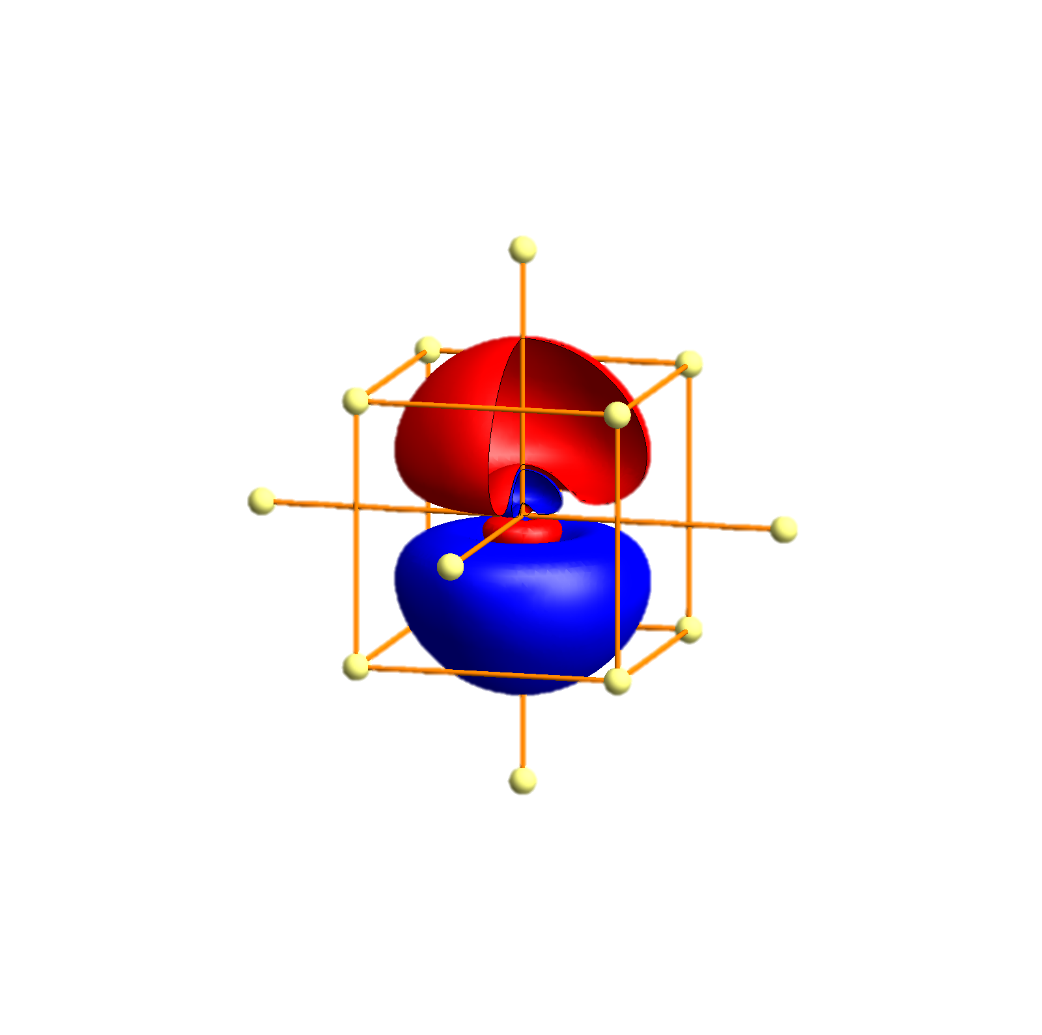
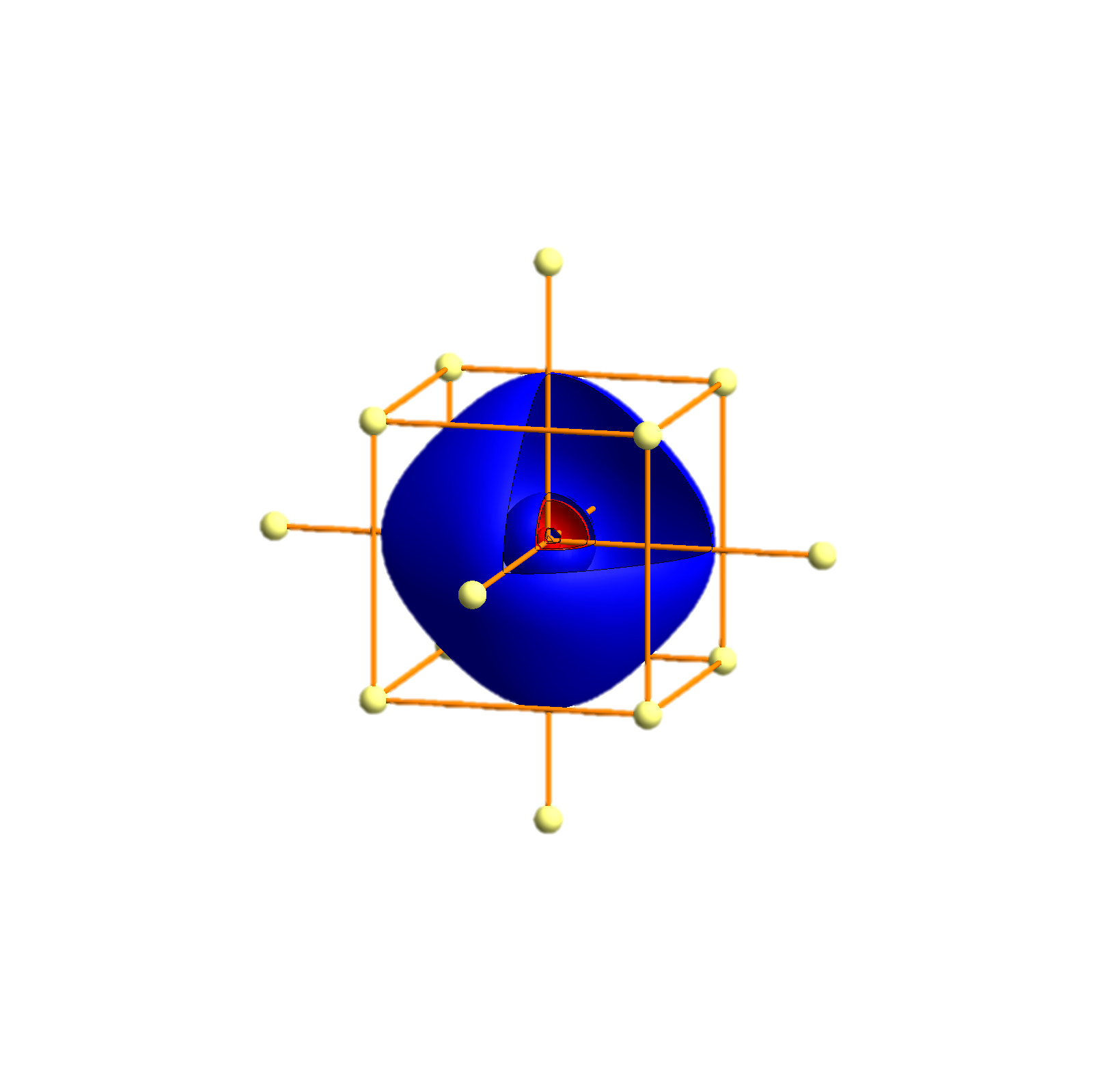
K- Tigth binding description – atomic orbitals
p_{x}
p_{y}
p_{z}
s
P
Γ
P
H
P
Γ
P
H
P
Γ
P

Slide 89
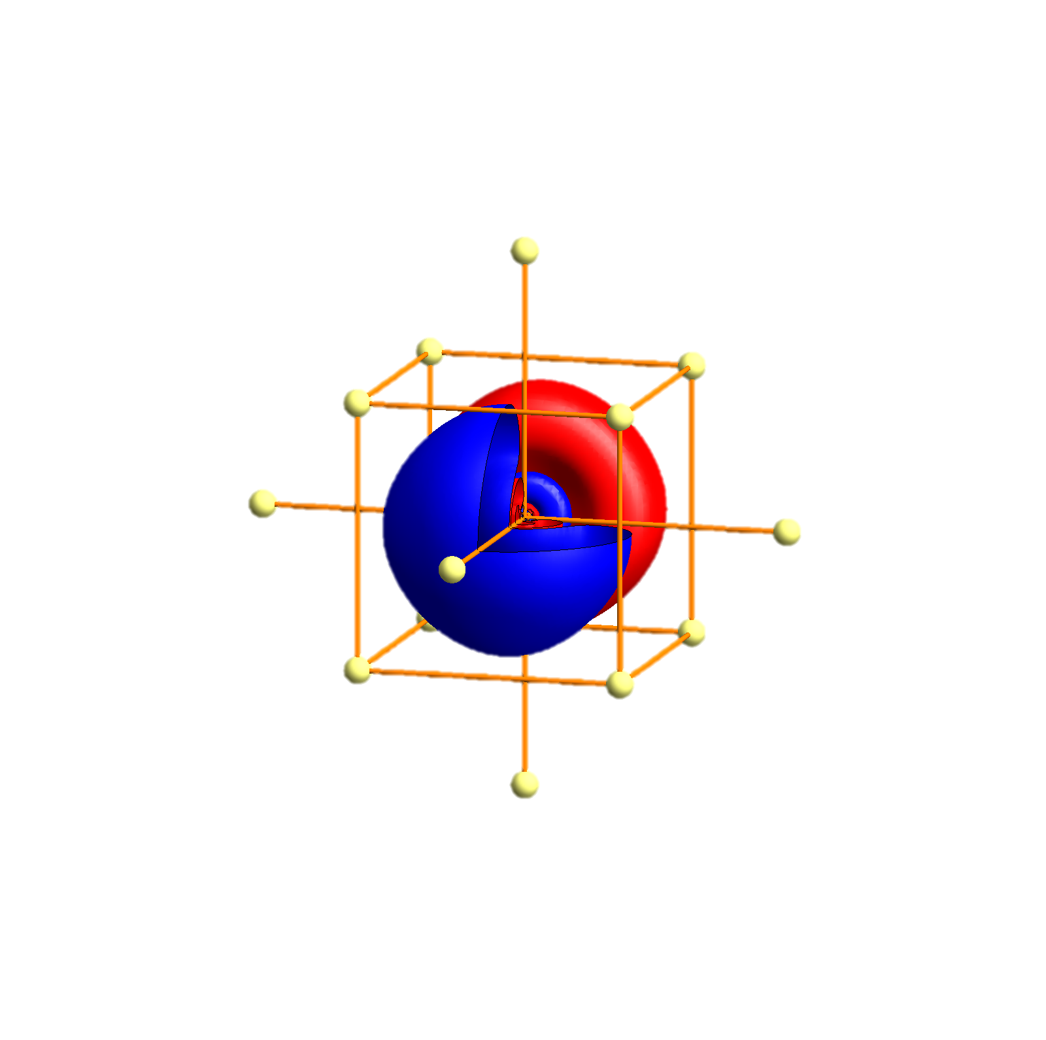
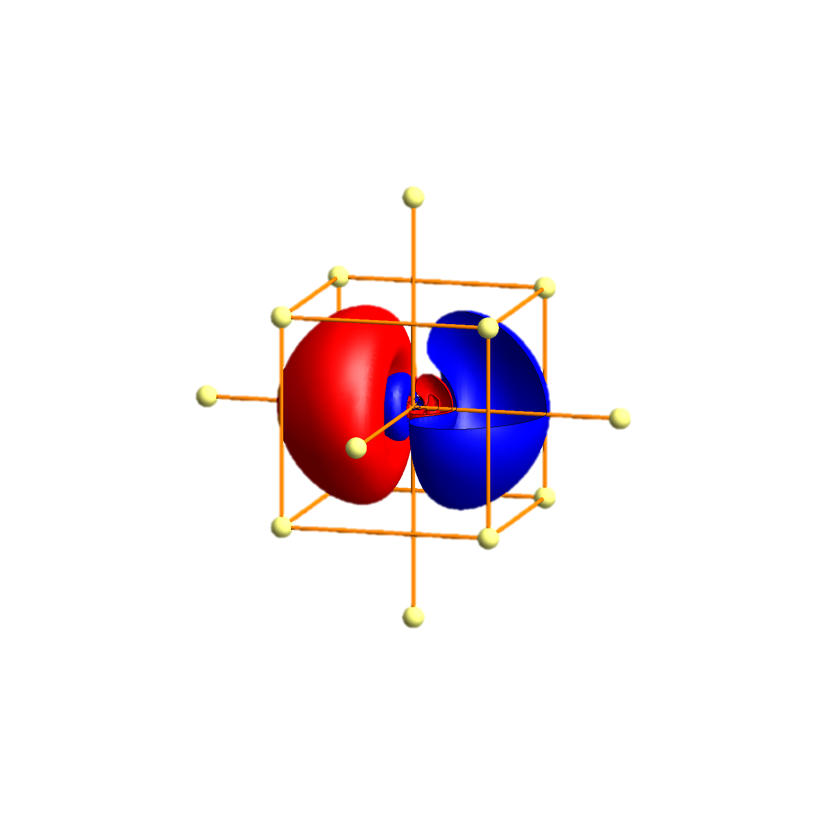
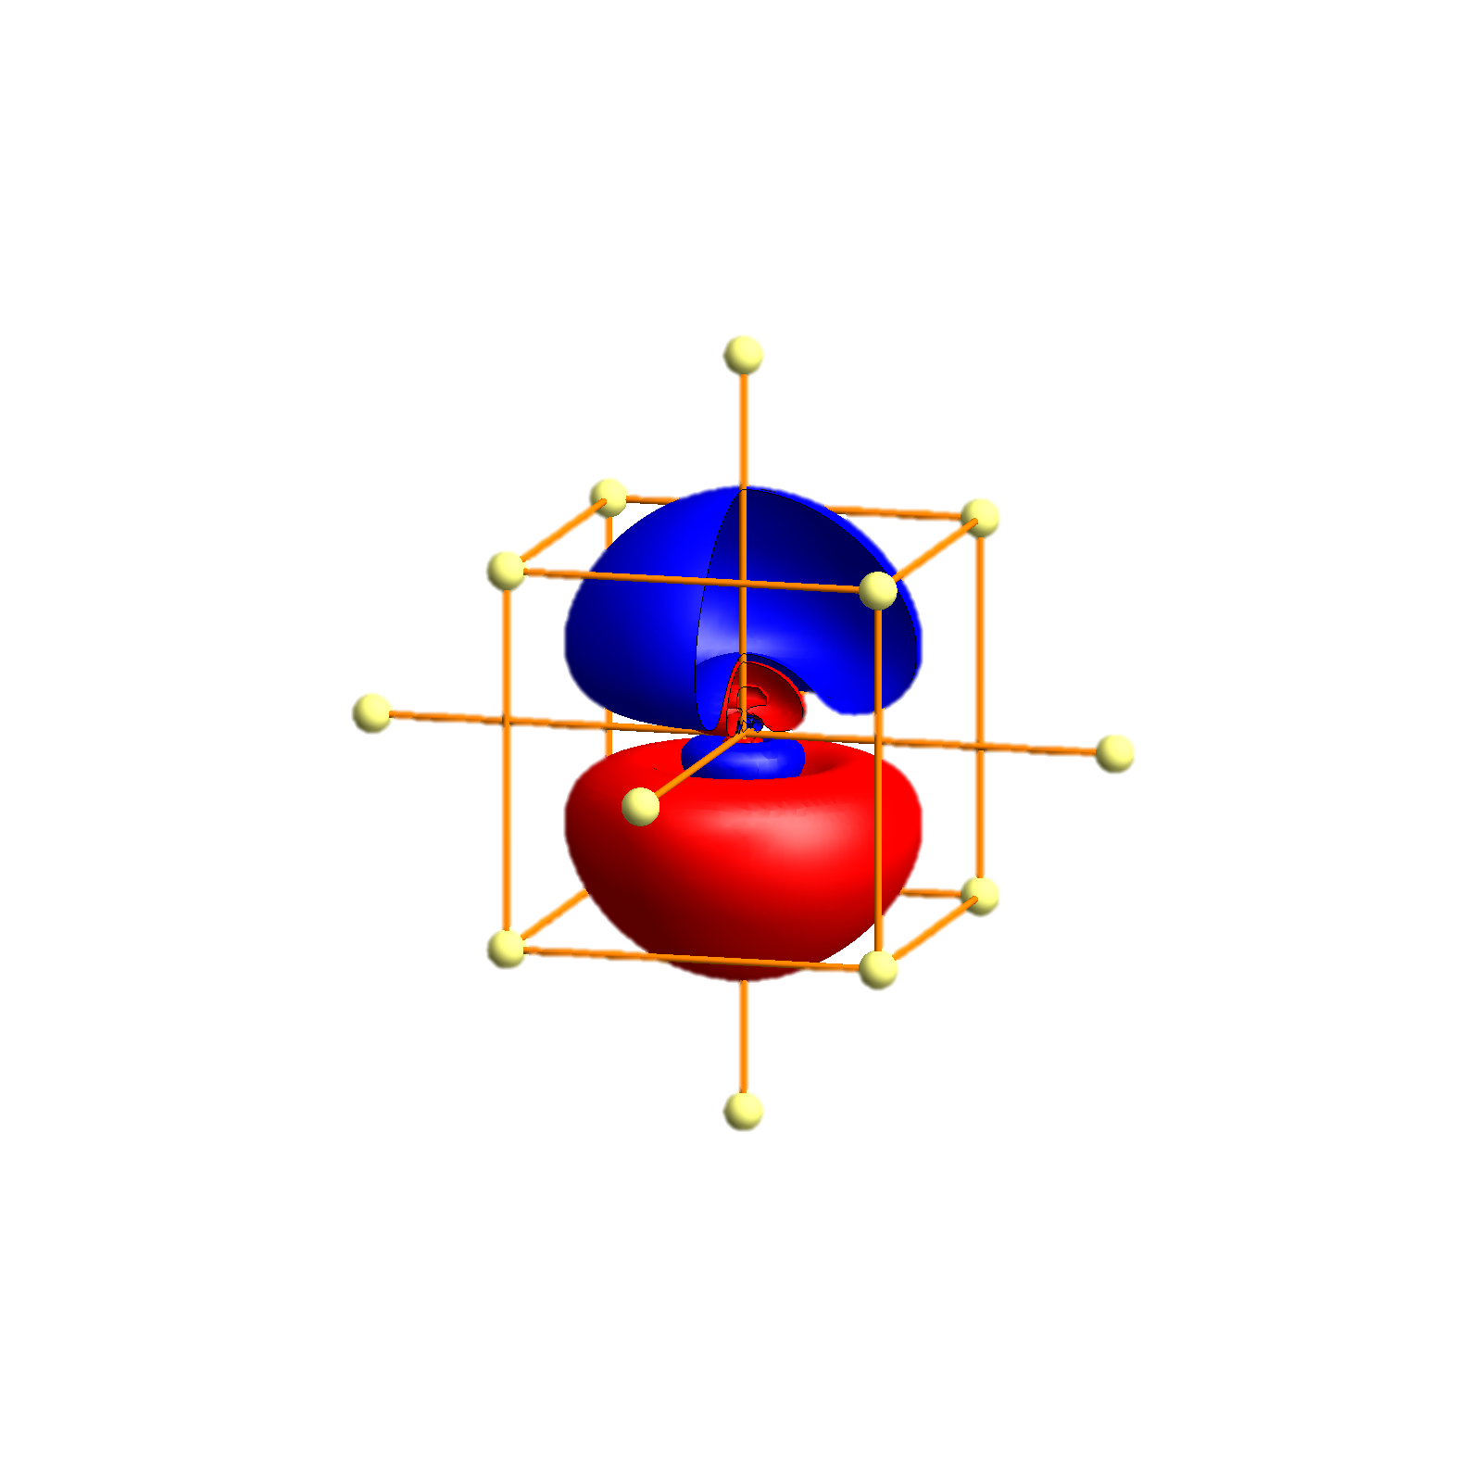
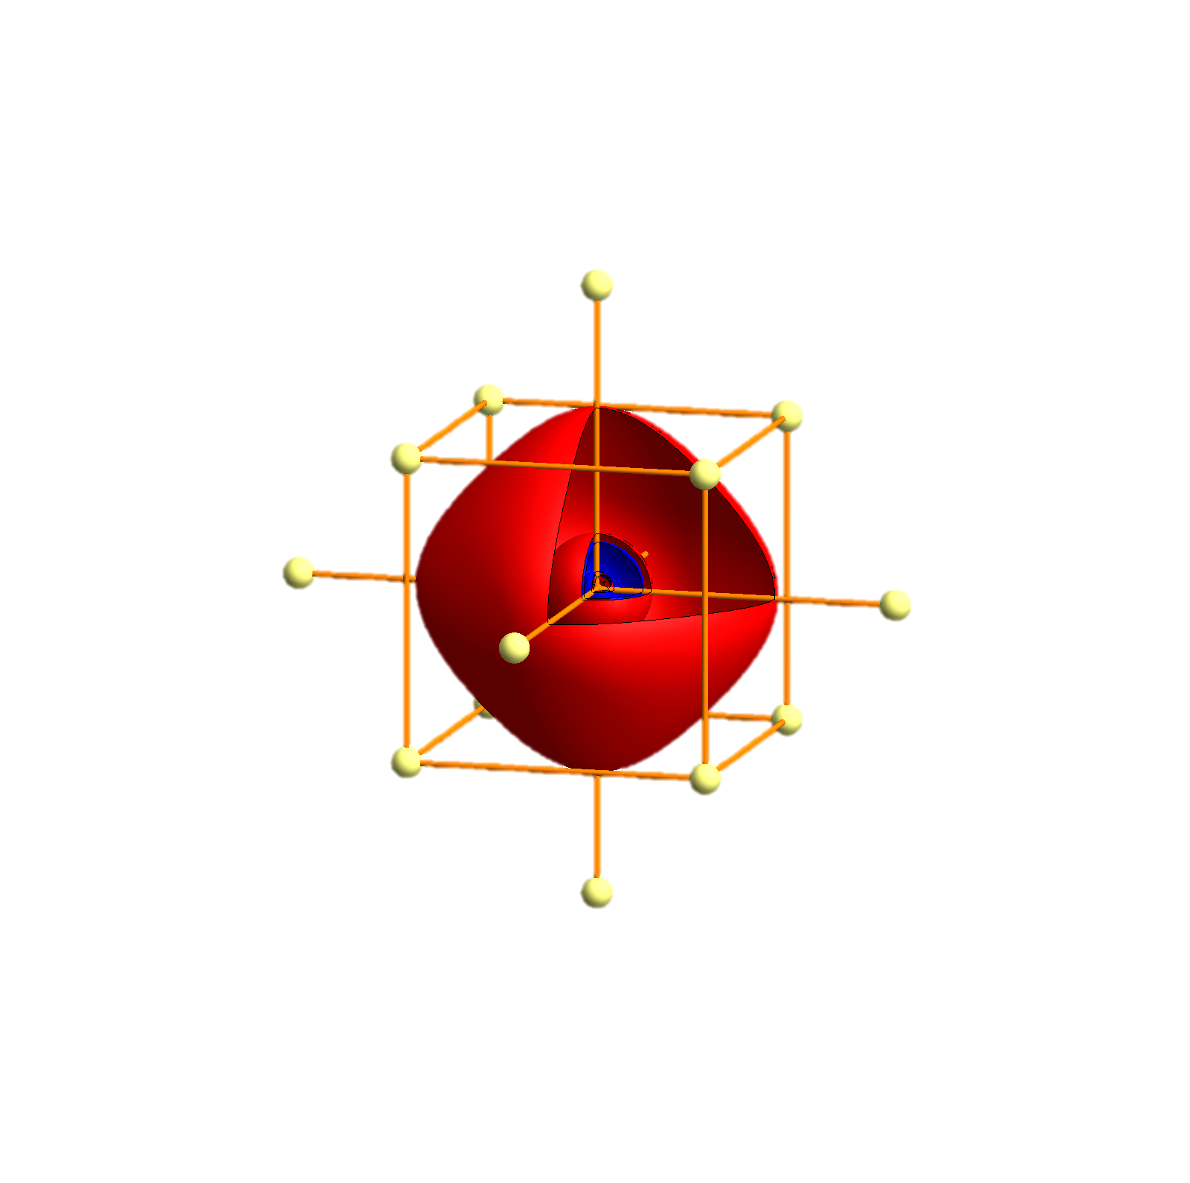
Rb - Tigth binding description – atomic orbitals
p_{x}
p_{y}
p_{z}
s
P
Γ
P
H
P
Γ
P
H
P
Γ
P

Slide 90


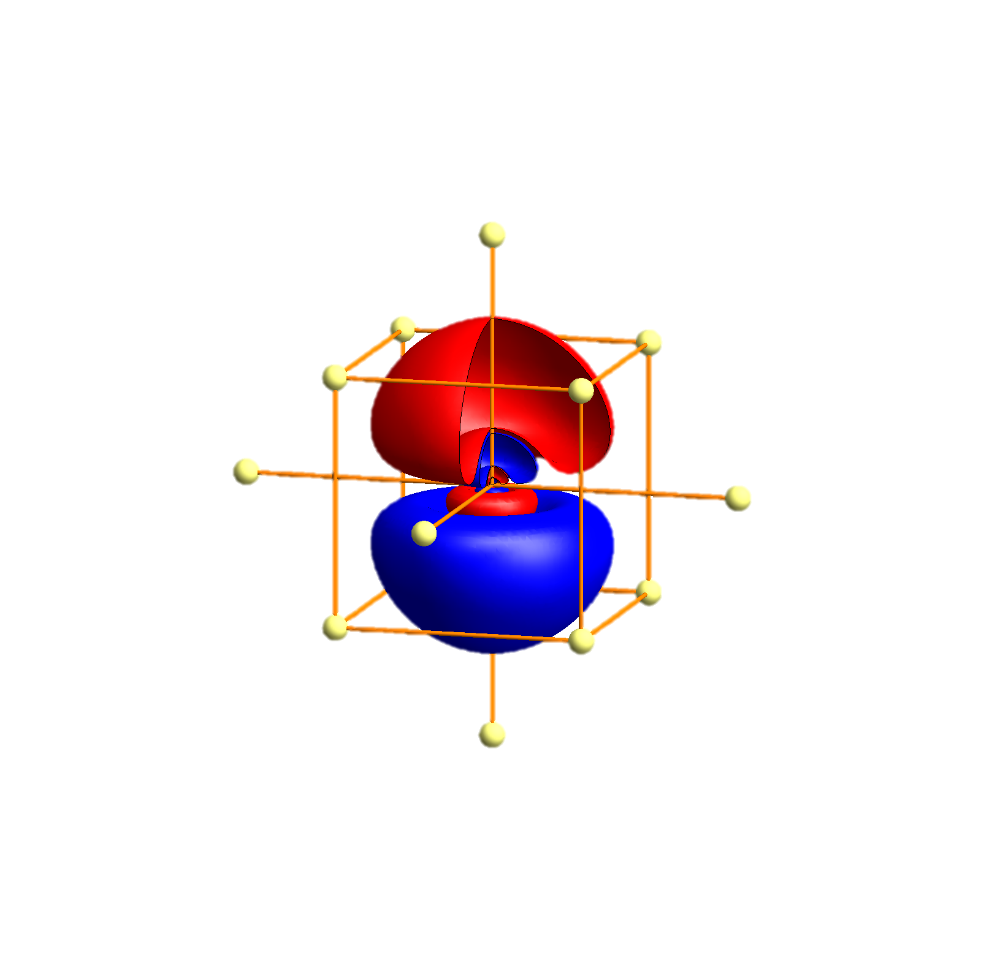
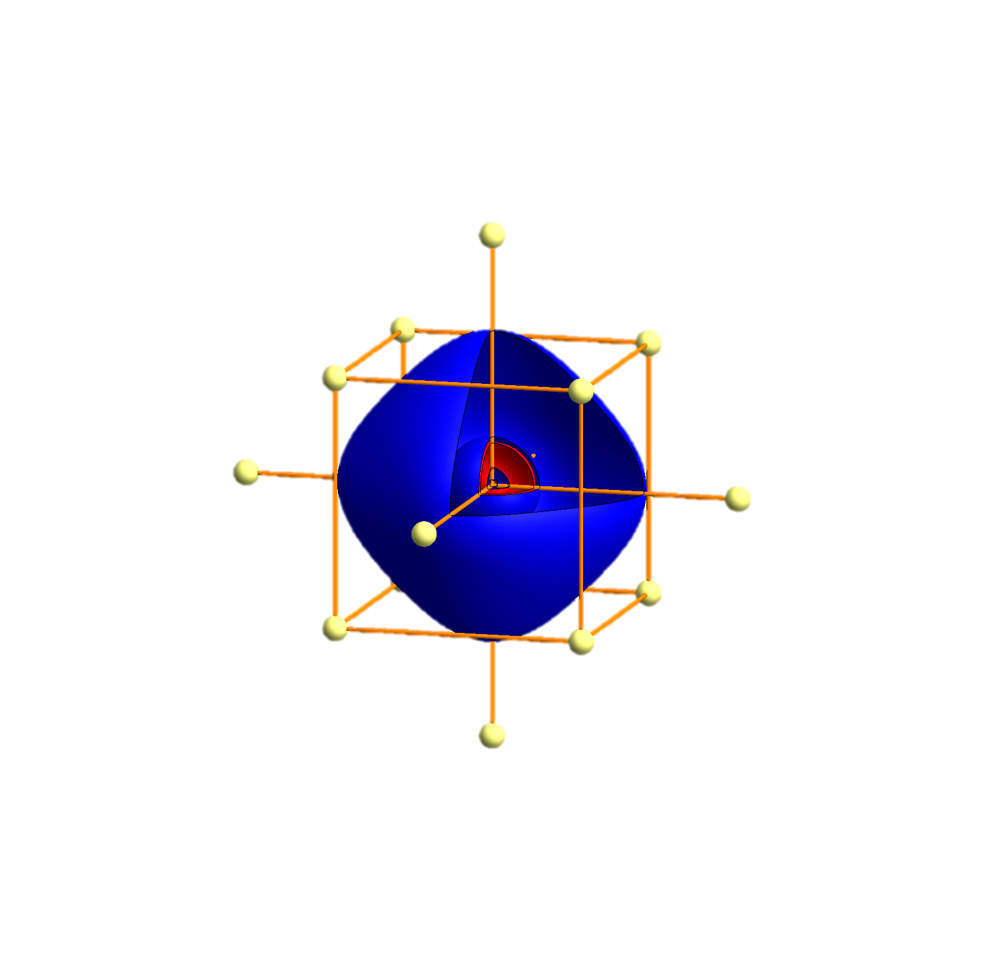
Cs - Tigth binding description – atomic orbitals
p_{x}
p_{y}
p_{z}
s
P
Γ
P
H
P
Γ
P
H
P
Γ
P

Slide 91


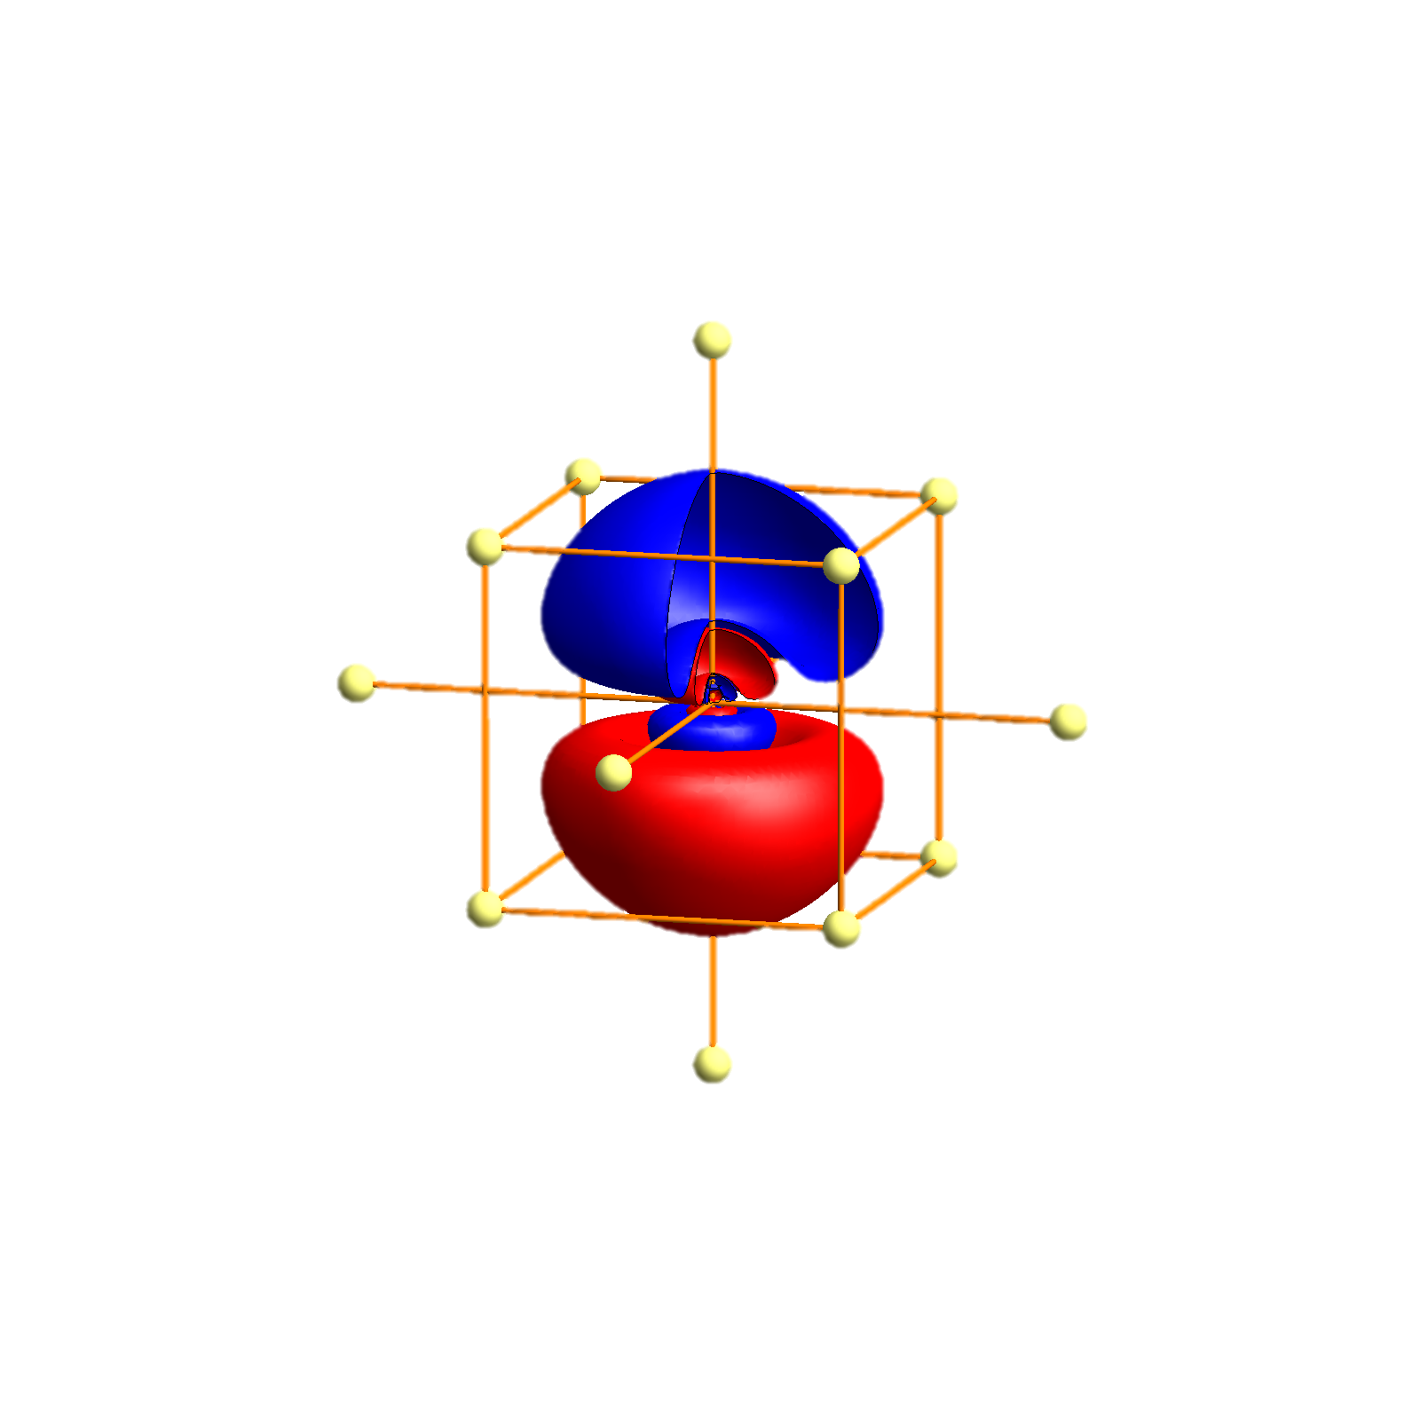
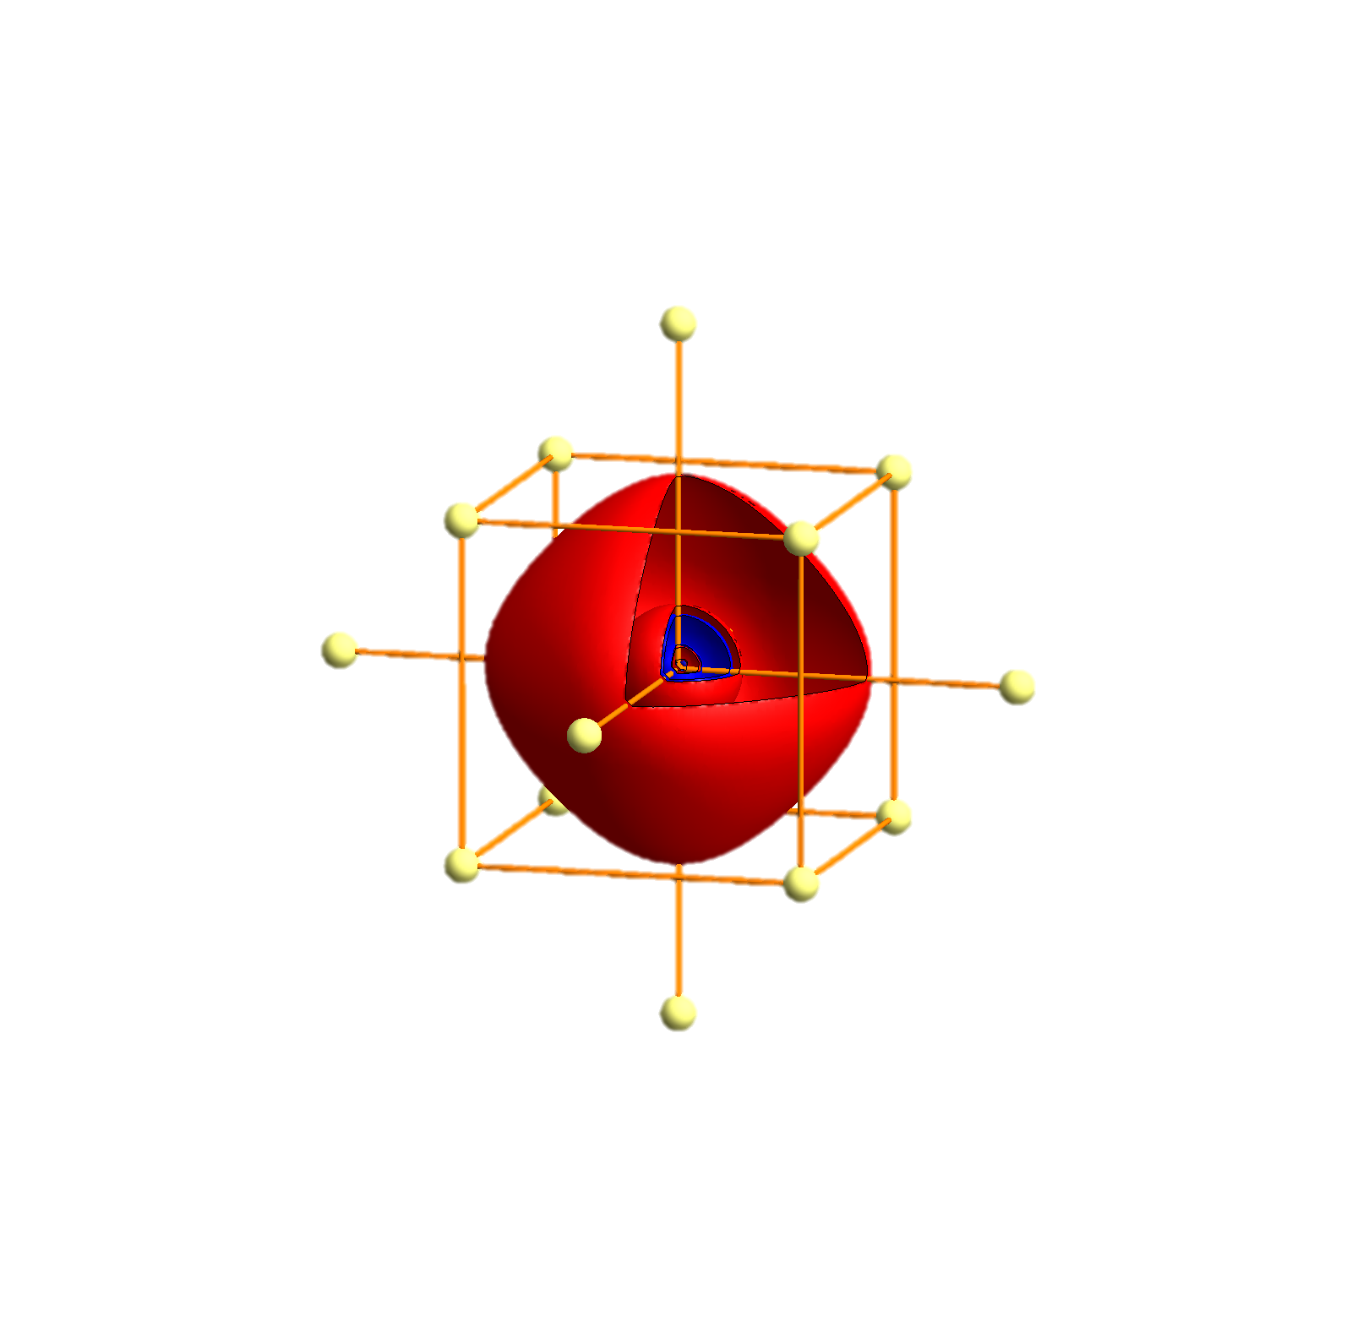
Fr - Tigth binding description – atomic orbitals
p_{x}
p_{y}
p_{z}
s
P
Γ
P
H
P
Γ
P
H
P
Γ
P

Slide 92
Double counting

Slide 94
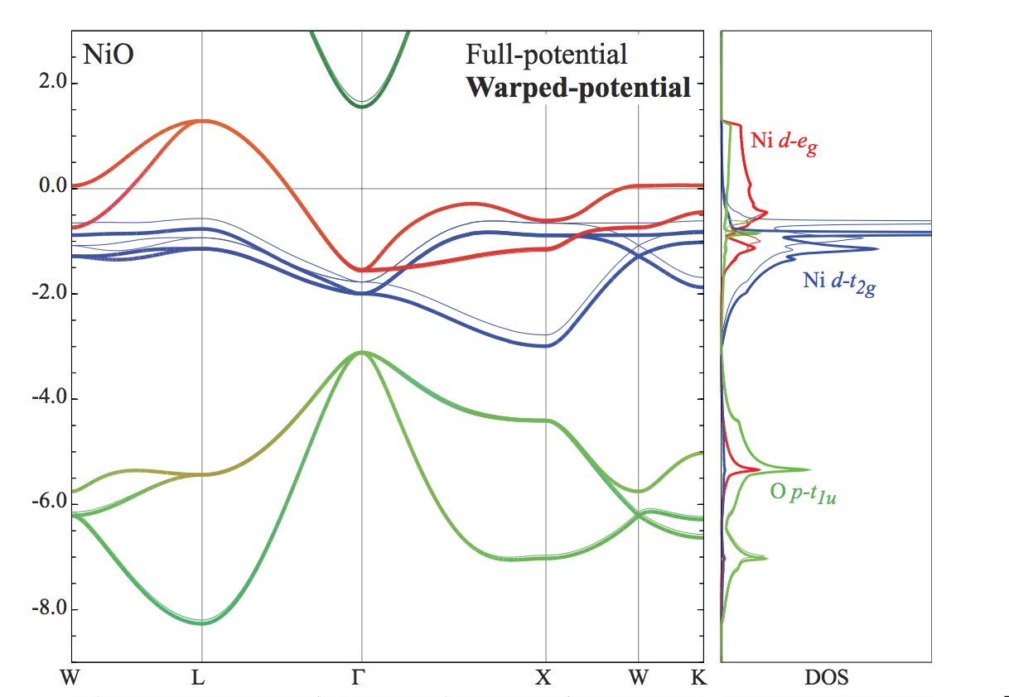
The non-spherical part – effective spurious crystal fields

Slide 96
Creating a cluster Hamiltonian

