Slide 1
RIXS
Resonant Inelastic X-ray Scattering
Resonant X-ray Raman Scattering (RXRS)
Resonant X-ray Emission Spectroscopy (RXES)
Resonant X-ray Energy Loss Spectroscopy (R-XELS)

Slide 2
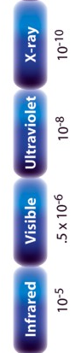
Core-valence RIXS
2p
electronic
dd, CT
magnon
vibrations
Ψ0

Slide 3
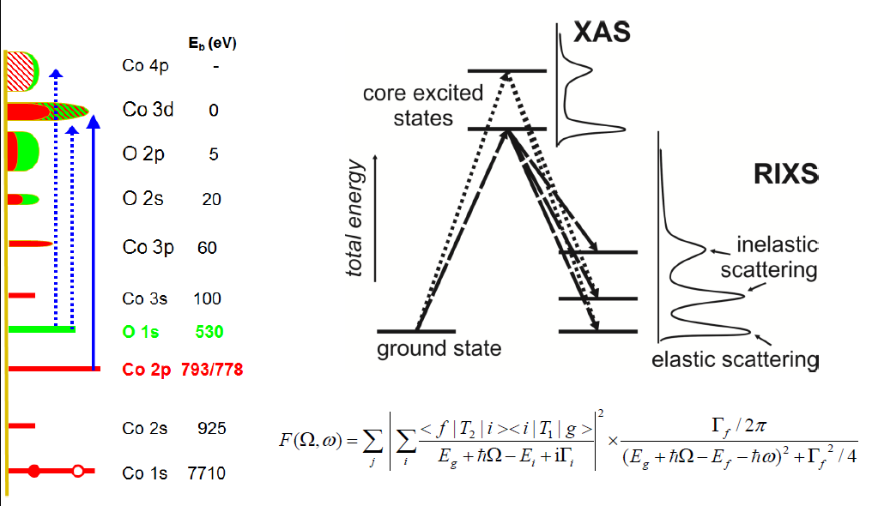
resonant inelastic x-ray scattering
Notes:
3

Slide 4
Cu2+ 2p3d RIXS (from 3d⁹ to 2p⁵3d¹⁰ to 3d⁹)
Atomic Multiplet Theory
ATOMIC
Dipole selection rule:
ΔJ=-1, 0 or +1
J=J’≠0
3d⁹
²D
²D_{5/2}
²D_{3/2}

Slide 5
Cu2+ 2p3d RIXS (from 3d⁹ to 2p⁵3d¹⁰ to 3d⁹)
Atomic Multiplet Theory
ATOMIC
Dipole selection rule:
ΔJ=-1, 0 or +1
J=J’≠0
2p⁵
²P
²P_{3/2}
²P_{1/2}
3d⁹
²D
²D_{5/2}
²D_{3/2}

Slide 6
Cu2+ 2p3d RIXS (from 3d⁹ to 2p⁵3d¹⁰ to 3d⁹)
Atomic Multiplet Theory
ATOMIC
Dipole selection rule:
ΔJ=-1, 0 or +1
J=J’≠0
2p⁵
²P
²P_{3/2}
²P_{1/2}
Only L₃ edge
Spin-orbit excitation
Elastic line in 2p3d RIXS
3d⁹
²D
²D_{5/2}
²D_{3/2}

Slide 7
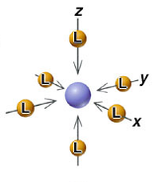
CRYSTAL FIELD EFFECT
Octahedral crystal field splitting
3d¹
²D
²E_{g}
²T_{2g}
metal ion
in free space
in symmetrical field
in octahedral ligand field
e_{g}
x²-y² z²
t_{2g}
yz xz xy
x²-y² yz z² xz xy

Slide 8
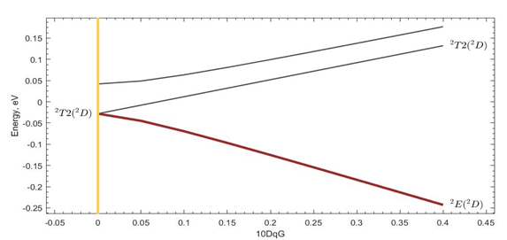
CRYSTAL FIELD EFFECT
Octahedral crystal field splitting
3d⁹
²D
²D_{5/2}
²D_{3/2}
²T_{2g (1)}
²T_{2g (2)}
²E_{g}

Slide 9
Cu2+ 2p3d RIXS (from 3d⁹ to 2p⁵3d¹⁰ to 3d⁹)
Atomic Multiplet Theory
OCTAHEDRAL
Dipole selection rule:
ΔJ=-1, 0 or +1
J=J’≠0
2p⁵
²P
²P_{3/2}
²P_{1/2}
Crystal field excitations
Elastic line in 2p3d RIXS
3d⁹
²D
²D_{5/2}
²D_{3/2}
²T_{2g (1)}
²T_{2g (2)}
²E_{g}

Slide 10
Cu2+ 2p3d RIXS (from 3d⁹ to 2p⁵3d¹⁰ to 3d⁹)
Atomic Multiplet Theory
OCTAHEDRAL
Dipole selection rule:
ΔJ=-1, 0 or +1
J=J’≠0
2p⁵
²P
²P_{3/2}
²P_{1/2}
Crystal field mixes J states
Both L₃ and L₂ edges
Crystal field excitations
Elastic line in 2p3d RIXS
3d⁹
²D
²D_{5/2}
²D_{3/2}
²T_{2g (1)}
²T_{2g (2)}
²E_{g}

Slide 11
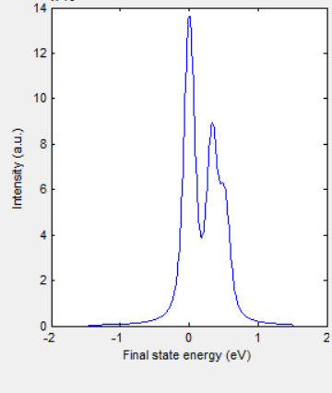
Cu2+ 2p3d RIXS (from 3d⁹ to 2p⁵3d¹⁰ to 3d⁹)
Atomic Multiplet Theory
OCTAHEDRAL
Dipole selection rule:
ΔJ=-1, 0 or +1
J=J’≠0
2p⁵
²P
²P_{3/2}
²P_{1/2}
3d⁹
²D
²D_{5/2}
²D_{3/2}
²T_{2g (1)}
²T_{2g (2)}
²E_{g}

Slide 12
Core-core RIXS
2p
3s
electronic
dd, CT
magnon
vibrations
Ψ0

Slide 13
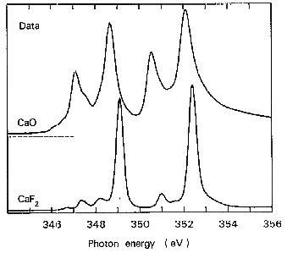
Resonant Inelastic X-ray Spectroscopy
2p3s RIXS of CaF₂
2p XAS of CaF₂
3d⁰
ω
2p⁵3d¹
ω’
3s¹3d¹

Slide 14
2p3s RIXS of CaF₂
2p3s RIXS of CaF₂
Ground state is 3d⁰
Excitation (i₀) 3d⁰ → (x) 2p⁵3d¹
Decay (x) 2p⁵3d¹ → (f) 3s¹3d¹

Slide 15
X-ray absorption from 3d⁰ to 2p⁵3d¹
Atomic Multiplet Theory
2p⁵3d¹
¹P
³F
¹D
³P
³D
¹P₁
³P₂
¹D₂
³P₁
³P₀
³F₄
³F₂
³F₃
³D₃
¹F
¹F₃
³D₁
³D₂
Dipole selection rule:
ΔJ=-1, 0 or +1
J=J’≠0
3d⁰
¹S
¹S₀

Slide 16
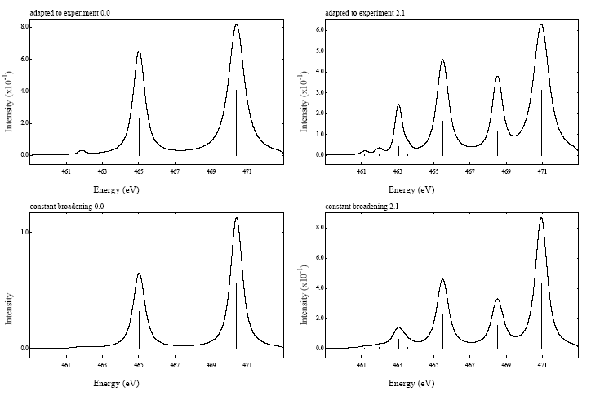
X-ray absorption from 3d⁰ to 2p⁵3d¹
Atomic Multiplet Theory
2p⁵3d¹
¹P
³F
¹D
³P
³D
¹P₁
³P₂
¹D₂
³P₁
³P₀
³F₄
³F₂
³F₃
³D₃
¹F
¹F₃
³D₁
³D₂
Dipole selection rule:
ΔJ=-1, 0 or +1
J=J’≠0
3d⁰
¹S
¹S₀

Slide 17
CRYSTAL FIELD EFFECT
Octahedral crystal field splitting
3d¹
²D
²E_{g}
²T_{2g}
metal ion
in free space
in symmetrical field
in octahedral ligand field
e_{g}
x²-y² z²
t_{2g}
yz xz xy
x²-y² yz z² xz xy

Slide 18
CRYSTAL FIELD EFFECT
Atomic Multiplet Theory
3d^{N}
J=0
J=4
J=1
J=2
J=3
A₁
T₂
T₁
E
A₁
E
T₂
A₂
T₂
T₁
T₁
    Branching rules:
    Same rules for any quantum number
    S, L or J

Slide 19
X-ray absorption from 3d⁰ to 2p⁵3d¹
Atomic Multiplet Theory
2p⁵3d¹
¹P
³F
¹D
³P
³D
¹P₁
³P₂
¹D₂
³P₁
³P₀
³F₄
³F₂
³F₃
³D₃
¹F
¹F₃
³D₁
³D₂
T₁
T₂
E
T₂
E
T₂
E
T₂
E
T₁
T₁
A₂
T₁
T₂
A₂
T₁
T₂
A₂
T₁
T₂
A₁
A₁
T₁
T₂
E
3d⁰
¹S
¹S₀
A₁
ee LS CFS

Slide 20
X-ray absorption from 3d⁰ to 2p⁵3d¹
Atomic Multiplet Theory
2p⁵3d¹
¹P
³F
¹D
³P
³D
¹P₁
³P₂
¹D₂
³P₁
³P₀
³F₄
³F₂
³F₃
³D₃
¹F
¹F₃
³D₁
³D₂
T₁
T₂
E
T₂
E
T₂
E
T₂
E
T₁
T₁
A₂
T₁
T₂
A₂
T₁
T₂
A₂
T₁
T₂
A₁
A₁
T₁
T₂
E
3d⁰
¹S
¹S₀
A₁
ee LS CFS
2 3 7 8 5

Slide 21
X-ray absorption from 3d⁰ to 2p⁵3d¹
Atomic Multiplet Theory
Dipole selection rule:
ΔJ=T₁
(cubic symmetry)
2p⁵3d¹
¹P
³F
¹D
³P
³D
¹P₁
³P₂
¹D₂
³P₁
³P₀
³F₄
³F₂
³F₃
³D₃
¹F
¹F₃
³D₁
³D₂
T₁
T₂
E
T₂
E
T₂
E
T₂
E
T₁
T₁
A₂
T₁
T₂
A₂
T₁
T₂
A₂
T₁
T₂
A₁
A₁
T₁
T₂
E
3d⁰
¹S
¹S₀
A₁
ee LS CFS
2 3 7 8 5

Slide 22
X-ray emission from 2p⁵3d¹ to 3s¹3d¹
Atomic Multiplet Theory
2p⁵3d¹
¹P
³F
¹D
³P
³D
¹P₁
³P₂
¹D₂
³P₁
³P₀
³F₄
³F₂
³F₃
³D₃
¹F
¹F₃
³D₁
³D₂
T₁
T₂
E
T₂
E
T₂
E
T₂
E
T₁
T₁
A₂
T₁
T₂
A₂
T₁
T₂
A₂
T₁
T₂
A₁
A₁
T₁
T₂
E
3s¹3d¹
¹D
³D
¹D₂
³D₁
³D₂
T₂
E
T₂
E
T₁
A₂
T₁
T₂
³D₃

Slide 23
X-ray emission from 2p⁵3d¹ to 3s¹3d¹
Atomic Multiplet Theory
2p⁵3d¹
¹P
³F
¹D
³P
³D
¹P₁
³P₂
¹D₂
³P₁
³P₀
³F₄
³F₂
³F₃
³D₃
¹F
¹F₃
³D₁
³D₂
T₁
T₂
E
T₂
E
T₂
E
T₂
E
T₁
T₁
A₂
T₁
T₂
A₂
T₁
T₂
A₂
T₁
T₂
A₁
A₁
T₁
T₂
E
3s¹3d¹
¹D
³D
¹D₂
³D₁
³D₂
T₂
E
T₂
E
T₁
A₂
T₁
T₂
³D₃
7x7 matrix
Dipole selection rule:
ΔJ=T₁ * T₁=T₁+T₂ +E +A₁

Slide 24
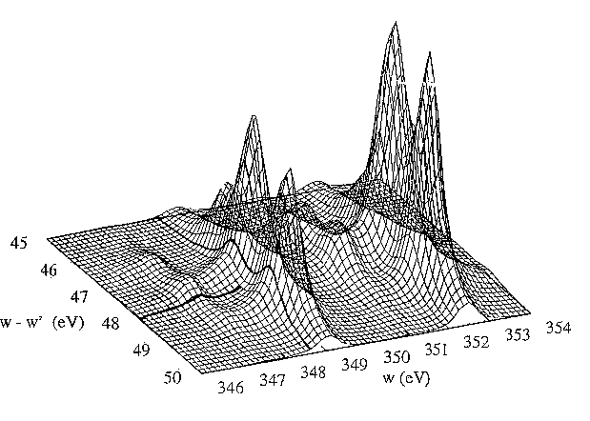
Resonant Inelastic X-ray Scattering
2p3s RIXS of CaF₂
3d⁰
ω
2p⁵3d¹
ω’
Phys. Rev. B.
53, 7099 (1996)
3s¹3d¹

Slide 25
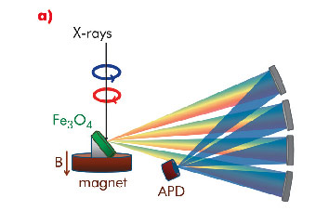
1s2p RIXS of transition metal ions
1s
2p
electronic
dd, CT
magnon
vibrations
Ψ0

Slide 26
K edge and 1s2p RIXS
1s2p RIXS of transition metal ions
Co^{III}(acac)
low-spin Co^{III}
3d⁶ [¹A₁]
T_{2g} full
E_{g} empty

Slide 27
K edge and 1s2p RIXS
1s2p RIXS of transition metal ions
Co^{III}(acac)
low-spin Co^{III}
3d⁶ [¹A₁]
T_{2g} full
E_{g} empty

Slide 28
Pre-edge and edge
Sharper pre-edge structures in 1s XAS
CoO
high-spin Co^{II}
3d⁷ [⁴T₂]
Only quadrupole peaks visible
3d⁷ → 1s¹3d⁸ → 2p⁵3d⁸

Slide 29
K pre-edge of TM oxides (LiCoO₂)
Pre-edges structures in 1s XAS
Co K edge of LiCoO₂
low-spin Co^{III}
3d⁶ [¹A₁]
T_{2g} full
E_{g} empty

Slide 30
K pre-edge of TM oxides (LiCoO₂)
Pre-edges structures in 1s XAS
Co K edge of LiCoO₂
low-spin Co^{III}
3d⁶ [¹A₁]
T_{2g} full
E_{g} empty

Slide 31
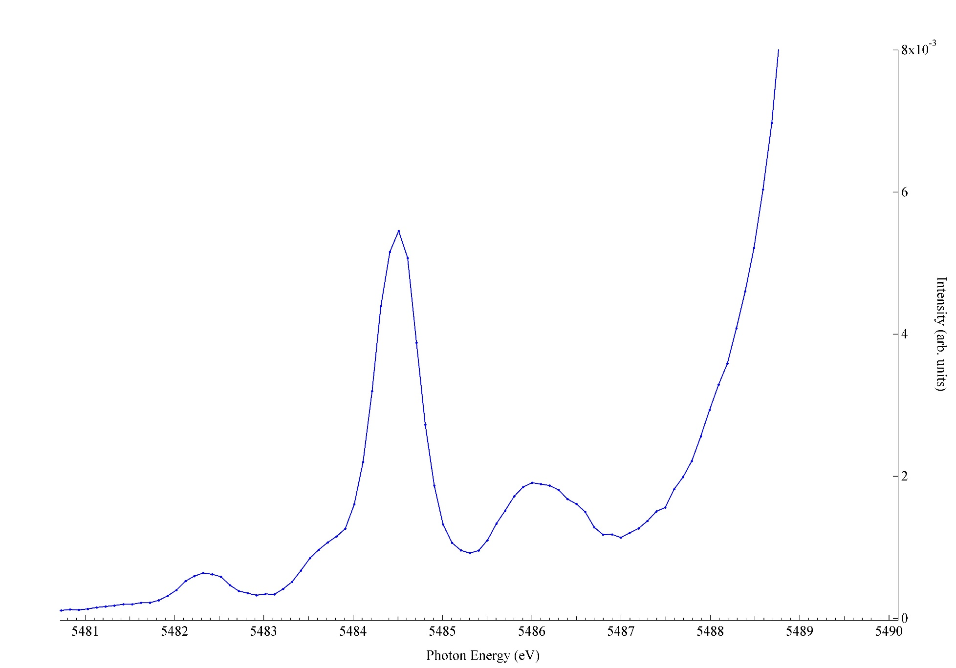
Does HERFD measure X-ray Absorption?
2p5d dipole
LaF₃
2p4f quadrupole
4f⁰→ 2p⁵ 4f¹
?
?

Slide 32
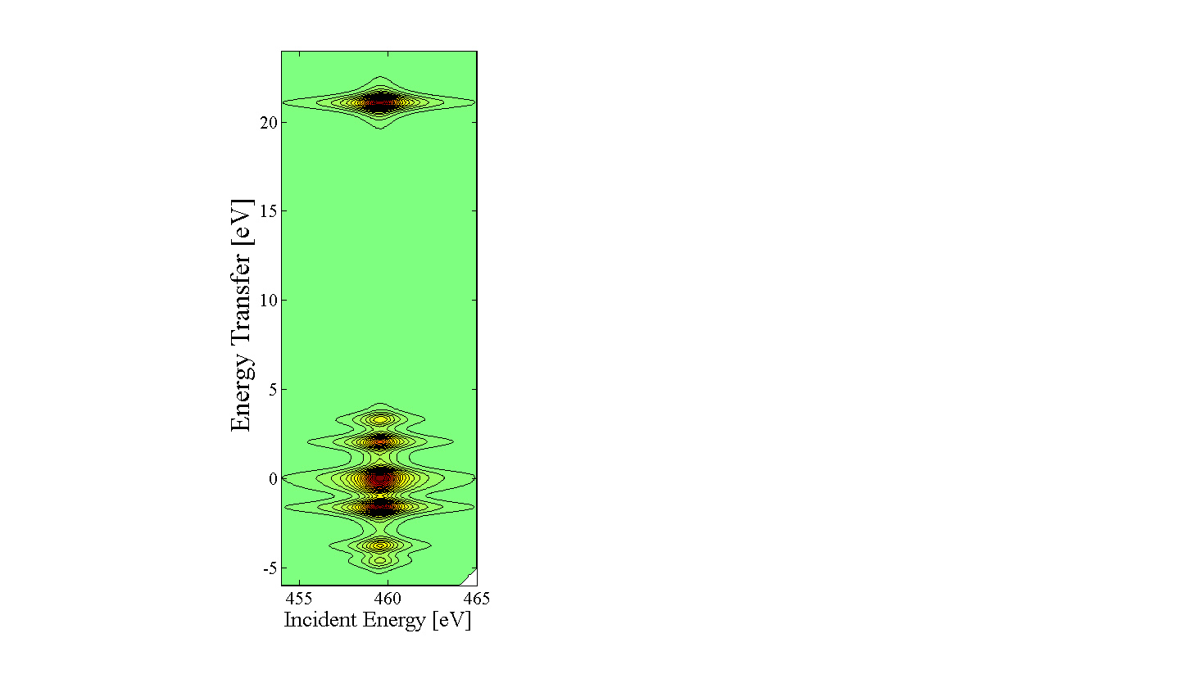
2p4d RIXS of LaF₃
4f⁰→ 2p⁵ 4f¹ → 4d⁹ 4f¹

Slide 33
K pre-edge of TM oxides
Pre-edges structures in 1s XAS

Slide 34
K pre-edge of TM oxides
Pre-edges structures in 1s XAS
J. Phys. Cond. Matt. 21, 104207 (2009); Phys. Rev. B. 81, 115115 (2010)

Slide 35
RIXS-MCD of CrO₂
[Zimmermann et al. J. Elec. Spec (2017)]

Slide 36
K edge and 1s2p RIXS
Hard x-ray RIXS
Reduce lifetime from 1.5 to 0.2 eV (HERFD XANES)
Reveal new features at pre-edge
Soft x-ray edges with hard x-rays
Spin-polarized XAS
Range extended EXAFS
Background free FY for low conc.
RIXS-MCD

Slide 37
2p3d RIXS of transition metal ions

Slide 38
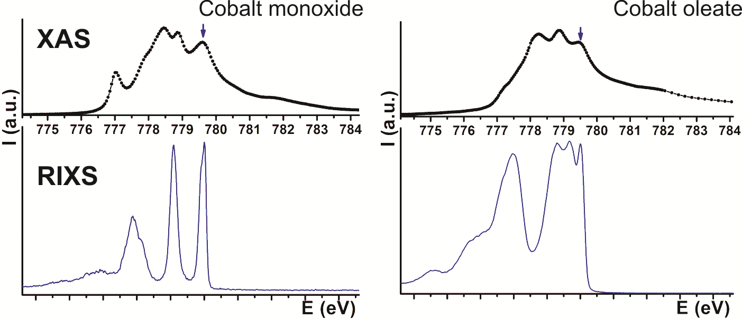
2p3d RIXS of transition metal ions
core
electronic
dd, CT
magnon
vibrations
Ψ0
3 2 1 0

Slide 39
2p3d RIXS
polarization, angles
(in, sample, out)
eV
electron-electron
crystal field
charge transfer
meV
spin-orbit, magnetic
distortions
vibrations
RIXS1998:
500 meV
RIXS 2022:
20 meV
Notes:
39

Slide 40
2p3d RIXS of isolated chromium ions (ruby)
[Co^{II}W₁₂O₄₀]·
[Van Schooneveld, Hunault et al., unpublished ]

Slide 41
Multiplet challenge: 2p3d RIXS on Cr³⁺
Notes:
41

Slide 42
Multiplet challenge: 2p3d RIXS on Cr³⁺
Optical resolution can be 0.01 meV
Spin-forbidden dd-excitations limited by experimental resolution
[Hunault, van Schooneveld, submitted]
Notes:
42

Slide 43
Spin-state in LaCoO₃ (single crystal)
Notes:
Low-loss region of RIXS in NiO.
Ground state: 3A2
Double group: T2, not split without exchange
Echange field H splits ground state into three Ms states as H times Ms,
So three states at –H, 0, +H.
The spin-flip peak in the figure is at 2H.
H is related to the superexchaneg energy

Slide 44
Spin state of LaCoO₃
⁵T₂
¹A₁
E
T₂
E
T₂
³T₁
E
T₂
NOTE: Term symbols and orbital occupations are only indications: they are mixed by electron-electron, spin-orbit, etc.
Notes:
Low-loss region of RIXS in NiO.
Ground state: 3A2
Double group: T2, not split without exchange
Echange field H splits ground state into three Ms states as H times Ms,
So three states at –H, 0, +H.
The spin-flip peak in the figure is at 2H.
H is related to the superexchaneg energy

Slide 45
Spin state of LaCoO₃
dd-excitations + fluorescence
[Tomiyasu et al. PRL 8, 119, 196402 (2017) ]
Notes:
Low-loss region of RIXS in NiO.
Ground state: 3A2
Double group: T2, not split without exchange
Echange field H splits ground state into three Ms states as H times Ms,
So three states at –H, 0, +H.
The spin-flip peak in the figure is at 2H.
H is related to the superexchaneg energy

Slide 46
Spin state of LaCoO₃
dd-excitations + fluorescence
[Tomiyasu et al. PRL 8, 119, 196402 (2017) ]
Notes:
Low-loss region of RIXS in NiO.
Ground state: 3A2
Double group: T2, not split without exchange
Echange field H splits ground state into three Ms states as H times Ms,
So three states at –H, 0, +H.
The spin-flip peak in the figure is at 2H.
H is related to the superexchaneg energy

Slide 47
Spin state of LaCoO₃
dd-excitations + fluorescence
[Tomiyasu et al. PRL 8, 119, 196402 (2017) ]
Notes:
Low-loss region of RIXS in NiO.
Ground state: 3A2
Double group: T2, not split without exchange
Echange field H splits ground state into three Ms states as H times Ms,
So three states at –H, 0, +H.
The spin-flip peak in the figure is at 2H.
H is related to the superexchaneg energy

Slide 48
Spin state of LaCoO₃
[Tomiyasu et al. PRL 8, 119, 196402 (2017) ]
Notes:
Low-loss region of RIXS in NiO.
Ground state: 3A2
Double group: T2, not split without exchange
Echange field H splits ground state into three Ms states as H times Ms,
So three states at –H, 0, +H.
The spin-flip peak in the figure is at 2H.
H is related to the superexchaneg energy

Slide 49
Spin state of LaCoO₃
Spin transition is from low-spin to high-spin,
. . . . but is it really high-spin?
[Tomiyasu et al. PRL 8, 119, 196402 (2017) ]
Notes:
Low-loss region of RIXS in NiO.
Ground state: 3A2
Double group: T2, not split without exchange
Echange field H splits ground state into three Ms states as H times Ms,
So three states at –H, 0, +H.
The spin-flip peak in the figure is at 2H.
H is related to the superexchaneg energy

Slide 50
Spin state of LaCoO₃
Order of states at zero Kelvin: LS < HS < IS
Strong coupling between LS and IS (not with HS)
Large dispersion of IS: Excitonic Insulator
[Sotnikov & KUnes, Sci. Rep 6, 30510 (2016); Wang et al. submitted ]
Notes:
Low-loss region of RIXS in NiO.
Ground state: 3A2
Double group: T2, not split without exchange
Echange field H splits ground state into three Ms states as H times Ms,
So three states at –H, 0, +H.
The spin-flip peak in the figure is at 2H.
H is related to the superexchaneg energy

Slide 51
Spin state of LaCoO₃
q-dep. RIXS
[Wang et al. 2018 ]
Notes:
Low-loss region of RIXS in NiO.
Ground state: 3A2
Double group: T2, not split without exchange
Echange field H splits ground state into three Ms states as H times Ms,
So three states at –H, 0, +H.
The spin-flip peak in the figure is at 2H.
H is related to the superexchaneg energy

Slide 52
2p3d RIXS of transition metal ions

Slide 53
Cu2+ 2p3d RIXS (from 3d⁹ to 2p⁵3d¹⁰ to 3d⁹)
Atomic Multiplet Theory
ATOMIC
Dipole selection rule:
ΔJ=-1, 0 or +1
J=J’≠0
2p⁵
²P
²P_{3/2}
²P_{1/2}
Only L₃ edge
Spin-orbit excitation
Elastic line in 2p3d RIXS
3d⁹
²D
²D_{5/2}
²D_{3/2}

Slide 54
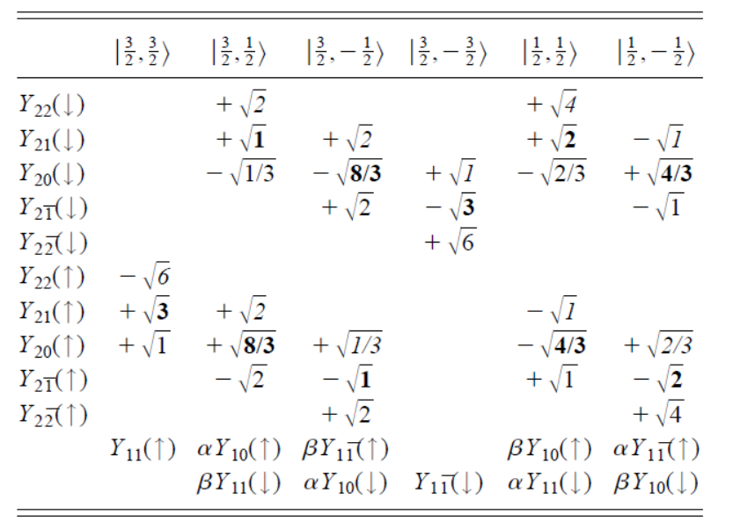
Cu2+ 2p3d RIXS (from 3d⁹ to 2p⁵3d¹⁰ to 3d⁹)
Atomic Multiplet Theory

Slide 55
Cu2+ 2p3d RIXS (from 3d⁹ to 2p⁵3d¹⁰ to 3d⁹)
Atomic Multiplet Theory

Slide 56
Magnon 2p3d RIXS in cuprates

Slide 57
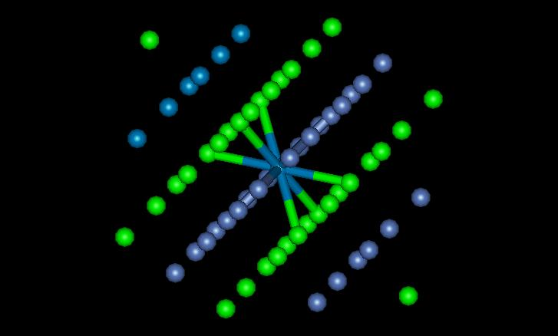

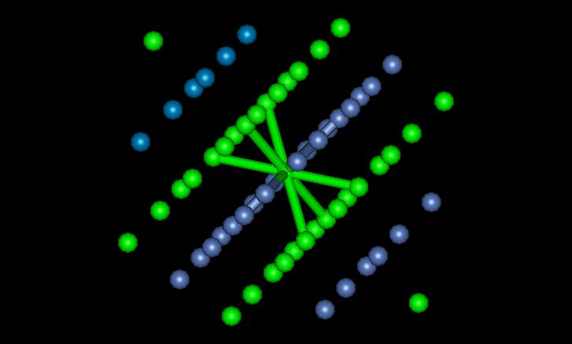
2p3d RIXS of NiO
Ni^{II} 3d⁸ [↑↑] → 2p⁵3d⁹[jj] → 3d⁸[↓↓]
Notes:
Cartoon of a spin-flip transition

Slide 58
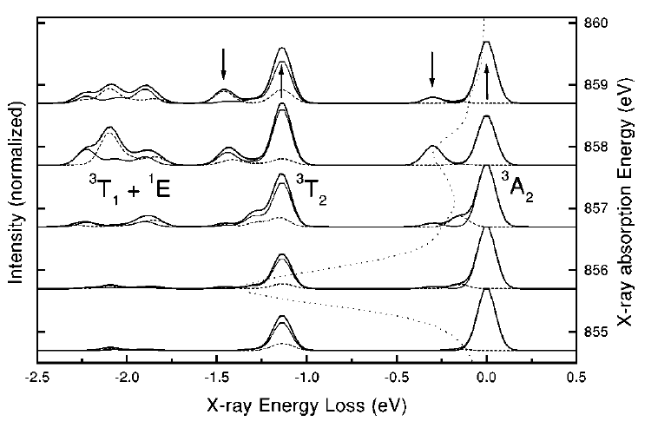
2p3d RIXS of NiO
ΔS
ΔM_{S}
‘spin-flip’
dd
spin-flip
[Phys. Rev. B. 57, 14584 (1998)]
Notes:
Low-loss region of RIXS in NiO.
Ground state: 3A2
Double group: T2, not split without exchange
Echange field H splits ground state into three Ms states as H times Ms,
So three states at –H, 0, +H.
The spin-flip peak in the figure is at 2H.
H is related to the superexchaneg energy

Slide 59
2p3d RIXS of NiO
[Phys. Rev. Lett. (2020)]
Notes:
Low-loss region of RIXS in NiO.
Ground state: 3A2
Double group: T2, not split without exchange
Echange field H splits ground state into three Ms states as H times Ms,
So three states at –H, 0, +H.
The spin-flip peak in the figure is at 2H.
H is related to the superexchaneg energy

Slide 60
2p3d RIXS of NiO
[Phys. Rev. Lett. (2020)]
Notes:
Low-loss region of RIXS in NiO.
Ground state: 3A2
Double group: T2, not split without exchange
Echange field H splits ground state into three Ms states as H times Ms,
So three states at –H, 0, +H.
The spin-flip peak in the figure is at 2H.
H is related to the superexchaneg energy

Slide 61
2p3d RIXS of Fe2O3

Slide 62
0,1 and 2-magnons in 2p3d RIXS of Fe2O3

Slide 63
0,1 and 2-magnons in 2p3d RIXS of Fe2O3

Slide 64
0,1 and 2-magnons in 2p3d RIXS of Fe2O3

Slide 65
0,1 and 2-magnons in 2p3d RIXS of Fe2O3

Slide 66
3-magnons in 2p3d RIXS of Fe2O3

Slide 67
3-magnons in 2p3d RIXS of Fe2O3

Slide 68
2p3d RIXS
polarization, angles
(in, sample, out)
eV
electron-electron
crystal field
charge transfer
meV
spin-orbit, magnetic
distortions
vibrations
RIXS1998:
500 meV
RIXS 2019:
20 meV
Notes:
68

Slide 69
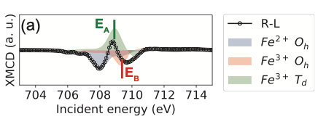
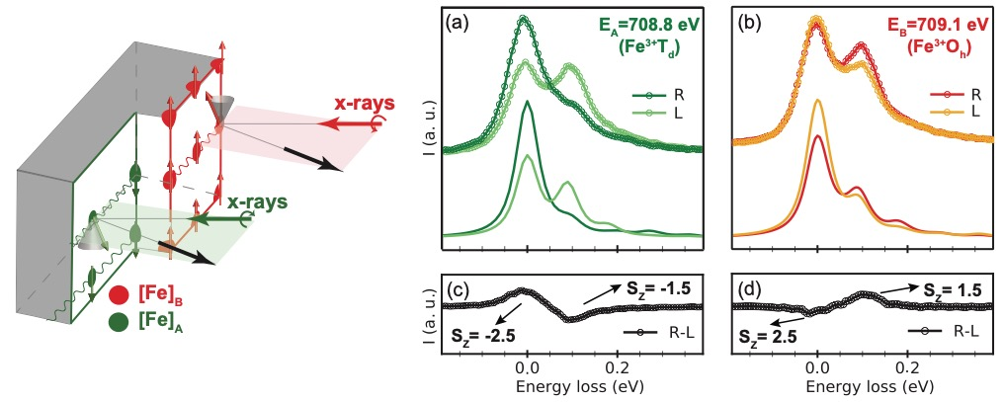
Disentangling the A and B sites
2p3d RIXS-MCD
J_{eff} = 90 meV
[Elnaggar et al. ACS Appl. Mat & Interf. (2019)]
Notes:
We first measured XMCD to disentangle the magnetic signals of Fe3O4 as the three Fe ions in Fe3O4
At an incidence energy of 708.8eV (labeled EA), the resonance is dominantly selective to the Fe3+ A sites as concluded by theoretical ligand field multiplet calculations. On the other hand, tuning the incident energy to EB = 709.1 eV excites mainly the Fe3+ B sites.
Measuring the RIXS spectra at the two energies reveal energy loss features centered at ∼ 90 meV for both incident energies
The dichroism sign is reversed between the RIXS measurements at the two energies.
Hence, by measuring Fe 2p3d RIXS at incident energies EA and EB, we can directly probe magnetic exchange of the anti-ferromagnetic Fe A and B sites separately.
We remark that our spin-flip assignment is also consistent with inelastic neutron scattering measurements showing two spin wave modes (∆5 and ∆′2) at ∼ 80meV that nearly do not disperse. These modes were predicted to propagate solely on the Fe B sublattice in agreement with our site selectivity at EB.
Another mode was observed at ∼ 125meV which propagates on the Fe A sublattice and also has a very weak dispersion. We expect to probe this mode by tuning the incident energy to EA, however our current analysis is not enough to establish the displacement of the peak with 35 meV between the two spin-flip excitations.
This methodology could be used for thin films and interfaces to probe selectively specific magnetic species in selective symmetries

Slide 70
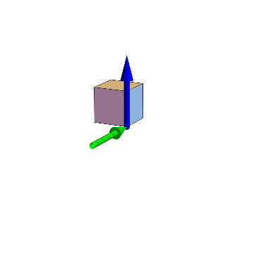
RIXS magnetic angular distribution
V(0)
Fe³⁺_{A}
B
E_{in}
H(90)
K_{in}
[Elnaggar et al. PRM 4, 024415 (2020)/PRL 123, 207210 (2019) / PRB 101, 085107 (2020)
Notes:
A complementary measurement to undertake is the spin-flip RIXS-MLD measurement which is sensitive to in-plane moments and site anisotropic effects.
The RIXS magnetic linear angular dependence was measured by rotating the incident polarization (εin) with respect to the crystallographic direction and the external magnetic field.
A strong angular dependence is observed. The angle between εin and the magnetic moment changes as a function of rotation leading to a strong angular dependence at the spin-flip excitation.
The maximum intensity of the spin-flip excitation occurs at ∼ 120◦
Notice that this represents a phase shift between the maximum of the elastic peak intensity and the spin-flip excitation

Slide 72
Yield detection
Electron yield
Fluorescence Yield (1. dilute limit)
FY (2. state dependent decay)
No XMCD sum rules in FY
FY (3. inverse PFY)
FY (4. dips and peaks)

Slide 73
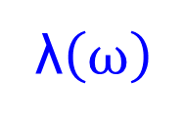
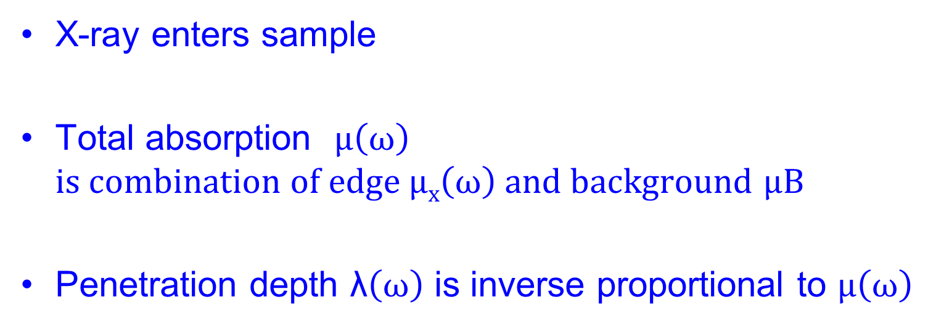
Yield detection
λ$\left(ω\right)$
X-ray enters sample
Total absorption $μ\left(ω\right)$
$is combination of edge μx\left(ω\right) and background$ $μB$
Penetration depth λ$\left(ω\right)$ is inverse proportional to $μ\left(ω\right)$

Slide 74
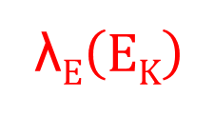
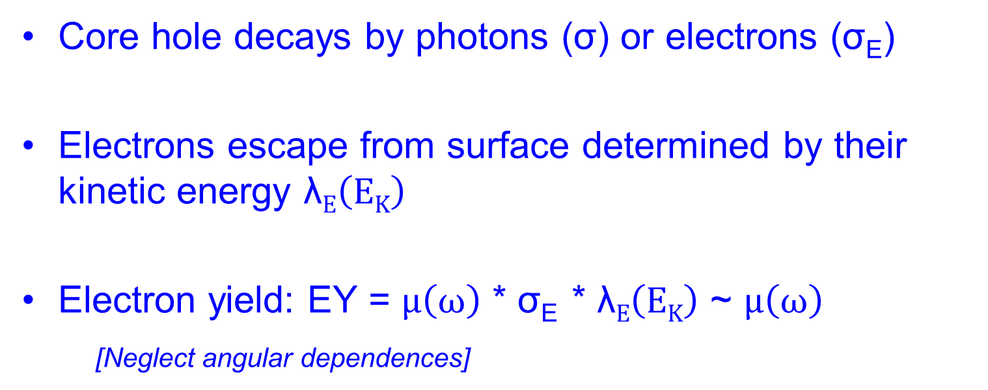
Electron Yield detection
λ$E\left(EK\right)$
λ$\left(ω\right)$
Core hole decays by photons (σ) or electrons (σ_{E})
Electrons escape from surface determined by their kinetic energy λ$E\left(EK\right)$
Electron yield: EY = $μ\left(ω\right)$ * σ_{E} * λ$E\left(EK\right)$ ~ $μ\left(ω\right)$
[Neglect angular dependences]

Slide 75
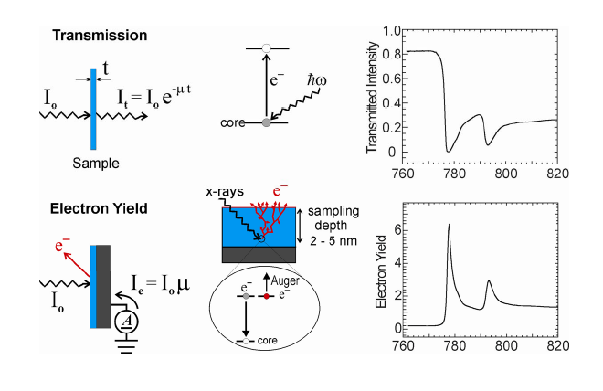
Electron Yield detection

Slide 76
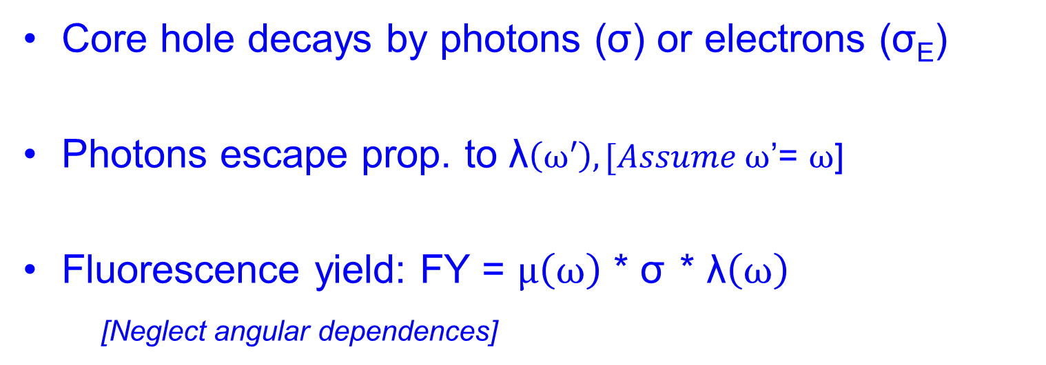
Fluorescence Yield detection
λ$\left(ω\right)$
Core hole decays by photons (σ) or electrons (σ_{E})
Photons escape prop. to λ$\left(ω′\right), [Assume ω$’= $ω$]
Fluorescence yield: FY = $μ\left(ω\right)$ * σ * λ$\left(ω\right)$
[Neglect angular dependences]

Slide 77
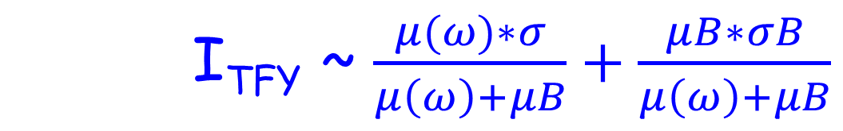
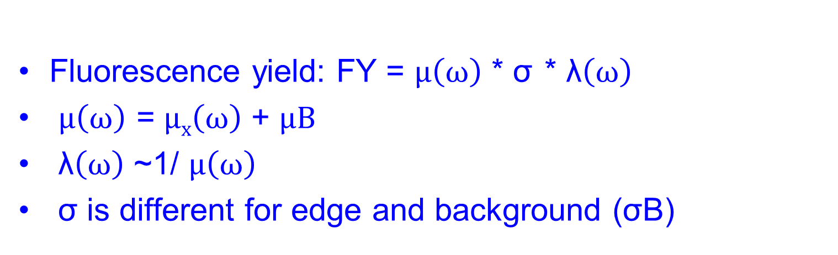
Fluorescence Yield detection
Fluorescence yield: FY = $μ\left(ω\right)$ * σ * λ$\left(ω\right)$
$μ\left(ω\right)$ = $μx\left(ω\right)$ + $μB$
λ$\left(ω\right)$ ~1/ $μ\left(ω\right)$
σ is different for edge and background (σB)
I_{TFY} ~ $\frac{μ(ω)∗σ}{μ\left(ω\right)+μB}+\frac{μB∗σB}{μ\left(ω\right)+μB}$

Slide 78
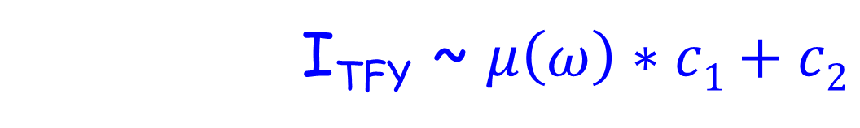
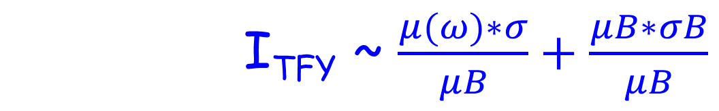
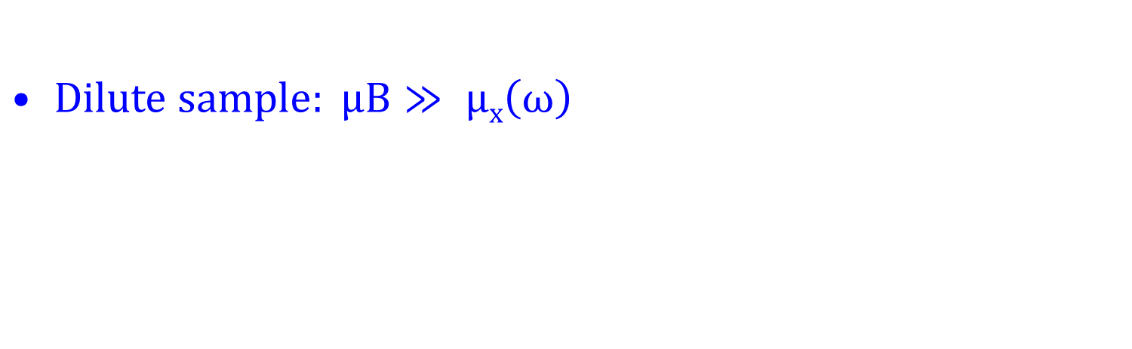
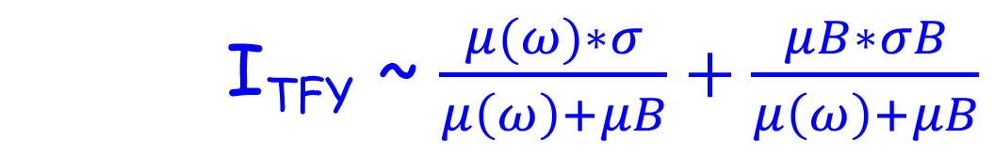
FY detection of dilute sample
I_{TFY} ~ $\frac{μ(ω)∗σ}{μ\left(ω\right)+μB}+\frac{μB∗σB}{μ\left(ω\right)+μB}$
$Dilute sample: μB≫ μx\left(ω\right)$
I_{TFY} ~ $\frac{μ(ω)∗σ}{μB}+\frac{μB∗σB}{μB}$
I_{TFY} ~ $μ\left(ω\right)∗c1+c2$

Slide 79
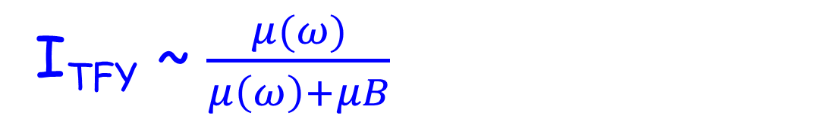
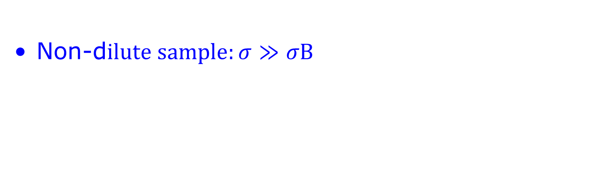
FY detection of concentrated (bulk) sample
I_{TFY} ~ $\frac{μ(ω)∗σ}{μ\left(ω\right)+μB}+\frac{μB∗σB}{μ\left(ω\right)+μB}$
Non-d$ilute sample:σ≫σB$
I_{TFY} ~ $\frac{μ(ω)}{μ\left(ω\right)+μB}$
“saturation & self-absorption”
De-saturation software
(μ(ω) based on CRXO)

Slide 80
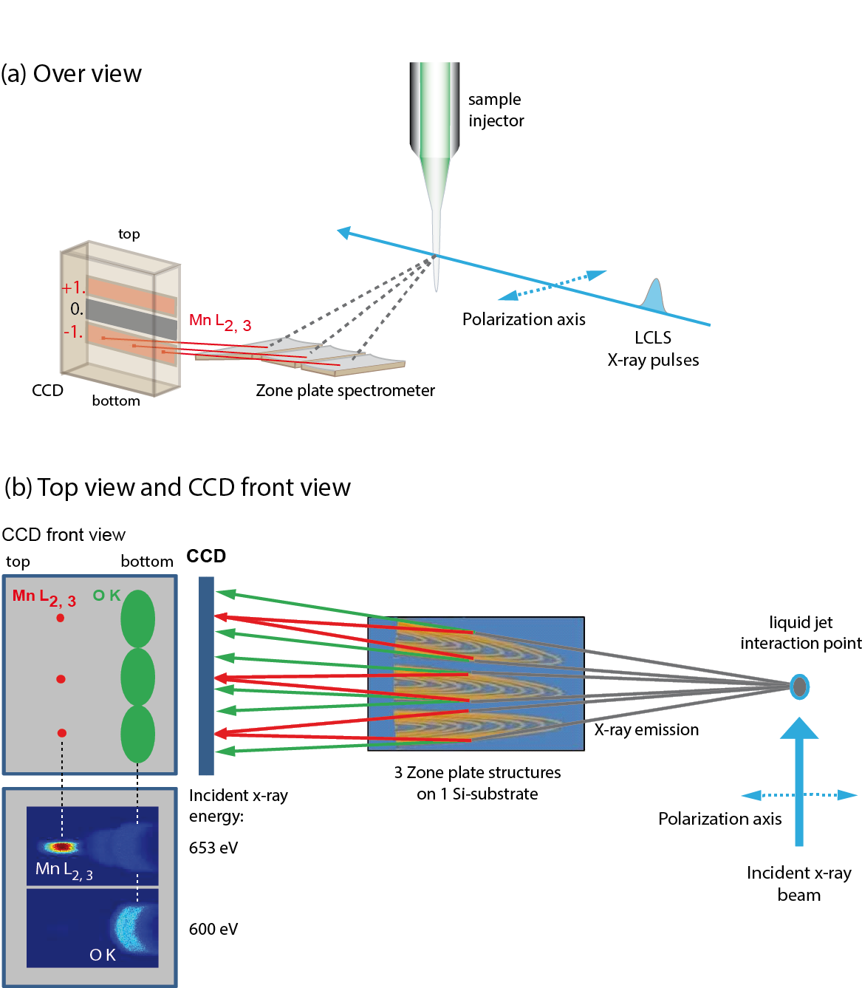
XAS of radiation sensitive sample
Single synchrotron pulselength is too long
Mitzner et al, J. Phys. Chem. Lett. 4, 3641 (2013)
Notes:
80

Slide 81
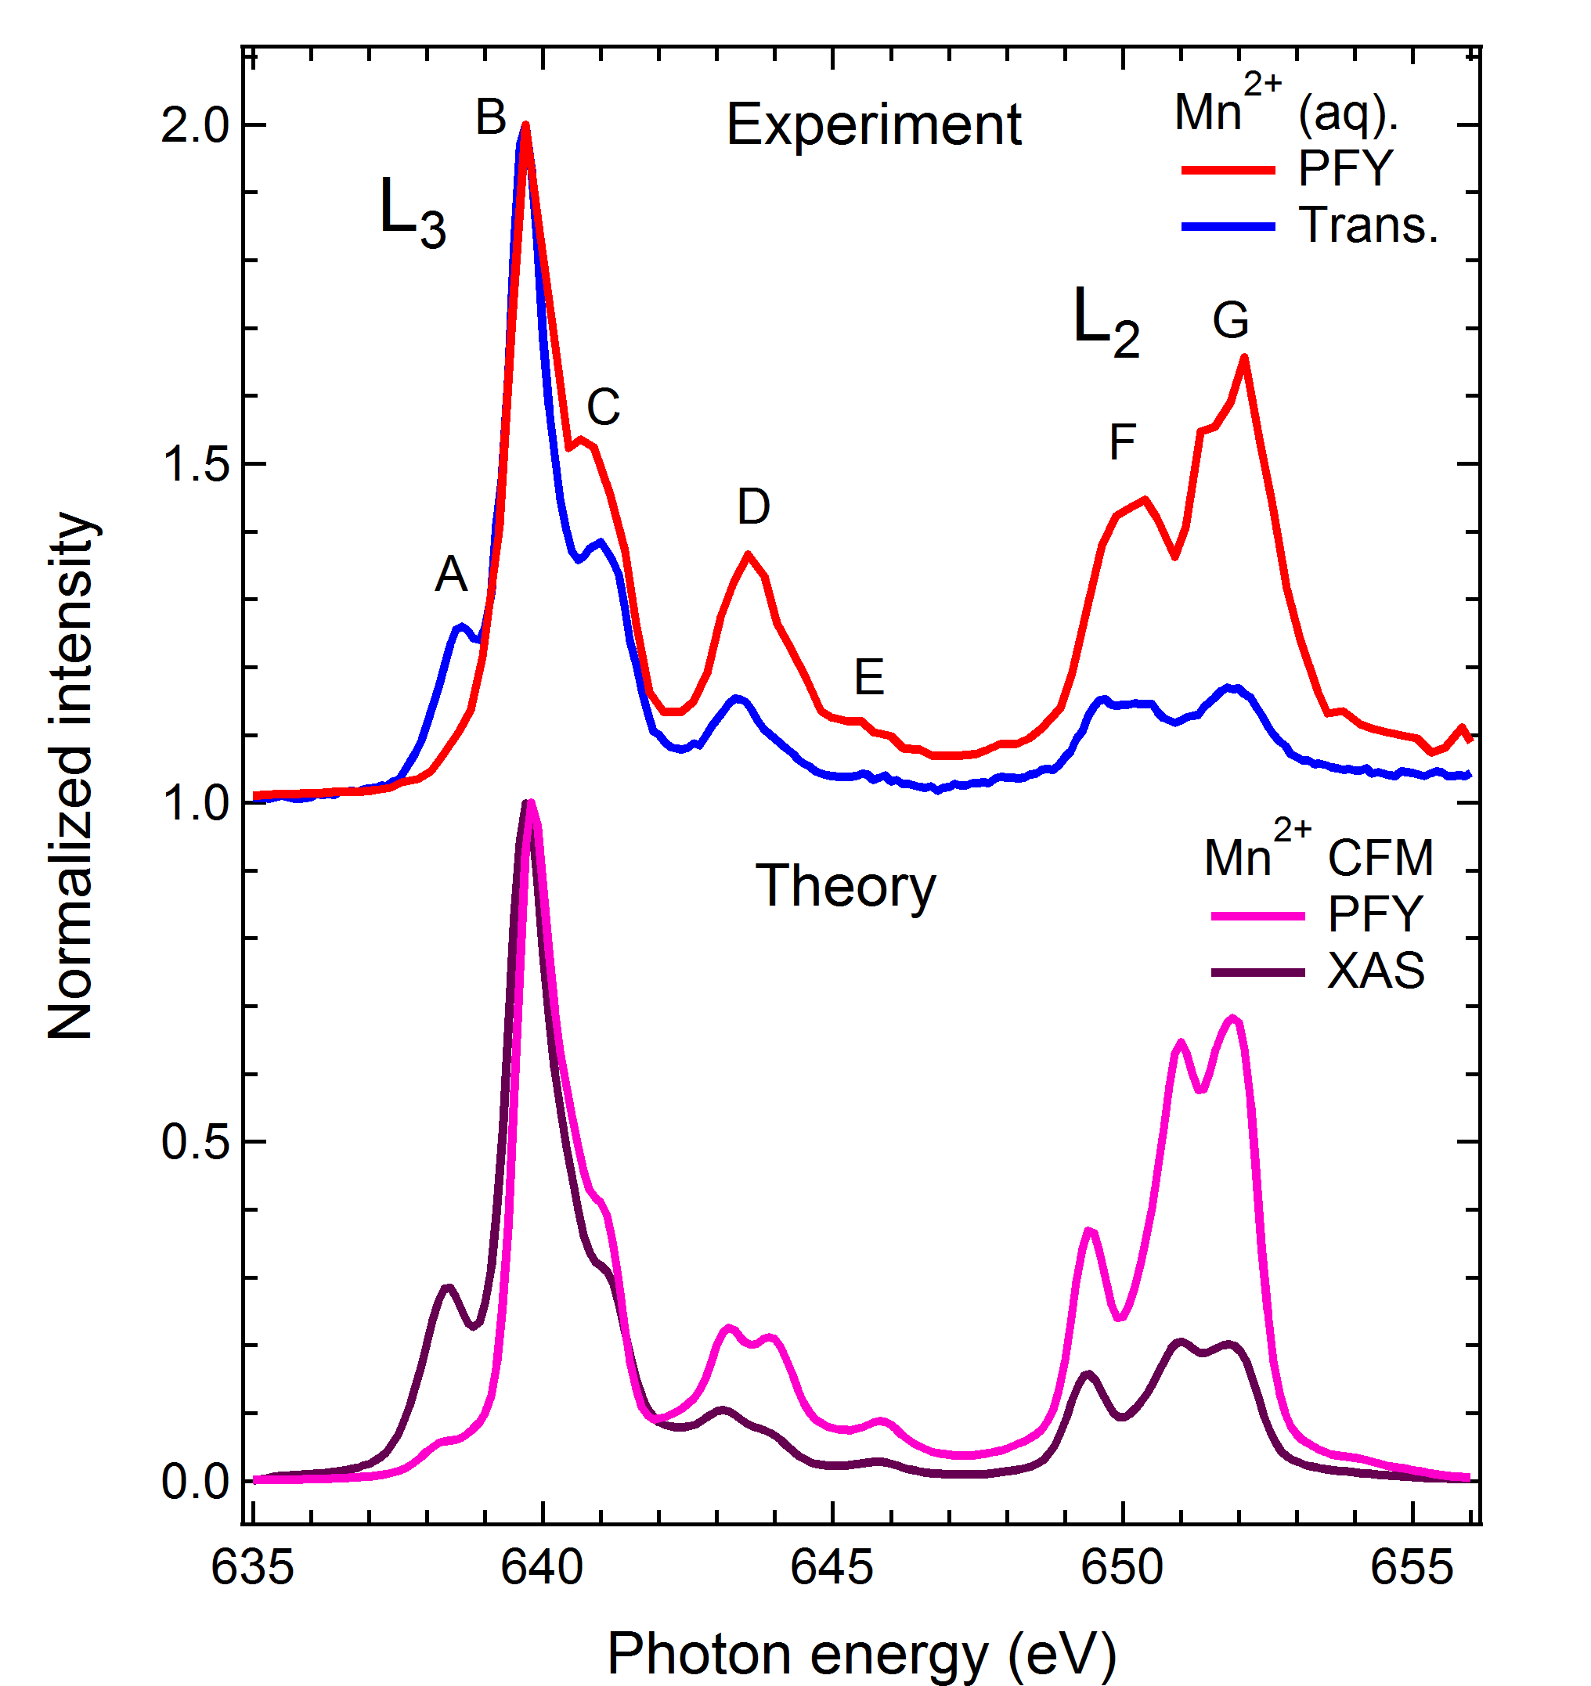
FY-XAS of radiation sensitive sample
Fluorescence does not measure XAS spectrum
Saturation ?
Mitzner et al, J. Phys. Chem. Lett. 4, 3641 (2013)
Notes:
81

Slide 82
FY-XAS of radiation sensitive sample
Fluorescence does not measure XAS spectrum
NO Saturation
State-dependent decay
Mitzner et al, J. Phys. Chem. Lett. 4, 3641 (2013)
Notes:
82

Slide 83
FY detection: State dependent decay
Yield methods assume a constant ratio between radiative and non-radiative decay
If this ratio is state (= energy) dependent then the related yield methods do not measure XAS.

Slide 84
FY detection: State dependent decay
L₃
FY
L₂
EY
Solid State Comm. 92, 991 (1994)

Slide 85
FY detection: State dependent decay
The dominant yield method is not visibly affected, thus for soft X-rays only FY is affected, not electron yield.

Slide 86
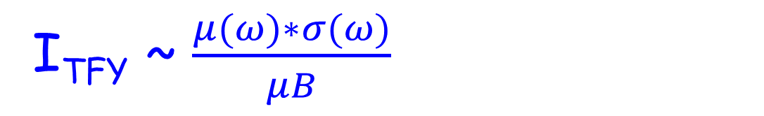
FY detection (state-dependent, dilute)
I_{TFY} ~ $\frac{μ(ω)∗σ}{μ\left(ω\right)+μB}+\frac{μB∗σB}{μ\left(ω\right)+μB}$
I_{TFY} ~ $\frac{μ(ω)∗σ(ω)}{μB}$
Main decay of 2p core hole is 2p3d RIXS
Integrate RIXS spectrum to 2p3d PFY
TFY ~ 2p3d PFY
NOTE: “RIXS” has angular dependence effects

Slide 87
XAS: transmission & FY
Mitzner et al, J. Phys. Chem. Lett. 4, 3641 (2013)
Notes:
87

Slide 88
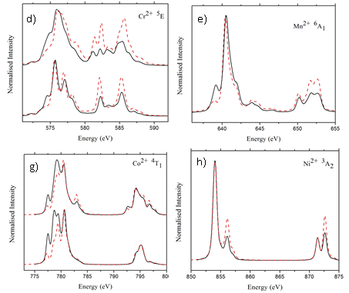
Fluorescence Yield detection
FY-XAS ≠ XAS L₂ edge increases High-energies increase
Kurian J. Phys. Cond. Matt. 24, 435602 (2012)

Slide 89
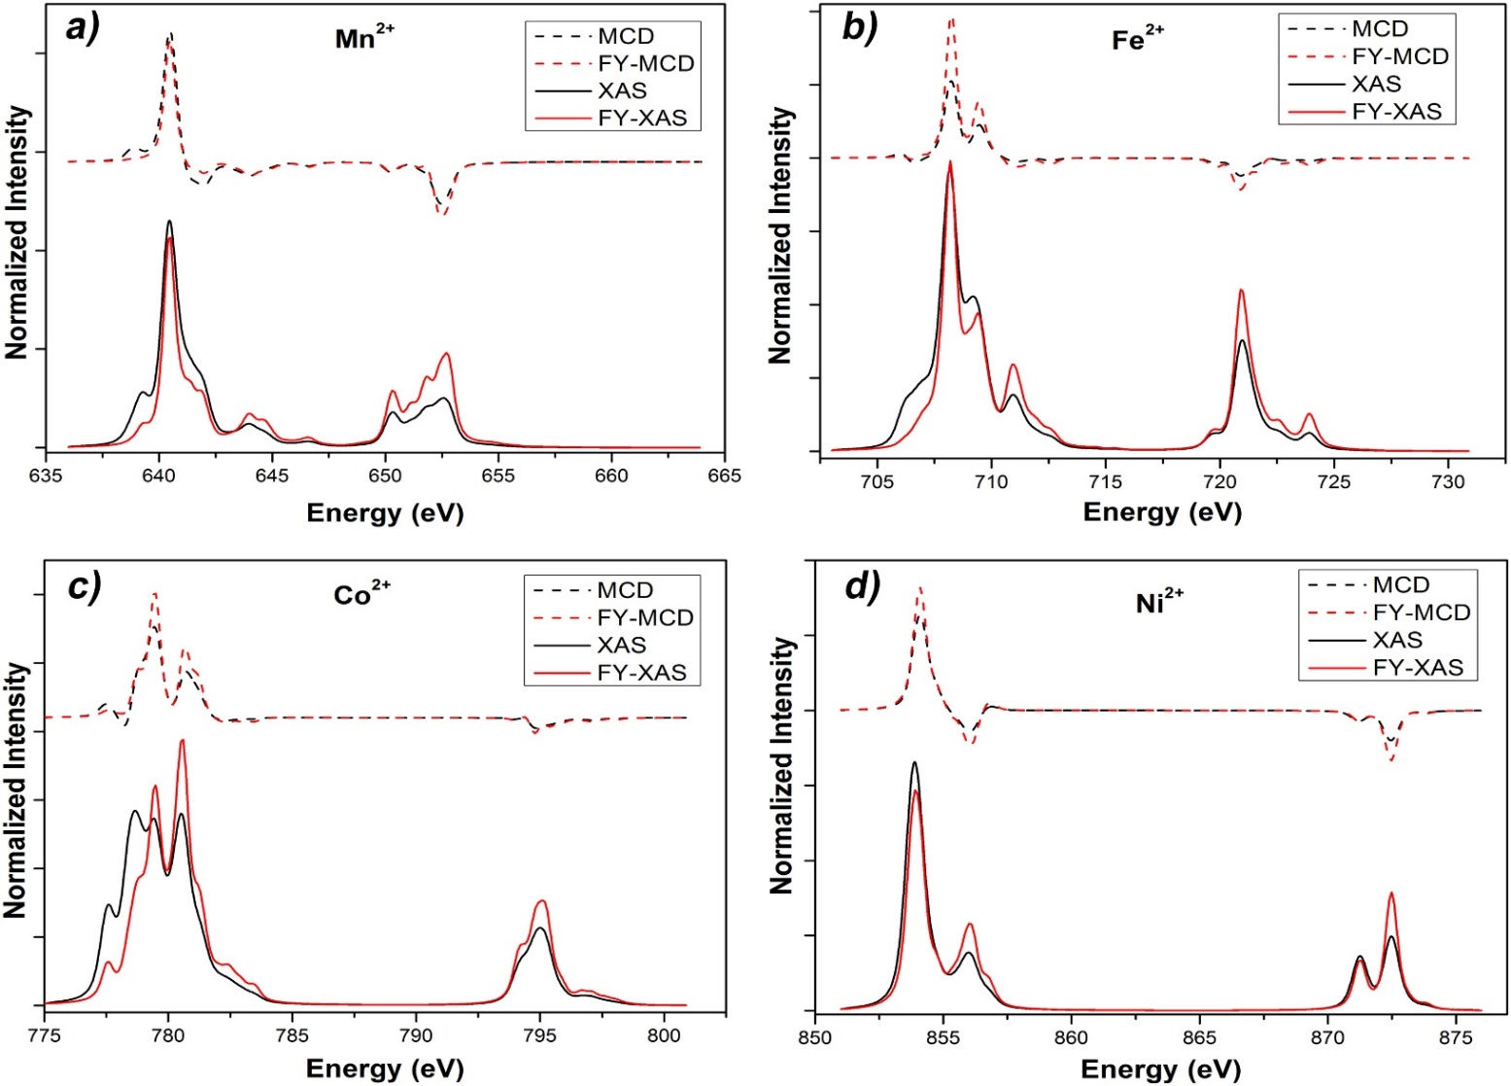
Fluorescence Yield XMCD
XMCD sum rules break down
Ni/Co 20%, Fe 30%, Mn > 100% error
Liu, Phys. Rev. B. 96, 054446 (2017)

Slide 90
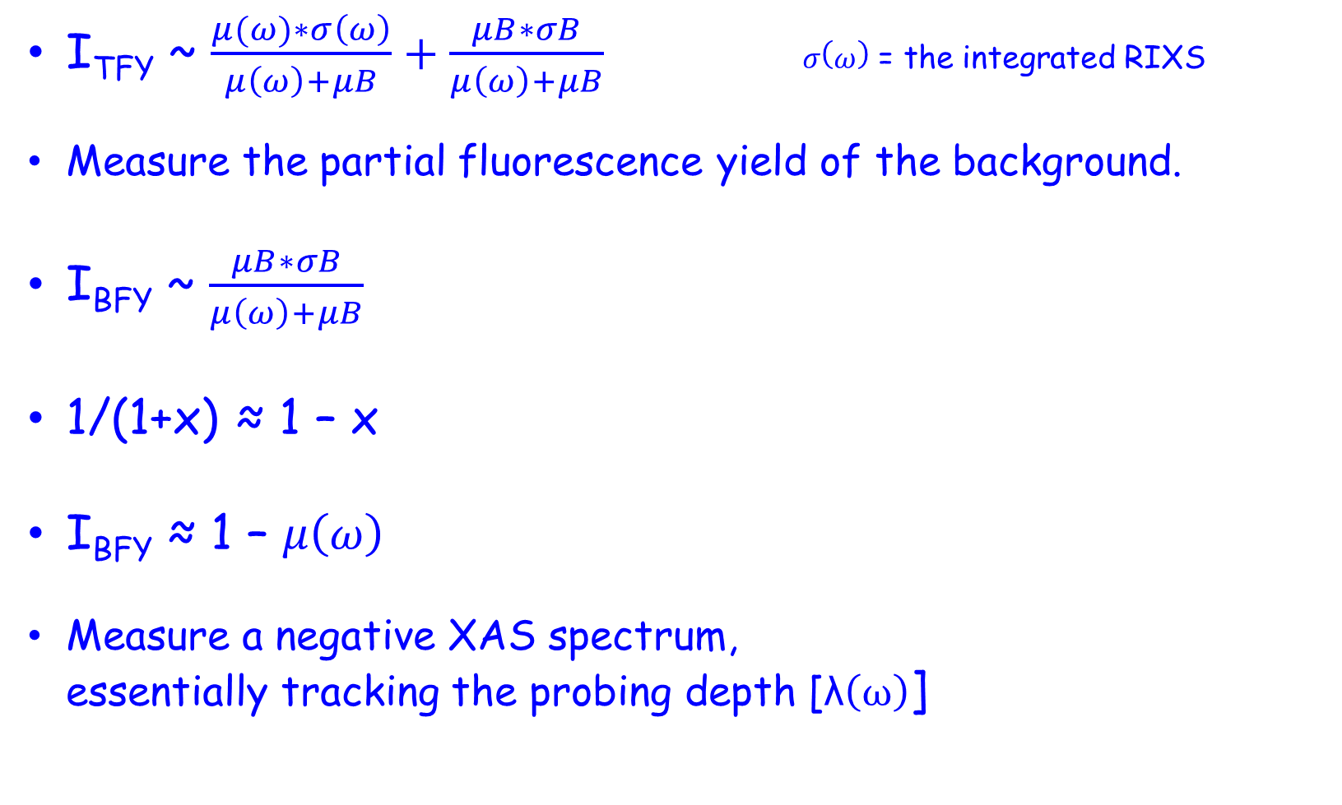
FY detection: 3 inverse PFY
I_{TFY} ~ $\frac{μ(ω)∗σ\left(ω\right)}{μ\left(ω\right)+μB}+\frac{μB∗σB}{μ\left(ω\right)+μB} σ\left(ω\right)$ = the integrated RIXS
Measure the partial fluorescence yield of the background.
I_{BFY} ~ $\frac{μB∗σB}{μ\left(ω\right)+μB}$
1/(1+x) ≈ 1 – x
I_{BFY} ≈ 1 – $μ\left(ω\right)$
Measure a negative XAS spectrum,
essentially tracking the probing depth [λ$\left(ω\right)$]

Slide 91
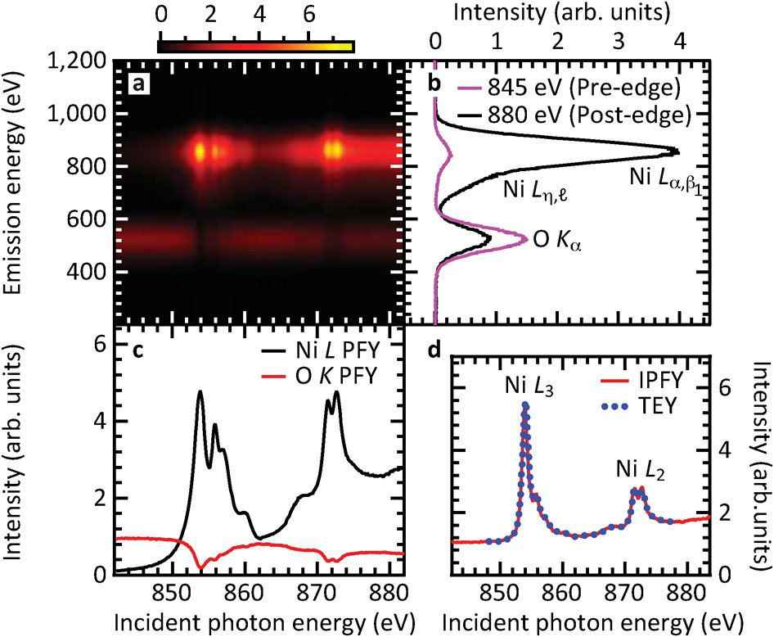
FY detection: 3 inverse PFY
Achkar ea, scientific reports 1, 82 (2011)

Slide 92

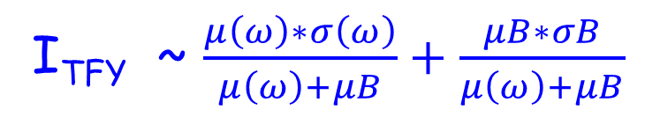
FY detection: 4 dips and peaks
Measure the total fluorescence yield
State-dependent metal PFY + IPFY
I_{TFY} ~ $\frac{μ\left(ω\right)∗σ\left(ω\right)}{μ\left(ω\right)+μB}+\frac{μB∗σB}{μ\left(ω\right)+μB}$
I_{TFY} ~ c₁ $∗ μ\left(ω\right)∗σ\left(ω\right)−\text{c}\text{2}\text{∗}μ\left(ω\right)$

Slide 93
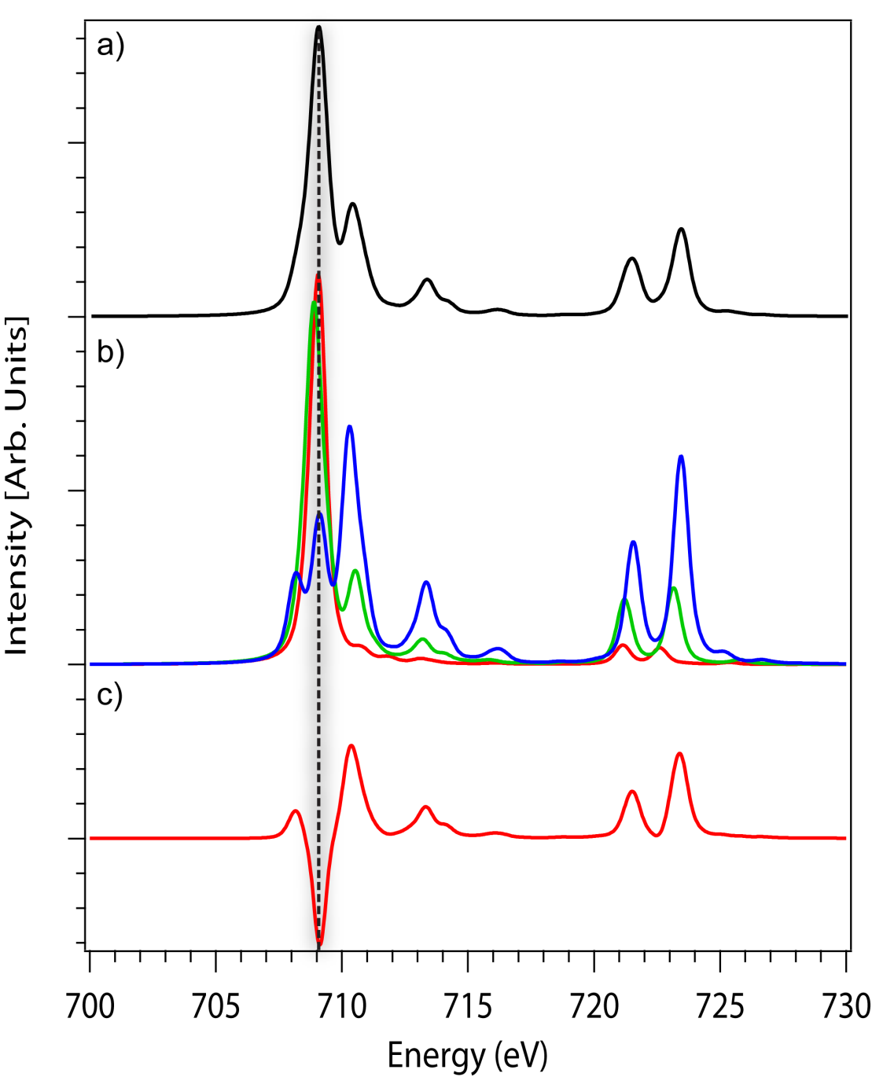
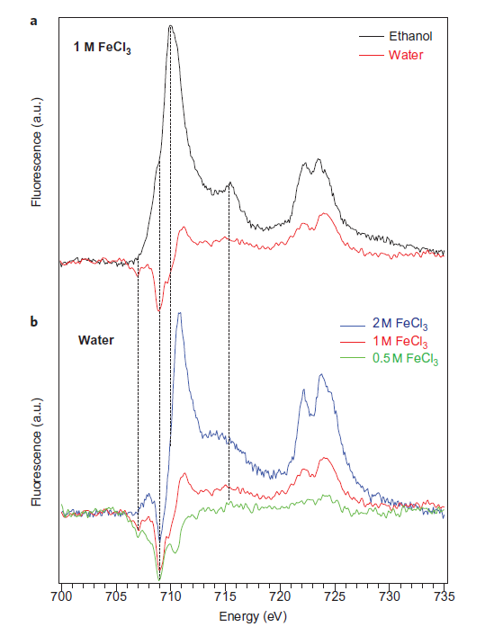
FY detection: 4 dips and peaks
Nature Chem. 4, 766 (2012) & Phys. Rev. Letter discussions (2014)

