Slide 1
X-ray Absorption Spectroscopy
Introduction to XAS
XAS spectral shape (oxygen K edge)
Charge transfer (core hole screening)
XPS spectral shape
XAS spectral shape (metal K edge)
Core hole decay & detection techniques
Overview of core hole spectroscopies
XAS with charge transfer multiplets

Slide 2
X-ray Absorption Spectroscopy
Element specific
Sensitive to low concentrations
Applicable under extreme conditions
SPACE: Combination with x-ray microscopy
TIME: femtosecond XAS
RESONANCE: RIXS, RPES, R diffraction
Notes:
XAS is element specific because each element has specific binding energies for its core levels.
The XAS edge energy is essentially given by the core level binding energy.

Slide 3
Interaction of x-rays with matter
Interaction of x-rays with matter
The photon moves towards the atom

Slide 4
Interaction of x-rays with matter
Interaction of x-rays with matter
The photon is scattered by an electron
X-ray scattering X-ray diffraction
X-ray scattering is independent of the x-ray energy

Slide 5
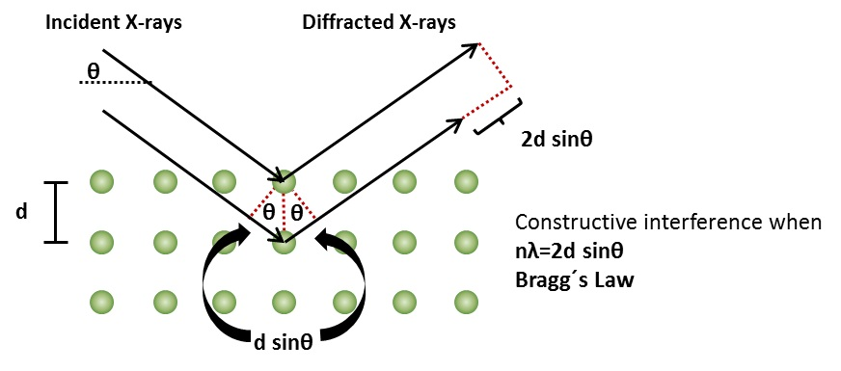
Interaction of x-rays with matter
Interaction of x-rays with matter
The photon is scattered by an electron
X-ray scattering X-ray diffraction

Slide 6
Interaction of x-rays with matter 1
Interaction of x-rays with matter
The photon meets an electron and is annihilated

Slide 7
Interaction of x-rays with matter
Interaction of x-rays with matter
The electron gains the energy of the photon and is turned into a blue electron.

Slide 8
Interaction of x-rays with matter
Interaction of x-rays with matter
The blue electron (feeling lonely) leaves the atom

Slide 9
Interaction of x-rays with matter
Interaction of x-rays with matter
The probability of photon annihilation determines
the intensity of the transmitted photon beam
I₀
I (XAS)
E_{k (XPS)}

Slide 10
Interaction of x-rays with matter
X-ray absorption
XAS, XPS
Elastic scattering (SAXS, XRD)
Inelastic scattering
Mn

Slide 11
X-ray absorption edges
X-ray Absorption Spectroscopy
Label
Orbital
eV
K
1s
6539
L _{I}
2s
769
L _{II}
2p_{1/2}
650
L _{III}
2p_{3/2}
639
M _{I}
3s
82
M _{II}
3p_{1/2}
47
M _{III}
3p_{3/2}
47

Slide 12
X-ray absorption edges
X-ray Absorption Spectroscopy
Label
Orbital
eV
K
1s
6539
L _{I}
2s
769
L _{II}
2p_{1/2}
650
L _{III}
2p_{3/2}
639
M _{I}
3s
82
M _{II}
3p_{1/2}
47
M _{III}
3p_{3/2}
47
BarKLa
The Nobel Prize in Physics 1917 was awarded to Charles Glover Barkla "for his discovery of the characteristic Röntgen radiation of the elements."

Slide 13
X-ray absorption edges
X-ray Absorption Spectroscopy
Label
Orbital
eV
K
1s
6539
L _{I}
2s
769
sharp
principal
diffuse
fundamental
L _{II}
2p_{1/2}
650
L _{III}
2p_{3/2}
639
M _{I}
3s
82
M _{II}
3p_{1/2}
47
J. Chem. Educ. 84, 757 (2007)
M _{III}
3p_{3/2}
47
BarKLa
The Nobel Prize in Physics 1917 was awarded to Charles Glover Barkla "for his discovery of the characteristic Röntgen radiation of the elements."

Slide 14
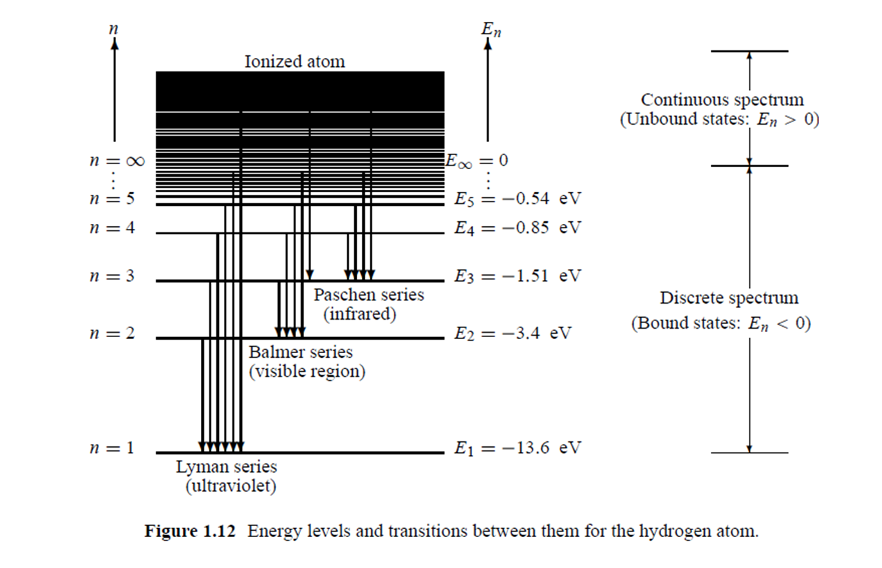
X-ray Absorption Spectroscopy
E = - Z²/n² * 13.6 eV
Atomic electronic structure X-ray absorption of an atom

Slide 15
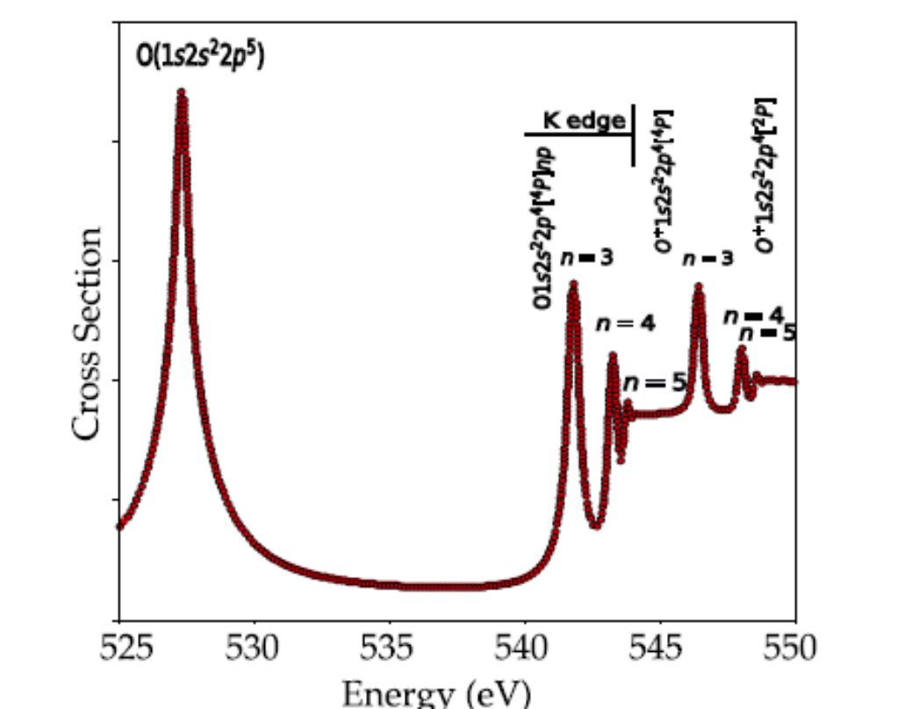
X-ray Absorption Spectroscopy
(Rydberg states)
Atomic electronic structure X-ray absorption of an oxygen atom

Slide 16
X-ray Absorption Spectroscopy
(σ* mixed with Rydberg states)
Molecular electronic structure X-ray absorption of an O2 molecule

Slide 17
X-ray Absorption Spectroscopy
Introduction to XAS
XAS spectral shape (oxygen K edge)
Charge transfer (core hole screening)
XPS spectral shape
XAS spectral shape (metal K edge)
Core hole decay & detection techniques
Overview of core hole spectroscopies
XAS with charge transfer multiplets

Slide 18
XAS: spectral shape (O 1s)
Electronic structure of a transition metal oxide
Main bonding:
O2p with metal 4sp
Gives valence band and conduction band,
Mixed in character
Additional bonding
O2p with metal 3d;
Gives mixed 3d bands split by crystal field in octahedral symmetry, T2g states have pi-bonding and Eg states have sigma-bonding.
oxygen 1s core state
is localized at an oxygen atom
4sp
E_{g}
T_{2g}
O2p
O2s
O 1s ~530 eV
Notes:
18

Slide 19
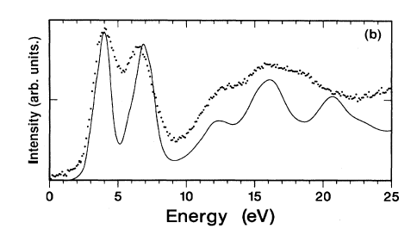
XAS: spectral shape (O 1s)
transition from oxygen 1s state
to an empty state
oxygen 1s core state
is localized at an oxygen atom
local empty DOS
dipole selection rule:
p-projected DOS
4sp
E_{g}
T_{2g}
O2p
O2s
O 1s ~530 eV
Fermi Golden Rule:
I_{XAS} = |<Φ_{f}|dipole| Φ_{i}>|² δ_{[ΔE=0]}
[Phys. Rev. B. 40, 5715 (1989); review in Chem. Rev. 120, 4056 (2020)]
Notes:
19

Slide 20
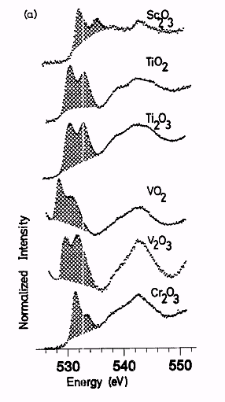
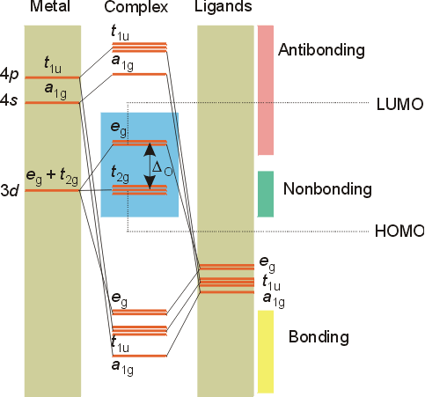
XAS: spectral shape (O 1s)
2p
2s
Phys. Rev. B.40, 5715 (1989)

Slide 21
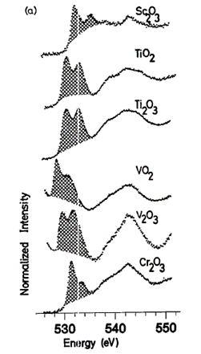
XAS: spectral shape
Electronic Structure: TiO₂
E
T₂
TiO₂: 3d⁰
E
T₂
Cr₂O₃: 3d³

Slide 22
XAS: spectral shape
Electronic Structure: TiO₂
E
T₂
4 >6
6
2 >3
5 >6
TiO₂: 3d⁰
E
T₂
Cr₂O₃: 3d⁰

Slide 23
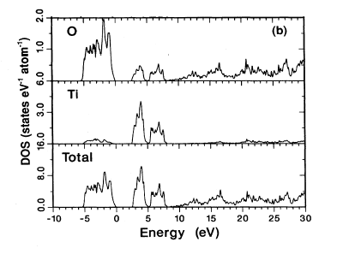
XAS: spectral shape (O 1s)
oxygen 1s > p DOS
Phys. Rev. B.40, 5715 (1989); 48, 2074 (1993)

Slide 24
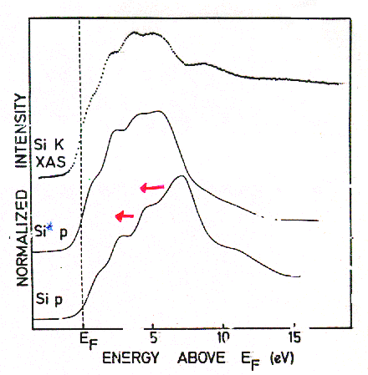
XAS: spectral shape
TiSi₂
Final State Rule: Spectral shape of XAS looks like final state DOS
Lecture Amelie Juhin
Phys. Rev. B. 41, 11899 (1991)

Slide 25
XAS: spectral shape (O 1s)
Crystal structure
Electronic structure calculation, for example Density Functional Theory (DFT)
(in the presence of the core hole)
Calculation of the oxygen
p-projected local empty DOS
Compare with experiment
CODES: FEFF, Wien2K, VASP, QE, etc.

Slide 26
XAS: spectral shape (Ti 2p)
2p > 3d
4sp
E_{g}
T_{2g}
O2p
O2s
Ti 2p ~460 eV
Expect the d (and s-) projected Ti DOS
Why is experiment different?
Notes:
26

Slide 27
XAS: spectral shape (Ti 2p)
2p > 3d
4sp
E_{g}
T_{2g}
O2p
O2s
Ti 2p ~460 eV
Expect the d (and s-) projected Ti DOS
2p spin-orbit coupling (~6 eV)
Notes:
27

Slide 28
XAS: spectral shape (Ti 2p)
2p3d 2-electron integrals
4sp
E_{g}
T_{2g}
O2p
O2s
Ti 2p ~460 eV
Expect local d-projected Ti DOS
Core spin-orbit splitting
Overlap of core 2p and valence 3d states
>> many electron excitations dominate
Notes:
28

Slide 29
XAS: spectral shape (Ti 2p)
X-ray absorption
Fermi Golden Rule:
I_{XAS} = |<Φ_{f}|dipole| Φ_{i}>|² δ_{[ΔE=0]}
I_{XAS} = |< 2p⁵ 3d¹ |dipole| 3d⁰>|² δ_{[ΔE=0]}
Can NOT approximate 2p-3d interaction as extra potential
Large core hole spin-orbit coupling
Single electron (excitation) approximation breaks down :
I_{XAS} = |<3d |dipole| 2p>|² ρ

Slide 30
XAS: spectral shape (O 1s)
X-ray absorption
Fermi Golden Rule:
I_{XAS} = |<Φ_{f}|dipole| Φ_{i}>|² δ_{[ΔE=0]}
I_{XAS} = |< 1s¹ 2p⁵ |dipole| 2p⁴>|² δ_{[ΔE=0]}
Can neglect local 2p-2p interaction
Can approximate 1s-2p interaction as extra potential
No core hole spin-orbit coupling
Single electron (excitation) approximation :
I_{XAS} = |<2p |dipole| 1s>|² ρ

Slide 31
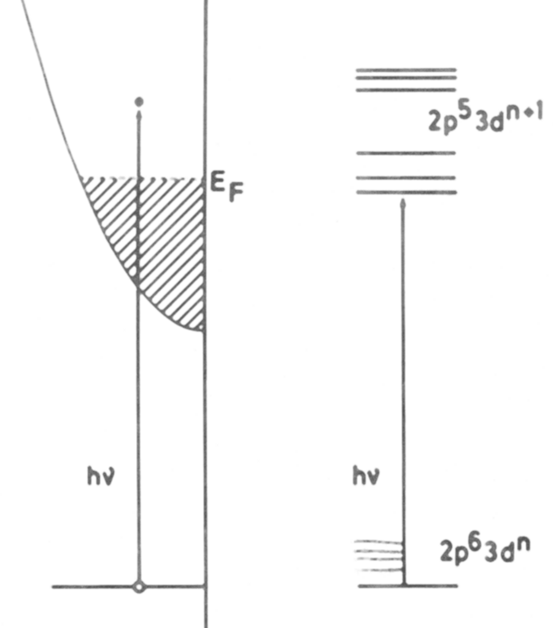
XAS
XAS: two models
Single Particle:
1s edges
(DFT codes, TD-DFT)
Total energy:
2p, 3s, 3p edges
(Multiplet codes)

Slide 32
X-ray Absorption Spectroscopy
Introduction to XAS
XAS spectral shape (oxygen K edge)
Charge transfer (core hole screening)
XPS spectral shape
XAS spectral shape (metal K edge)
Core hole decay & detection techniques
Overview of core hole spectroscopies
XAS with charge transfer multiplets

Slide 33
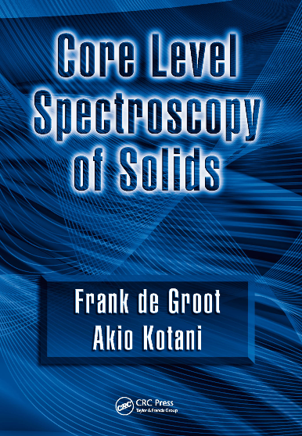
Charge Transfer Multiplet program
Used for the analysis of XAS, EELS,
Photoemission, Auger, XES involving d and f-shells
ATOMIC INTERACTIONS
⇓
CRYSTAL FIELD
⇓
CHARGE TRANSFER
CHARGE TRANSFER MULTIPLETS
Lecture Marie-Anne Arrio
Notes:
The TT-multiplets program can be used to explain the spectral shapes of all core level spectroscopies. XAFS, photoemission, auger, etc.
The program combines three advanced computer codes, an atomic physics code to describe all atomic interactions, a group theory code to describe the local symmetry (think of crystal fields) and model Hamiltonians to describe many body effects correlated systems.
AS A SIDE REMARK I WOULD LIKE TO MENTION that the active site in a catalyst is a perfect example of a correlated system. (in biocatalysis this is often realised)
The integrated program gives accurate descriptions of core level spectra, from a set of uniform electronic structure parameters.
The program is important for all of the new spectroscopies that I will describe.
The program is distributed from my homepage and it is used at some 50 institutes worldwide.

Slide 34
Multiplet calculations
valence e-e interactions F_{dd}
core-valence e-e F_{pd} G_{pd}
core & valence spin-orbit ζ
crystal field 10Dq, Ds, Dt
molecular field, M or H
e-e screening κ
charge transfer Δ, U, Q
hopping T_{Γ}
ionic 3d
4f, 5f
atomic 3d
covalent 3d
mixed valence f
ATOMIC
SYMMETRY
BONDING

Slide 35
Charge transfer effects
Charge Transfer Effects
Hubbard U for a 3d⁸ ground state:
U= E(3d⁷) + E(3d⁹) – E(3d⁸) – E(3d⁸)
Ligand-to-Metal Charge Transfer (LMCT):
Δ= E(3d⁹L) – E(3d⁸)

Slide 36
Charge transfer effects
Charge Transfer Effects
Main screening mechanism in XAS of oxides:
Ligand-to-metal charge transfer
Charge transfer energy Δ is important for XAS
Hubbard U is NOT important for XAS spectral shape

Slide 37
Charge transfer effects
Charge transfer effects in XAS and XPS
Ground state: 3d⁸ + 3d⁹L
Energy of 3d⁹L: Charge transfer energy Δ
3d⁹L
Δ
3d⁸
Ground State

Slide 38
Charge transfer effects
Charge Transfer Effects
3d⁹L
Δ
3d⁸

Slide 39
Charge transfer effects
Charge Transfer Effects
9
3d⁹L
Δ
8
3d⁸

Slide 40
Charge transfer effects
Charge Transfer Effects
β 3d⁸ - α 3d⁹L
α 3d⁸ + β 3d⁹L
3d⁹L
Δ
3d⁸

Slide 41
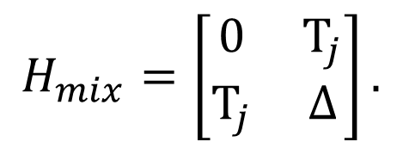
Charge transfer effects
Charge Transfer Effects
$$H_{mix}=\left[\begin{matrix}0 & T_{j} \\ T_{j} & ∆\end{matrix}\right].$$
3d⁹L
E_{1,2} = ½ [Δ±√(Δ²+4T²)]
Δ=2 and T=0
E_{1,2} = ½ [2±√(2²+0)] = 0 and 2
Δ
3d⁸

Slide 42
Charge transfer effects
Charge Transfer Effects
$$H_{mix}=\left[\begin{matrix}0 & T_{j} \\ T_{j} & ∆\end{matrix}\right].$$
3d⁹L
E_{1,2} = ½ [Δ±√(Δ²+4T²)]
Δ=2 and T=1
E_{1,2} = ½ [2±√(2²+4)] = 1 ± √2
Δ
3d⁸

Slide 43
Charge transfer effects
Charge Transfer Effects in NiO
E(3d⁹L) – E(3d⁸) = Δ
E(3d¹⁰LL‘) – E(3d⁸) = 2Δ
X

Slide 44
Charge transfer effects
Charge Transfer Effects in NiO
E(3d⁹L) – E(3d⁸) = Δ
E(3d¹⁰LL‘) – E(3d⁸) = 2Δ +U

Slide 45
Charge transfer effects
Charge Transfer Effects

Slide 46
Charge transfer effects
Charge Transfer Effects in XAS
Δ+U-Q
Δ

Slide 47
Charge transfer effects
Charge Transfer Effects
NiO: Ground state: 3d⁸ + 3d⁹L
Energy of 3d⁹L: Charge transfer energy Δ
3d⁹L
3d⁸
2p⁵3d¹⁰L
2p⁵3d⁹
Δ
Δ+U-Q ≈ Δ

Slide 48
β 3d⁸ - α 3d⁹L
α 3d⁸ + β 3d⁹L
β’ c3d⁹ – α’ c3d¹⁰L
α' c3d⁹ + β’ c3d¹⁰L
Charge transfer effects
~0
~1
Δ
Δ+U-Q ≈ Δ
Intensity bonding combination: [α α’+ β β’]²
α ≈ α’ ≈ (α²+ β²⁾² =1

Slide 49
β 3d⁵ - α 3d⁶L
α 3d⁵ + β 3d⁶L
β’ c3d⁶ – α’ c3d⁷L
α' c3d⁶ + β’ c3d⁷L
Charge transfer effects
~0
~1
Δ
Δ+U-Q ≈ Δ
Intensity anti-bonding combination: [α β’- β α’]²
α ≈ α’ ≈ (αβ – βα)² =0

Slide 50
Charge transfer effects
Charge Transfer Effects
Neutral experiments are self-screened
XAS, optical, EPR, EELS, RIXS
>> small screening satellites
>> crystal field theory can be used
Ionising experiments are not self-screened
XPS, Auger,
>> large screening > large satellites
>> crystal field theory can not be used

Slide 51
Charge transfer effects in XAS and XPS
Charge transfer effects in XAS and XPS
Transition metal oxide: Ground state: 3d⁵ + 3d⁶L
Energy of 3d⁶L: Charge transfer energy Δ
3d⁶L
XPS
2p⁵3d⁵
XAS
2p⁵3d⁷L
Δ
3d⁵
Δ-Q
Ground State
Δ+U-Q ≈ Δ
2p⁵3d⁶L
2p⁵3d⁶

Slide 52
X-ray Absorption Spectroscopy
Introduction to XAS
XAS spectral shape (oxygen K edge)
Charge transfer (core hole screening)
XPS spectral shape
XAS spectral shape (metal K edge)
Core hole decay & detection techniques
Overview of core hole spectroscopies
XAS with charge transfer multiplets

Slide 53
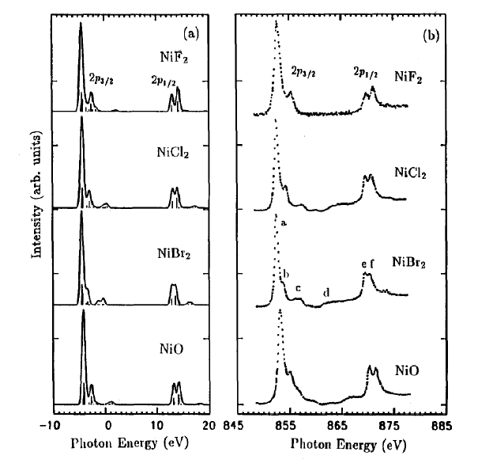
Charge transfer effects in XAS
Charge transfer
XAS = neutral
Self screened
Small charge transfer satellites

Slide 54
Charge transfer effects in XAS
Charge Transfer Effects in XAS
Δ+U-Q
Δ

Slide 55
Charge transfer effects in XPS
Charge Transfer Effects in XPS
Δ-Q
Δ

Slide 56
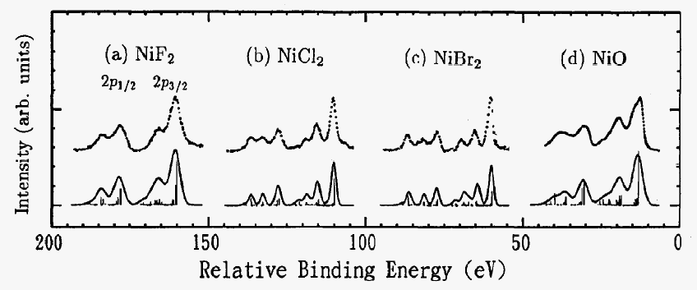
Charge transfer effects in XPS
Charge transfer effects in XPS
XAS = neutral
Self screened
Small charge transfer satellites
XPS = ionising
Large screening
Large charge transfer satellites

Slide 57
Charge transfer effects in XPS
1s and 2p XPS of Fe2O3

Slide 58
Charge transfer effects in XPS
1s and 2p XPS of Fe2O3

Slide 59
Charge transfer effects in XPS
1s and 2p XPS of Fe2O3

Slide 60
Charge transfer effects in XPS
1s and 2p XPS of Fe2O3
LDA + DMFT:
Use actual DMFT-based band structure
result to couple to the localised states
More on Thursday/friday
Phys. Rev. B.100, 075146 (2019)

Slide 61
X-ray Absorption Spectroscopy
Introduction to XAS
XAS spectral shape (oxygen K edge)
Charge transfer (core hole screening)
XPS spectral shape
XAS spectral shape (metal K edge)
Core hole decay & detection techniques
Overview of core hole spectroscopies
XAS with charge transfer multiplets

Slide 62
XAS
XAS: two models
Single Particle:
1s edges
(DFT codes, TD-DFT)
Total energy:
2p, 3s, 3p edges
(Multiplet codes)

Slide 63
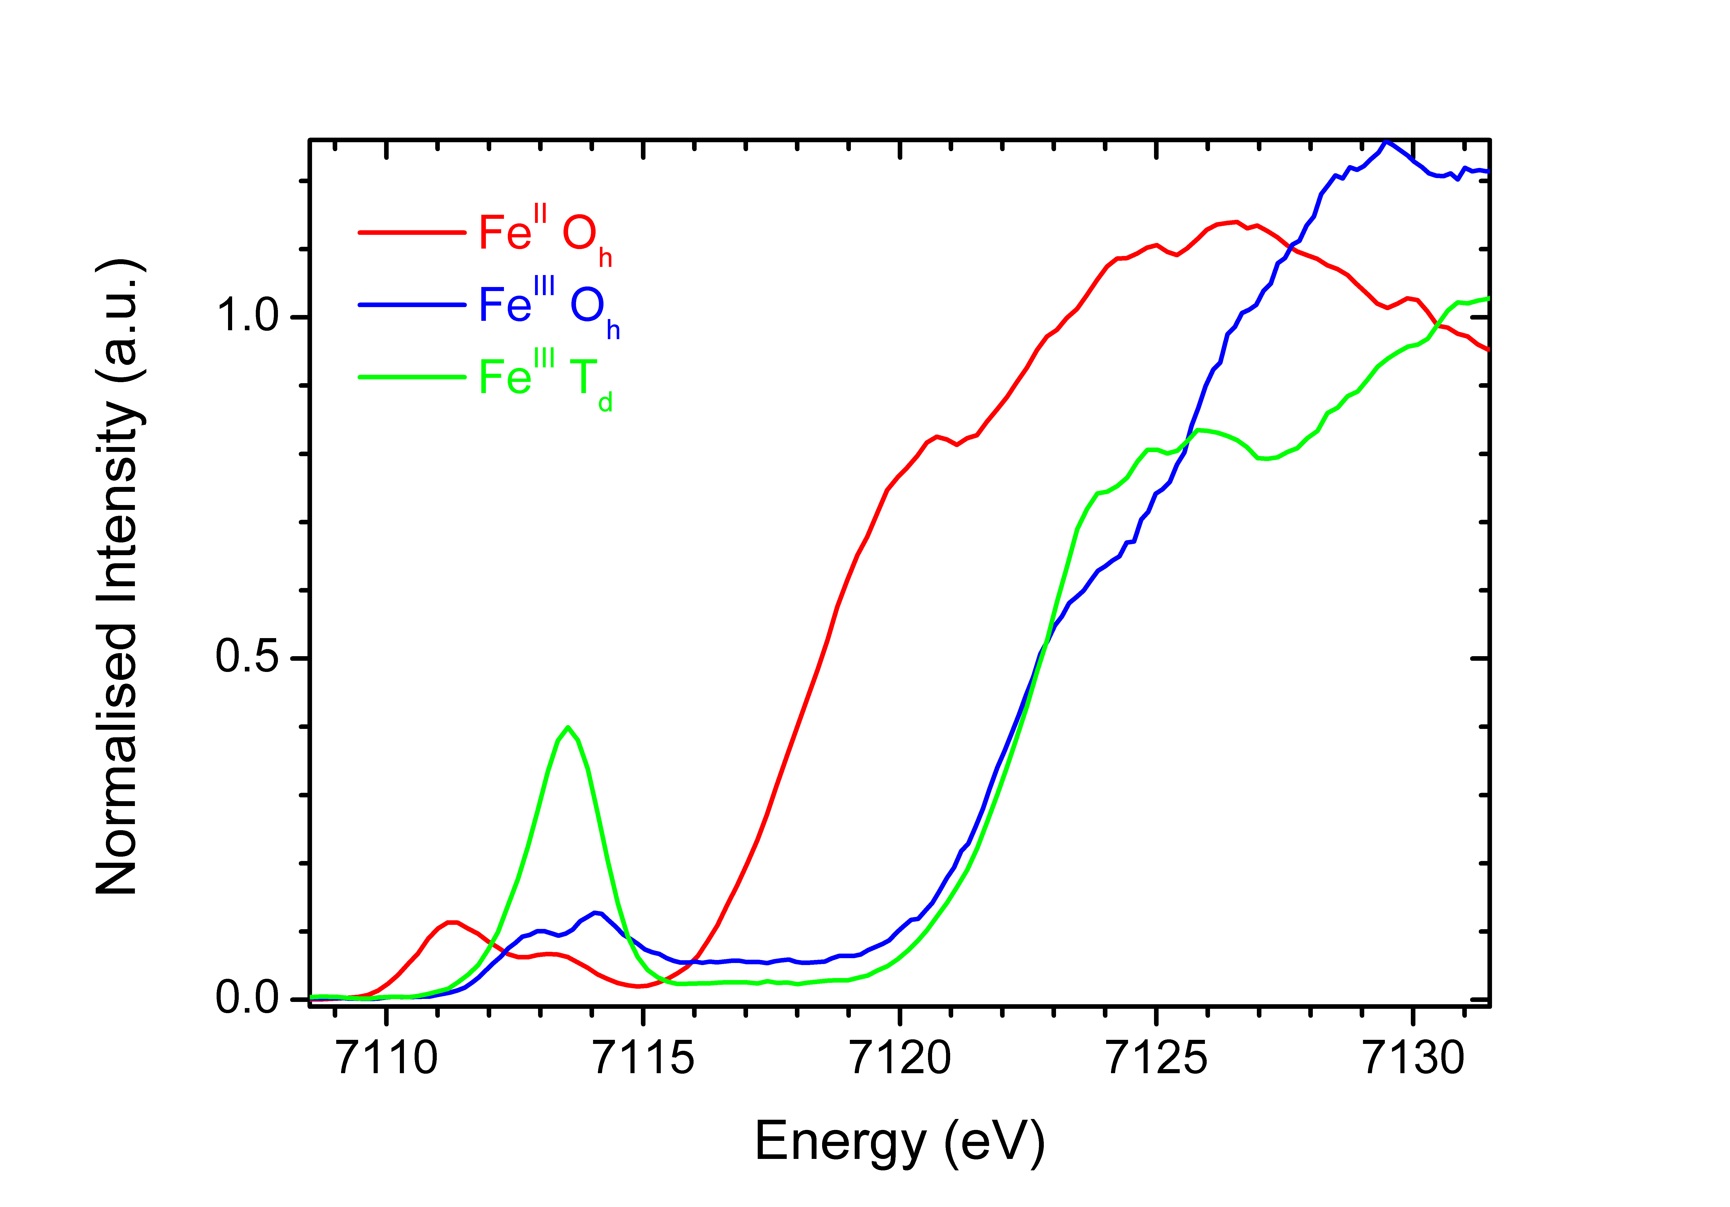
Iron 1s XAS
Metal K edges: dipole & quadrupole
exciton
edge jump
3d systems
1s > p dipole
1s > 3d quadrupole
[J. Phys. Chem. B. 109, 20751 (2005)]
Notes:
63

Slide 64
pre-edge (interpretation)
1s
1
3d
N
4p
1
edge
3d
4p
1s
1
3d
N+1
4p
0
pre-edge
N
0

Slide 65
pre-edge (interpretation)
1s
1
3d
N
4p
1
edge
3d
4p
1s
1
3d
N+1
4p
0
pre-edge
N
0
[J. Phys. Cond. Matt. 21, 104207 (2009)]

Slide 66
K edge and 1s2p RIXS
1s2p RIXS of transition metal ions
Co^{III}(acac)
low-spin Co^{III}
3d⁶ [¹A₁]
T_{2g} full
E_{g} empty

Slide 67
K pre-edge of TM oxides (LiCoO₂)
Pre-edges structures in 1s XAS
Co K edge of LiCoO₂
low-spin Co^{III}
3d⁶ [¹A₁]
T_{2g} full
E_{g} empty

Slide 68
K pre-edge of TM oxides (LiCoO₂)
Pre-edges structures in 1s XAS
Co K edge of LiCoO₂
low-spin Co^{III}
3d⁶ [¹A₁]
T_{2g} full
E_{g} empty

Slide 69
K pre-edge of TM oxides
Pre-edges structures in 1s XAS
J. Phys. Cond. Matt. 21, 104207 (2009); Phys. Rev. B. 81, 115115 (2010)

Slide 70
K edge and 1s2p RIXS
K main edge (interpretation)
K main edge (+non-local peaks) calculated
from transitions to empty states
Calculated with TD-DFT/BSE, for example:
Exciting, Ocean
Calculated with DFT, for example:
Multiple scattering (FEFF, FDMNES)
Band structure (Wien2K, VASP, QuantumEspresso)
Molecular DFT (ADF, ORCA)

Slide 71
K edge and 1s2p RIXS
K main edge (interpretation)
LiCoO₂
LDA+U + Q
d
a
K main edge calculated from transitions to empty states
[Juhin PRB 81, 115115 (2010)]

Slide 72
K main edge (interpretation)
1s XPS spectrum of NiO has multiple peaks
One photon energy relates to many different electron kinetic energies:
[Ghiasi et al., PRB 100, 075146 (2019)]

Slide 73
K main edge (interpretation)
1s XPS spectrum has multiple peaks
One photon energy relates to many different electron kinetic energies:
One cannot do XAS calculations with a single kinetic energy
1s XAS does NOT look (exactly) like the empty DOS
[Ghiasi et al., PRB 100, 075146 (2019)]

Slide 74
X-ray Absorption Spectroscopy
Introduction to XAS
XAS spectral shape (oxygen K edge)
Charge transfer (core hole screening)
XPS spectral shape
XAS spectral shape (metal K edge)
Core hole decay & XAS detection
Overview of core hole spectroscopies
XAS with charge transfer multiplets

Slide 75
X-ray absorption & Auger
X-ray Absorption Spectroscopy
Auger decay
X-ray emission
Notes:
75

Slide 76
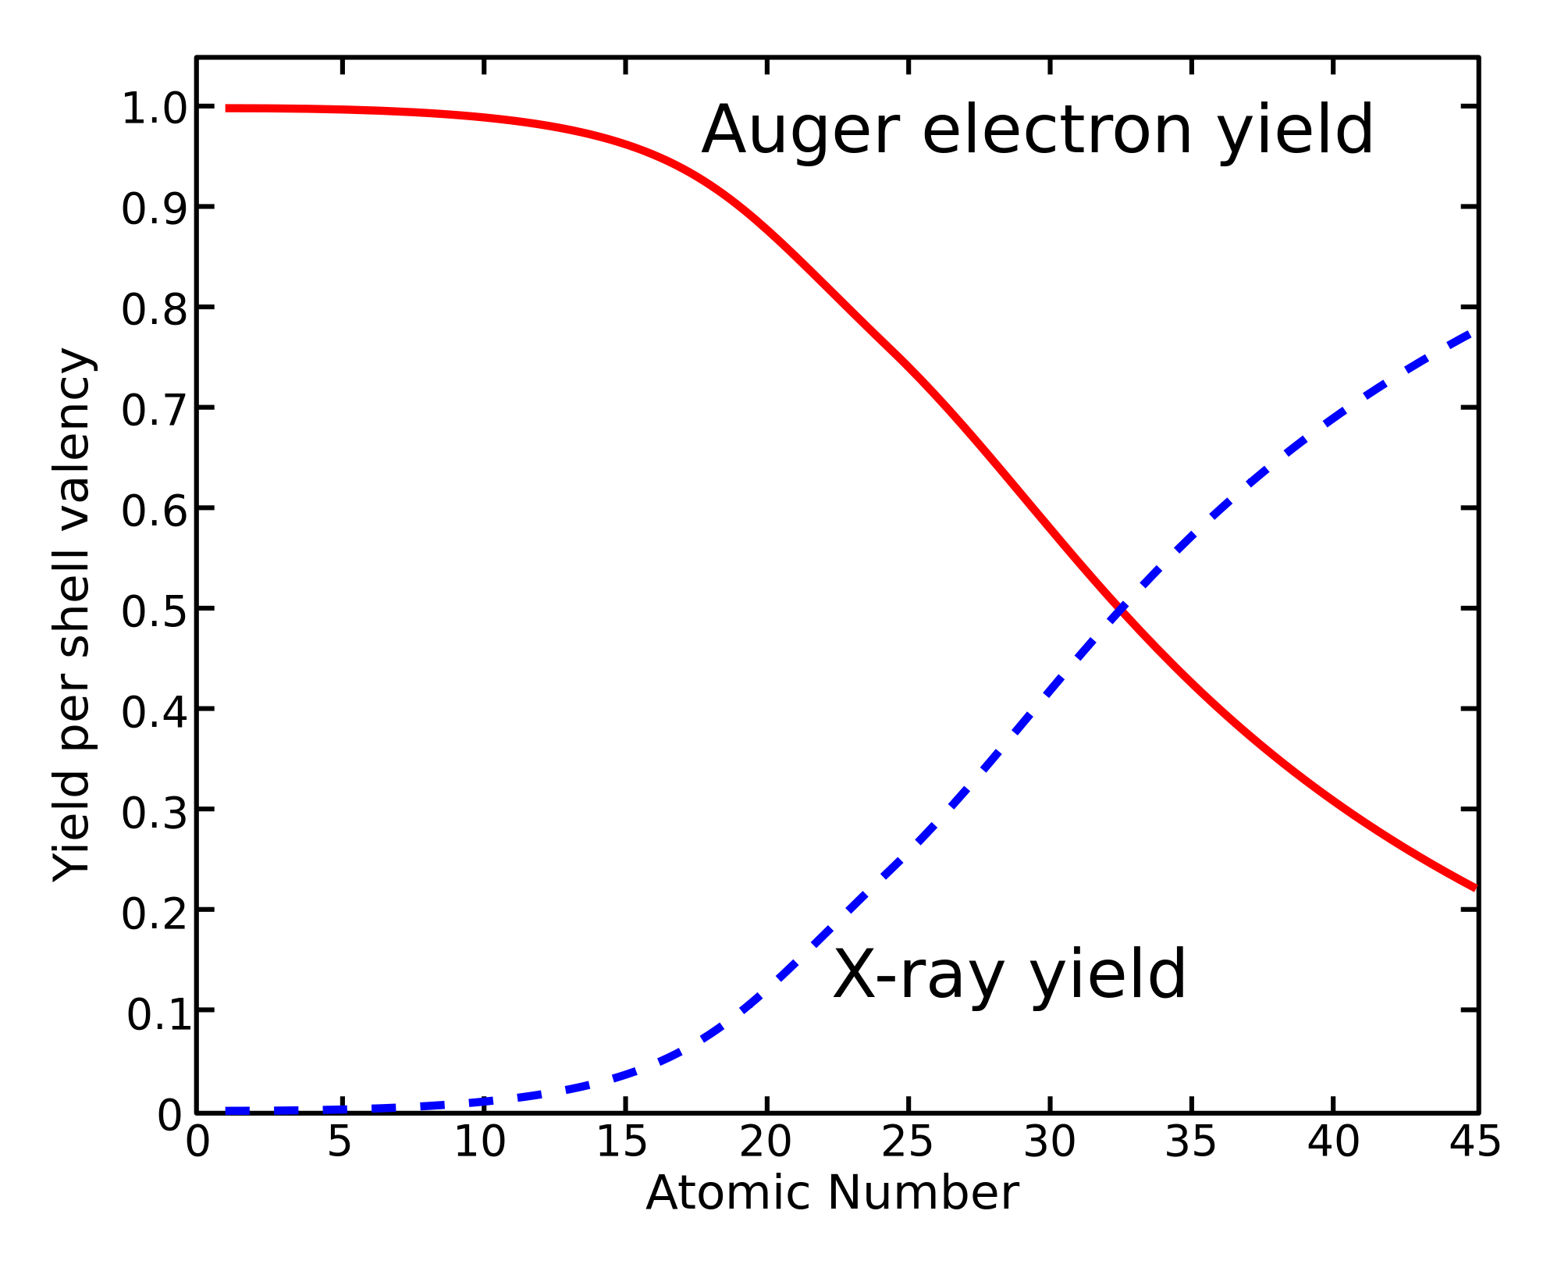
X-ray Absorption Spectroscopy
1s core state
Soft x-rays: Auger
Hard x-rays: fluorescence
Notes:
76

Slide 77
XAS: detection techniques

Slide 78
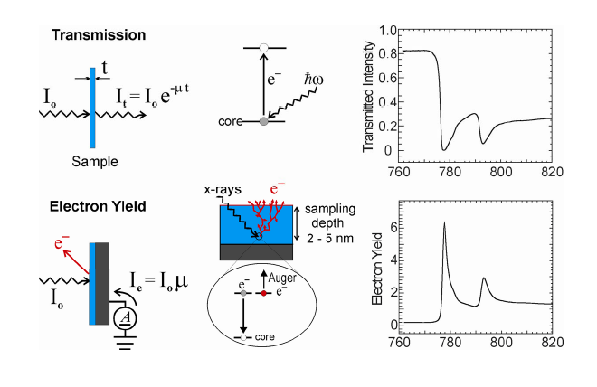
XAS: detection techniques
Use decay channels as detector
Uniform thickness
Uniform concentration of absorbing element
Thin enough for photons

Slide 79
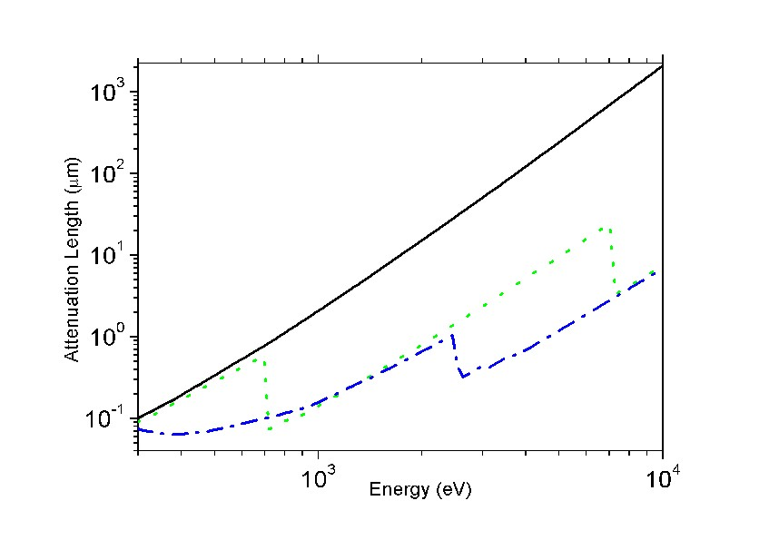
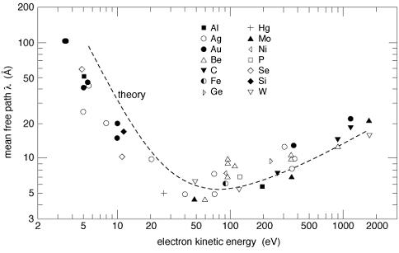
XAS: detection techniques
X-ray penetration lengths &
electron escape depths
100-1000 nm
(CXRO, but 20 nm for L edges)
1-5 nm

Slide 80
XAS: detection techniques
Use decay channels as detector
X-ray penetrate 1000 nm (λ_{X})
Electrons escape from 5 nm (λ_{E})
Number of core holes created in first 5 nm is proportional to μ
I_{TEY} ~ 1 / λ_{X} = μ_{X}

Slide 81
XAS: detection techniques
Transmission
(pinhole, saturation > thin samples)
Electron Yield
(surface sensitive)
Fluorescence Yield
(saturation & self-absorption:
> dilute samples)
[L edges are intrinsically distorted]

Slide 82
X-ray Absorption Spectroscopy
Introduction to XAS
XAS spectral shape (oxygen K edge)
Charge transfer (core hole screening)
XPS spectral shape
XAS spectral shape (metal K edge)
Core hole decay & XAS detection
Overview of core hole spectroscopies
XAS with charge transfer multiplets

Slide 83
Write down all core level spectroscopies
Excitation
Decay
Resonances/scattering
Notes:
The TT-multiplets program can be used to explain the spectral shapes of all core level spectroscopies. XAFS, photoemission, auger, etc.
The program combines three advanced computer codes, an atomic physics code to describe all atomic interactions, a group theory code to describe the local symmetry (think of crystal fields) and model Hamiltonians to describe many body effects correlated systems.
AS A SIDE REMARK I WOULD LIKE TO MENTION that the active site in a catalyst is a perfect example of a correlated system. (in biocatalysis this is often realised)
The integrated program gives accurate descriptions of core level spectra, from a set of uniform electronic structure parameters.
The program is important for all of the new spectroscopies that I will describe.
The program is distributed from my homepage and it is used at some 50 institutes worldwide.

Slide 84
X-ray spectroscopies
3d⁸ + ω
XAS¹
2p⁵3d⁹

Slide 85
X-ray spectroscopies
3d⁸ + ω
XPS²
XAS¹
2p⁵3d⁹
2p⁵3d⁸+e’

Slide 86
X-ray spectroscopies
3d⁸ + ω
XPS²
XAS¹
2p⁵3d⁹
2p⁵3d⁸+e’
XES³
IXS⁸
3d⁸ + ω’
RIXS⁵

Slide 87
X-ray spectroscopies
3d⁸ + ω
XPS²
XAS¹
2p⁵3d⁹
2p⁵3d⁸+e’
AES⁴
XES³
3p⁴3d⁹+e’
IXS⁸
RAES⁶
3d⁸ + ω’
3d⁷ + e’
RIXS⁵
RPES⁷

Slide 88
X-ray spectroscopies
3d⁸ + ω
XPS²
XAS¹
2p⁵3d⁹
2p⁵3d⁸+e’
AES⁴
XES³
3p⁴3d⁹+e’
XES
IXS⁸
RAES⁶
3d⁸ + ω’
3d⁷ + e’
3d⁷ +e’+ω’
RIXS⁵
RPES⁷
XES

Slide 89
Electron spectroscopies
3d⁸ + e
APS
2p⁵3d¹⁰

Slide 90
Electron spectroscopies
3d⁸ + e
APS
2p⁵3d¹⁰
XES
3d⁹ + ω’
RIPES

Slide 91
Electron spectroscopies
3d⁸ + e
APS
2p⁵3d¹⁰
XES
AES
3d⁹ + ω’
3d⁸+e’
RIPES
REELS

Slide 92
Electron spectroscopies
3d⁸ + e
APS⁹
EELS¹²
2p⁵3d¹⁰
XES
AES
3d⁹ + ω’
3d⁸+e’
RIPES¹⁰
REELS¹¹

Slide 93
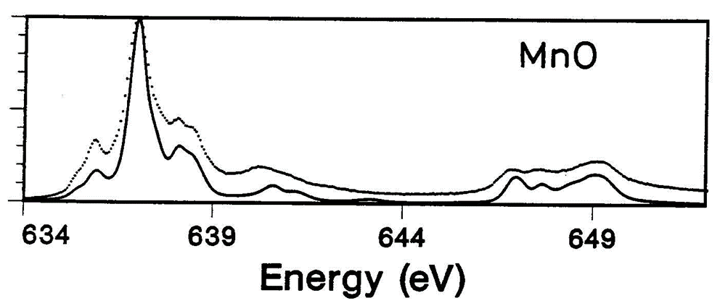
 | absorption | ω' | e'
x-ray (ω) | XAS
electron (e)
X-ray Absorption Spectroscopy
3d⁵ + ω
XAS
2p⁵3d⁶
[Phys. Rev. B. 42, 5459 (1990)]

Slide 94
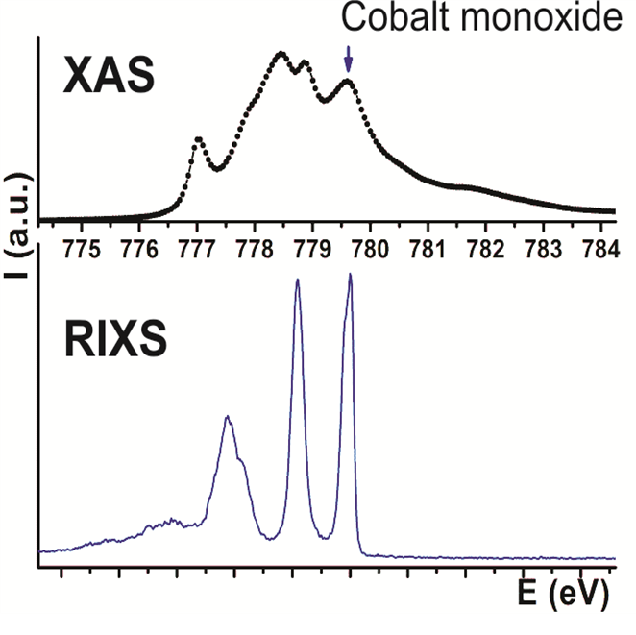
 | absorption | ω' | e'
x-ray (ω) | XAS | (R)IXS
electron (e)
Resonant Inelastic X-ray Scattering
3d⁷ + ω
XAS
2p⁵3d⁸
RIXS
=XAS*XES
XES
3d⁷ + ω’
IXS
[van Schooneveld et al., J. Phys. Chem. C. 116, 15218 (2012)]

Slide 95
 | absorption | ω' | e'
x-ray (ω) | XAS | (R)IXS | (R)PES
electron (e)
Resonant
Photoemission
3d⁸ + ω
XAS
2p⁵3d⁹
R-PES
=XAS*AES
(R-AES)
AES
3p⁵3d⁸+e’
XPS
[Finazzi et al., Phys. Rev. B. 59, 9933 (1999)]

Slide 96
 | absorption | ω' | e'
x-ray (ω) | XAS | (R)IXS | (R)PES
electron (e) | APS
Appearance Potential Spectroscopy
3d⁸ + e
APS
2p⁵3d¹⁰
[Fukoda et al., J. Appl. Phys. 106, 023701 (2009)]

Slide 97
 | absorption | ω' | e'
x-ray (ω) | XAS | (R)IXS | (R)PES
electron (e) | APS | (R)IPES
Resonant Inverse Photoemission
4f¹ + e
APS
3d⁹4f³
RIPES
=APS*XES
XES
4f² + ω’
IPES
[Tanaka&Jo, JPSJ. 65, 615 (1995)]

Slide 98
 | absorption | ω' | e'
x-ray (ω) | XAS | (R)IXS | (R)PES
electron (e) | APS | (R)IPES | (R)EELS
Resonant Electron Energy Loss
3d⁸ + e
APS
NiO
2p⁵3d¹⁰
R-EELS
=APS*AES
AES
3d⁸+e’
EELS
[Gorschluter et al., J. Elec. Spec 87, 211 (1998)]

Slide 99
 | absorption | ω' | e'
x-ray (ω) | XAS | (R)IXS | (R)PES
electron (e) | APS | (R)IPES | (R)EELS

Slide 100
Resonant spectroscopies
RIXS (ω,ω’)
RAES (ω,e’)
RPES (ω,e’)
XES (ω’,e’)
RIPES (e,ω’)
REELS (e,e’)
(+ coincidence) (+ polarization) (+ momentum)
(+ time, space, cascade)
RIXS
X-ray out (ω’)
X-ray in (ω)

Slide 101
X-ray Absorption Spectroscopy
Introduction to XAS
XAS spectral shape (oxygen K edge)
Charge transfer (core hole screening)
XPS spectral shape
XAS spectral shape (metal K edge)
Core hole decay & XAS detection
Overview of core hole spectroscopies
XAS with charge transfer multiplets

Slide 102
XAS: spectral shape
1s XAS: K edges
Calculation of the
p-projected local empty DOS (FEFF, Wien2K, VASP, QE, Ocean)
2p XAS: L edges
Calculation of the
final state with
charge transfer multiplets (CRISPY, CTM4XAS)

Slide 103
HAMILTONIANS USING MULTIPLETS
Charge Transfer Multiplet program
Model Hamiltonians used for the analysis of XAS, EELS, XES, RIXS, XPS, Auger, RPES involving d and f-shells ATOMIC
⇓
CRYSTAL FIELD
⇓
CLUSTER
⇓
DMFT + IMPURITY
Notes:
The TT-multiplets program can be used to explain the spectral shapes of all core level spectroscopies. XAFS, photoemission, auger, etc.
The program combines three advanced computer codes, an atomic physics code to describe all atomic interactions, a group theory code to describe the local symmetry (think of crystal fields) and model Hamiltonians to describe many body effects correlated systems.
AS A SIDE REMARK I WOULD LIKE TO MENTION that the active site in a catalyst is a perfect example of a correlated system. (in biocatalysis this is often realised)
The integrated program gives accurate descriptions of core level spectra, from a set of uniform electronic structure parameters.
The program is important for all of the new spectroscopies that I will describe.
The program is distributed from my homepage and it is used at some 50 institutes worldwide.

Slide 104
2p XAS of TiO₂
Atomic multiplets: 2p XAS of Ti⁴⁺
2p XAS of Ti⁴⁺ ions
Ground state of Ti⁴⁺ is 3d⁰
Dipole transition 3d⁰→2p⁵3d¹
Ground state symmetry: ¹S₀
Final state symmetry: ²P⊗²D gives
¹P, ¹D, ¹F, and ³P, ³D, ³F

Slide 106
3d XAS of rare earths
4f electrons are localized
No effect of surroundings (crystal field < lifetime broadening)
3d XAS is self screened > no charge transfer effect
Initial state
electron-electron interaction.
Valence spin-orbit coupling
Final state
+ core hole – valence hole ‘multiplet’ interaction.
+ core hole spin-orbit coupling

Slide 107
3d XAS of rare earths
Nd³⁺ 4f³ system: ground state is ⁴I_{9/2}

Slide 108
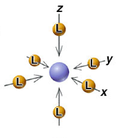
CRYSTAL FIELD EFFECT
Octahedral crystal field splitting
3d¹
²D
²E_{g}
²T_{2g}
metal ion
in free space
in symmetrical field
in octahedral ligand field
e_{g}
x²-y² z²
t_{2g}
yz xz xy
x²-y² yz z² xz xy

Slide 109
CRYSTAL FIELD EFFECT
Atomic Multiplet Theory
3d^{N}
J=0
J=4
J=1
J=2
J=3
A₁
T₂
T₁
E
A₁
E
T₂
A₂
T₂
T₁
T₁
Branching rules:
Same rules for any quantum number
S, L or J

Slide 110
X-ray absorption from 3d⁰ to 2p⁵3d¹
Atomic Multiplet Theory
2p⁵3d¹
¹P
³F
¹D
³P
³D
¹P₁
³P₂
¹D₂
³P₁
³P₀
³F₄
³F₂
³F₃
³D₃
¹F
¹F₃
³D₁
³D₂
T₁
T₂
E
T₂
E
T₂
E
T₂
E
T₁
T₁
A₂
T₁
T₂
A₂
T₁
T₂
A₂
T₁
T₂
A₁
A₁
T₁
T₂
E
3d⁰
¹S
¹S₀
A₁
ee LS CFS

Slide 111
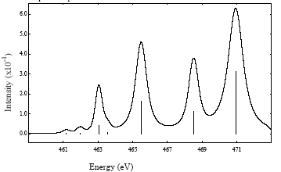
X-ray absorption from 3d⁰ to 2p⁵3d¹
Atomic Multiplet Theory
Dipole selection rule:
ΔJ=T₁
(cubic symmetry)
2p⁵3d¹
¹P
³F
¹D
³P
³D
¹P₁
³P₂
¹D₂
³P₁
³P₀
³F₄
³F₂
³F₃
³D₃
¹F
¹F₃
³D₁
³D₂
T₁
T₂
E
T₂
E
T₂
E
T₂
E
T₁
T₁
A₂
T₁
T₂
A₂
T₁
T₂
A₂
T₁
T₂
A₁
A₁
T₁
T₂
E
3d⁰
¹S
¹S₀
A₁
ee LS CFS
2 3 7 8 5

Slide 112
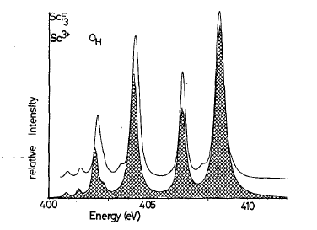
2p XAS of ScF3 with crystal field multiplets
Comparison with Experiment
PHYS. Rev. B. 41, 928 (1990) [google drive]

Slide 113
2p XAS of 3d transition metal oxides
3d electrons are less localized
Effect of surroundings (crystal field effect)
3d XAS is self screened > weak charge transfer effect
Initial state
electron-electron interaction.
valence spin-orbit coupling
crystal field effect
Final state
core hole – valence hole ‘multiplet’ interaction.
core hole spin-orbit coupling
crystal field effect

Slide 114
ATOMIC MULTIPLETS 3d⁸
Atomic Multiplet Theory
electron-electron
Interaction
(~2 eV)
spin-orbit
coupling
(~50 meV)
3d⁸
¹S
³F
¹G
³P
¹D
¹S₀
³P₂
¹G₄
³P₁
³P₀
³F₄
³F₂
³F₃
¹D₂
Ground state:
Given by Hunds rules
max S
max L
max J (if more than half full)

Slide 115
X-ray absorption from 3d⁸ to 2p⁵3d⁹
Atomic Multiplet Theory
2p⁵3d⁹
¹P
³F
¹D
³P
³D
¹P₁
³P₂
¹D₂
³P₁
³P₀
³F₄
³F₂
³F₃
³D₃
¹F
¹F₃
³D₁
³D₂
Dipole selection rule:
ΔJ=-1, 0 or +1
3d⁸
¹S
³F
¹G
³P
¹D
¹S₀
³P₂
¹G₄
³P₁
³P₀
³F₄
³F₂
³F₃
¹D₂

Slide 116
X-ray absorption from 3d⁸ to 2p⁵3d⁹
Atomic Multiplet Theory
2p⁵3d⁹
¹P
³F
¹D
³P
³D
¹P₁
³P₂
¹D₂
³P₁
³P₀
³F₄
³F₂
³F₃
³D₃
¹F
¹F₃
³D₁
³D₂
Dipole selection rule:
ΔJ=-1, 0 or +1
3d⁸
¹S
³F
¹G
³P
¹D
¹S₀
³P₂
¹G₄
³P₁
³P₀
³F₄
³F₂
³F₃
¹D₂

Slide 117
X-ray absorption from 3d⁸ to 2p⁵3d⁹
Atomic Multiplet Theory
2p⁵3d⁹
¹P
³F
¹D
³P
³D
¹P₁
³P₂
¹D₂
³P₁
³P₀
³F₄
³F₂
³F₃
³D₃
¹F
¹F₃
³D₁
³D₂
T₁
T₂
E
T₂
E
T₂
E
T₂
E
T₁
T₁
A₂
T₁
T₂
A₂
T₁
T₂
A₂
T₁
T₂
A₁
A₁
T₁
T₂
E
3d⁸
Atomic
crystal field
+ spin-orbit
dipole transition
³F₄
A₁
³A₂
T₂
x
T₁
=
A₂
T₁
T₂
E
2 3 7 8 5

Slide 118
Charge transfer effects
Charge Transfer Effects
NiO: Ground state: 3d⁸ + 3d⁹L
Energy of 3d⁹L: Charge transfer energy Δ
3d⁹L
3d⁸
2p⁵3d¹⁰L
2p⁵3d⁹
Δ
Δ+U-Q ≈ Δ

Slide 119
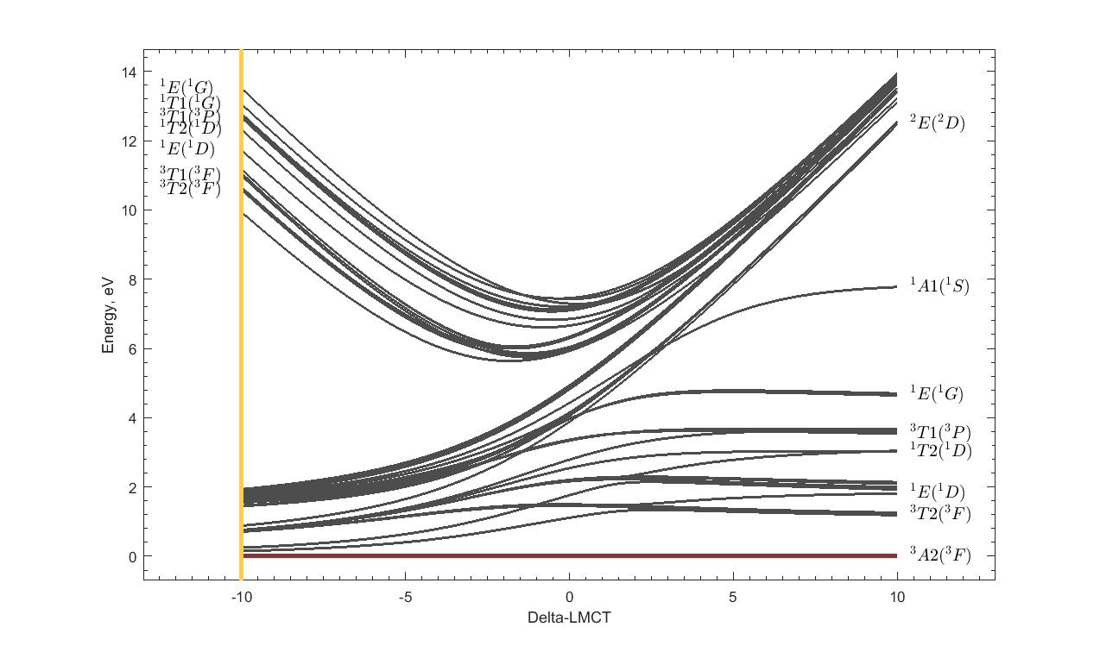
Tanabe-Sugano diagrams with charge transfer
Tanabe-Sugano with Charge transfer
α 3d⁸ + β 3d⁹L
NiO
Cu³⁺

Slide 120
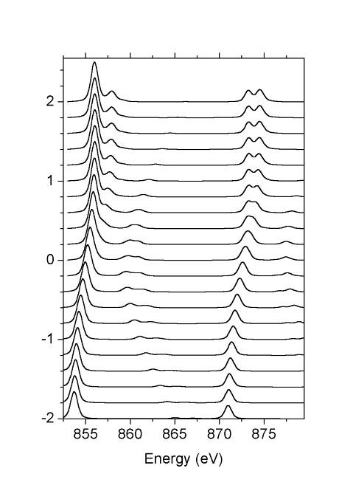
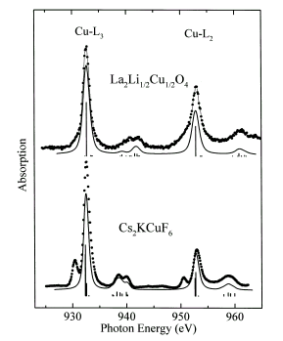
Charge transfer effects in XAS
Charge Transfer effects
3d⁸ + 3d⁹L
Δ=10
30% 3d⁸
¹A₁
Δ=5
NiO
Δ=0
La₂Li_{½}Cu_{½}O₄
30% 3d⁸
³A₂
Δ=-5
Δ=-10
Chem. Phys. Lett. 297, 321 (1998)

Slide 121
LMCT and MLCT: π - bonding
Fe^{III}: Ground state: 3d⁵ + 3d⁶L
3d⁶L
3d⁵
2p⁵3d⁷L
2p⁵3d⁶
Δ
Δ+U-Q ≈ Δ
with Ed Solomon (Stanford) JACS 125, 12894 (2003),
JACS 128, 10442 (2006), JACS 129, 113 (2007)

Slide 122
LMCT and MLCT: π - bonding
Fe^{III}: Ground state: 3d⁵ + 3d⁶L + 3d⁴L
2p⁵3d⁵L
2p⁵3d⁷L
2p⁵3d⁶
3d⁴L
3d⁶L
3d⁵
Δ_{π}-U+Q ≈ Δ_{π} + 2
Δ_{π}
Δ
Δ+U-Q ≈ Δ - 2
with Ed Solomon (Stanford) JACS 125, 12894 (2003),
JACS 128, 10442 (2006), JACS 129, 113 (2007)

Slide 123
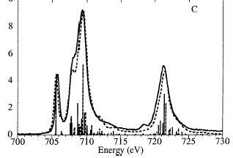
LMCT and MLCT: π - bonding
Fe^{III}(tacn)₂
Fe^{III}(CN)₆
with Ed Solomon (Stanford) JACS 125, 12894 (2003),
JACS 128, 10442 (2006), JACS 129, 113 (2007)

Slide 124
X-ray Absorption Spectroscopy
Introduction to XAS
XAS spectral shape (oxygen K edge)
Charge transfer (core hole screening)
XPS spectral shape
XAS spectral shape (metal K edge)
Core hole decay & XAS detection
Overview of core hole spectroscopies
XAS with charge transfer multiplets

