Slide 1
Polarization and dichroism in X-ray Absorption Spectroscopy
Heba Elnaggar
CNRS, Sorbonne University
Hebatalla.elnaggar@sorbonne-universite.fr
Hands on spectroscopy calculations of quantum material - Heidelberg

Slide 2

Dichroism
Avoid glare (LH light)
Dichroism:
Difference of the propagation of light measured with
two orthogonal polarization
states of the incoming light
Notes:
I think most of us are familiar with dichroism in the optical regime from our daily lives. For example from polarized glasses and how it avoids glare.
Glare tends to happen when lightwaves strike a flat surface, causing the light to reflect, or bounce off the surface, in a horizontal manner (brewster law). This causes the light to be intense, which can hurt the eyes and make it more difficult to see.
The filters on polarized lenses absorbs LH light and hence stops the glare.

Slide 3
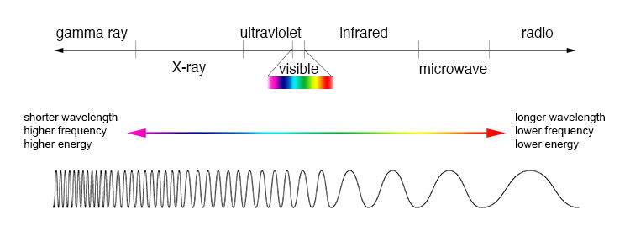
Introduction to X-ray dichroism
Measurement:
Linear Dichroism (LD):
Difference measured with LH / LV
Circular Dichroism (CD):
Difference measured with CR / CL
Origin:
Magnetic Dichroism (MD):
Difference in magnetic system
Natural Dichroism (ND):
Difference in structurally distorted system
Magneto-chiral Dichroism (MχD):
Difference in a magnetic + chiral system
And more …
Notes:
So similar to the optical regime, dichrosim effect is also present in the x-ray regime.
And there are many different types of dichroism and classifications.
For example, it can be classified according to the measurement. So in this case we can say that it is linear dichroism when it is measured with linear light.

Slide 4
Why do we need X-ray dichroism?
The measurement of dichroism is often challenging…
Control polarization, orientation of sample, single crystals required, several measurements …
but provides access to properties that can be lost in the average measurements!
What we will discuss:
How can we calculate X-ray polarization dependence and dichroism?
X-ray Linear Dichroism (XLD)
X-ray Magnetic Circular Dichroism (XMCD)
Can we predict all X-ray dichroism effects?

Slide 5
How can we calculate XAS polarization dependence?

Slide 6
How do we calculate XAS dichroism?
Fermi golden rule!
Transition operator
Initial state
Final state

Slide 7
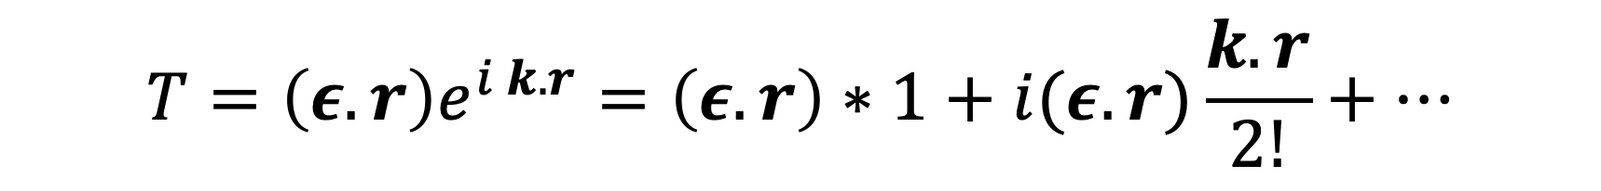
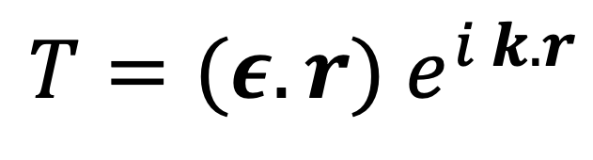
How do we calculate XAS dichroism?
$$T=(ε.r){ e}^{i k.r}$$
Wave vector
Polarization vector
Position vector
Taylor expansion:
$${T=\left(ε.r\right)e}^{i k.r}=\left(ε.r\right)∗1+i(ε.r)\frac{k.r}{2!}+…$$
Dipole
Quadrupole

Slide 8
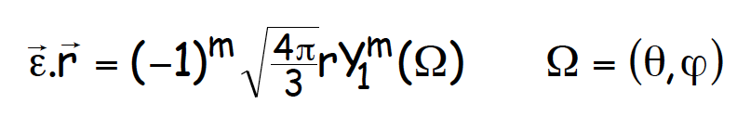
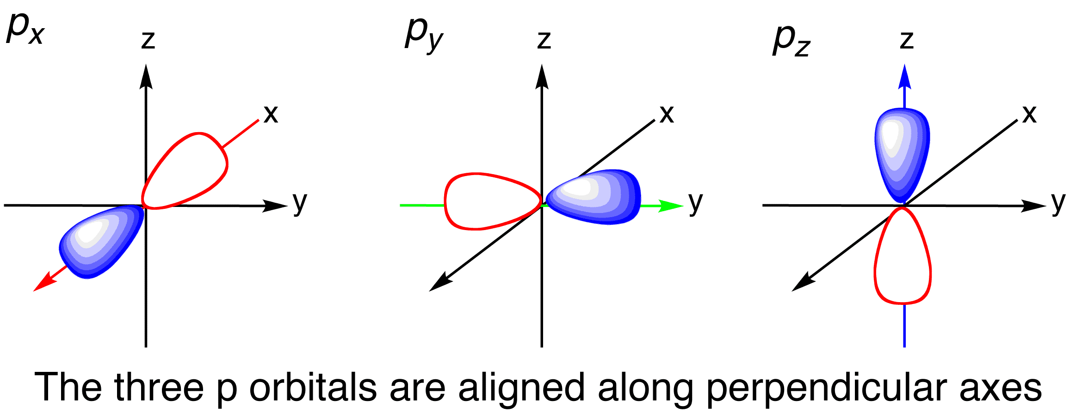





Dipole transition operator
Dipole:
Expression in terms of l=1 spherical harmonics (p orbitals):
$$ε||y$$
Defined wrt to the crystal axes
$$ε||x$$
$$ε||z$$
${(Y}_{1}^{1}−$ $Y_{1}^{−1})/\sqrt{2}$
$${i(Y}_{1}^{1}+Y_{1}^{−1})/\sqrt{2}$$
$$Y_{1}^{0}$$
Examples: transition operator used for L2,3 edges and K-edges

Slide 9
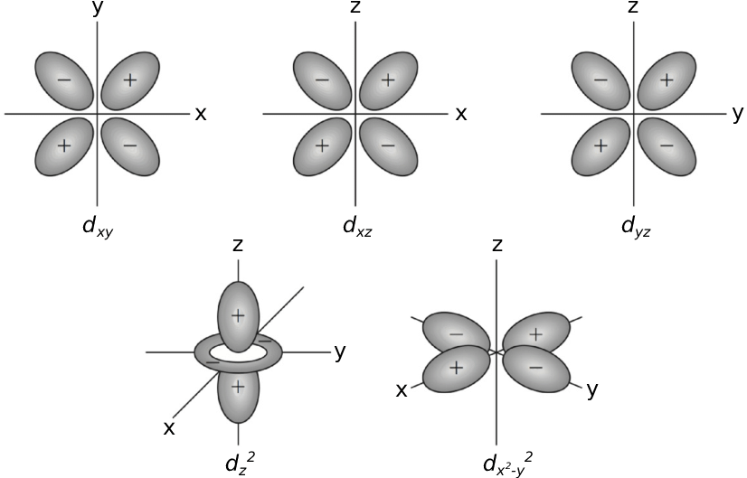


Quadrupole transition operator (e.g. K edge of TM)
Quadrupole:
Expression in l=2 spherical harmonics (d orbitals):
$$ε\left|\left|x, k\right|\right|y$$
Available in a Mathematic Notebook!
$$\left(ε.r\right)∗(k.r)$$
$${i(Y}_{2}^{−2}−Y_{2}^{2})/\sqrt{12}$$
Examples: transition operator used for K pre-edges

Slide 10
X-ray Linear Dichroism (XLD)

Slide 11
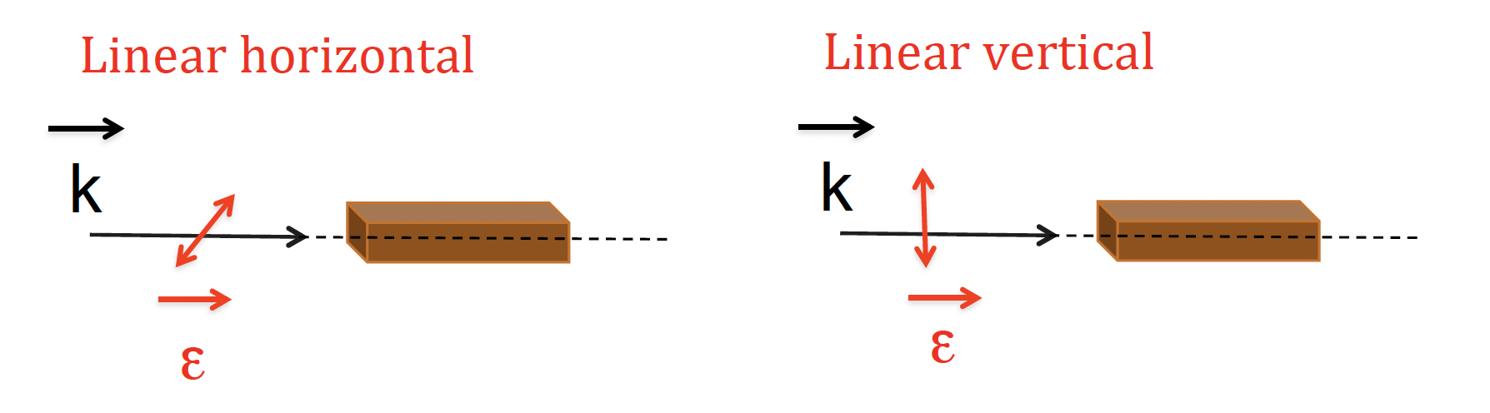
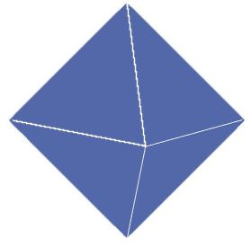
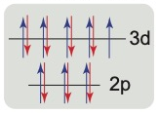

X-ray Linear Dichroism in Oh Cu²⁺
Cu²⁺ Ion
e_{g}:(d_{x}²_{- y}², d_{z}²)
d⁹
t_{2g}:(d_{xy}, d_{zy}, d_{zx})
HOLE: ~ $\frac{\text{d}\text{x}\text{2}\text{−} \text{y}\text{2}}{\sqrt{2}}+\frac{\text{d}\text{z} \text{2}}{\sqrt{2}}$

Slide 12
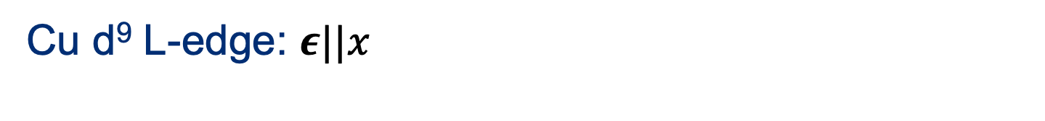
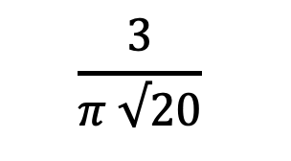

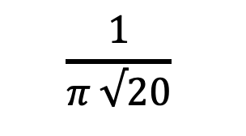
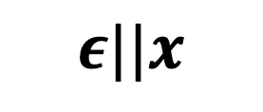
X-ray Linear Dichroism in Oh Cu²⁺
$$ε||x$$
Dipole
(think px orbitals)
2p electron
(think p orbitals)
3d electron
(think d orbitals)
<f| | T | |i>
$$ε||x$$
z
z
$$\frac{1}{π √20}$$
y
y
x
x
z
$$\frac{3}{π √20}$$
z
y
y
x
x

Slide 13

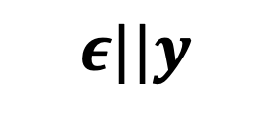
X-ray Linear Dichroism in Oh Cu²⁺
$$ε||y$$
Dipole
(think p orbitals)
2p electron
(think p orbitals)
3d electron
(think d orbitals)
<f| | T | |i>
$$ε||y$$
z
z
$$\frac{1}{π √20}$$
y
y
x
x
z
$$\frac{3}{π √20}$$
z
y
y
x
x

Slide 14
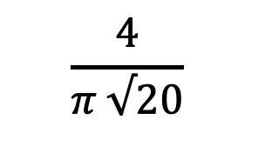

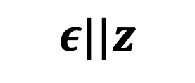
X-ray Linear Dichroism in Oh Cu²⁺
$$ε||z$$
Dipole
(think p orbitals)
3d electron
(think d orbitals)
2p electron
(think p orbitals)
<f| | T | |i>
$$ε||z$$
z
z
$$\frac{4}{π √20}$$
y
y
x
x
z
y
x

Slide 15
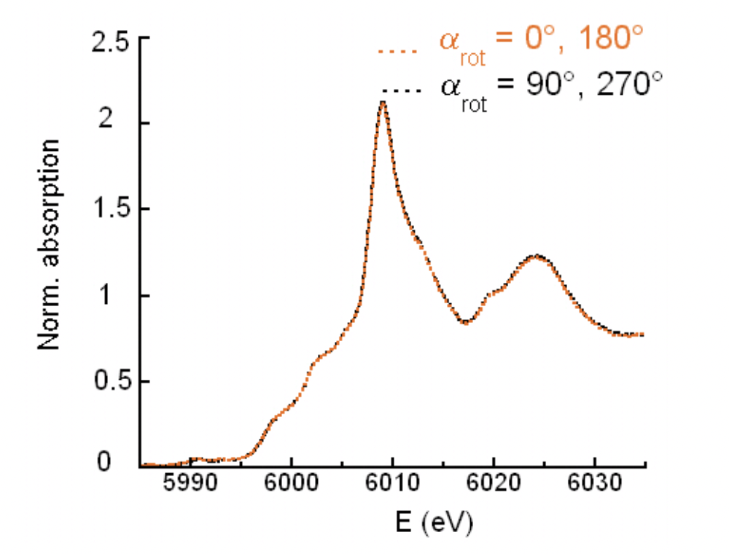
X-ray Linear Dichroism in Oh symmetry
Quanty Calculation of L2,3 XAS of Oh Cu²⁺
Experimental results of K-edge XAS of Oh Cr³⁺ in MgAl2O4
Dipole: p -> d
Dipole: s -> p
Juhin et. al., Phys. Rev. B 78, 195103, 2008
Dipole transition in Oh symmetry are isotropic !

Slide 16

Dipole XLD in reduced symmetry
Cu²⁺ Ion
b_{1g}:(d_{x}²_{- y}² )
a_{1g}:(d_{z}²)
d⁹
b_{2g}:(d_{xy})
Elongated Oh
e_{g}:( d_{zy}, d_{zx})
HOLE: ~ $\text{d}\text{x}\text{2}\text{−} \text{y}\text{2}$

Slide 17
X-ray Linear Dichroism in D_{4h} Cu²⁺
$$ε||x$$
Dipole
(think p orbitals)
2p electron
(think p orbitals)
3d electron
(think d orbitals)
<f| | T | |i>
$$ε||x$$
z
z
y
y
x
x

Slide 18
X-ray Linear Dichroism in D_{4h} Cu²⁺
$$ε||y$$
Dipole
(think p orbitals)
2p electron
(think p orbitals)
3d electron
(think d orbitals)
<f| | T | |i>
$$ε||y$$
z
z
y
y
18
x
x

Slide 19
X-ray Linear Dichroism in D_{4h} Cu²⁺
$$ε||z$$
Dipole
(think p orbitals)
2p electron
(think p orbitals)
3d electron
(think d orbitals)
<f| | T | |i>
$$ε||z$$
z
y
x

Slide 20
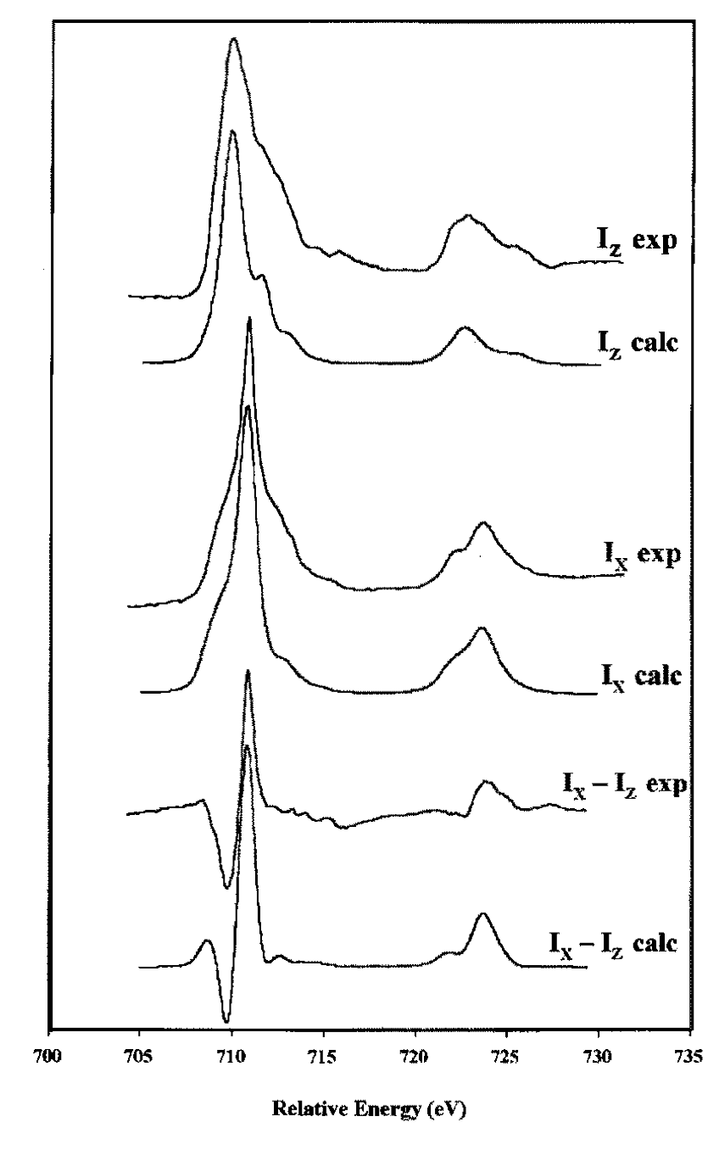
X-ray Linear Dichroism in D_{4h} symmetry
Quanty Calculation of L2,3 XAS of D_{4h} Cu²⁺
Experimental results of L2,3 XAS of D_{4h} Fe²⁺
Dipole transition in lower symmetries give rise to X-ray Linear Dichroism
XAS is proportional to the #holes
XLD tells us which holes are these
Schofield et. al., Miner. B 62, 65, 1998

Slide 21
X-ray Magnetic Circular Dichroism (XMCD)

Slide 22
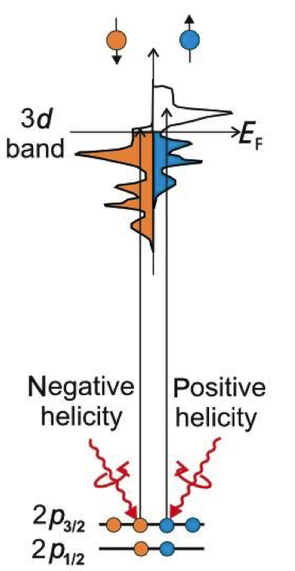
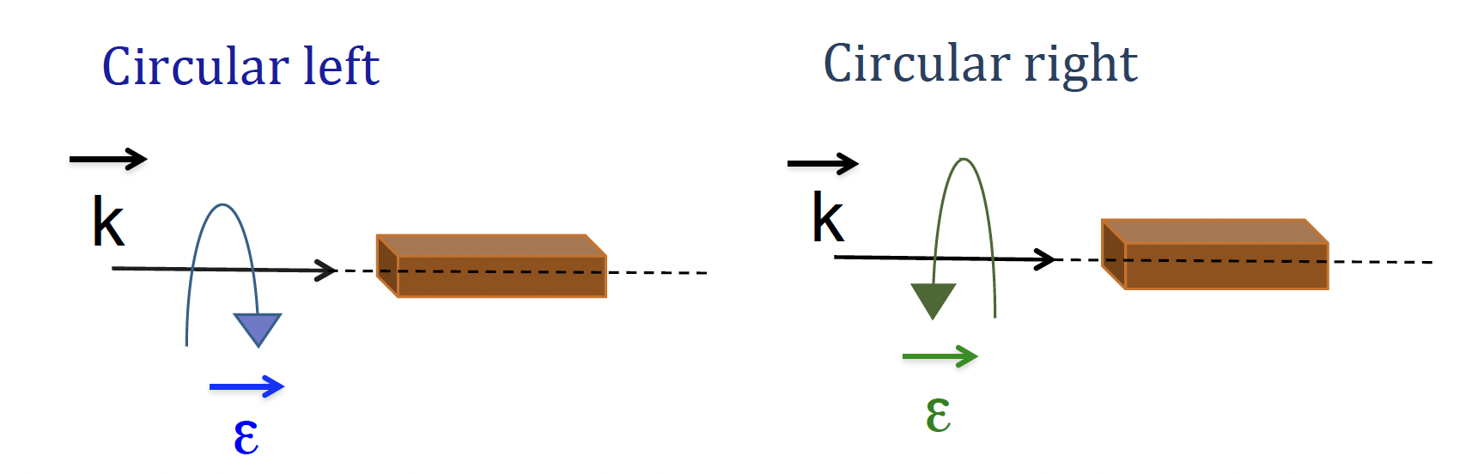
X-ray Magnetic Circular Dichroism (XMCD)
For ferro/ferri-magnetic materials
B
B
At L3,2 edges:
Valence band has a spin-imbalance due to the magnetic ordering
Right- and left-circularly polarized photons carry opposite momentum (+1, -1)
Angular momentum of the photon interacts with the spin of the electron by means of the SOC
Thole et. al., Phys. Rev. lett. (1992). 68
Notes:
Angular momentum of the photon interacts with the spin of the electron by means of the SOC (Fano effect).
◮ Right- and left-circularly polarized photons carry opposite momentum ⇒ there is a spin imbalance in the photocurrent produced by the right- and left-circularly polarized x-rays.
2. Valence band acts as a spin detector for the (spin-imbalanced) photocurrent.

Slide 23
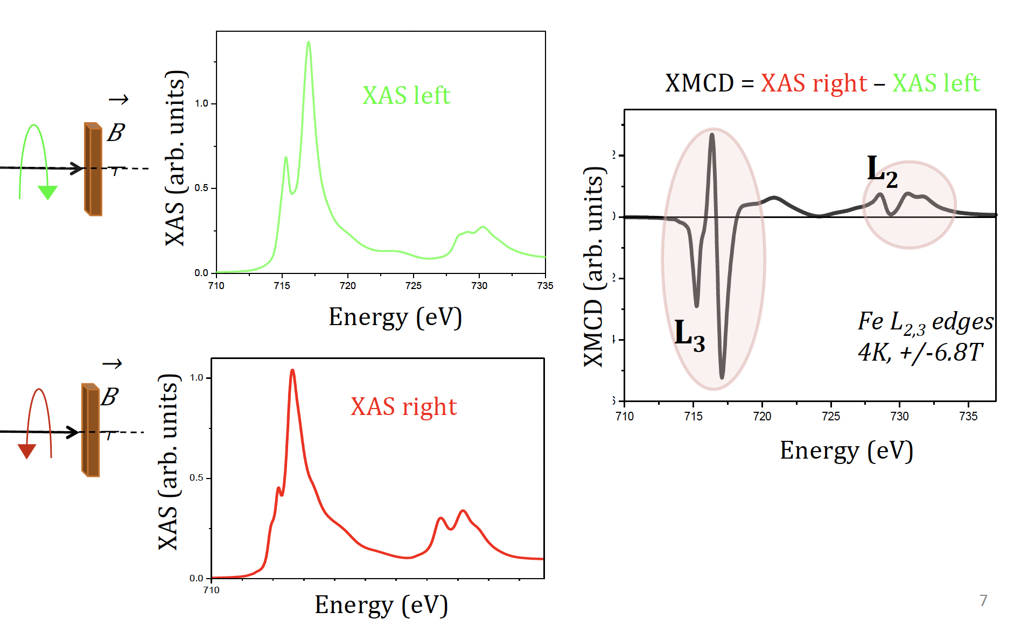
XMCD in CoFe₂O₄
Experimental results of Fe L2,3 XMCD
Sum rules:
Relate dichroism to the average ground state magnetic moment

Slide 24
Sum Rules for XMCD
Isotropic ∼ number of holes
XAS
XMCD ∼ average orbital magnetic moment
XMCD
XMCD ∼ average spin magnetic moment
XMCD
Thole et. al., Phys. Rev. lett, 68, 1992
Notes:
One can deduce ground state proper

Slide 25
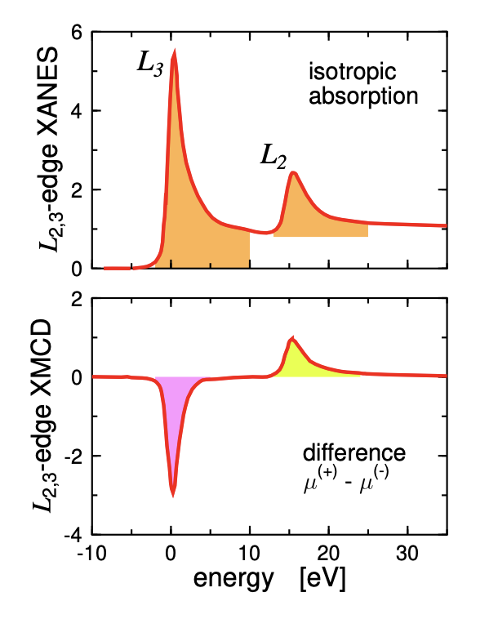

However …
Issues to consider:
Background removal
(edge position, mixing of edges, detection mode “FY?”)
Magnetic dipole term
Can be calculated by Quanty!
Notes:
Tz : provides a measure of the anisotropy of the field of the spins when the atomic cloud is distorted, either by the spin-orbit interaction or by crystal-field effects [7].

Slide 26
What other dichroism effects exist?
Can we describe them in a compact way?

Slide 27

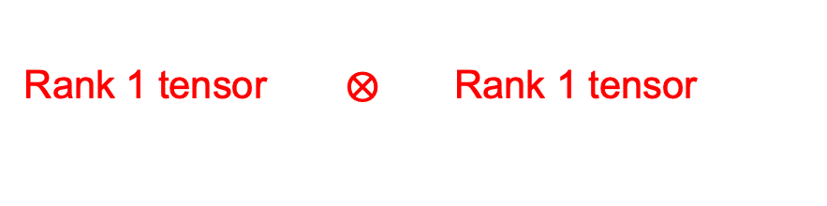
General expression of the XAS
Rank 1 tensor $⨂{ \text{Rank}\text{ 1 }\text{tensor}}$
Rank 2 tensor:
T_{X} - T_{X} | T_{X} - T_{Y} | T_{X} - T_{Z}
T_{Y} - T_{X} | T_{Y} - T_{X} | T_{Y} - T_{Z}
T_{Z} - T_{X} | T_{Z} - T_{Y} | T_{Z} - T_{Z}
Off-diagonal: ->
y polarized light is changed by the system to an x polarized
Low symmetry system or magnetic system

Slide 28
X-ray Linear Dichroism
D4h
Slide: M. W. Haverkort

Slide 29


X-ray Magnetic Circular Dichroism
Magnetism breaks time reversal symmetry.
This results in the asymmetry of the off-diagonal elements
XMCD= i ${(σ}_{yx}−σ_{xy})$
Slide: M. W. Haverkort

Slide 30
The full XAS Tensor
We can compute all possible dichroisms from the conductivity tensor!
Maximum of nine spectra required in the most general case
Slide: M. W. Haverkort

Slide 31
Can we measure the full XAS tensor?

Slide 32
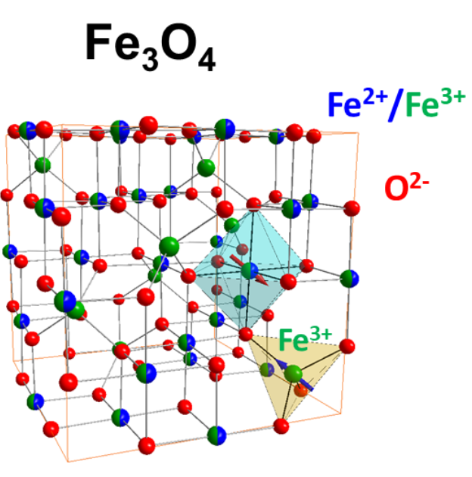
Magnetite: Fe L_{3,2}-edge XAS
Magnetite: [Fe³⁺]_{Td} [Fe²⁺ , Fe³⁺]_{Oh}O₄
Ferrimagnetic system:
We expect to measure XMCD and that the tensor has off-diagonal elements
The Fe²⁺ Oh are distorted to D_{3d}:
We expect to measure XLD and that the tensor has different components in various directions

Slide 33
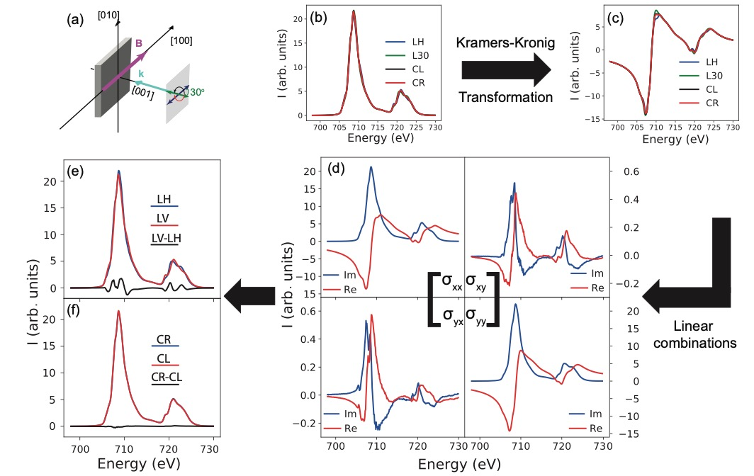
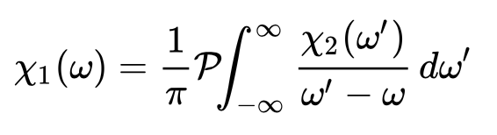
Magnetite: Fe L_{3,2}-edge XAS
To get all elements:
9 independent measurements
Linear polarization (diagonals + symmetric off diagonals)
Circular polarization (asymmetric off diagonals)
Imaginary: measured
Real: transformation
Elnaggar et. al., J. Synchrotron Rad. (2021). 28, 247–258

Slide 34
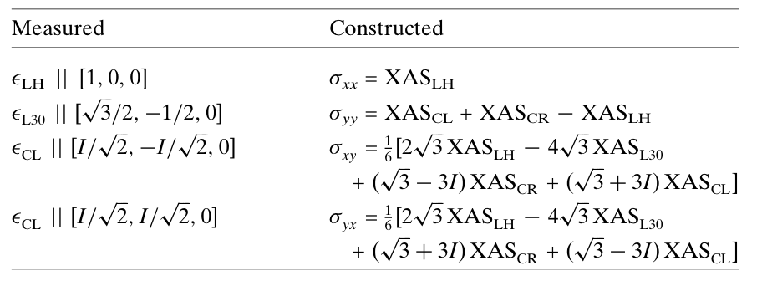
Building the tensor
Elnaggar et. al., J. Synchrotron Rad. (2021). 28, 247–258

Slide 35
Building the tensor
Nine linear independent measurements to construct the full tensor
Elnaggar et. al., J. Synchrotron Rad. (2021). 28, 247–258

Slide 36
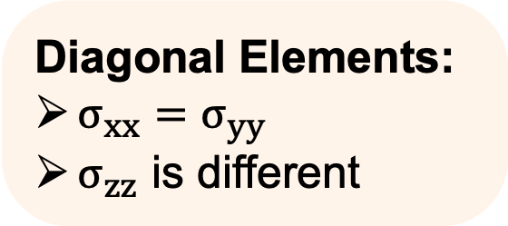
Analyzing the tensor: Diagonal XMLD
Diagonal Elements:
$σ_{xx}=σ_{yy}$
$σ_{zz}$ is different
XMLD in dipole cubic
symmetry due to magnetism!
Elnaggar et. al., J. Synchrotron Rad. (2021). 28, 247–258

Slide 37
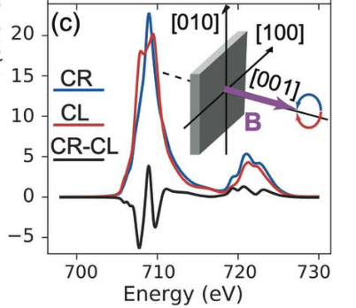
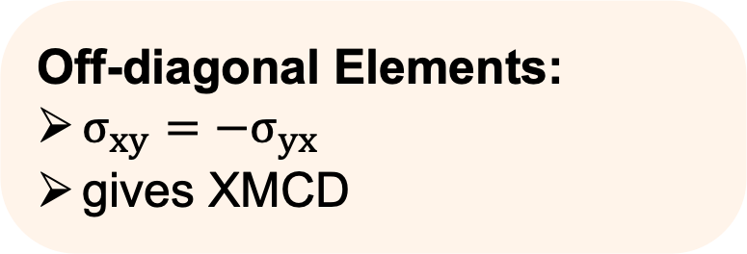
Analyzing the tensor: XMCD
Off-diagonal Elements:
$σ_{xy}={−σ}_{yx}$
gives XMCD
XMCD in cubic symmetry
Elnaggar et. al., J. Synchrotron Rad. (2021). 28, 247–258

Slide 38
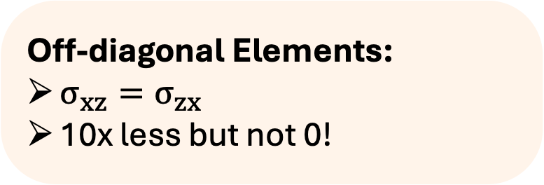
Analyzing the tensor: small distortion
Off-diagonal Elements:
$σ_{xz}=σ_{zx}$
10x less but not 0!
XMLD signature of small non-cubic distortion leading to mixing of x-z direction
Elnaggar et. al., J. Synchrotron Rad. (2021). 28, 247–258

Slide 39
All dichroism effects in your system
Nine linear independent measurements to construct the full tensor
Elnaggar et. al., J. Synchrotron Rad. (2021). 28, 247–258

Slide 40
Concluding Remarks
Dichroism holds a lot of information about the system which is wasted when we only look on the average
There are many dichroism signals (e.g., magnetic, structural, chiral, linear, circular,…)
Analysing the symmetry of our system is a great tool to predict which dichroism signals to expect (e.g. cubic no dichroism for dipole transitions, …)
XMCD + sum rules relate the spectra to ground state properties (e.g., spin and orbital moments) which is a powerful quantitative tool to study magnetism.
We can describe all the dichroism effects in a system in a compact way using the tensor expression of the XAS cross-section

Slide 42
Can we regroup the conductivity tensor to more transparent terms?

Slide 43

Fe₃O₄ : Creating a Spherical Tensor (rank 2)
Create linear combination based on spherical symmetry
Rank 0 --> Isotropic
$${{XAS}_{iso}=\frac{1}{3}(σ}_{xx}+σ_{yy}+σ_{zz})$$

Slide 44
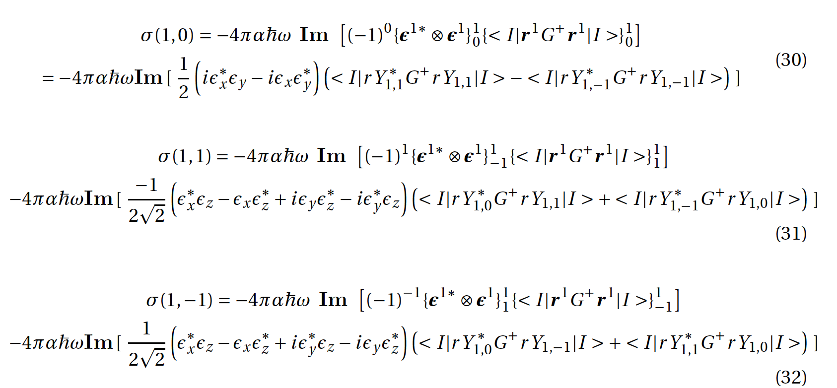
Fe₃O₄ : Creating a Spherical Tensor (rank 2)
Create linear combination based on spherical symmetry
Rank 1 --> circular dichroism, 3 terms

Slide 45
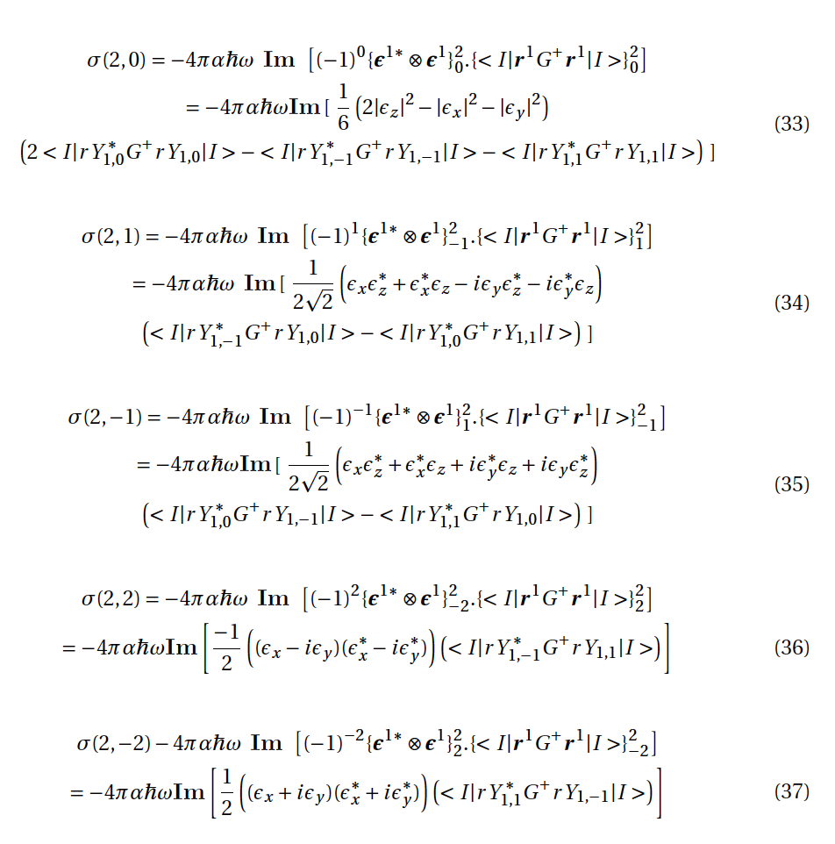
Fe₃O₄ : Creating a Spherical Tensor (rank 2)
Create linear combination based on spherical symmetry
Rank 2 --> Linear dichroism, 5 terms

Slide 46
How is all this helpful?

Slide 47
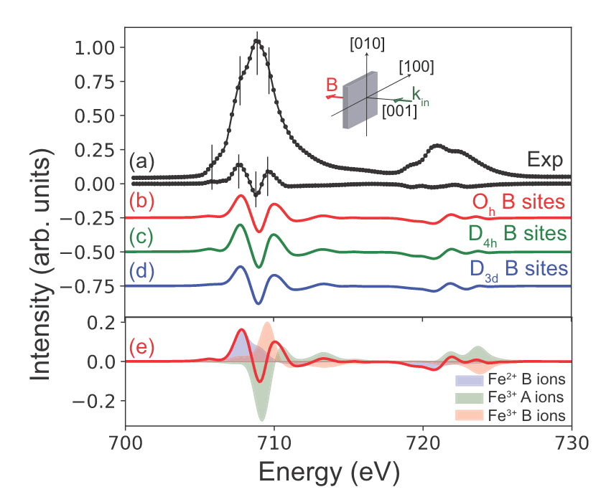
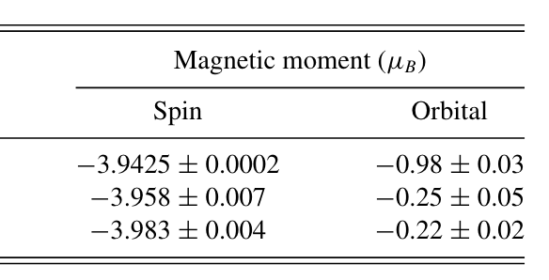
Fe₃O₄: Quantifying Magnetic Moments from XMCD
Magnetite: [Fe³⁺]_{Td} [Fe²⁺ , Fe³⁺]_{Oh}O₄
Elnaggar et. al., Phys. Rev. Mat. (2020). 4, 024415

Slide 48
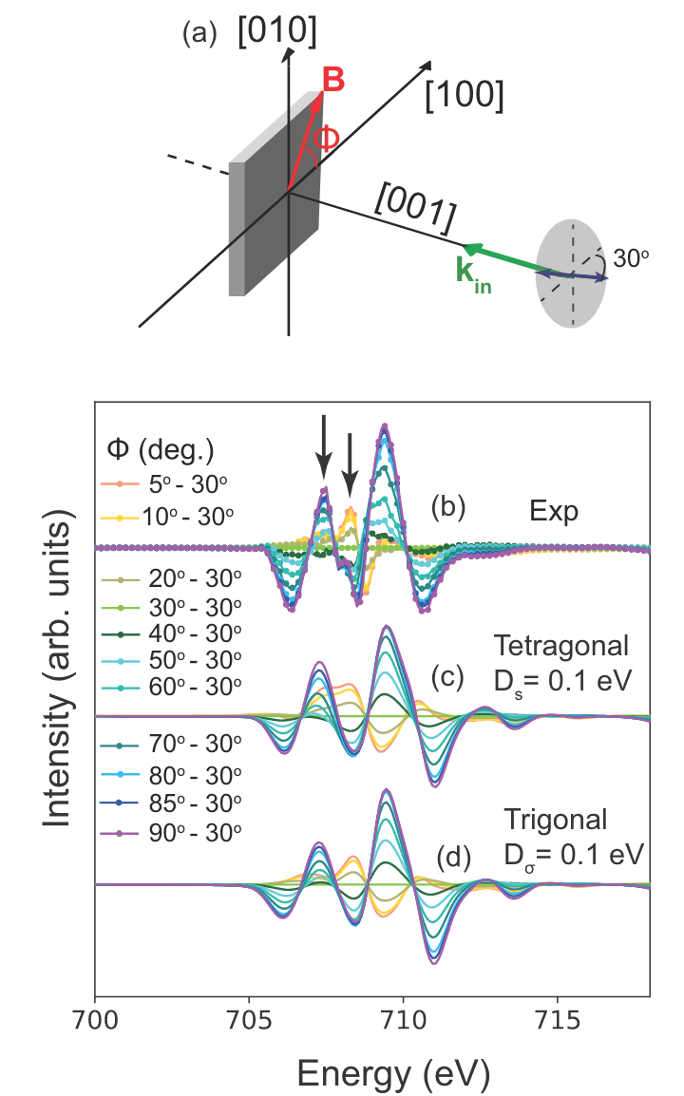
Fe₃O₄: Quantifying Small Distortion from XMLD
Magnetite: [Fe³⁺]_{Td} [Fe²⁺ , Fe³⁺]_{Oh}O₄
Trigonal distortion
D_{σ} = 0.1 eV
XMLD has two effects:
Structure
Magnetic
Elnaggar et. al., Phys. Rev. Mat. (2020). 4, 024415

Slide 49
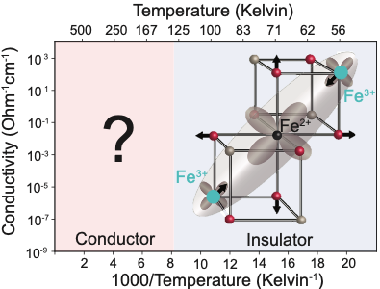
Fe₃O₄: Quantifying Small Distortion from XMLD
Magnetite: [Fe³⁺]_{Td} [Fe²⁺ , Fe³⁺]_{Oh}O₄
Trigonal
Tetragonal
Elnaggar et. al., Phys. Rev. Mat. (2020). 4, 024415

