Slide 1
Fluorescence Yield detection
XPS
Ground state analysis

Slide 2
Fluorescence Yield detection
FY (1. dilute limit)
FY (2. state dependent decay)
FY (3. inverse PFY)
FY (4. dips and peaks)

Slide 3
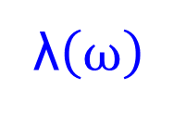
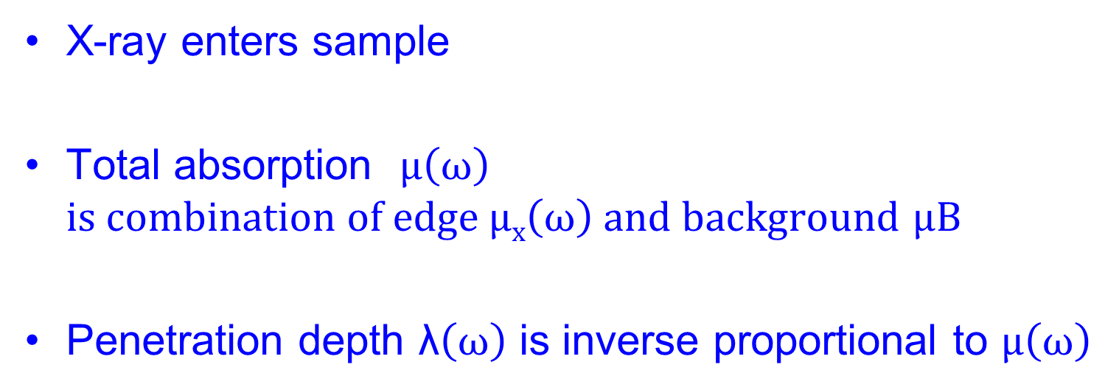
Fluorescence Yield detection
λ$\left(ω\right)$
X-ray enters sample
Total absorption $μ\left(ω\right)$ $is combination of edge μx\left(ω\right) and background$ $μB$
Penetration depth λ$\left(ω\right)$ is inverse proportional to $μ\left(ω\right)$

Slide 4
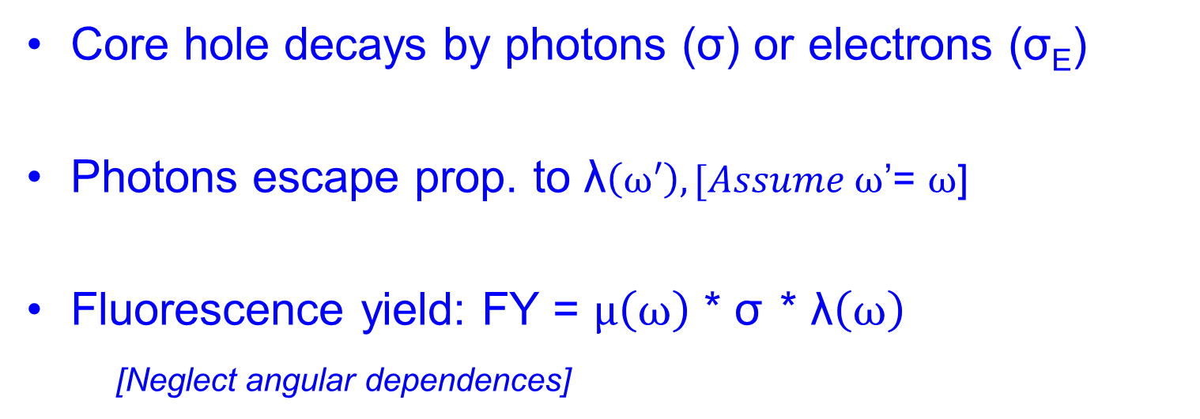
Fluorescence Yield detection
λ$\left(ω\right)$
Core hole decays by photons (σ) or electrons (σ_{E})
Photons escape prop. to λ$\left(ω′\right), [Assume ω$’= $ω$]
Fluorescence yield: FY = $μ\left(ω\right)$ * σ * λ$\left(ω\right)$
[Neglect angular dependences]

Slide 5
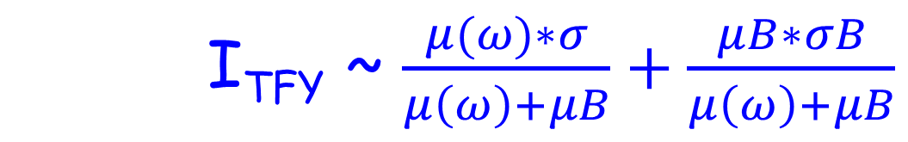
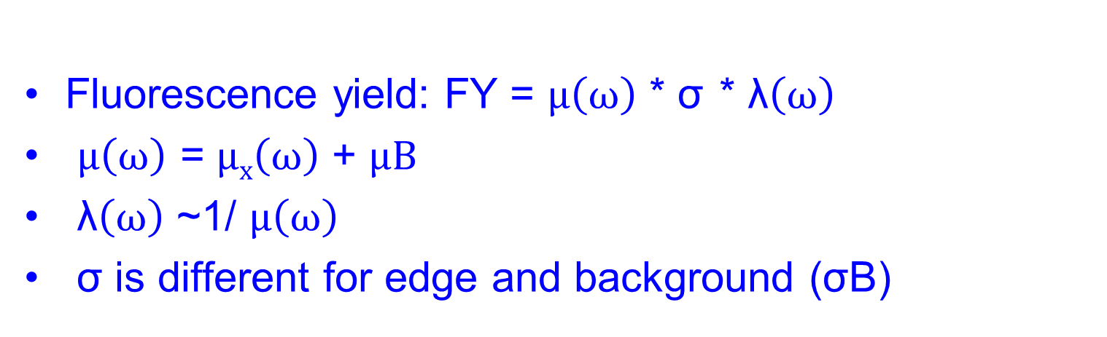
Fluorescence Yield detection
Fluorescence yield: FY = $μ\left(ω\right)$ * σ * λ$\left(ω\right)$
$μ\left(ω\right)$ = $μx\left(ω\right)$ + $μB$
λ$\left(ω\right)$ ~1/ $μ\left(ω\right)$
σ is different for edge and background (σB)
I_{TFY} ~ $\frac{μ(ω)∗σ}{μ\left(ω\right)+μB}+\frac{μB∗σB}{μ\left(ω\right)+μB}$

Slide 6
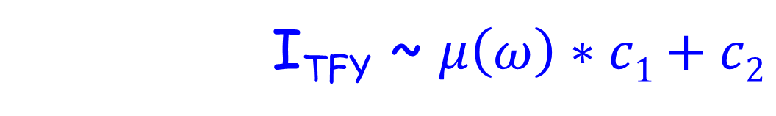
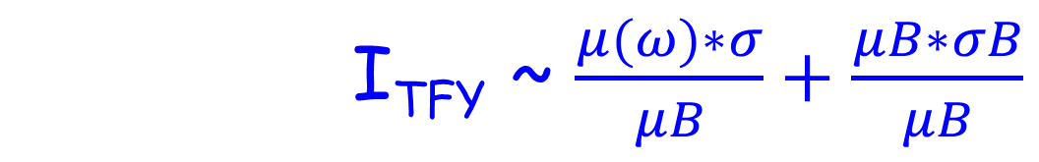
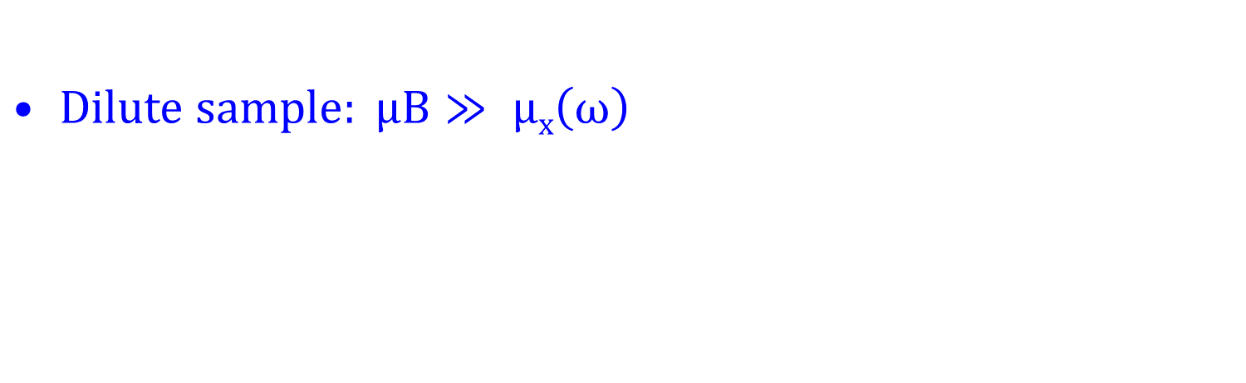
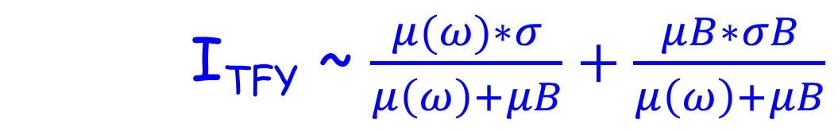
FY detection of dilute sample
I_{TFY} ~ $\frac{μ(ω)∗σ}{μ\left(ω\right)+μB}+\frac{μB∗σB}{μ\left(ω\right)+μB}$
$Dilute sample: μB≫ μx\left(ω\right)$
I_{TFY} ~ $\frac{μ(ω)∗σ}{μB}+\frac{μB∗σB}{μB}$
I_{TFY} ~ $μ\left(ω\right)∗c1+c2$

Slide 7
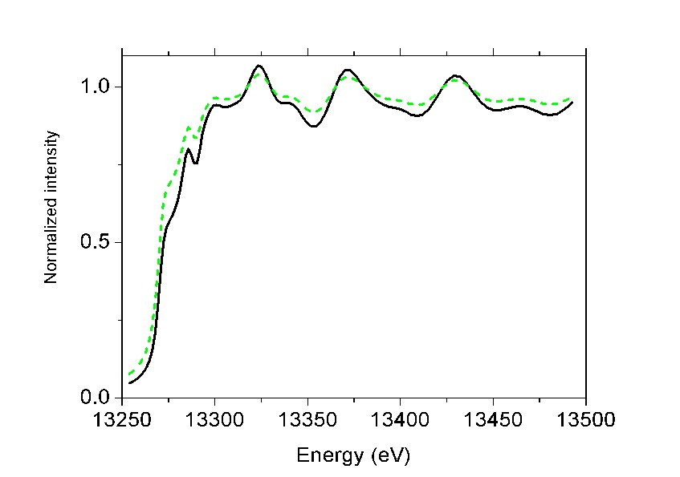
Fluorescence Yield
FY detection of non-dilute sample
“saturation & self-absorption”
De-saturation software
(μ(ω) based on CRXO)

Slide 8
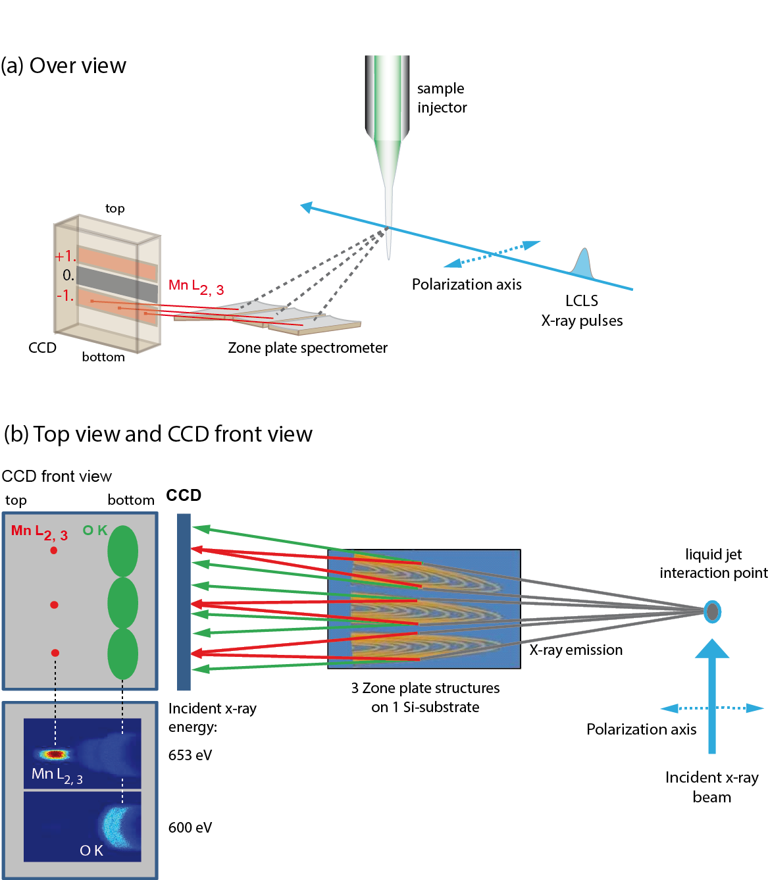
XAS of radiation sensitive sample
Single synchrotron pulselength is too long
Mitzner et al, J. Phys. Chem. Lett. 4, 3641 (2013)
Notes:
8

Slide 9
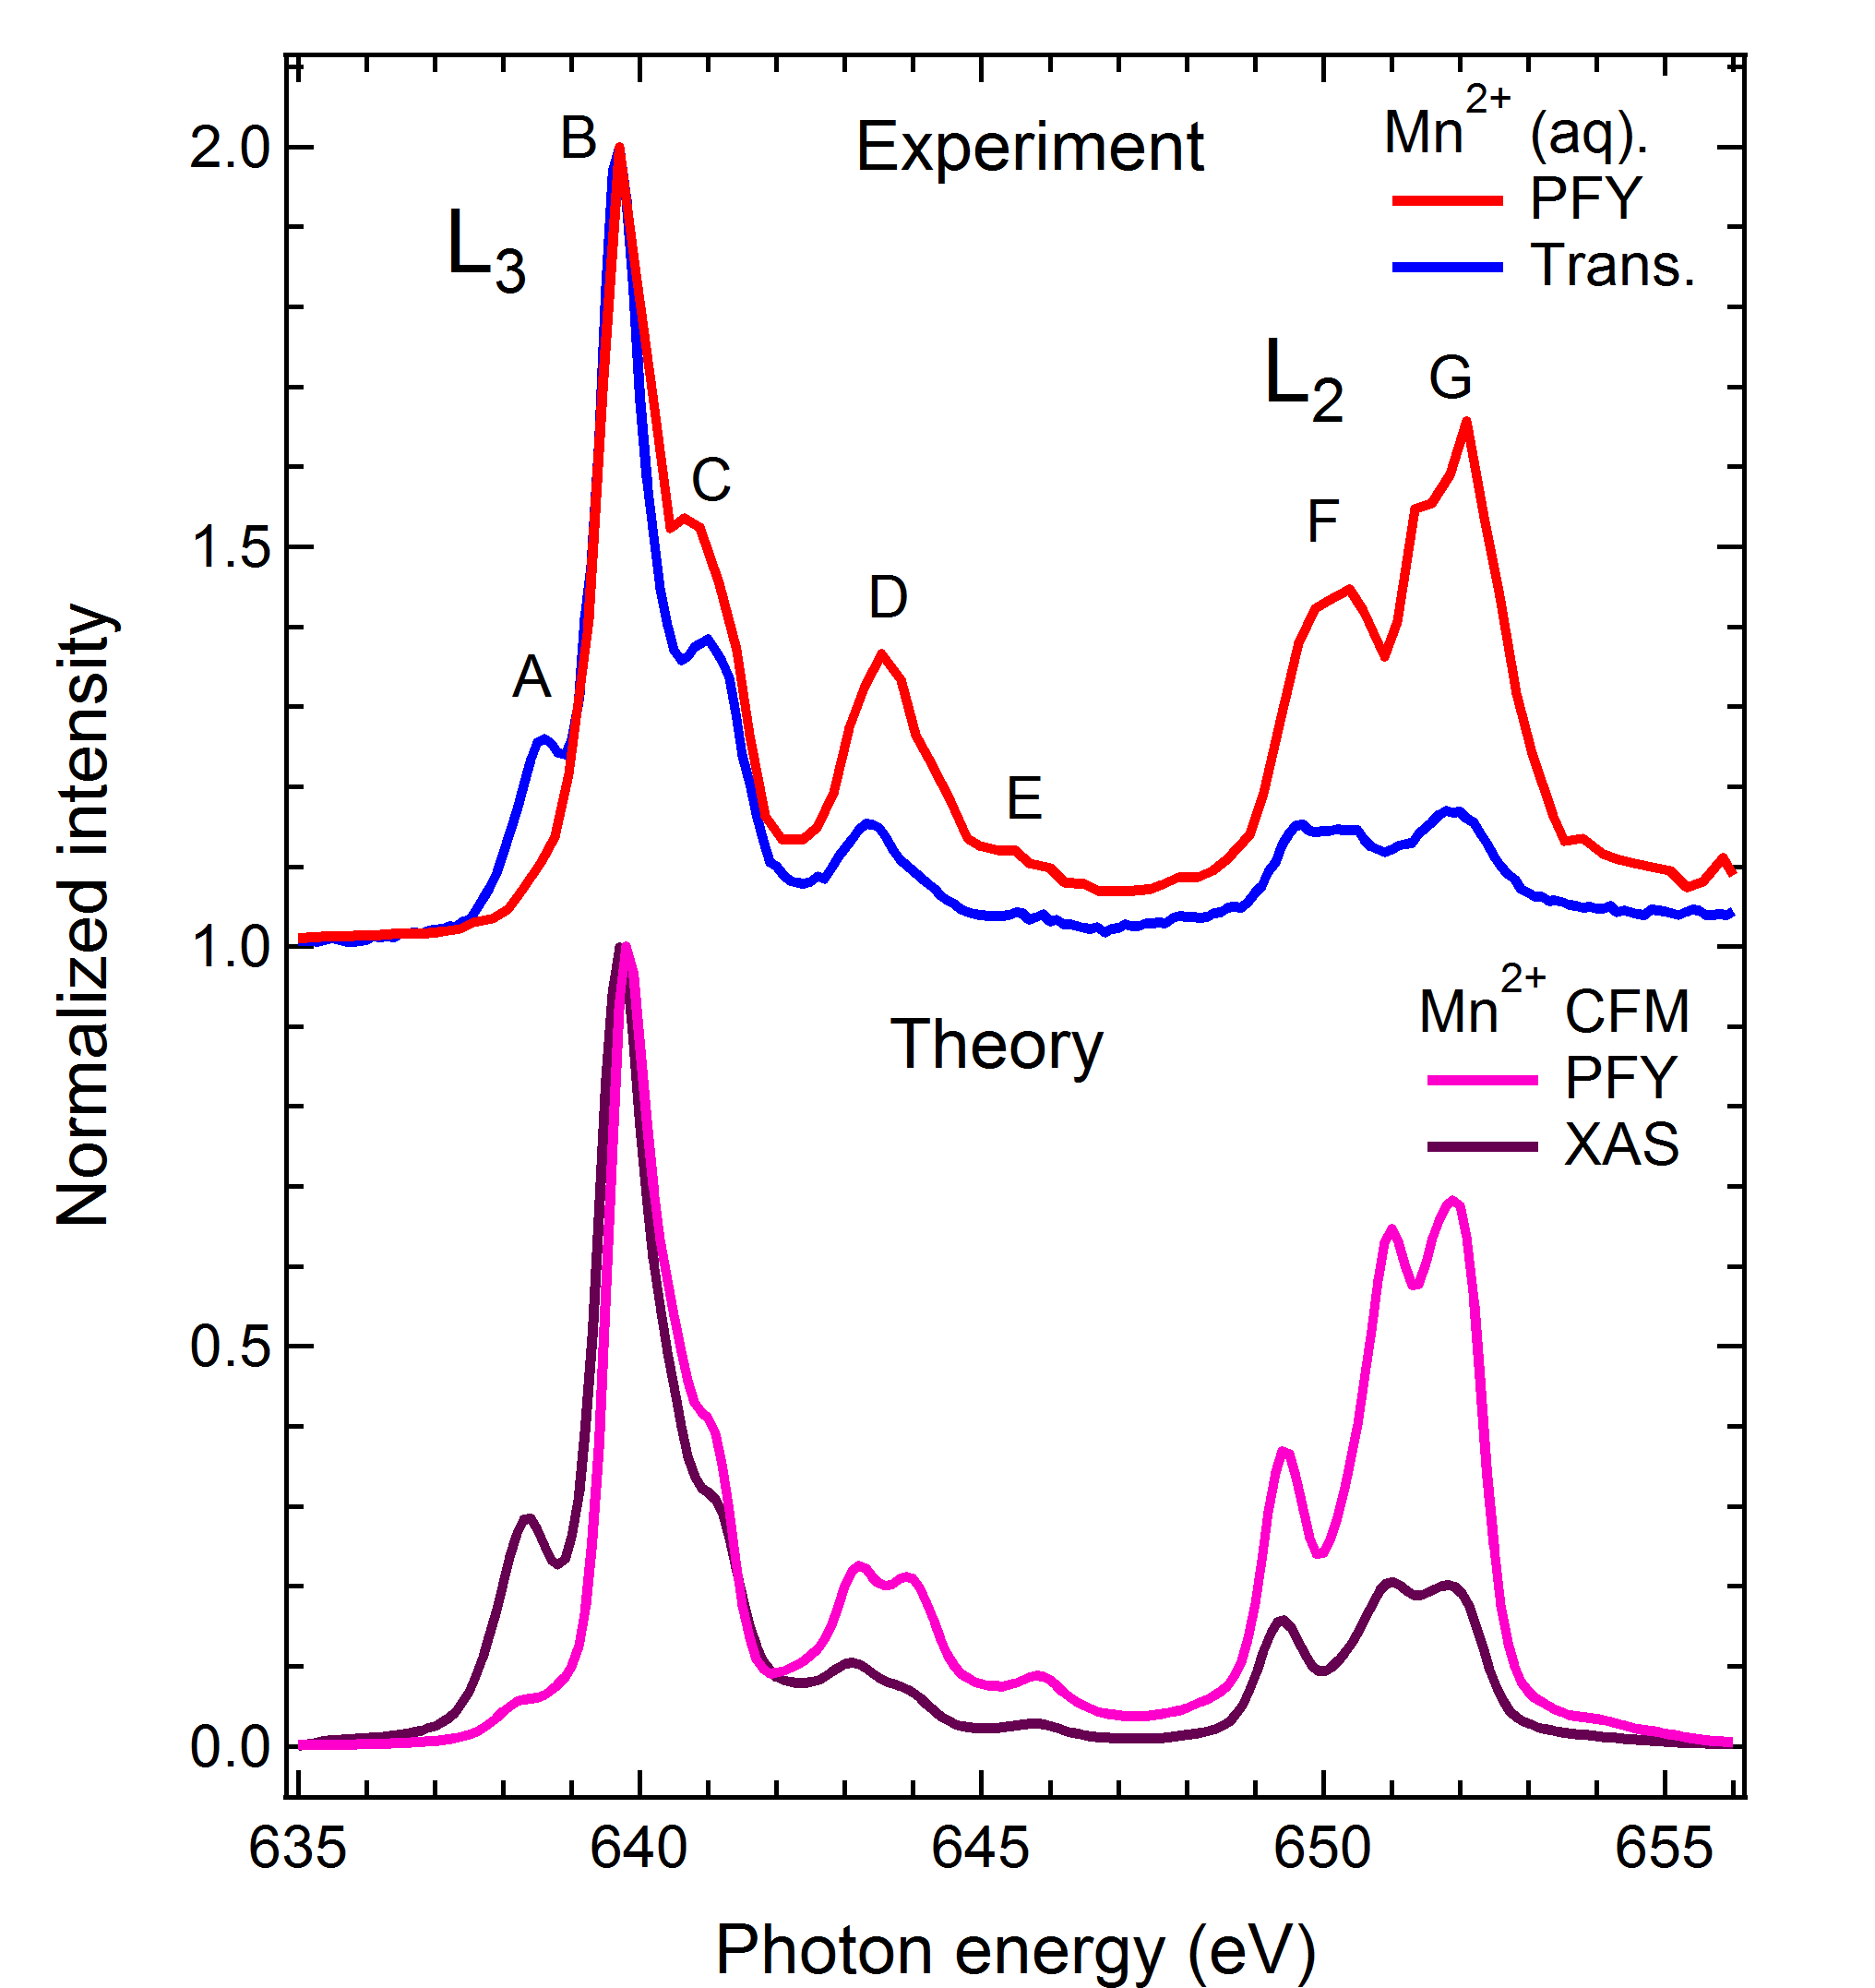
FY-XAS of radiation sensitive sample
Fluorescence does not measure XAS spectrum
Saturation ?
Mitzner et al, J. Phys. Chem. Lett. 4, 3641 (2013)
Notes:
9

Slide 10
FY-XAS of radiation sensitive sample
Fluorescence does not measure XAS spectrum
NO Saturation
State-dependent decay
Mitzner et al, J. Phys. Chem. Lett. 4, 3641 (2013)
Notes:
10

Slide 11
FY detection: State dependent decay
Yield methods assume a constant ratio between radiative and non-radiative decay
If this ratio is state (= energy) dependent then the related yield methods do not measure XAS.
The dominant yield method is not visibly affected, thus for soft X-rays only FY is affected, not electron yield.

Slide 12
FY detection: State dependent decay
L₃
FY
L₂
EY
Solid State Comm. 92, 991 (1994)

Slide 13
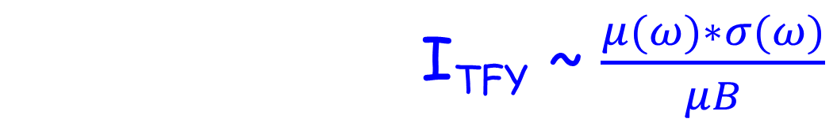
FY detection (state-dependent, dilute)
I_{TFY} ~ $\frac{μ(ω)∗σ}{μ\left(ω\right)+μB}+\frac{μB∗σB}{μ\left(ω\right)+μB}$
I_{TFY} ~ $\frac{μ(ω)∗σ(ω)}{μB}$
Main decay of 2p core hole is 2p3d RIXS
Integrate RIXS spectrum to 2p3d PFY
TFY ~ 2p3d PFY
NOTE: “RIXS” has angular dependence effects

Slide 14
XAS: transmission & FY
Mitzner et al, J. Phys. Chem. Lett. 4, 3641 (2013)
Notes:
14

Slide 15
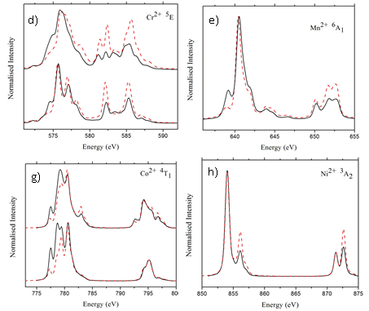
Fluorescence Yield detection
FY-XAS ≠ XAS L₂ edge increases High-energies increase
Kurian J. Phys. Cond. Matt. 24, 435602 (2012)

Slide 16
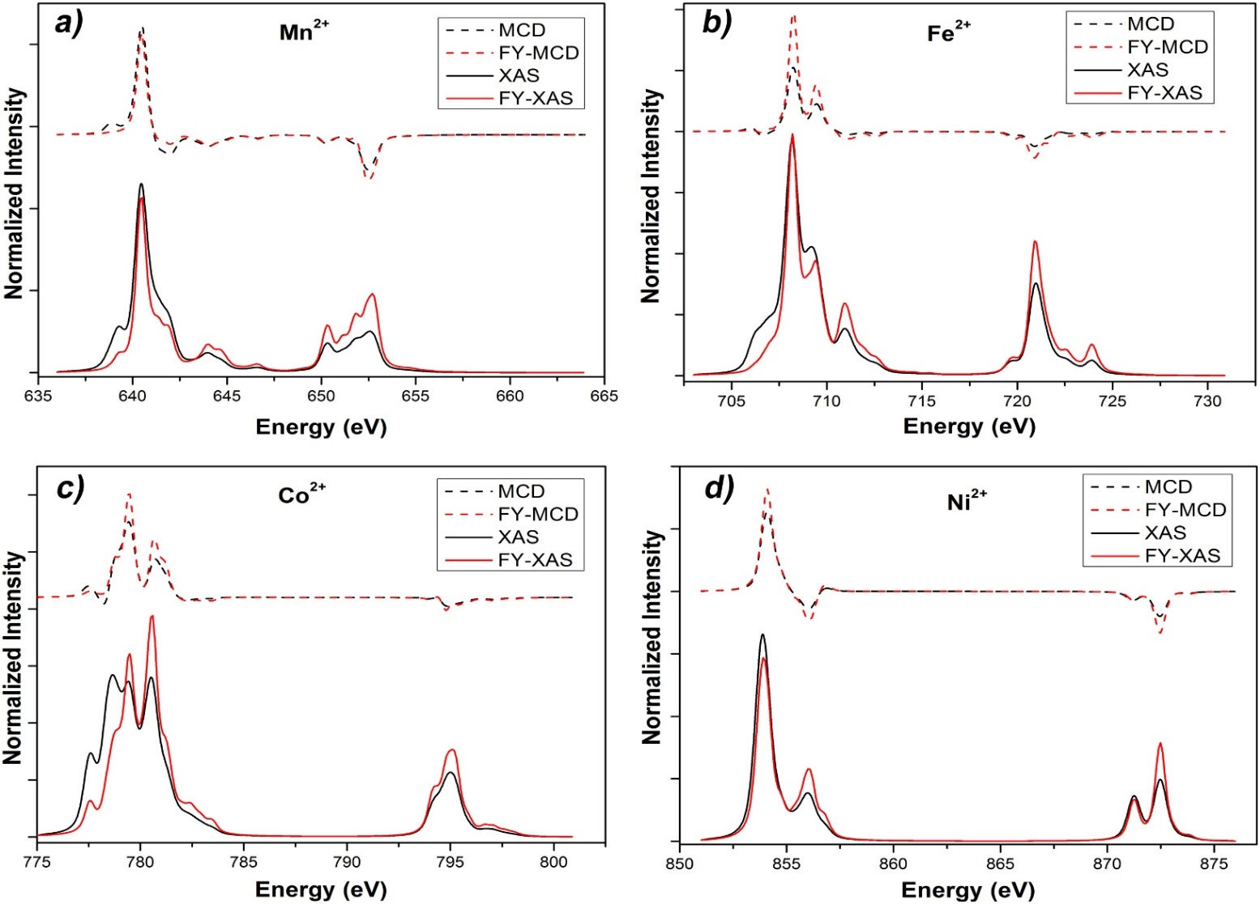
Fluorescence Yield XMCD
XMCD sum rules break down
Ni/Co 20%, Fe 30%, Mn > 100% error
Liu ea, Phys. Rev. B. 96, 054446 (2017)

Slide 17
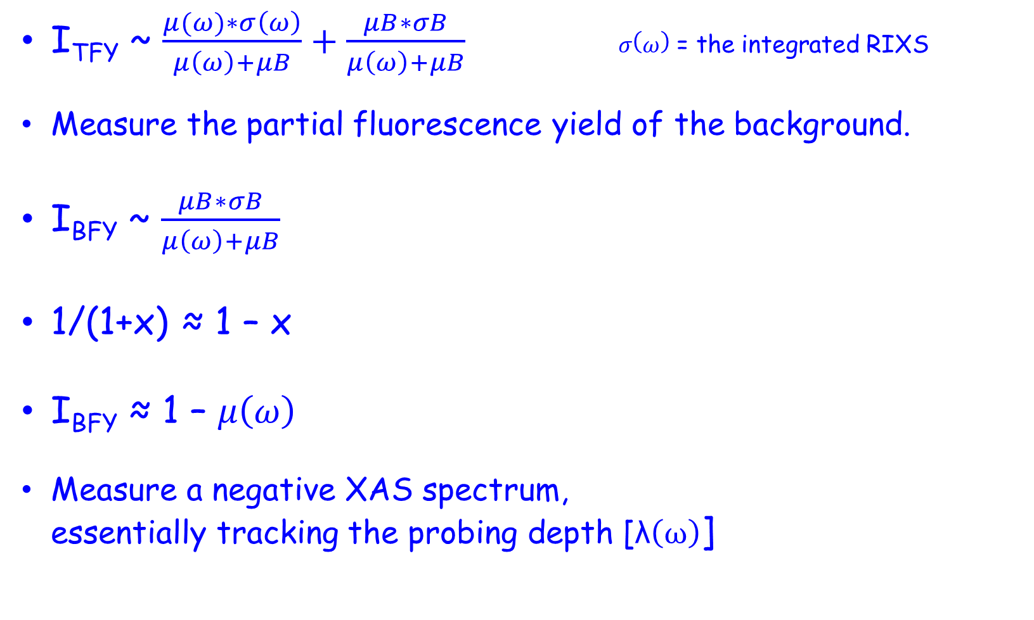
FY detection: 3 inverse PFY
I_{TFY} ~ $\frac{μ(ω)∗σ\left(ω\right)}{μ\left(ω\right)+μB}+\frac{μB∗σB}{μ\left(ω\right)+μB} σ\left(ω\right)$ = the integrated RIXS
Measure the partial fluorescence yield of the background.
I_{BFY} ~ $\frac{μB∗σB}{μ\left(ω\right)+μB}$
1/(1+x) ≈ 1 – x
I_{BFY} ≈ 1 – $μ\left(ω\right)$
Measure a negative XAS spectrum, essentially tracking the probing depth [λ$\left(ω\right)$]

Slide 18
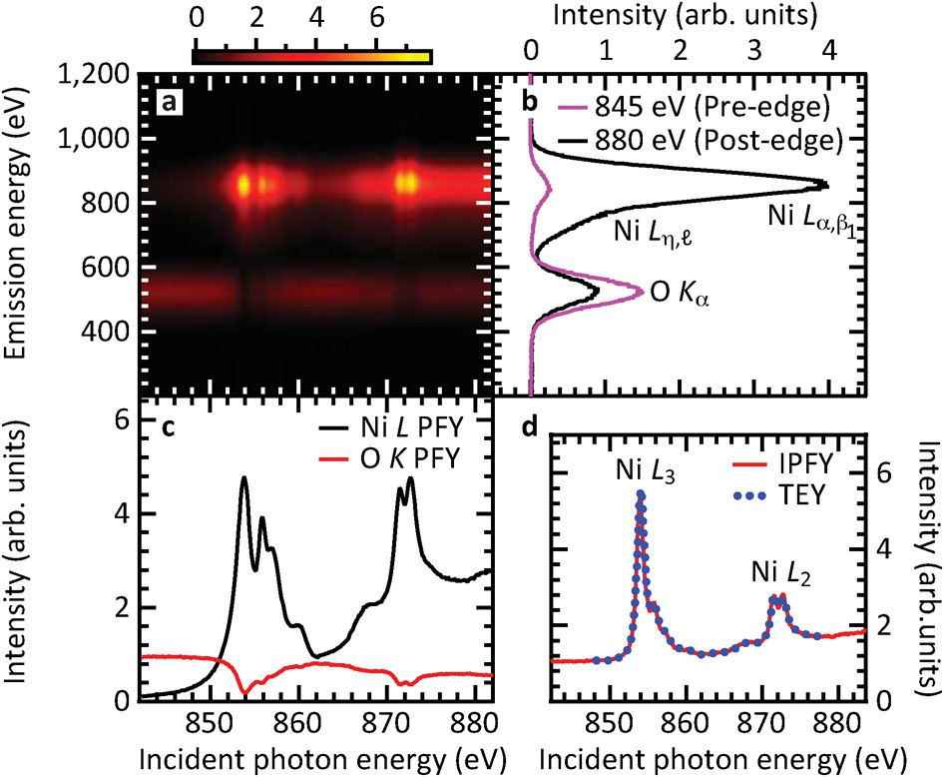
FY detection: 3 inverse PFY
Achkar ea, scientific reports 1, 82 (2011)

Slide 19
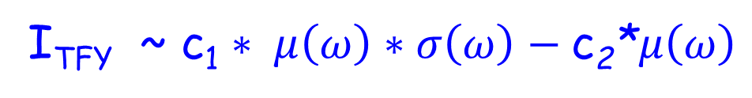
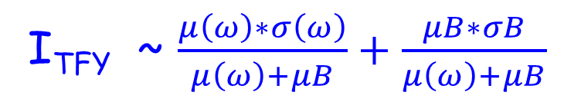
FY detection: 4 dips and peaks
Measure the total fluorescence yield
State-dependent decay modified metal PFY
+ Negative IPFY
I_{TFY} ~ $\frac{μ\left(ω\right)∗σ\left(ω\right)}{μ\left(ω\right)+μB}+\frac{μB∗σB}{μ\left(ω\right)+μB}$
I_{TFY} ~ c₁ $∗ μ\left(ω\right)∗σ\left(ω\right)−\text{c}\text{2}\text{∗}μ\left(ω\right)$

Slide 20
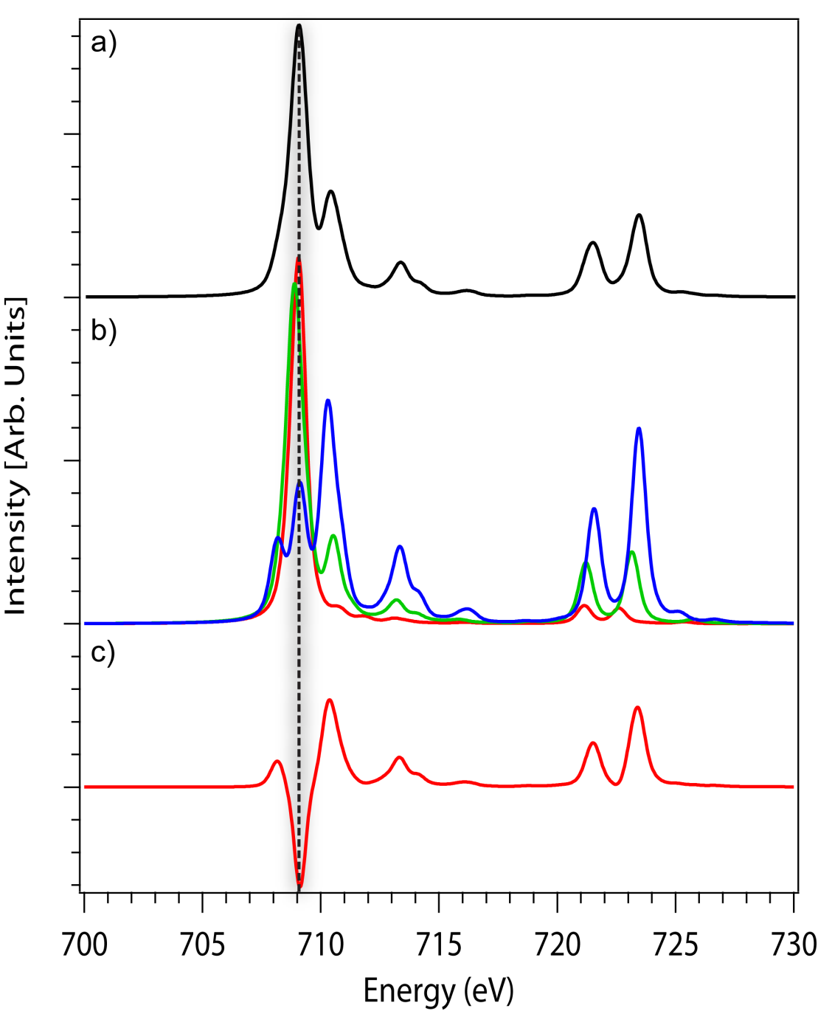
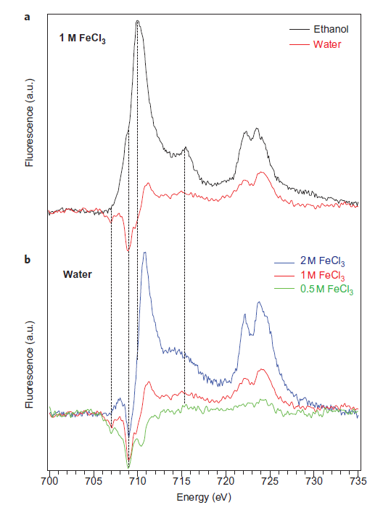
FY detection: 4 dips and peaks
Nature Chem. 4, 766 (2012) & Phys. Rev. Letter discussions (2014)

Slide 21
XPS

Slide 22
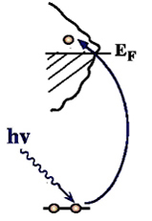
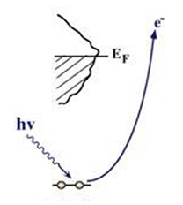
XAS and XPS
X-ray absorption and X-ray photoemission
I(ω_{FIXED})

Slide 23
Charge transfer effects in XAS and XPS
Charge transfer effects in XAS and XPS
Transition metal oxide: Ground state: 3d⁵ + 3d⁶L
Energy of 3d⁶L: Charge transfer energy Δ
3d⁶L
XPS
2p⁵3d⁵
XAS
2p⁵3d⁷L
Δ
3d⁵
Δ-Q
Ground State
Δ+U-Q ≈ Δ
2p⁵3d⁶L
2p⁵3d⁶

Slide 24
Charge transfer effects in XAS
Charge Transfer Effects in XAS
Δ+U-Q
Δ

Slide 25
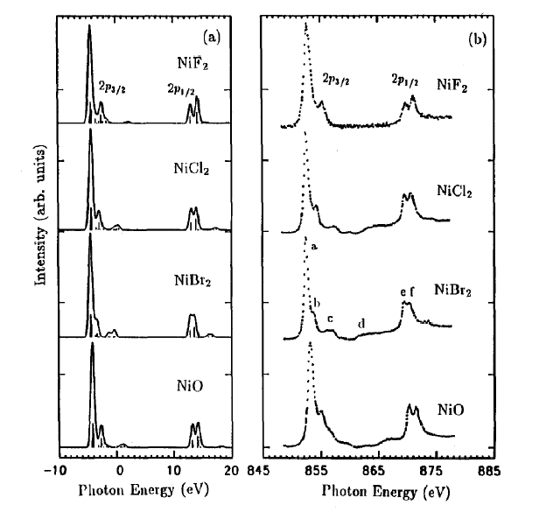
Charge transfer effects in XAS
Charge transfer
XAS = neutral
Self screened
Small charge transfer satellites

Slide 26
Charge transfer effects in XPS
Charge Transfer Effects in XPS
Δ-Q
Δ

Slide 27
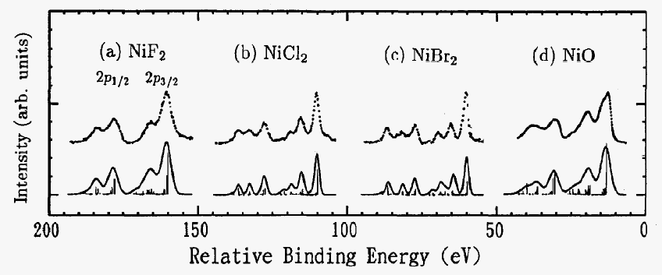
Charge transfer effects in XPS
Charge transfer effects in XPS
XAS = neutral
Self screened
Small charge transfer satellites
XPS = ionising
Large screening
Large charge transfer satellites

Slide 28
Charge transfer effects in XPS
1s and 2p XPS of Fe2O3

Slide 29
Charge transfer effects in XPS
1s and 2p XPS of Fe2O3

Slide 30
Charge transfer effects in XPS
1s and 2p XPS of Fe2O3

Slide 31
Charge transfer effects in XPS
1s and 2p XPS of Fe2O3

Slide 32
Resonant Auger of NiO

Slide 33
Resonant Auger of NiO
Phys. Rev. B. 59, 9933 (1999)

Slide 34
Resonant Auger of NiO
3d⁸ → 2p⁵3d⁹
2p⁵3d⁹ → 3s⁰3d⁹ε
Phys. Rev. B. 59, 9933 (1999)

Slide 35
Resonant Auger of NiO
3d⁸ → 2p⁵3d⁹
3d⁹L→ 2p⁵3d¹⁰L
2p⁵3d⁹ → 3s⁰3d⁹ε
2p⁵3d¹⁰L → 3s⁰3d¹⁰ε
ONLY 2 PEAKS
Phys. Rev. B. 59, 9933 (1999)

Slide 36
Resonant Auger of NiO
Phys. Rev. B. 59, 9933 (1999)

Slide 37
Resonant Auger of NiO
Phys. Rev. B. 59, 9933 (1999)

Slide 38
Resonant Auger of NiO

Slide 39
Ground state analysis

Slide 40
Hunds rules
Term symbols with maximum spin S are lowest in energy,
Among these terms: Term symbols with maximum L are lowest in energy
In the presence of spin-orbit coupling, the lowest term has
J = |L-S| if the shell is less than half full
J = L+S if the shell is more than half full

Slide 41
Hunds rules
max S > max L > max J (if more than half full)
What is the Hund’s rule ground states for 3d² ?
2 ↑ | 1 ↑ | 0 ↑ | -1 ↑ | -2 ↑
2 ↓ | 1 ↓ | 0 ↓ | -1 ↓ | -2 ↓

Slide 42
Hunds rules
max S > max L > max J (if more than half full)
What is the Hund’s rule ground states for 3d² ?
2 ↑ | 1 ↑ | 0 ↑ | -1 ↑ | -2 ↑
2 ↓ | 1 ↓ | 0 ↓ | -1 ↓ | -2 ↓
L=3, S=1
J=2 Term symbol = ³F₂

Slide 43
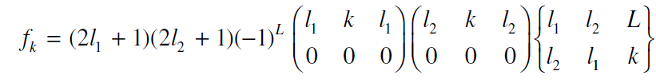
Hunds rules
max S > max L > max J (if more than half full)
What is the Hund’s rule ground states for 3d² ?
2 ↑ | 1 ↑ | 0 ↑ | -1 ↑ | -2 ↑
2 ↓ | 1 ↓ | 0 ↓ | -1 ↓ | -2 ↓

Slide 44
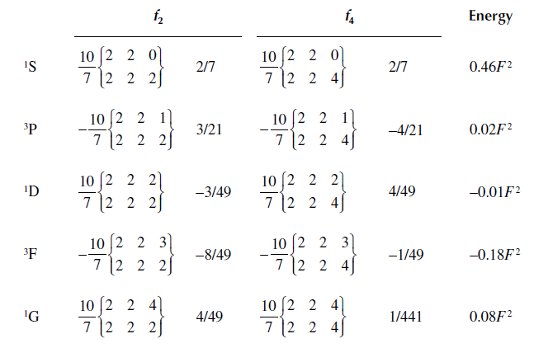
What is the Hund’s rule ground states for 3d² ?
Hunds rules

Slide 45
Crystal Field Effects on 3d⁸ states
Energy
Symmetries O_{h}
Total symmetry
¹S
4.6 eV
¹A₁
³P
0.2 eV
³T₁
¹D
-0.1 eV
¹E + ¹T₂
³F
-1.8 eV
³A₂ + ³T₁ + ³T₂
¹G
0.8 eV
¹A₁+¹T₁+¹T₂+¹E

Slide 46
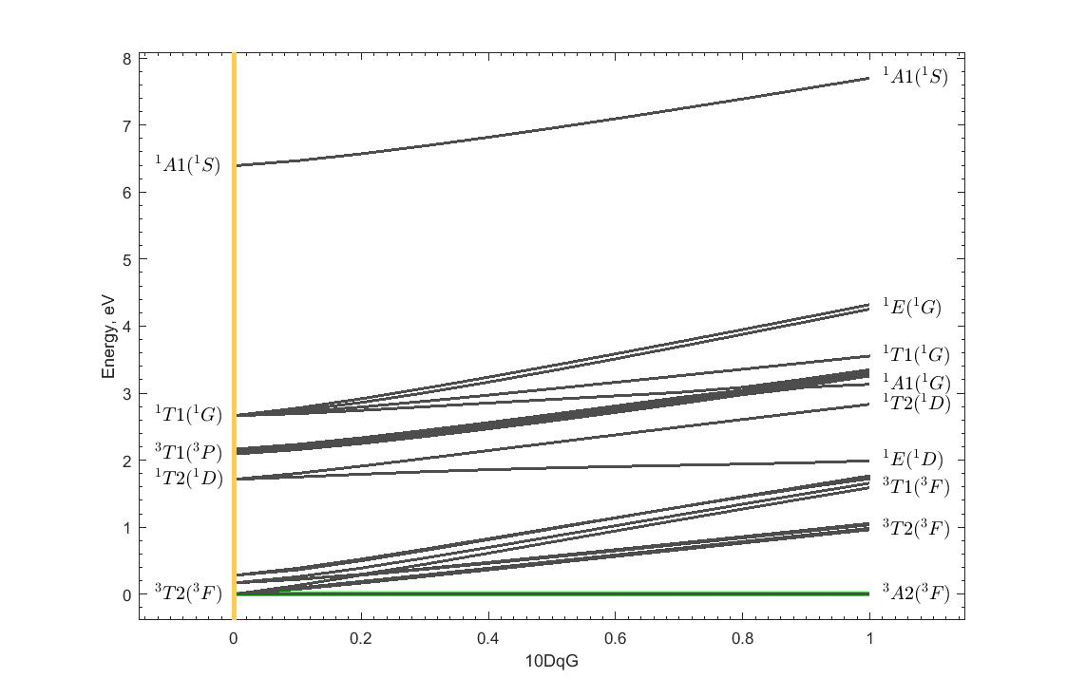
Crystal Field Effects: Tanabe-Sugano

Slide 47
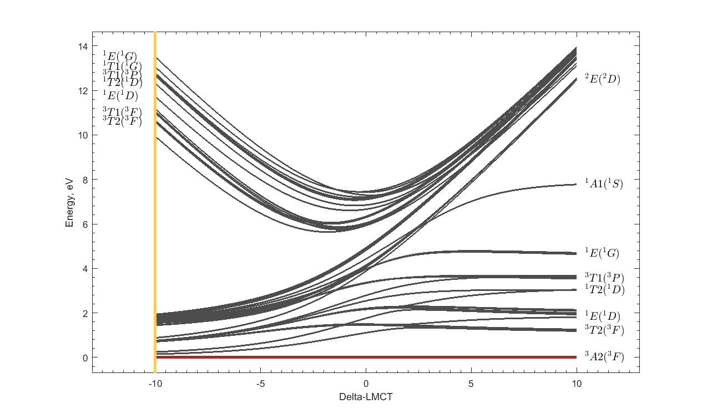
Tanabe-Sugano with Charge transfer
α 3d⁸ + β 3d⁹L

Slide 48
CTM4DOC
48
[Delgado et al. J. Synchrot. Rad 23, 1264 (2016)]

Slide 49
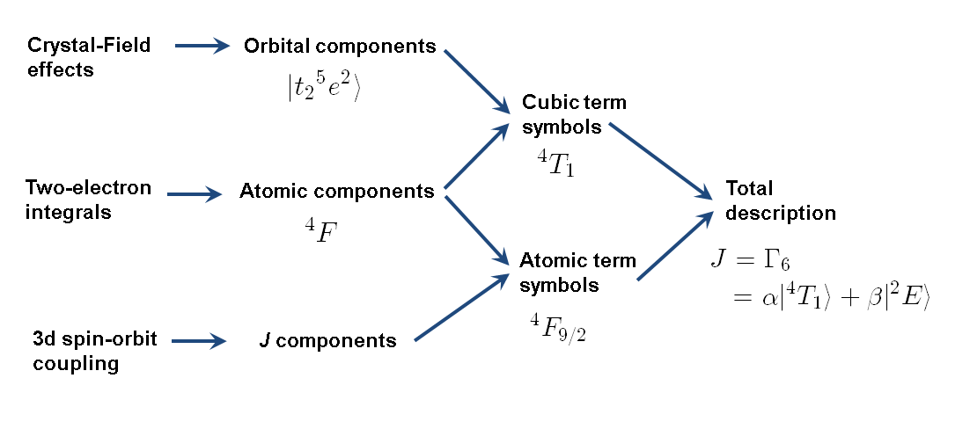
CTM4DOC
+ charge transfer
+ translation symmetry
49
[Delgado et al. J. Synchrot. Rad 23, 1264 (2016)]

Slide 50
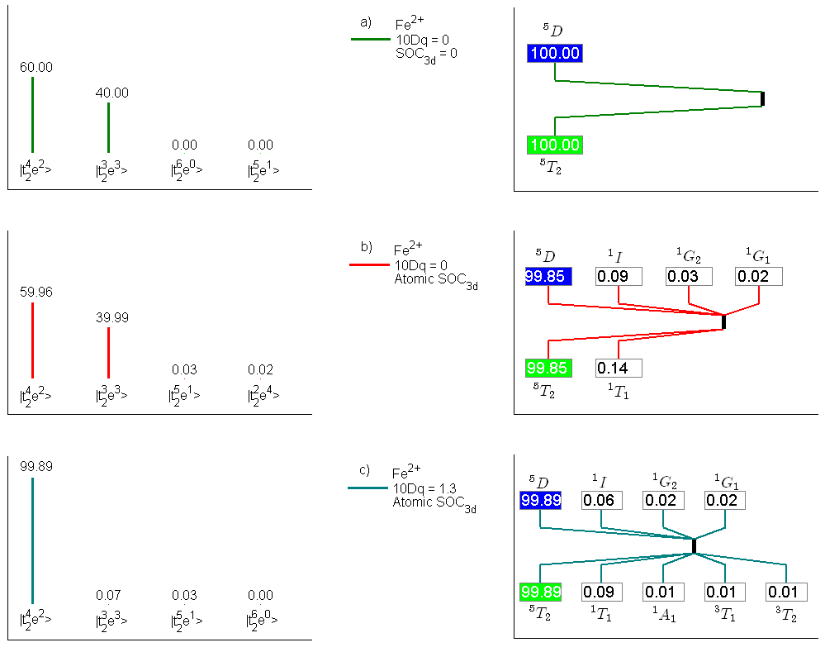
CTM4DOC
50

Slide 51
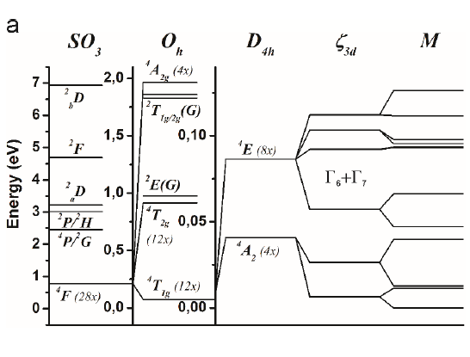
CTM4DOC
51

