Slide 1
Resonant Inelastic X-ray Scattering
core-core RIXS
core-valence RIXS
RIXS

Slide 2
RIXS
Resonant Inelastic X-ray Scattering
Resonant X-ray Raman Scattering (RXRS)
Resonant X-ray Emission Spectroscopy (RXES)
Resonant X-ray Energy Loss Spectroscopy (R-XELS)

Slide 3
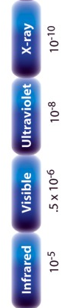
Core-core RIXS
2p
3s
electronic
dd, CT
magnon
vibrations
Ψ0

Slide 4
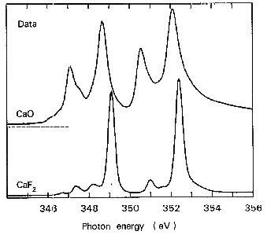
Resonant Inelastic X-ray Spectroscopy
2p3s RIXS of CaF₂
2p XAS of CaF₂
3d⁰
ω
2p⁵3d¹
ω’
3s¹3d¹

Slide 5
2p3s RIXS of CaF₂
2p3s RIXS of CaF₂
Ground state is 3d⁰
Excitation (i₀) 3d⁰ → (x) 2p⁵3d¹
Decay (x) 2p⁵3d¹ → (f) 3s¹3d¹

Slide 6
Resonant Inelastic X-ray Scattering
2p3s RIXS of CaF₂

Slide 7
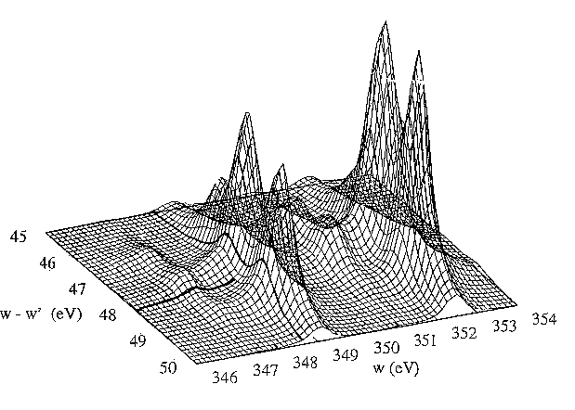
Resonant Inelastic X-ray Scattering
2p3s RIXS of CaF₂
3d⁰
ω
2p⁵3d¹
ω’
Phys. Rev. B.
53, 7099 (1996)
3s¹3d¹

Slide 8
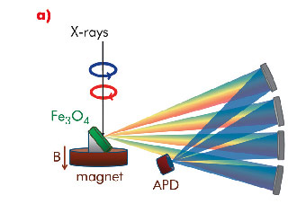
1s2p RIXS of transition metal ions
1s
2p
electronic
dd, CT
magnon
vibrations
Ψ0

Slide 9
K edge and 1s2p RIXS
1s2p RIXS of transition metal ions
Co^{III}(acac)
low-spin Co^{III}
3d⁶ [¹A₁]
T_{2g} full
E_{g} empty

Slide 10
K edge and 1s2p RIXS
1s2p RIXS of transition metal ions
Co^{III}(acac)
low-spin Co^{III}
3d⁶ [¹A₁]
T_{2g} full
E_{g} empty

Slide 11
Pre-edge and edge
Sharper pre-edge structures in 1s XAS
CoO
high-spin Co^{II}
3d⁷ [⁴T₂]
Only quadrupole peaks visible
3d⁷ → 1s¹3d⁸ → 2p⁵3d⁸

Slide 12
K pre-edge of TM oxides (LiCoO₂)
Pre-edges structures in 1s XAS
Co K edge of LiCoO₂
low-spin Co^{III}
3d⁶ [¹A₁]
T_{2g} full
E_{g} empty

Slide 13
K pre-edge of TM oxides (LiCoO₂)
Pre-edges structures in 1s XAS
Co K edge of LiCoO₂
low-spin Co^{III}
3d⁶ [¹A₁]
T_{2g} full
E_{g} empty

Slide 14
K pre-edge of TM oxides
Pre-edges structures in 1s XAS

Slide 15
K pre-edge of TM oxides
Pre-edges structures in 1s XAS
J. Phys. Cond. Matt. 21, 104207 (2009); Phys. Rev. B. 81, 115115 (2010)

Slide 16
K edge and 1s2p RIXS
Hard x-ray RIXS
Reduce lifetime from 1.5 to 0.2 eV (HERFD XANES)
Reveal new features at pre-edge
Soft x-ray edges with hard x-rays
Spin-polarized XAS
Range extended EXAFS
Background free FY for low conc.
RIXS-MCD

Slide 17
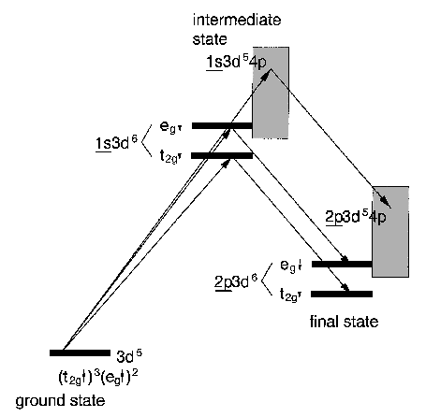
Resonant Inelastic X-ray Scattering
RIXS: soft x-ray edge with hard x-rays
1s2p RIXS of Fe₂O₃
Quadrupole to 3d-states
Dipole to 4p-states
Decay of 2p-electron into 1s-hole
Final state identical to 2p XAS

Slide 18
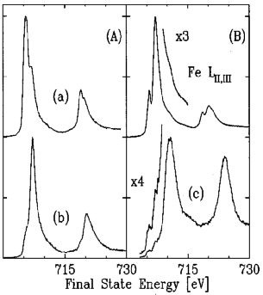
Resonant Inelastic X-ray Scattering
RIXS: soft x-ray edge with hard x-rays
1s2p RIXS
2p-XAS
1s2p RIXS of Fe₂O₃
Phys. Rev. B.
58, 13452 (1998)

Slide 19
Chemical Dependence of Kβ Emission
RIXS: selective XAS
Selective XAS
Experiment
Theory
Equal center-of-gravity energies used in calculations!

Slide 20
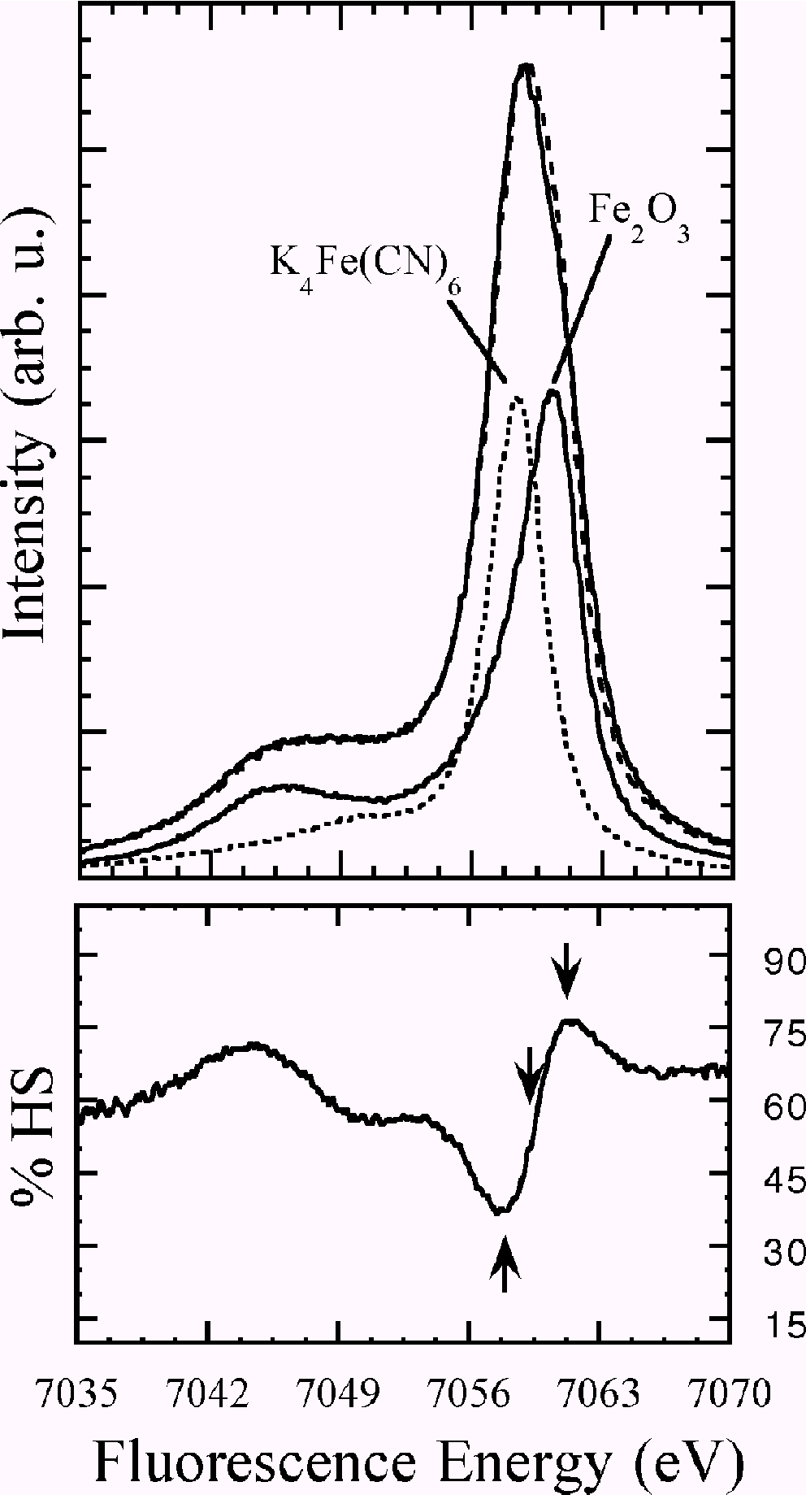
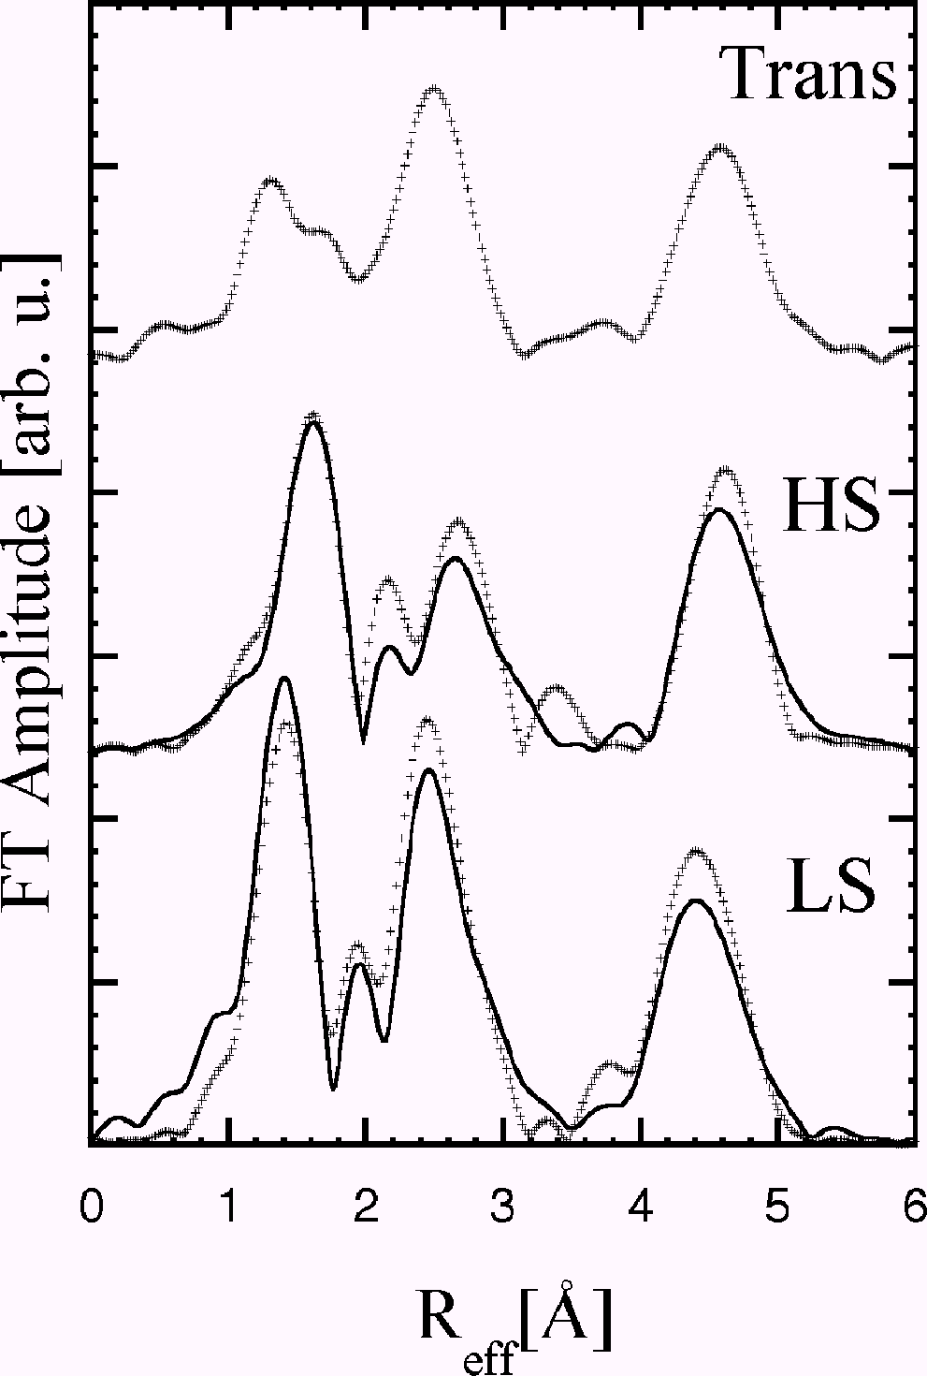
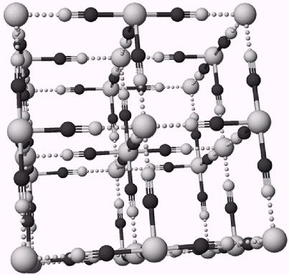
RIXS: selective XAS
Selective XAS
Inorg. Chem.
41, 3121 (2002)

Slide 21
RIXS: range extended EXAFS
Lanthanum edges relative close in energy
Only short EXAFS region possible
Use partial FY: see only one edge
Glatzel ea, Phys. Rev. B. 72, 014117 (2005)

Slide 22
RIXS: range extended EXAFS
Extra absorption at new edge
Probing depth is changing
Only works for dilute samples
Glatzel ea, Phys. Rev. B. 72, 014117 (2005)

Slide 23
Core-valence RIXS

Slide 24
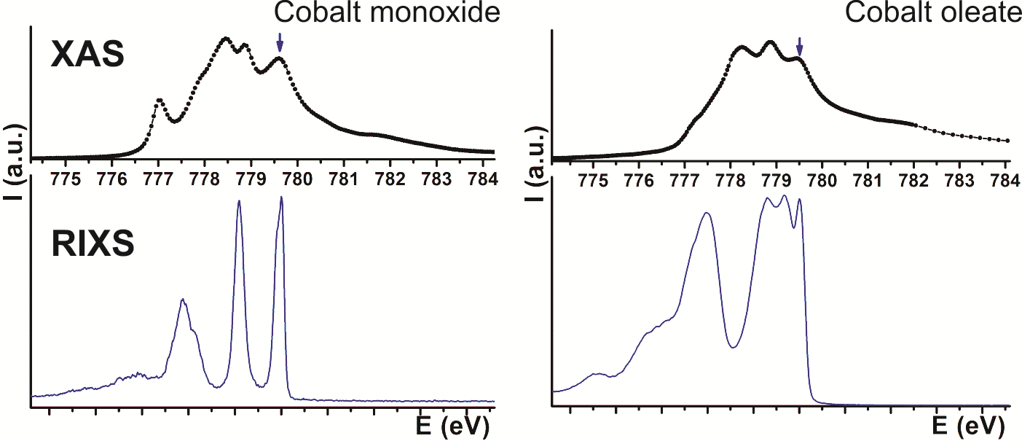
2p3d RIXS of transition metal ions
core
electronic
dd, CT
magnon
vibrations
Ψ0
3 2 1 0

Slide 25
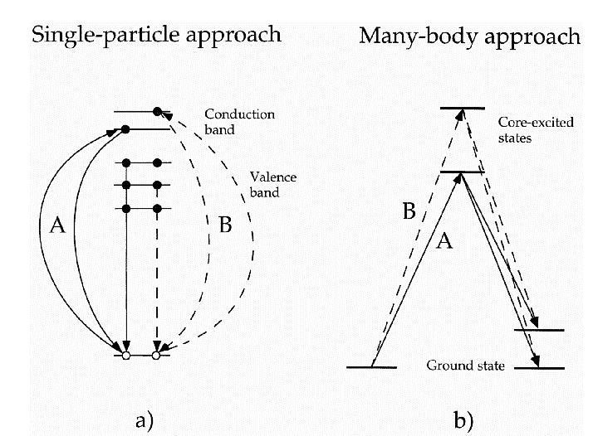
Resonant Inelastic X-ray Scattering

Slide 26
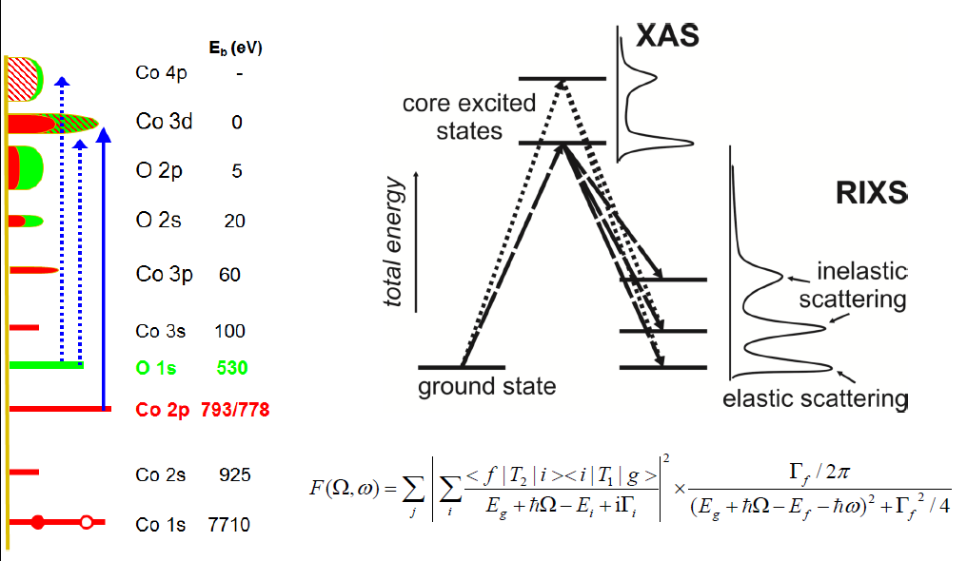
resonant inelastic x-ray spectroscopy
Notes:
26

Slide 27
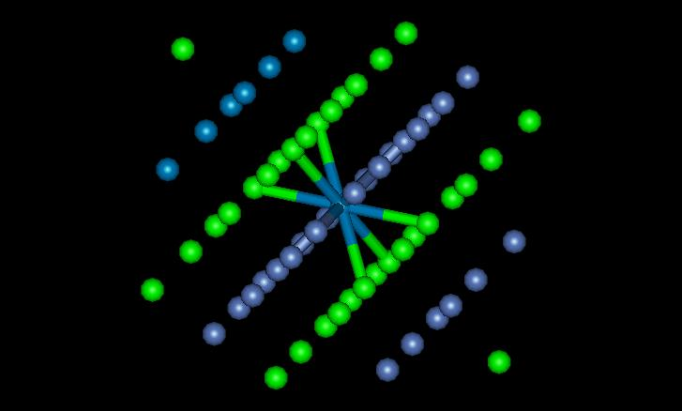

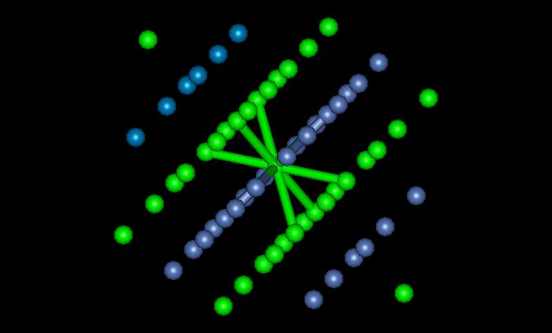
2p3d RIXS of NiO
Ni^{II} 3d⁸ [↑↑] → 2p⁵3d⁹[jj] → 3d⁸[↓↓]
Notes:
Cartoon of a spin-flip transition

Slide 28
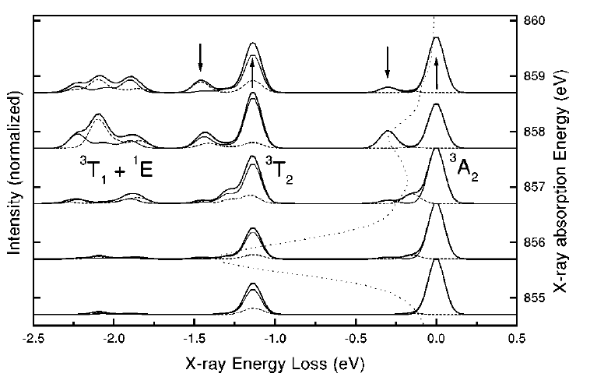
2p3d RIXS of NiO
ΔS
ΔM_{S}
‘spin-flip’
dd
spin-flip
Phys. Rev. B. 57, 14584 (1998)
Notes:
Low-loss region of RIXS in NiO.
Ground state: 3A2
Double group: T2, not split without exchange
Echange field H splits ground state into three Ms states as H times Ms,
So three states at –H, 0, +H.
The spin-flip peak in the figure is at 2H.
H is related to the superexchaneg energy

Slide 29
2p3d RIXS
polarization, angles
(in, sample, out)
eV
electron-electron
crystal field
charge transfer
meV
spin-orbit, magnetic
distortions
vibrations
RIXS1998:
500 meV
RIXS 2018:
30 meV
Notes:
29

Slide 30
Energy dependence in 2p3d RIXS
In 2p3d RIXS the intensity of
charge transfer is smaller than dd-excitations
[Ament et al., Rev. Mod. Phys. 83, 705 (2011)]
Notes:
Low-loss region of RIXS in NiO.
Ground state: 3A2
Double group: T2, not split without exchange
Echange field H splits ground state into three Ms states as H times Ms,
So three states at –H, 0, +H.
The spin-flip peak in the figure is at 2H.
H is related to the superexchaneg energy

Slide 31
Energy dependence in 2p3d RIXS
2 eV – 10 eV
charge transfer
0.0 eV – 6 eV
dd excitations (atomic + crystal field)
0.0 – 0.5 eV
spin-flip (magnon)
symmetry distortions
HS-LS transition point
spin-orbit coupling
vibrations (phonon)
Notes:
Low-loss region of RIXS in NiO.
Ground state: 3A2
Double group: T2, not split without exchange
Echange field H splits ground state into three Ms states as H times Ms,
So three states at –H, 0, +H.
The spin-flip peak in the figure is at 2H.
H is related to the superexchaneg energy

Slide 32
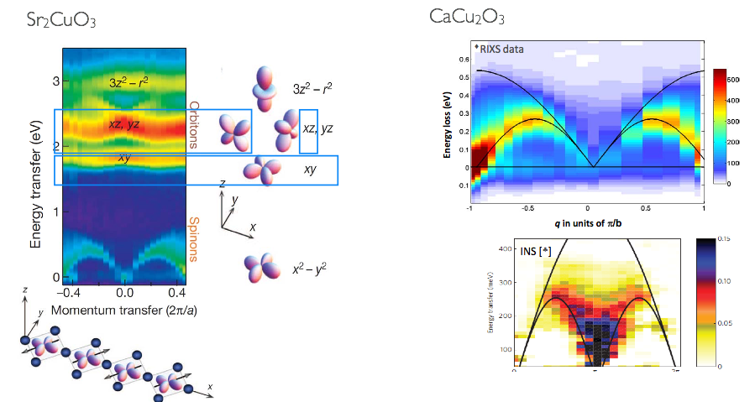
2p3d RIXS in cuprates
2p3d RIXS
Schlappa et al., Nature (2012)
Bisogni et al., ^{arXiv:1310.8346}
Notes:
Low-loss region of RIXS in NiO.
Ground state: 3A2
Double group: T2, not split without exchange
Echange field H splits ground state into three Ms states as H times Ms,
So three states at –H, 0, +H.
The spin-flip peak in the figure is at 2H.
H is related to the superexchaneg energy

Slide 33
Select specific states in 2p3d RIXS (Fe₃O₄)
exchange
spin-orbit + exchange
[Huang et al. Nature Comm. 8, 15929 (2017) ]
Notes:
Low-loss region of RIXS in NiO.
Ground state: 3A2
Double group: T2, not split without exchange
Echange field H splits ground state into three Ms states as H times Ms,
So three states at –H, 0, +H.
The spin-flip peak in the figure is at 2H.
H is related to the superexchaneg energy

Slide 34
Select specific states in 2p3d RIXS (Fe₃O₄)
exchange
Interference shows that lifetime broadening
(fwhm) is only 100 meV, not 200 meV
20 fs >>> 40 fs
spin-orbit + exchange
[Huang et al. Nature Comm. 8, 15929 (2017) ]
Notes:
Low-loss region of RIXS in NiO.
Ground state: 3A2
Double group: T2, not split without exchange
Echange field H splits ground state into three Ms states as H times Ms,
So three states at –H, 0, +H.
The spin-flip peak in the figure is at 2H.
H is related to the superexchaneg energy

Slide 35
2p3d RIXS of isolated chromium ions (ruby)
[Co^{II}W₁₂O₄₀]·
[Van Schooneveld, Hunault et al., unpublished ]

Slide 36
Multiplet challenge: 2p3d RIXS on Cr³⁺
Notes:
36

Slide 37
Multiplet challenge: 2p3d RIXS on Cr³⁺
Optical resolution can be 0.01 meV
Spin-forbidden dd-excitations limited by experimental resolution
[Hunault, van Schooneveld, submitted]
Notes:
37

Slide 38
Spin-state in LaCoO₃ (single crystal)
Notes:
Low-loss region of RIXS in NiO.
Ground state: 3A2
Double group: T2, not split without exchange
Echange field H splits ground state into three Ms states as H times Ms,
So three states at –H, 0, +H.
The spin-flip peak in the figure is at 2H.
H is related to the superexchaneg energy

Slide 39
Spin state of LaCoO₃
⁵T₂
¹A₁
E
T₂
E
T₂
³T₁
E
T₂
NOTE: Term symbols and orbital occupations are only indications: they are mixed by electron-electron, spin-orbit, etc.
Notes:
Low-loss region of RIXS in NiO.
Ground state: 3A2
Double group: T2, not split without exchange
Echange field H splits ground state into three Ms states as H times Ms,
So three states at –H, 0, +H.
The spin-flip peak in the figure is at 2H.
H is related to the superexchaneg energy

Slide 40
Spin state of LaCoO₃
dd-excitations + fluorescence
[Tomiyasu et al. PRL 8, 119, 196402 (2017) ]
Notes:
Low-loss region of RIXS in NiO.
Ground state: 3A2
Double group: T2, not split without exchange
Echange field H splits ground state into three Ms states as H times Ms,
So three states at –H, 0, +H.
The spin-flip peak in the figure is at 2H.
H is related to the superexchaneg energy

Slide 41
Spin state of LaCoO₃
dd-excitations + fluorescence
[Tomiyasu et al. PRL 8, 119, 196402 (2017) ]
Notes:
Low-loss region of RIXS in NiO.
Ground state: 3A2
Double group: T2, not split without exchange
Echange field H splits ground state into three Ms states as H times Ms,
So three states at –H, 0, +H.
The spin-flip peak in the figure is at 2H.
H is related to the superexchaneg energy

Slide 42
Spin state of LaCoO₃
dd-excitations + fluorescence
[Tomiyasu et al. PRL 8, 119, 196402 (2017) ]
Notes:
Low-loss region of RIXS in NiO.
Ground state: 3A2
Double group: T2, not split without exchange
Echange field H splits ground state into three Ms states as H times Ms,
So three states at –H, 0, +H.
The spin-flip peak in the figure is at 2H.
H is related to the superexchaneg energy

Slide 43
Spin state of LaCoO₃
[Tomiyasu et al. PRL 8, 119, 196402 (2017) ]
Notes:
Low-loss region of RIXS in NiO.
Ground state: 3A2
Double group: T2, not split without exchange
Echange field H splits ground state into three Ms states as H times Ms,
So three states at –H, 0, +H.
The spin-flip peak in the figure is at 2H.
H is related to the superexchaneg energy

Slide 44
Spin state of LaCoO₃
Spin transition is from low-spin to high-spin,
. . . . but is it really high-spin?
[Tomiyasu et al. PRL 8, 119, 196402 (2017) ]
Notes:
Low-loss region of RIXS in NiO.
Ground state: 3A2
Double group: T2, not split without exchange
Echange field H splits ground state into three Ms states as H times Ms,
So three states at –H, 0, +H.
The spin-flip peak in the figure is at 2H.
H is related to the superexchaneg energy

Slide 45
Spin state of LaCoO₃
Order of states at zero Kelvin: LS < HS < IS
Strong coupling between LS and IS (not with HS)
Large dispersion of IS: Excitonic Insulator
[Sotnikov & KUnes, Sci. Rep 6, 30510 (2016); Wang et al. submitted ]
Notes:
Low-loss region of RIXS in NiO.
Ground state: 3A2
Double group: T2, not split without exchange
Echange field H splits ground state into three Ms states as H times Ms,
So three states at –H, 0, +H.
The spin-flip peak in the figure is at 2H.
H is related to the superexchaneg energy

Slide 46
Spin state of LaCoO₃
q-dependent RIXS with 90 meV resolution at 20 K
[data treatment: remove fluorescence and isolate states related to the triplet states (IS)]
[Wang et al. submitted ]
Notes:
Low-loss region of RIXS in NiO.
Ground state: 3A2
Double group: T2, not split without exchange
Echange field H splits ground state into three Ms states as H times Ms,
So three states at –H, 0, +H.
The spin-flip peak in the figure is at 2H.
H is related to the superexchaneg energy

Slide 47
Spin state of LaCoO₃
q-dep. RIXS
[Wang et al. submitted ]
Notes:
Low-loss region of RIXS in NiO.
Ground state: 3A2
Double group: T2, not split without exchange
Echange field H splits ground state into three Ms states as H times Ms,
So three states at –H, 0, +H.
The spin-flip peak in the figure is at 2H.
H is related to the superexchaneg energy

Slide 48
Spin-state in LaCoO₃ (thin films)
Notes:
Low-loss region of RIXS in NiO.
Ground state: 3A2
Double group: T2, not split without exchange
Echange field H splits ground state into three Ms states as H times Ms,
So three states at –H, 0, +H.
The spin-flip peak in the figure is at 2H.
H is related to the superexchaneg energy

Slide 49
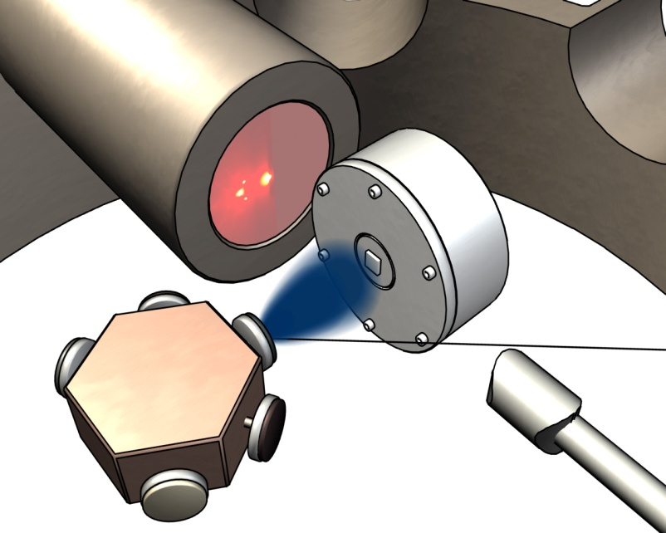
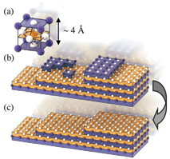
LaCoO₃ thin films
Synthesis: Pulsed laser deposition in
combination with in situ monitoring by RHEED
Samples: 4nm (10 ML) and 60 nm films
LaCoO₃/LaAlO₃ and LaCoO₃/SrTiO₃
[PLD @ Twente University (Gertjan Koster) ]
Notes:
In order to have a good comparison, we considered three different kind of strains.
First is the relaxed one, with is LaCoO3 crystal.
Then we have the LaCoO3 films grown on the SrTiO3 and LaAlO3.
They are presented two different strained style.

Slide 50
LaCoO₃ thin films
Single crystal
LaCoO₃/SrTiO₃
LaCoO₃/LaAlO₃
In-plane
tensile
strained
In-plane
compressive
strained
Notes:
In order to have a good comparison, we considered three different kind of strains.
First is the relaxed one, with is LaCoO3 crystal.
Then we have the LaCoO3 films grown on the SrTiO3 and LaAlO3.
They are presented two different strained style.

Slide 51
LaCoO₃ thin films
Notes:
In order to have a good comparison, we considered three different kind of strains.
First is the relaxed one, with is LaCoO3 crystal.
Then we have the LaCoO3 films grown on the SrTiO3 and LaAlO3.
They are presented two different strained style.

Slide 52
LaCoO₃ thin films
Notes:
In order to have a good comparison, we considered three different kind of strains.
First is the relaxed one, with is LaCoO3 crystal.
Then we have the LaCoO3 films grown on the SrTiO3 and LaAlO3.
They are presented two different strained style.

Slide 53
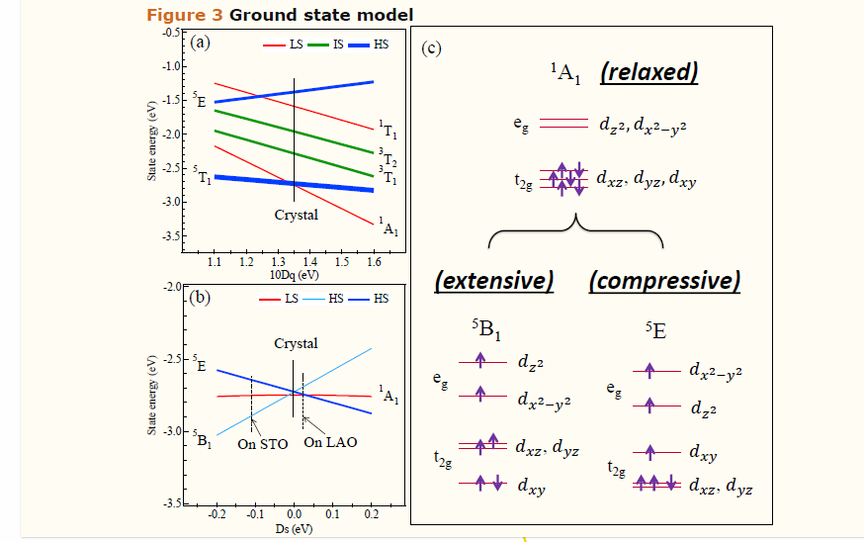
LaCoO₃ thin films
⁵B₂
relaxed
⁵B₂

Slide 54
Spin state of LaCoO₃
Single Crystal:
Low spin at 20 Kelvin.
Gas of mobile bosonic (IS) excitons
HS states are bound bi-excitons
Thin films:
Interface induced stress → high-spin ground states
LaCoO₃/SrTiO₃ has ⁵B₂ ground state
LaCoO₃/LaAlO₃ has ⁵E ground state
Notes:
Low-loss region of RIXS in NiO.
Ground state: 3A2
Double group: T2, not split without exchange
Echange field H splits ground state into three Ms states as H times Ms,
So three states at –H, 0, +H.
The spin-flip peak in the figure is at 2H.
H is related to the superexchaneg energy

Slide 55
Yield detection
2p core hole in 3d metal ions decays for 80+% by 2p3d x-ray emission
2p3d RIXS analysis has implications for fluorescence yield detection

Slide 56
Yield detection
Electron yield
Fluorescence Yield (1. dilute limit)
FY (2. state dependent decay)
No XMCD sum rules in FY
FY (3. inverse PFY)
FY (4. dips and peaks)

Slide 57
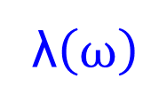
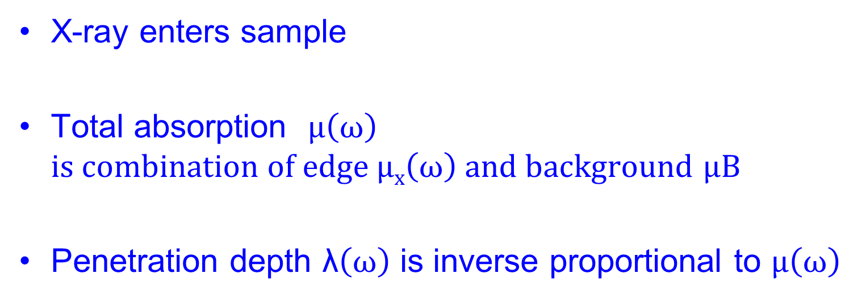
Yield detection
λ$\left(ω\right)$
X-ray enters sample
Total absorption $μ\left(ω\right)$
$is combination of edge μx\left(ω\right) and background$ $μB$
Penetration depth λ$\left(ω\right)$ is inverse proportional to $μ\left(ω\right)$

Slide 58
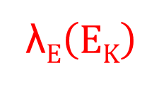
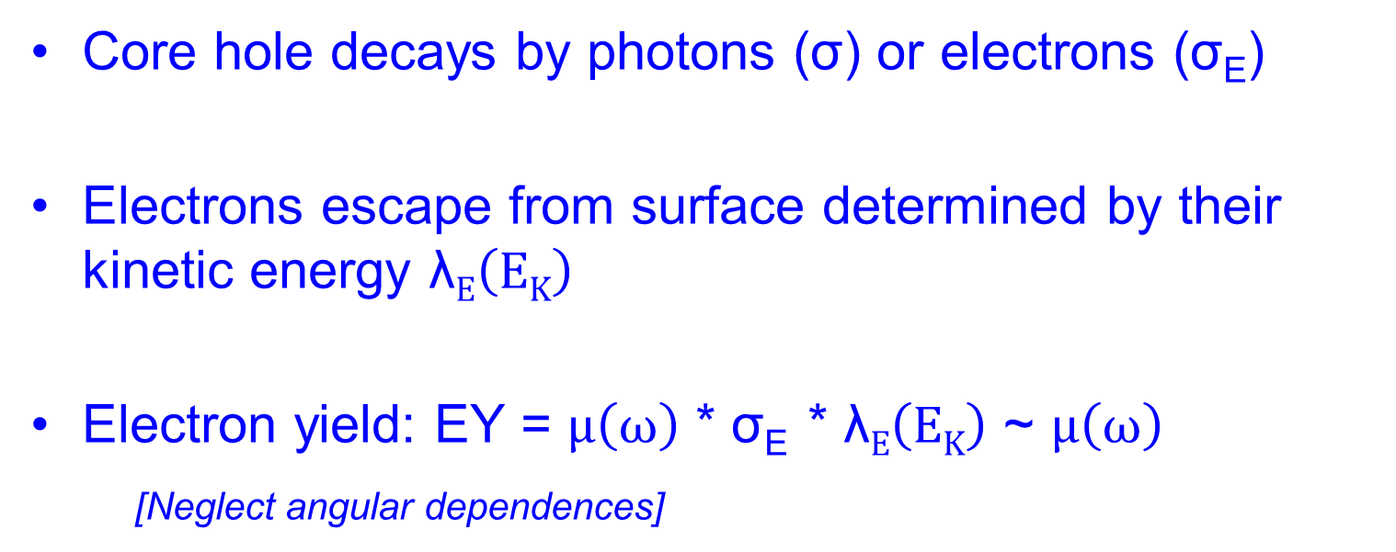
Electron Yield detection
λ$E\left(EK\right)$
λ$\left(ω\right)$
Core hole decays by photons (σ) or electrons (σ_{E})
Electrons escape from surface determined by their kinetic energy λ$E\left(EK\right)$
Electron yield: EY = $μ\left(ω\right)$ * σ_{E} * λ$E\left(EK\right)$ ~ $μ\left(ω\right)$
[Neglect angular dependences]

Slide 59
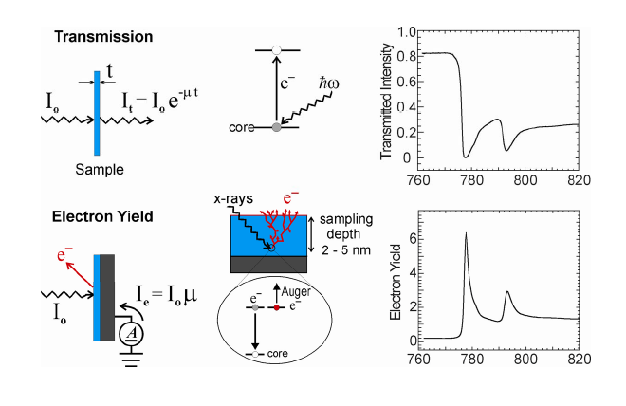
Electron Yield detection

Slide 60
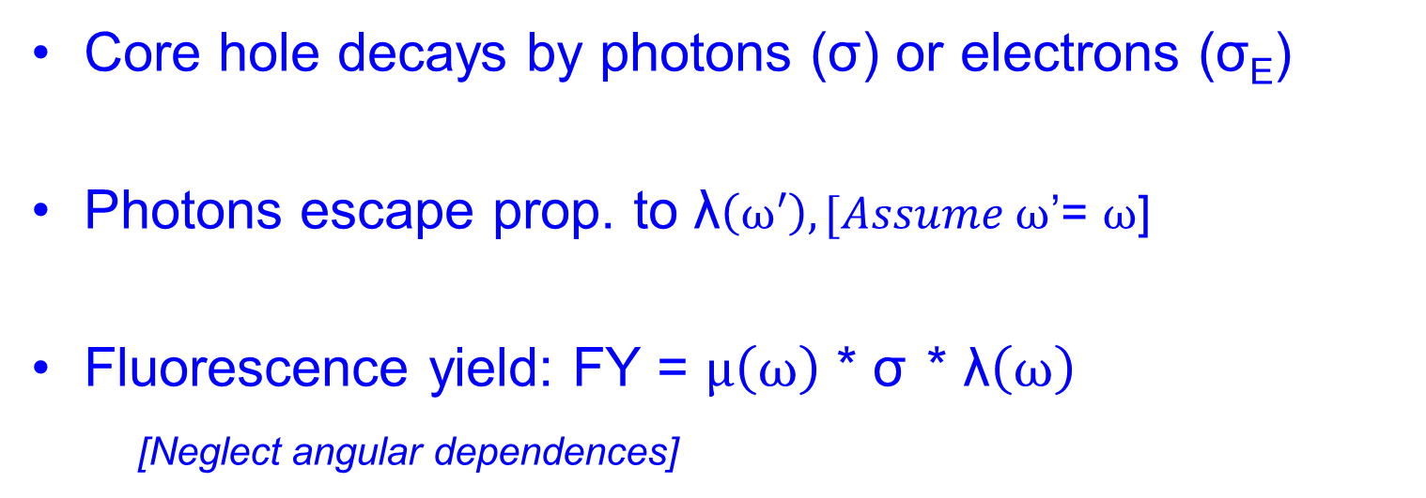
Fluorescence Yield detection
λ$\left(ω\right)$
Core hole decays by photons (σ) or electrons (σ_{E})
Photons escape prop. to λ$\left(ω′\right), [Assume ω$’= $ω$]
Fluorescence yield: FY = $μ\left(ω\right)$ * σ * λ$\left(ω\right)$
[Neglect angular dependences]

Slide 61
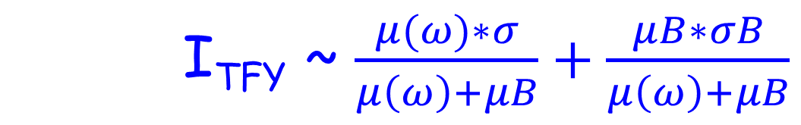
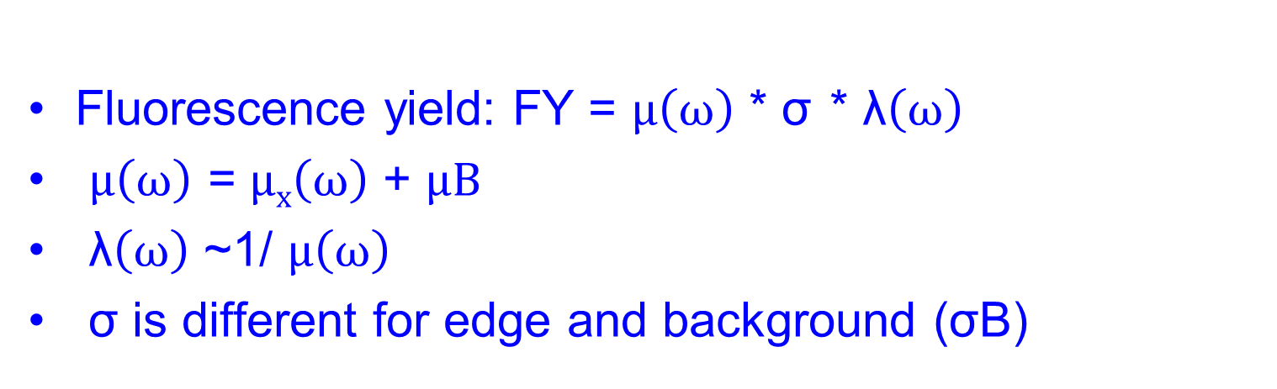
Fluorescence Yield detection
Fluorescence yield: FY = $μ\left(ω\right)$ * σ * λ$\left(ω\right)$
$μ\left(ω\right)$ = $μx\left(ω\right)$ + $μB$
λ$\left(ω\right)$ ~1/ $μ\left(ω\right)$
σ is different for edge and background (σB)
I_{TFY} ~ $\frac{μ(ω)∗σ}{μ\left(ω\right)+μB}+\frac{μB∗σB}{μ\left(ω\right)+μB}$

Slide 62
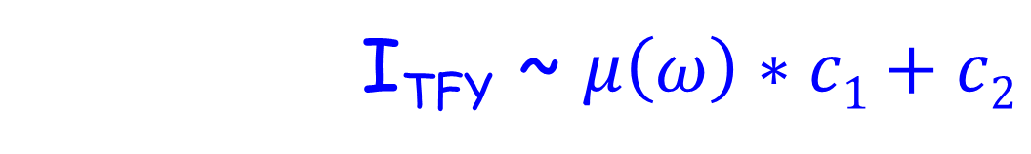
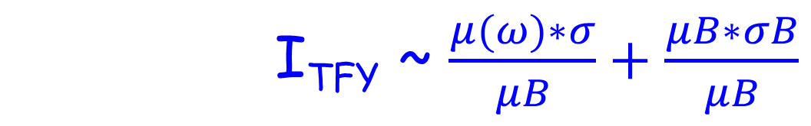
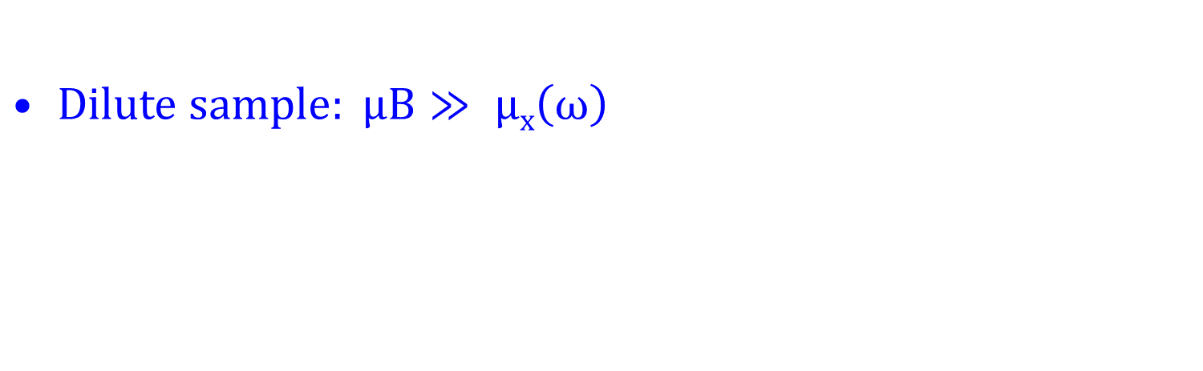
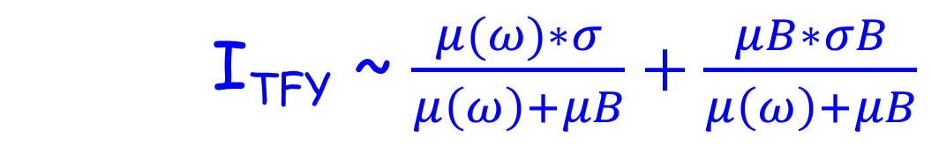
FY detection of dilute sample
I_{TFY} ~ $\frac{μ(ω)∗σ}{μ\left(ω\right)+μB}+\frac{μB∗σB}{μ\left(ω\right)+μB}$
$Dilute sample: μB≫ μx\left(ω\right)$
I_{TFY} ~ $\frac{μ(ω)∗σ}{μB}+\frac{μB∗σB}{μB}$
I_{TFY} ~ $μ\left(ω\right)∗c1+c2$

Slide 63
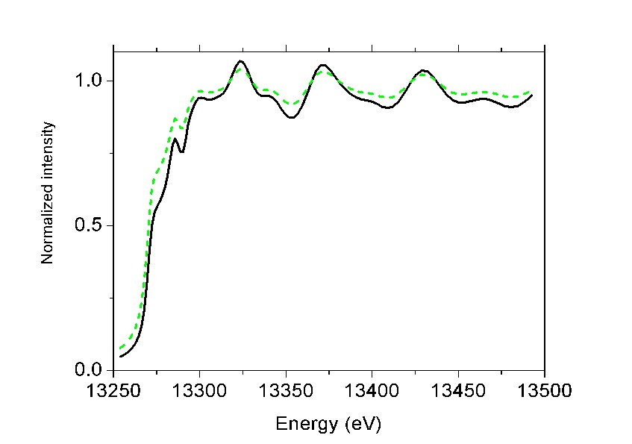
Fluorescence Yield
FY detection of non-dilute sample
“saturation & self-absorption”
De-saturation software
(μ(ω) based on CRXO)

Slide 64
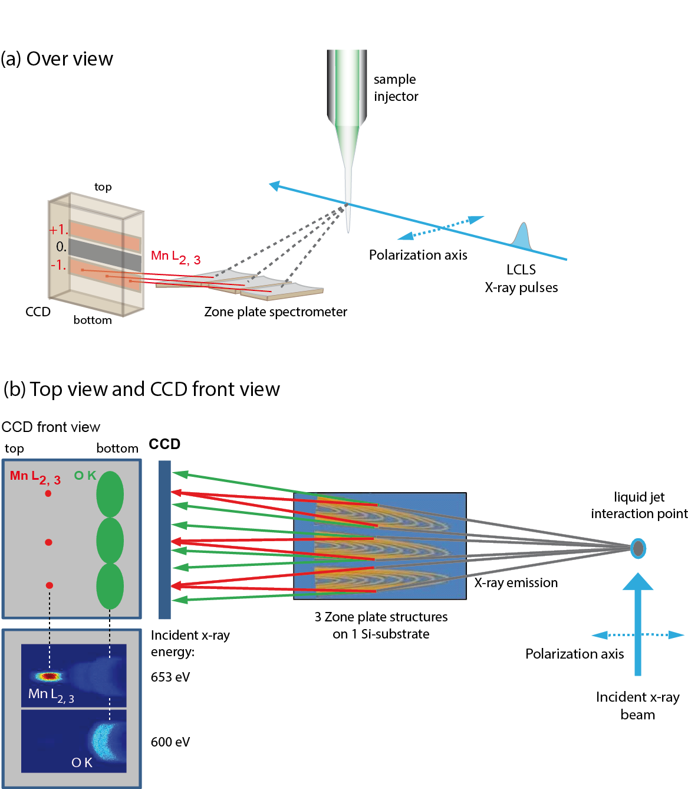
XAS of radiation sensitive sample
Single synchrotron pulselength is too long
Mitzner et al, J. Phys. Chem. Lett. 4, 3641 (2013)
Notes:
64

Slide 65
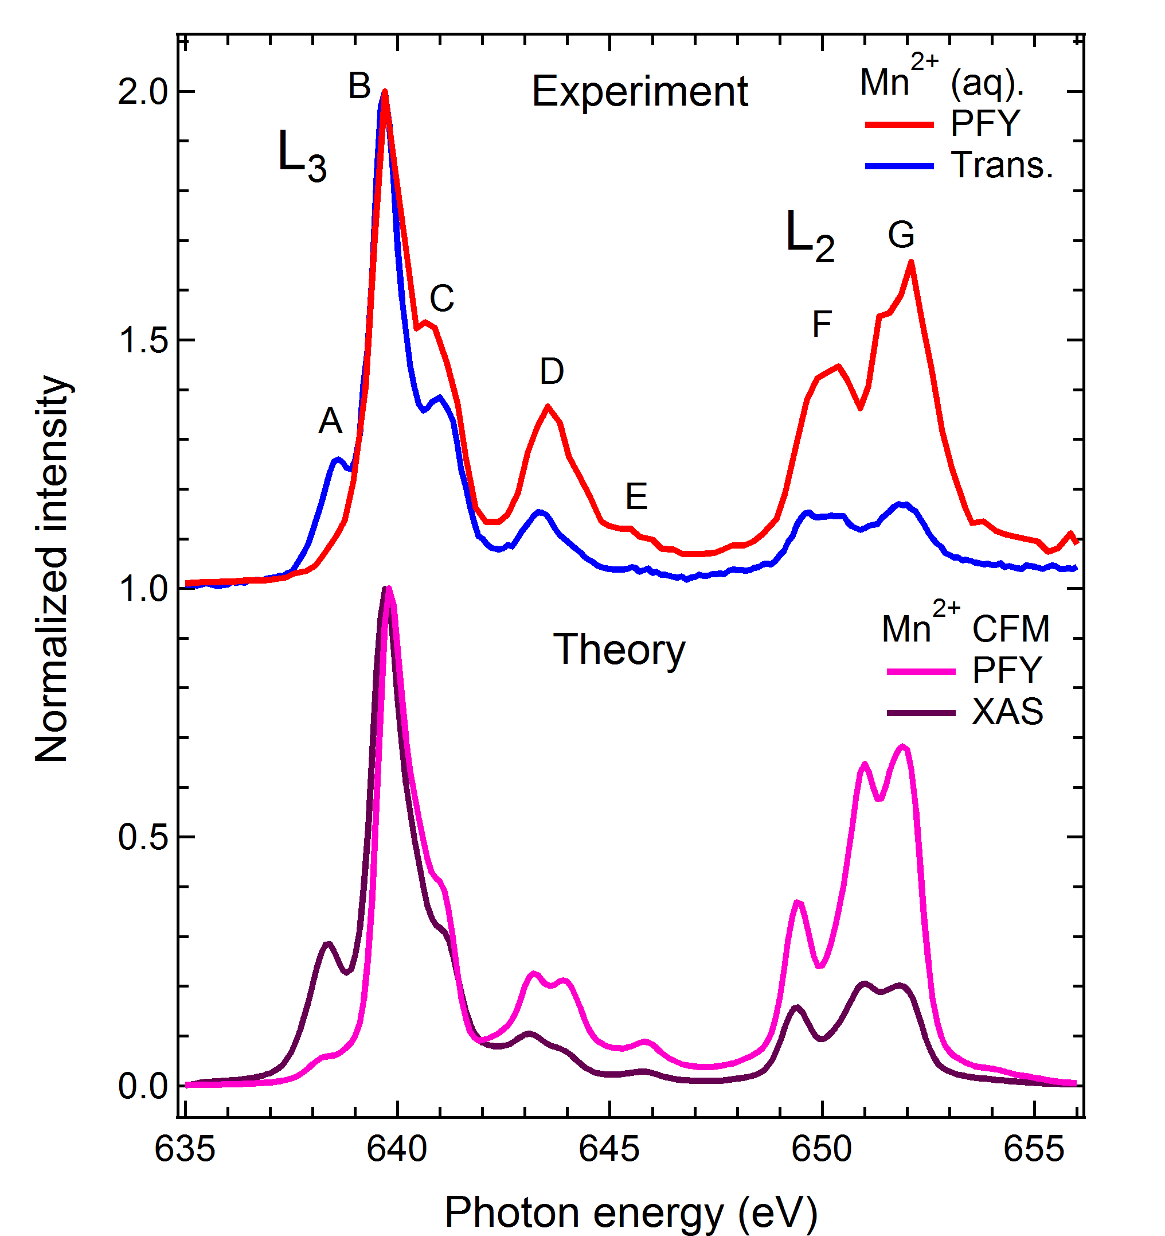
FY-XAS of radiation sensitive sample
Fluorescence does not measure XAS spectrum
Saturation ?
Mitzner et al, J. Phys. Chem. Lett. 4, 3641 (2013)
Notes:
65

Slide 66
FY-XAS of radiation sensitive sample
Fluorescence does not measure XAS spectrum
NO Saturation
State-dependent decay
Mitzner et al, J. Phys. Chem. Lett. 4, 3641 (2013)
Notes:
66

Slide 67
FY detection: State dependent decay
Yield methods assume a constant ratio between radiative and non-radiative decay
If this ratio is state (= energy) dependent then the related yield methods do not measure XAS.
The dominant yield method is not visibly affected, thus for soft X-rays only FY is affected, not electron yield.

Slide 68
FY detection: State dependent decay
L₃
FY
L₂
EY
Solid State Comm. 92, 991 (1994)

Slide 69
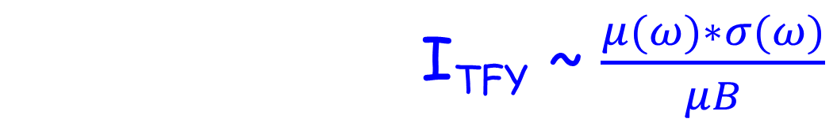
FY detection (state-dependent, dilute)
I_{TFY} ~ $\frac{μ(ω)∗σ}{μ\left(ω\right)+μB}+\frac{μB∗σB}{μ\left(ω\right)+μB}$
I_{TFY} ~ $\frac{μ(ω)∗σ(ω)}{μB}$
Main decay of 2p core hole is 2p3d RIXS
Integrate RIXS spectrum to 2p3d PFY
TFY ~ 2p3d PFY
NOTE: “RIXS” has angular dependence effects

Slide 70
XAS: transmission & FY
Mitzner et al, J. Phys. Chem. Lett. 4, 3641 (2013)
Notes:
70

Slide 71
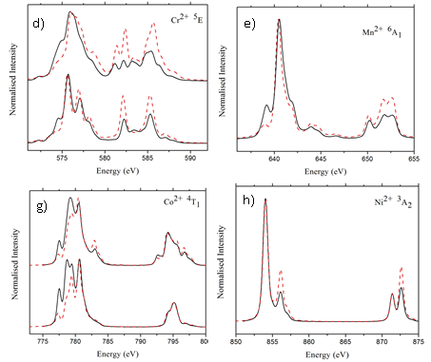
Fluorescence Yield detection
FY-XAS ≠ XAS L₂ edge increases High-energies increase
Kurian J. Phys. Cond. Matt. 24, 435602 (2012)

Slide 72
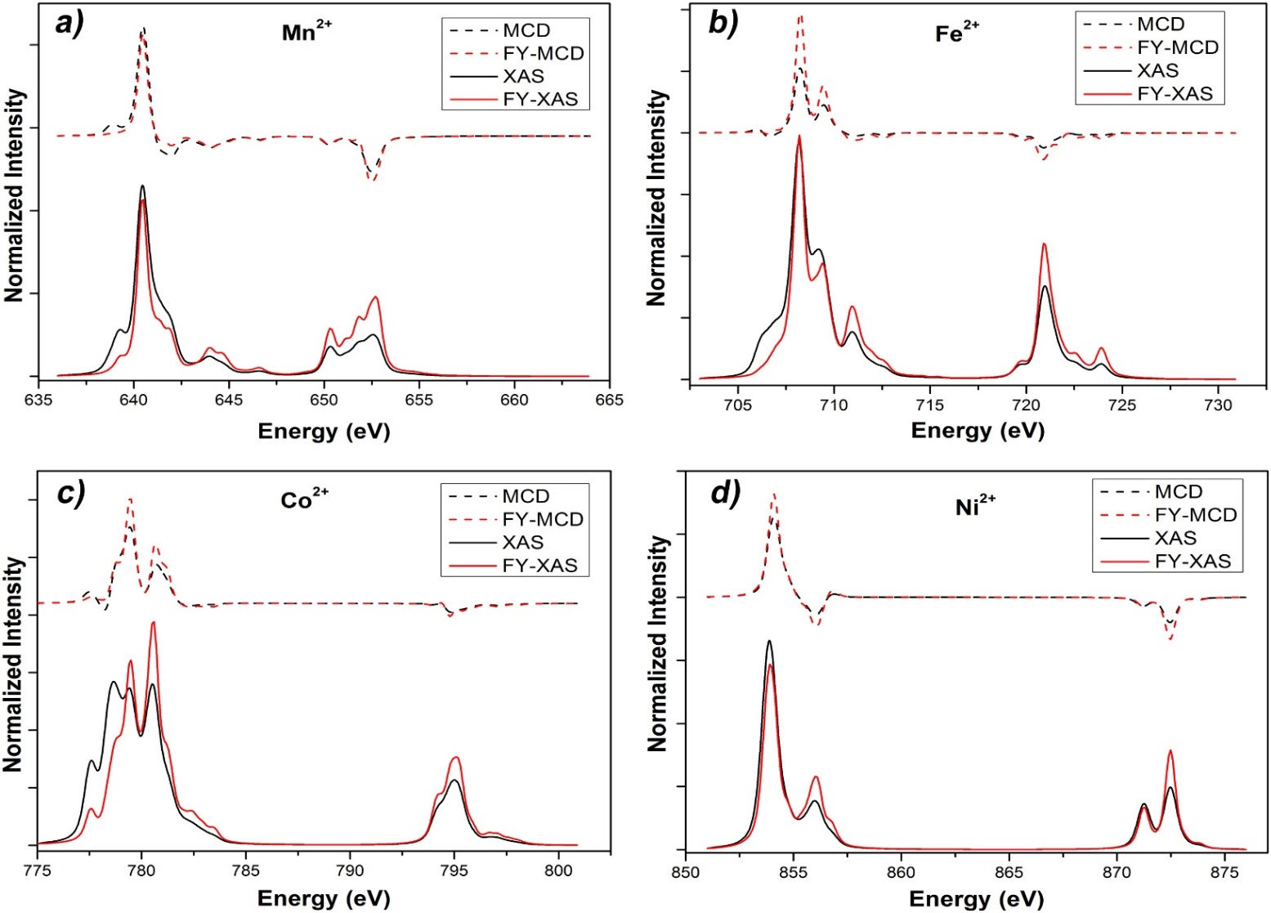
Fluorescence Yield XMCD
XMCD sum rules break down
Ni/Co 20%, Fe 30%, Mn > 100% error
Liu ea, Phys. Rev. B. 96, 054446 (2017)

Slide 73
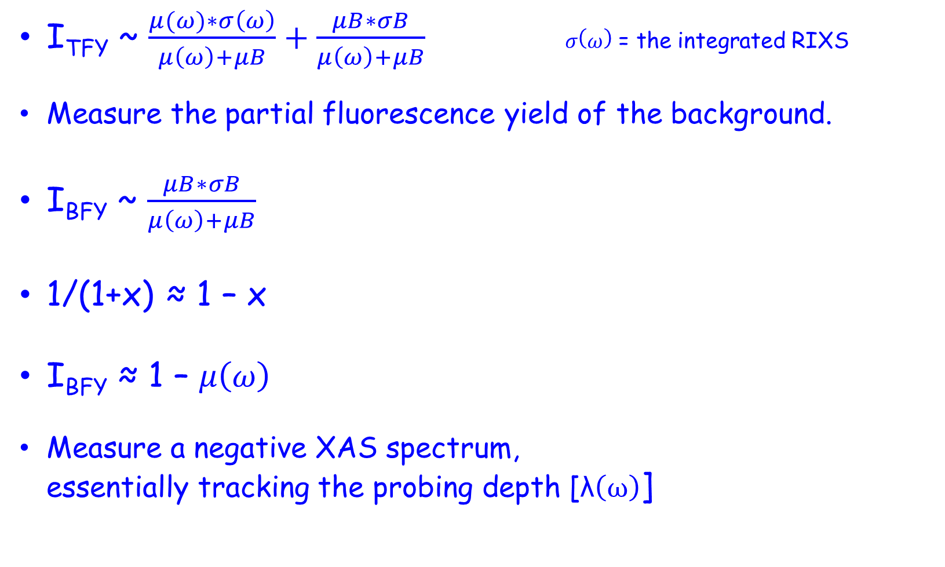
FY detection: 3 inverse PFY
I_{TFY} ~ $\frac{μ(ω)∗σ\left(ω\right)}{μ\left(ω\right)+μB}+\frac{μB∗σB}{μ\left(ω\right)+μB} σ\left(ω\right)$ = the integrated RIXS
Measure the partial fluorescence yield of the background.
I_{BFY} ~ $\frac{μB∗σB}{μ\left(ω\right)+μB}$
1/(1+x) ≈ 1 – x
I_{BFY} ≈ 1 – $μ\left(ω\right)$
Measure a negative XAS spectrum,
essentially tracking the probing depth [λ$\left(ω\right)$]

Slide 74
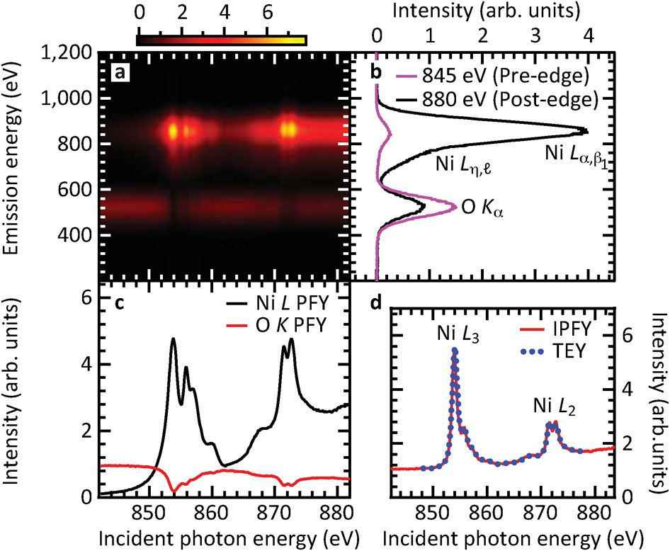
FY detection: 3 inverse PFY
Achkar ea, scientific reports 1, 82 (2011)

Slide 75
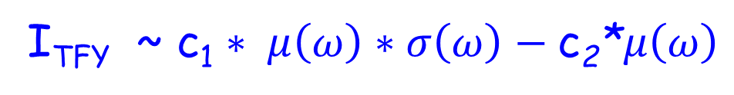
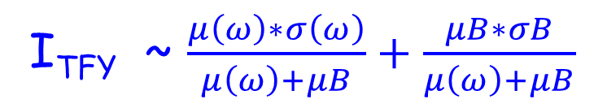
FY detection: 4 dips and peaks
Measure the total fluorescence yield
State-dependent decay modified metal PFY
+ Negative IPFY
I_{TFY} ~ $\frac{μ\left(ω\right)∗σ\left(ω\right)}{μ\left(ω\right)+μB}+\frac{μB∗σB}{μ\left(ω\right)+μB}$
I_{TFY} ~ c₁ $∗ μ\left(ω\right)∗σ\left(ω\right)−\text{c}\text{2}\text{∗}μ\left(ω\right)$

Slide 76
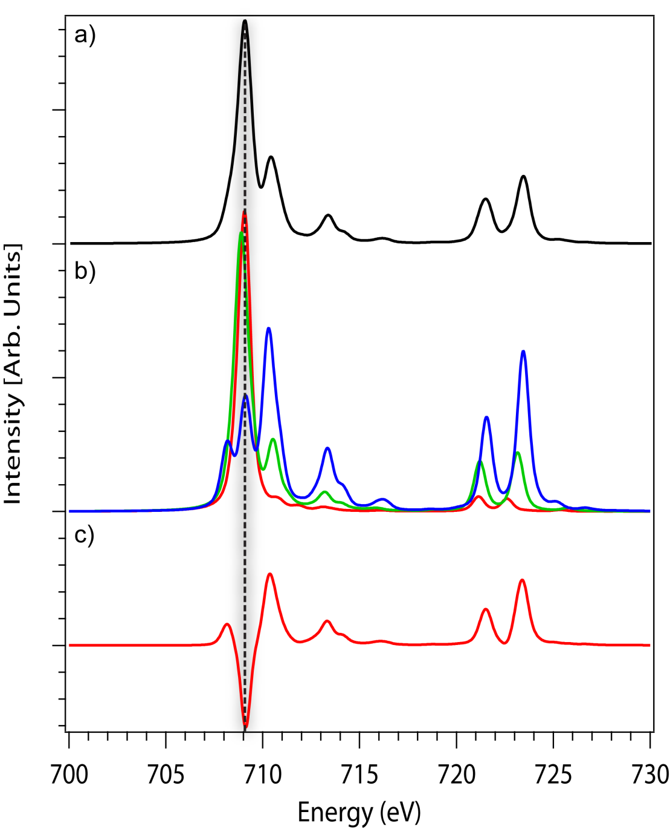
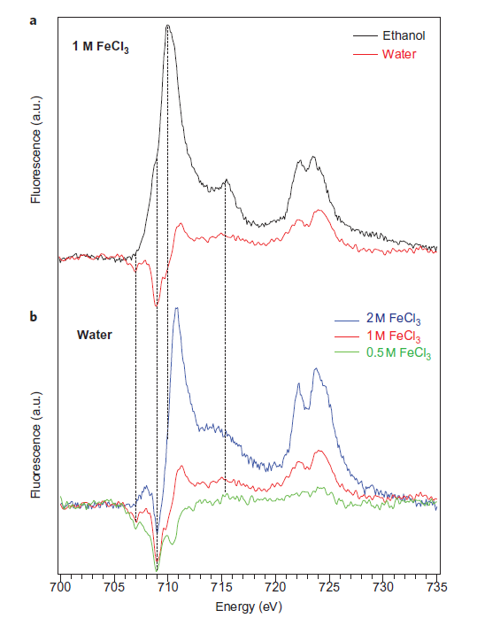
FY detection: 4 dips and peaks
Nature Chem. 4, 766 (2012) & Phys. Rev. Letter discussions (2014)

