Slide 1
Spin-orbit coupling
Maurits W. Haverkort
Institute for theoretical physics, Heidelberg University

Slide 2
Spin – relativistic quantum-mechanical effect
We need to solve the Dirac equation in a solid
…
It turns out that energies in solids are small compared to the rest-mass energy of an electron (0.5 MeV) and we thus can use perturbation theory.
We need to derive the low energy effective Hamiltonians.
I have some formulas but I’ll try to keep it to a minimum. (and discuss the physical implications of the formula’s).
Let's start with some history

Slide 3
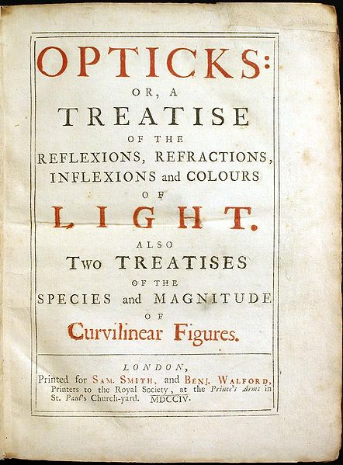
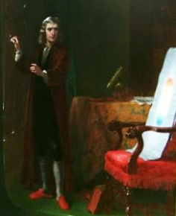
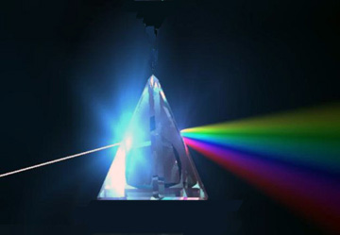
The dawn of quantum mechanics

Slide 4
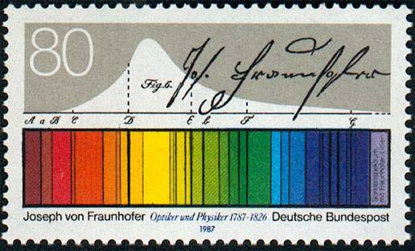
The dawn of quantum mechanics
Observation of discrete line spectra

Slide 5
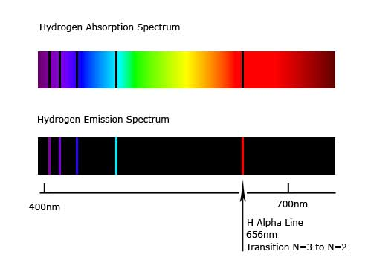
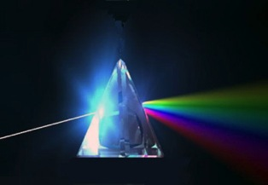
The dawn of quantum mechanics
http://en.wikipedia.org/wiki/Hydrogen_spectral_series

Slide 6
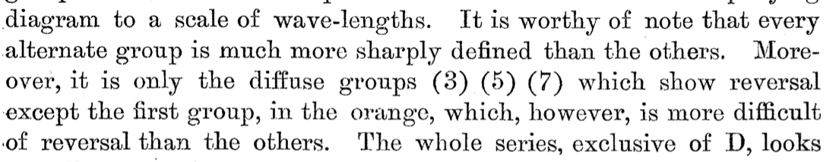
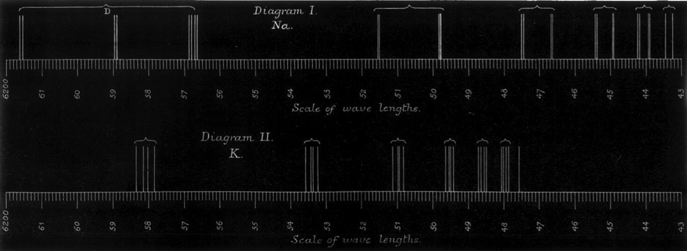
Systematic study, sharp and diffuse lines of alkali metals
G. D. Living and J. Dewar, (1879)
Proceedings of the Royal society of London

Slide 7
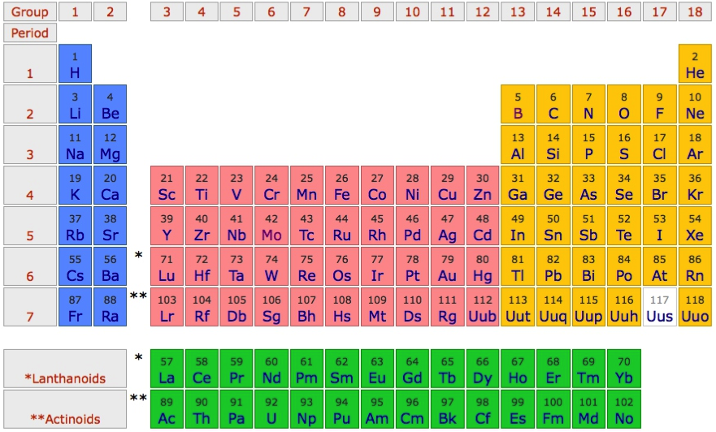
sharp and diffuse lines
Excitation by temperature
Decay p to s – sharp lines
Decay p to d – diffuse lines
Later found
series from ground-state (s orbital) directly to p-orbital – principle lines

Slide 8
sharp and diffuse lines
Excitation by temperature
Decay p to s – sharp lines
Decay p to d – diffuse lines
Even later found
Excitations into the f shell – ?? fundamental lines ??

Slide 9
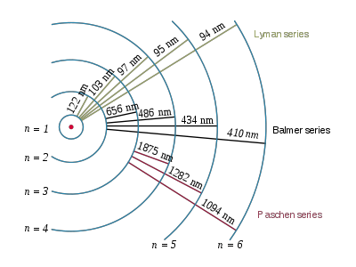
The dawn of quantum mechanics
Bohr model
1906-1914
1885
1908
http://en.wikipedia.org/wiki/Hydrogen_spectral_series

Slide 10
The dawn of quantum mechanics
Bohr model
1888
http://en.wikipedia.org/wiki/Hydrogen_spectral_series

Slide 11
The dawn of quantum mechanics
1926

Slide 12
The Schrödinger equation
Kinetic energy
Potential energy
Coulomb energy

Slide 13
The Schrödinger equation
Kinetic energy
Potential energy
Coulomb energy
Problems:
The equation does not describe spin – ad-hoc added (Pauli)
The equation is not Lorenz invariant, different observers in different reference frames will come to different conclusions based on this equation.

Slide 14
The Dirac equation
Classical

Slide 15
The Dirac equation
Classical
Klein-Gordon equation
To many solutions and some are non-physical:
Relativistic
Klein-Gordon equation

Slide 16
The Dirac equation
Find a linear equation
Requirement on α and β
Not possible for (complex numbers) but possible for matrices

Slide 17
The Dirac equation
Find a linear equation
If α and β are 2 by 2 matrices then ψ needs to be a vector of length 2. Could represent spin down and spin up states!

Slide 18
The Dirac equation
Find a linear equation
Requirement on α and β
Not possible for 2 by 2 matrices.
Need 4 by 4 matrices

Slide 19
The Dirac equation
Take α and β to be matrices and ψ a vector (of length 4)

Slide 20
The Dirac equation – solution of freely static electron
Dirac predicted 4 related particles.
Electron with spin up
Electron with spin down
Positron with spin up
Positron with spin down

Slide 21
The Dirac equation – solution of freely moving electron p//S
Large component
Small component

Slide 22
The Dirac equation – solution of freely moving electron p | S

Slide 23
The Dirac equation mixing between spin – some numbers

Slide 24
The Dirac equation mixing between spin – some numbers

Slide 25
The Dirac equation mixing between spin – some numbers

Slide 26
The Dirac equation mixing between spin – some numbers
0.1 pro mile mixing between large and small component for electrons with a kinetic energy of 100 eV
What are the relevant kinetic energies in a solid?

Slide 27
Velocity of valence electrons in solids ?
Energy momentum relation of a free electron
Maximal velocity is given by the Fermi momentum

Slide 28
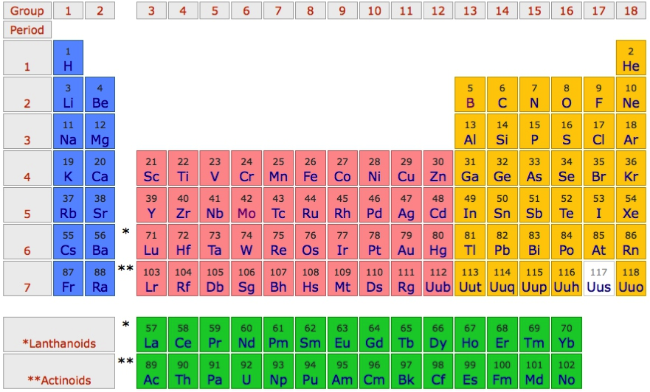
Velocity of valence electrons in solids ?
Compare velocity of valence electrons in Alkali metals

Slide 29
Free electron like description

Slide 30
Free electron like description

Slide 31
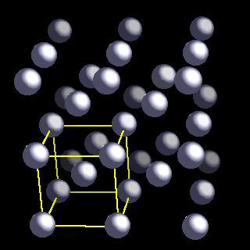
Brillion zone of Li

Slide 32
Brillion zone of Li

Slide 33
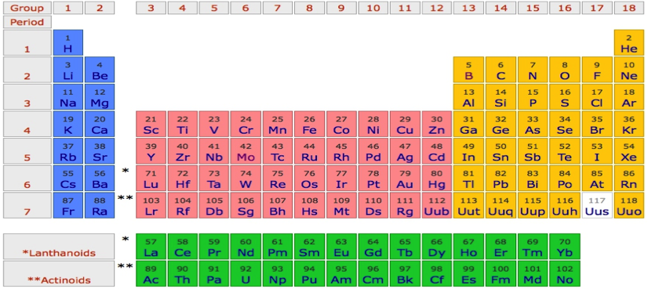
Li
P
Γ
P
H
P
Γ
P
H
P
Γ
P

Slide 34
Na
P
Γ
P
H
P
Γ
P
H
P
Γ
P

Slide 35
K
P
Γ
P
H
P
Γ
P
H
P
Γ
P

Slide 36
Rb
P
Γ
P
H
P
Γ
P
H
P
Γ
P

Slide 37
Cs
P
Γ
P
H
P
Γ
P
H
P
Γ
P

Slide 38
Fr
P
Γ
P
H
P
Γ
P
H
P
Γ
P

Slide 39
Velocity of valence electrons in solids ?
Element | r [A]
Li | 3.493
Na | 4.235
K | 5.247
Rb | 5.585
Cs | 6.067
Fr | 6.550

Slide 40
Velocity of valence electrons in solids ?
Element | r [A] | E_{f} [eV]
Li | 3.493 | 3.459
Na | 4.235 | 3.258
K | 5.247 | 2.205
Rb | 5.585 | 2.058
Cs | 6.067 | 1.725
Fr | 6.550 | 1.602

Slide 41
Velocity of valence electrons in solids ?
Element | r [A] | E_{f} [eV] | V_{f} [c]
Li | 3.493 | 3.459 | 0.00367
Na | 4.235 | 3.258 | 0.00357
K | 5.247 | 2.205 | 0.00293
Rb | 5.585 | 2.058 | 0.00283
Cs | 6.067 | 1.725 | 0.00259
Fr | 6.550 | 1.602 | 0.00250

Slide 42
Velocity of valence electrons in solids ?
Element | r [A] | E_{f} [eV] | V_{f} [c] | Small component
Li | 3.493 | 3.459 | 0.00367 | 0.00183
Na | 4.235 | 3.258 | 0.00357 | 0.00178
K | 5.247 | 2.205 | 0.00293 | 0.00146
Rb | 5.585 | 2.058 | 0.00283 | 0.00141
Cs | 6.067 | 1.725 | 0.00259 | 0.00129
Fr | 6.550 | 1.602 | 0.00250 | 0.00125

Slide 43
Velocity of valence electrons in solids ?
Element | r [A] | E_{f} [eV] | V_{f} [c] | Small component | Relativistic energy [μeV]
Li | 3.493 | 3.459 | 0.00367 | 0.00183 | 35
Na | 4.235 | 3.258 | 0.00357 | 0.00178 | 31
K | 5.247 | 2.205 | 0.00293 | 0.00146 | 14
Rb | 5.585 | 2.058 | 0.00283 | 0.00141 | 12
Cs | 6.067 | 1.725 | 0.00259 | 0.00129 | 8
Fr | 6.550 | 1.602 | 0.00250 | 0.00125 | 7
Something is missing

Slide 44
Something is missing
Crystal: lattice of positively charged nuclei
Potential due to the nuclei varies wildly in the crystal
“Velocity” kinetic energy not constant, but large close to the nucleus.

Slide 45
Something is missing

Slide 46
Something is missing
Close to the nucleus the small component becomes large and relativistic effects can play a role
Need to solve full Dirac equation of the entire solid?

Slide 47
Where do we stand
Spin-orbit coupling is a relativistic effect
Electrons in solids only have large velocities close to the nucleus.
(close means ~1 a₀ or 0.5 Angstrom)
Close to the nucleus potentials are rather spherical and we can approximate the wave-functions in that range by radial functions times angular functions. (Not valid in the intermediate range, where bonding happens)
A reasonable approximation to understand relativistic effects and spin-orbit coupling is to start from atomic (like) functions and treat these relativistic, then build the solid by using tight binding theory.
Example on Li, Na, K, Rb, Cs, Fr

Slide 48
Li - Tigth binding description – “atomic” orbitals
φ_{2s}(r)
Li-atom
neighbor
Li-atom
neighbor
Li-atom

Slide 49
Li - Tigth binding description – “atomic” orbitals

Slide 50
Li - Tigth binding description – “atomic” orbitals
Non-orthogonal
Basis, but that is ok.

Slide 51
Li - Tigth binding description – “atomic” orbitals
Tight binding description of free electron like state

Slide 52
Li - Tigth binding description – “atomic” orbitals

Slide 53
Li - Tigth binding description – “atomic” orbitals

Slide 54
Li - Tigth binding description – “atomic” orbitals

Slide 55
Li - Tigth binding description – “atomic” orbitals

Slide 56
Li - Tigth binding description – “atomic” orbitals

Slide 57
Li - Tigth binding description – “atomic” orbitals

Slide 58
Li - Tigth binding description – “atomic” orbitals

Slide 59
Li - Tigth binding description – “atomic” orbitals

Slide 60
Li - Tigth binding description – “atomic” orbitals
p_{x}
s

Slide 61
Li - Tigth binding description – “atomic” orbitals
p_{z}
s
p_{x}
p_{y}

Slide 62
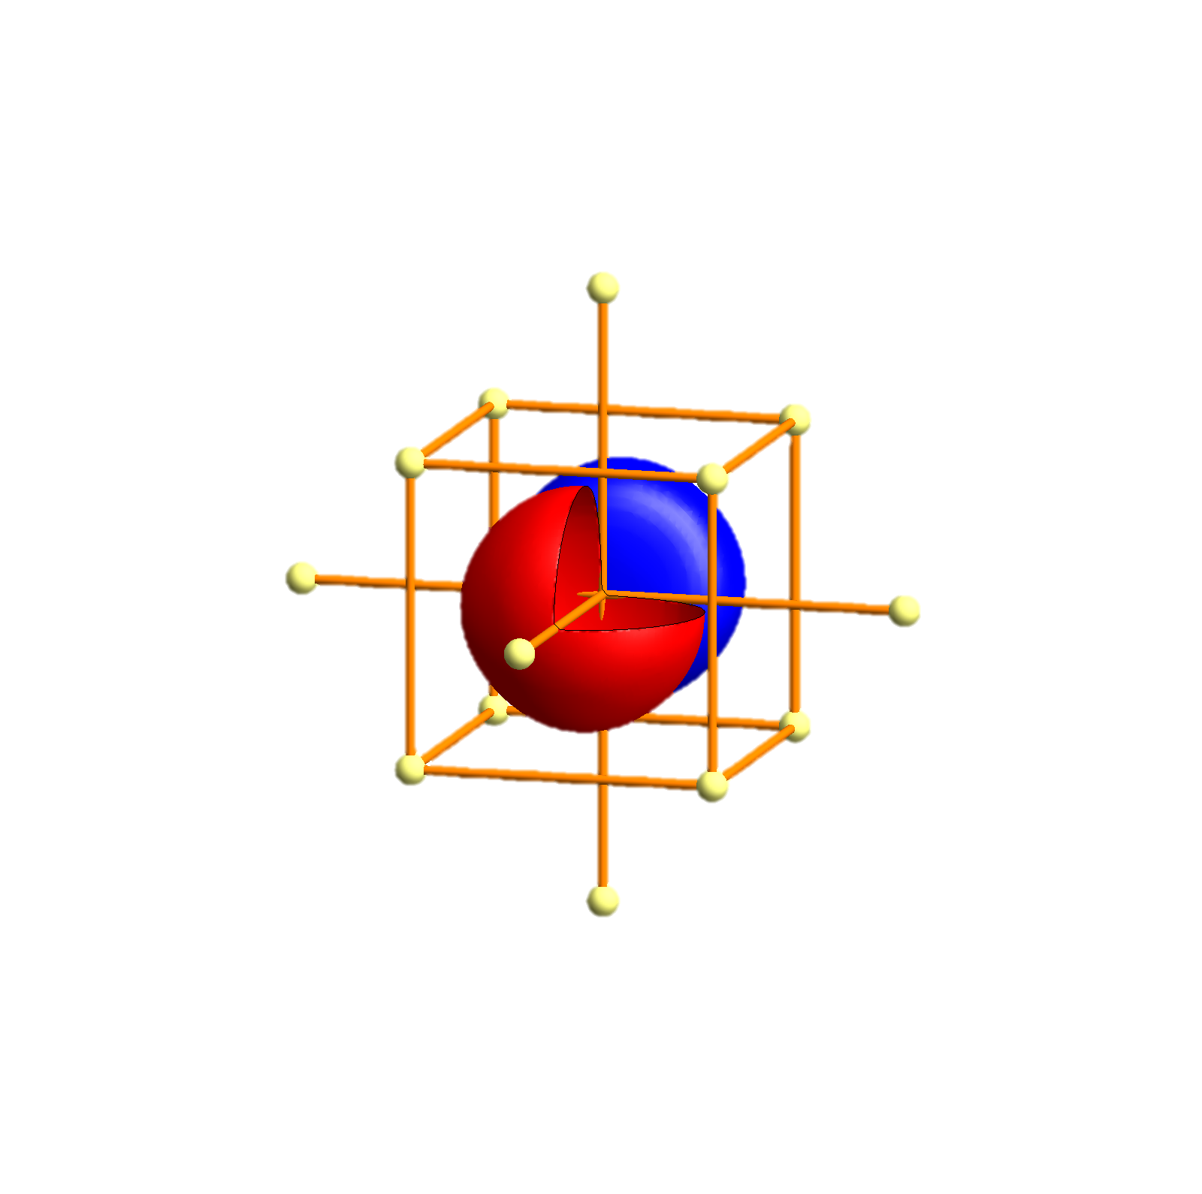
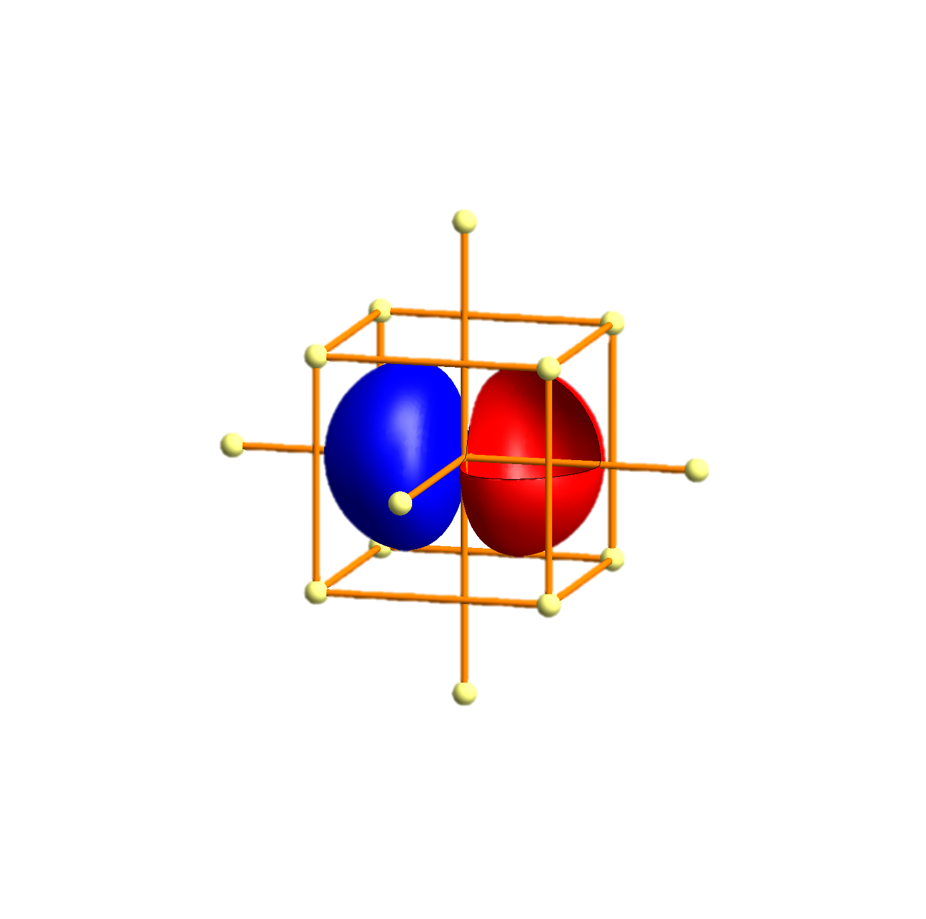
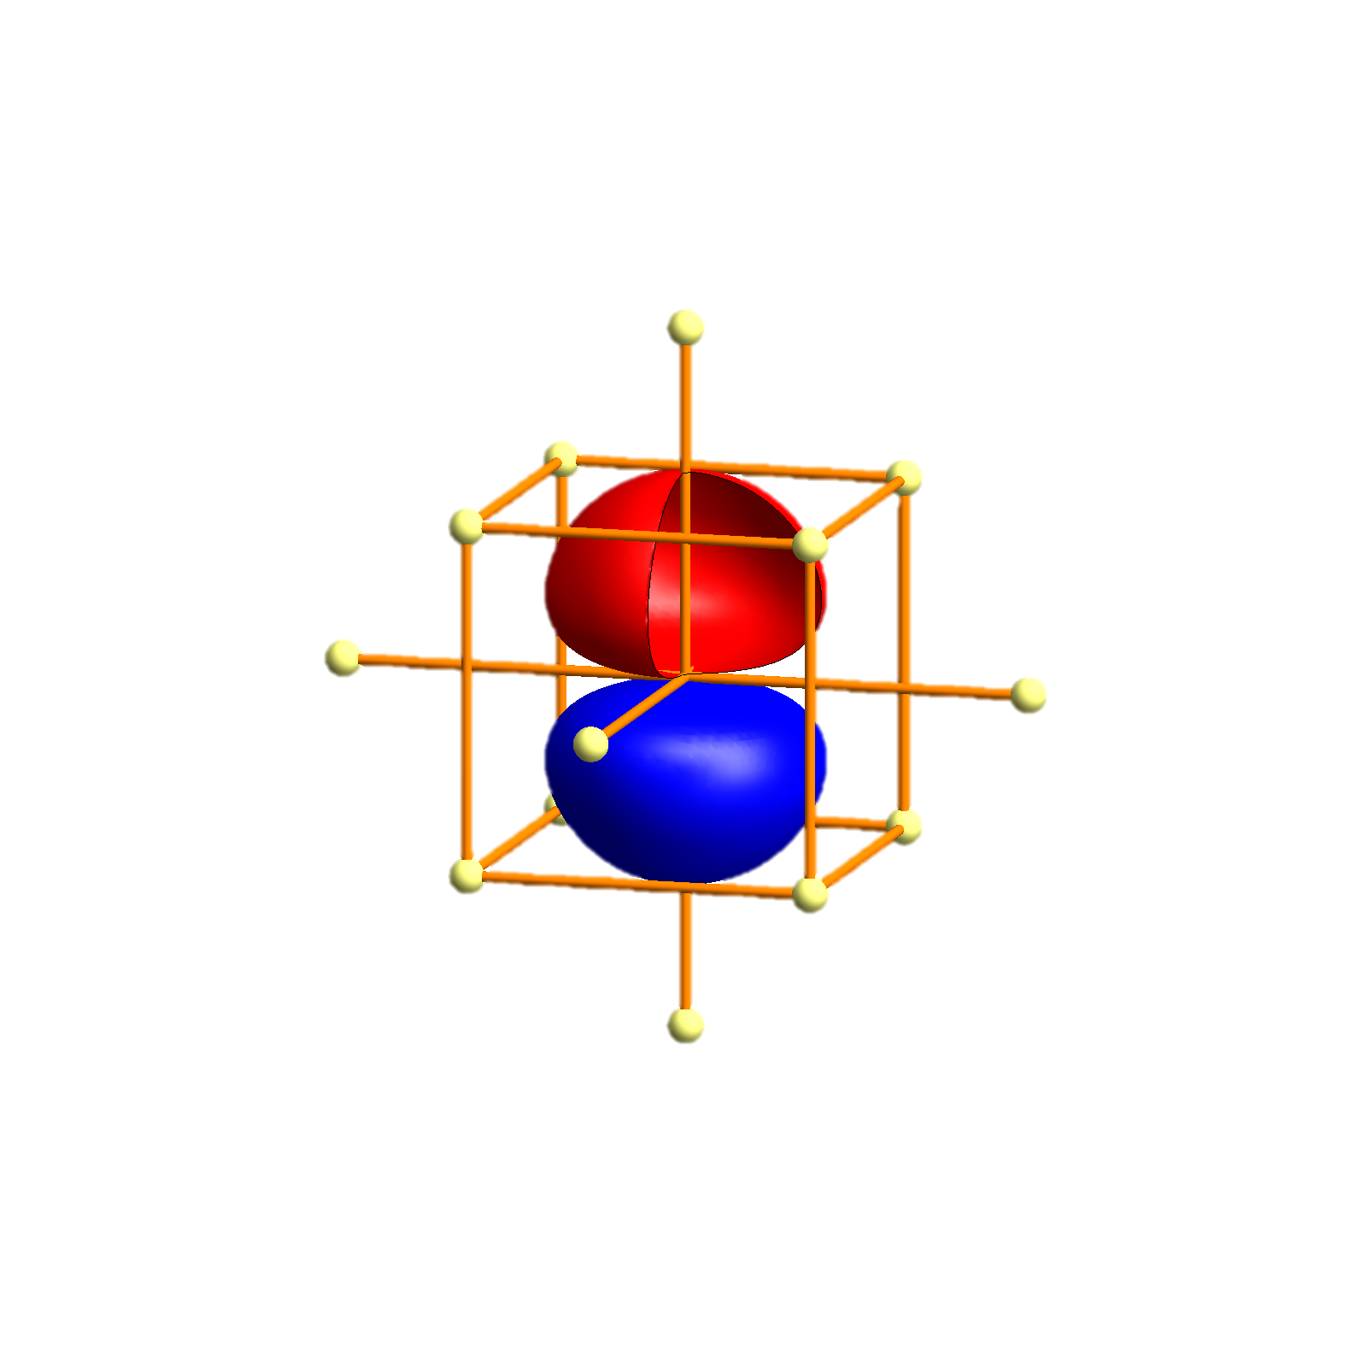
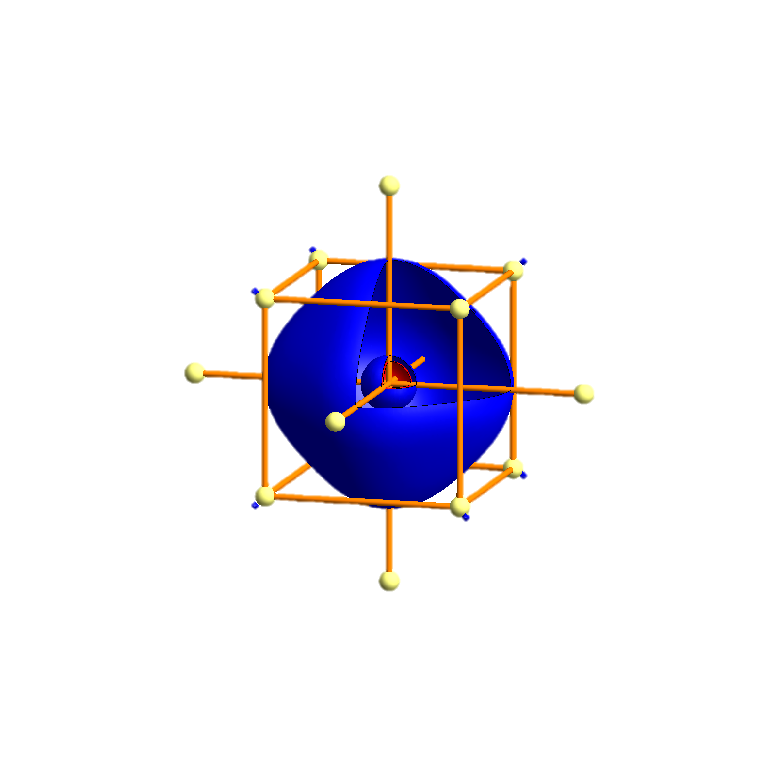
Li - Tigth binding description – atomic orbitals
p_{x}
p_{x}
p_{y}
p_{z}
s
s
P
Γ
P
H
P
Γ
P
H
P
Γ
P

Slide 63
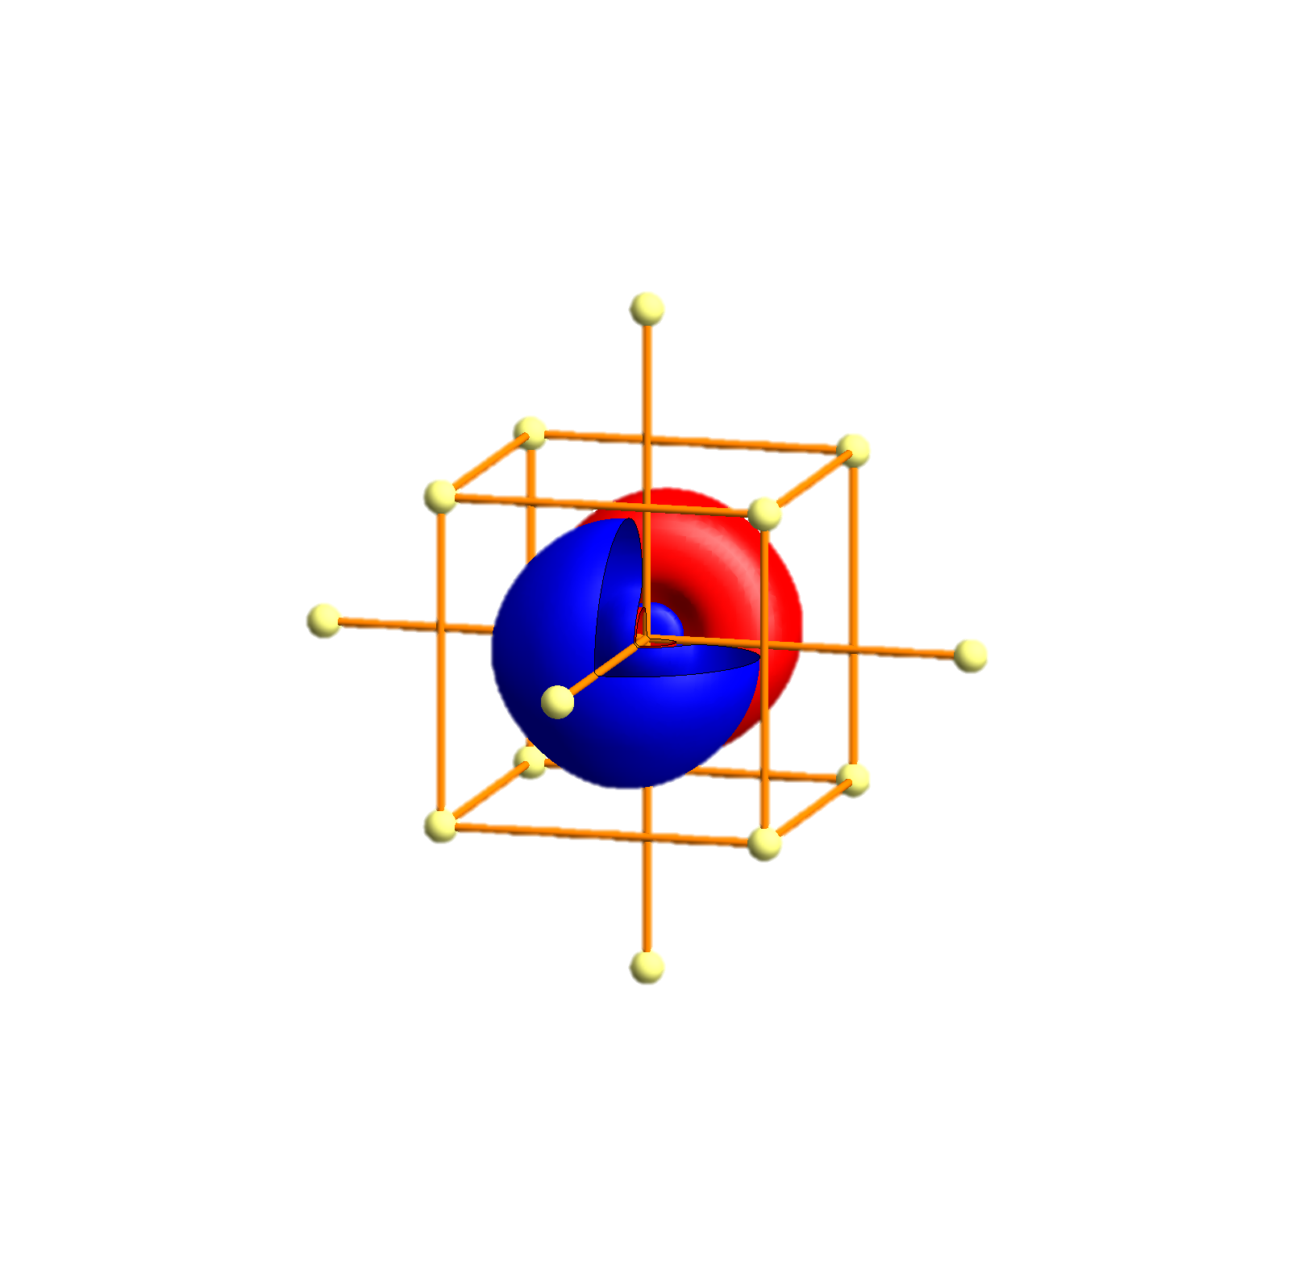
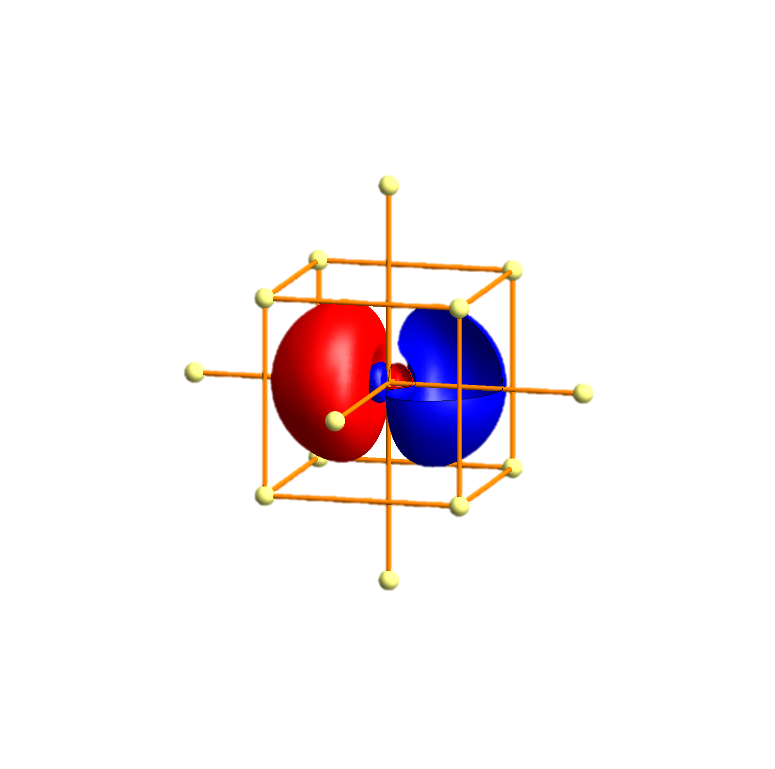
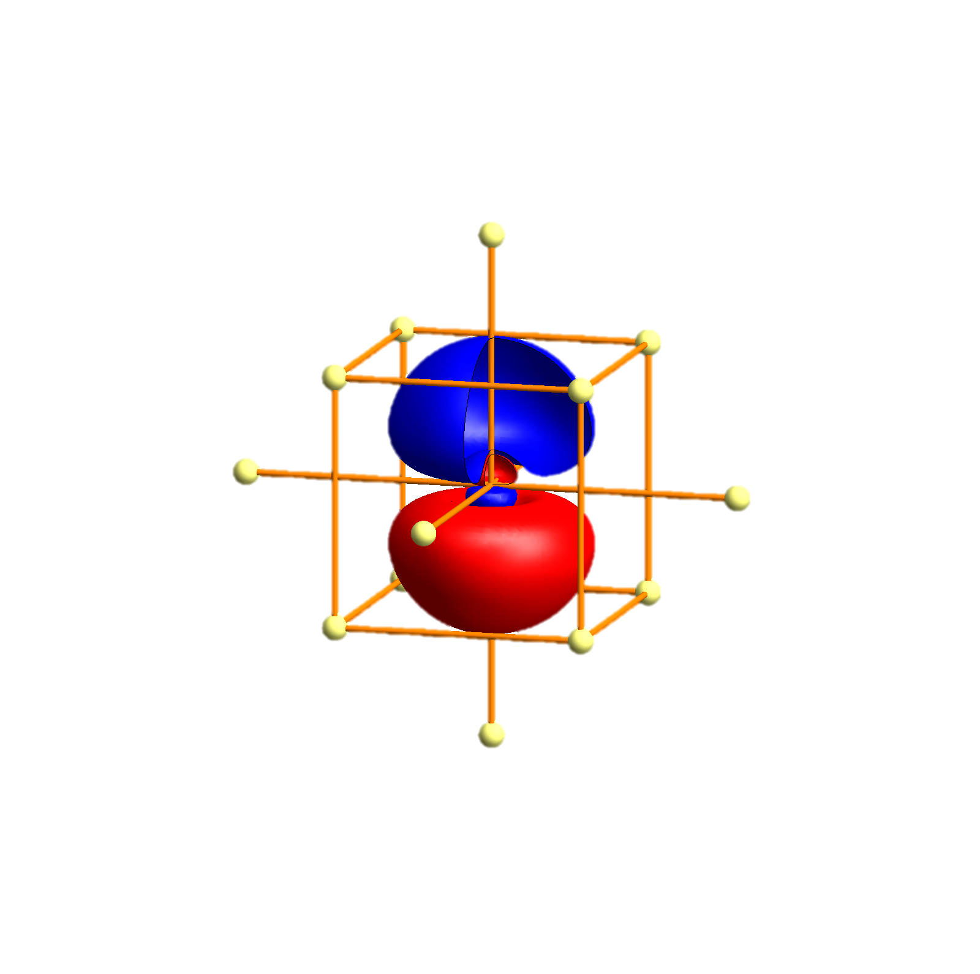
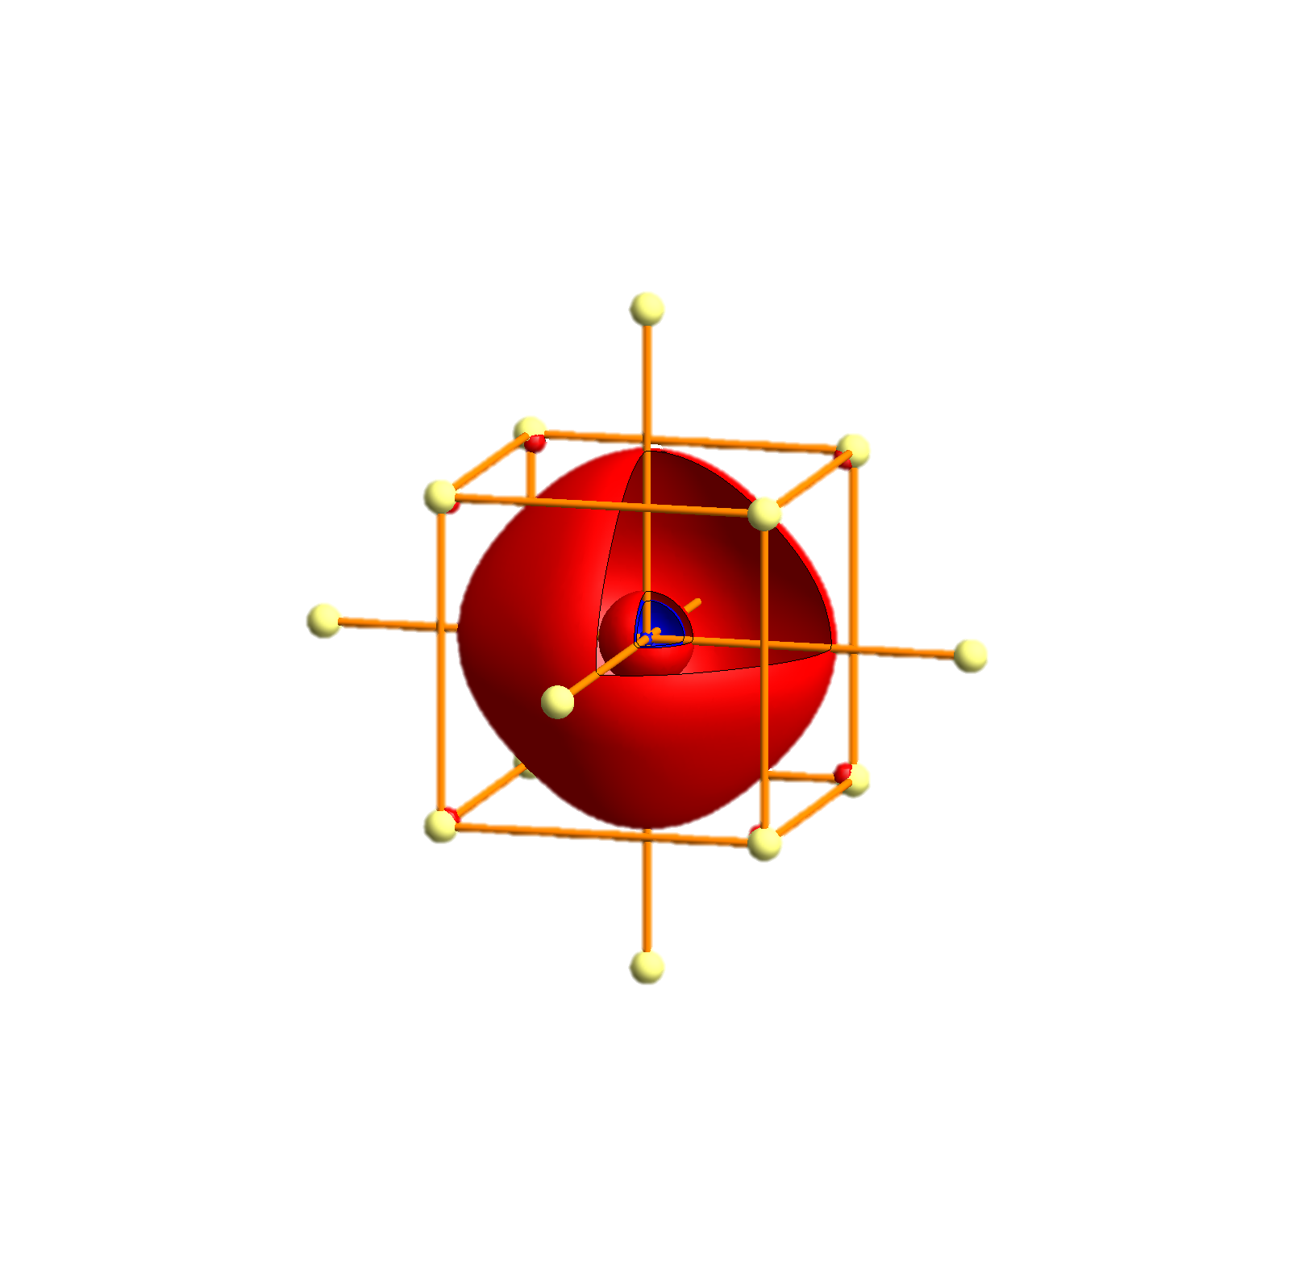
Na - Tigth binding description – atomic orbitals
p_{x}
p_{y}
p_{z}
s

Slide 64
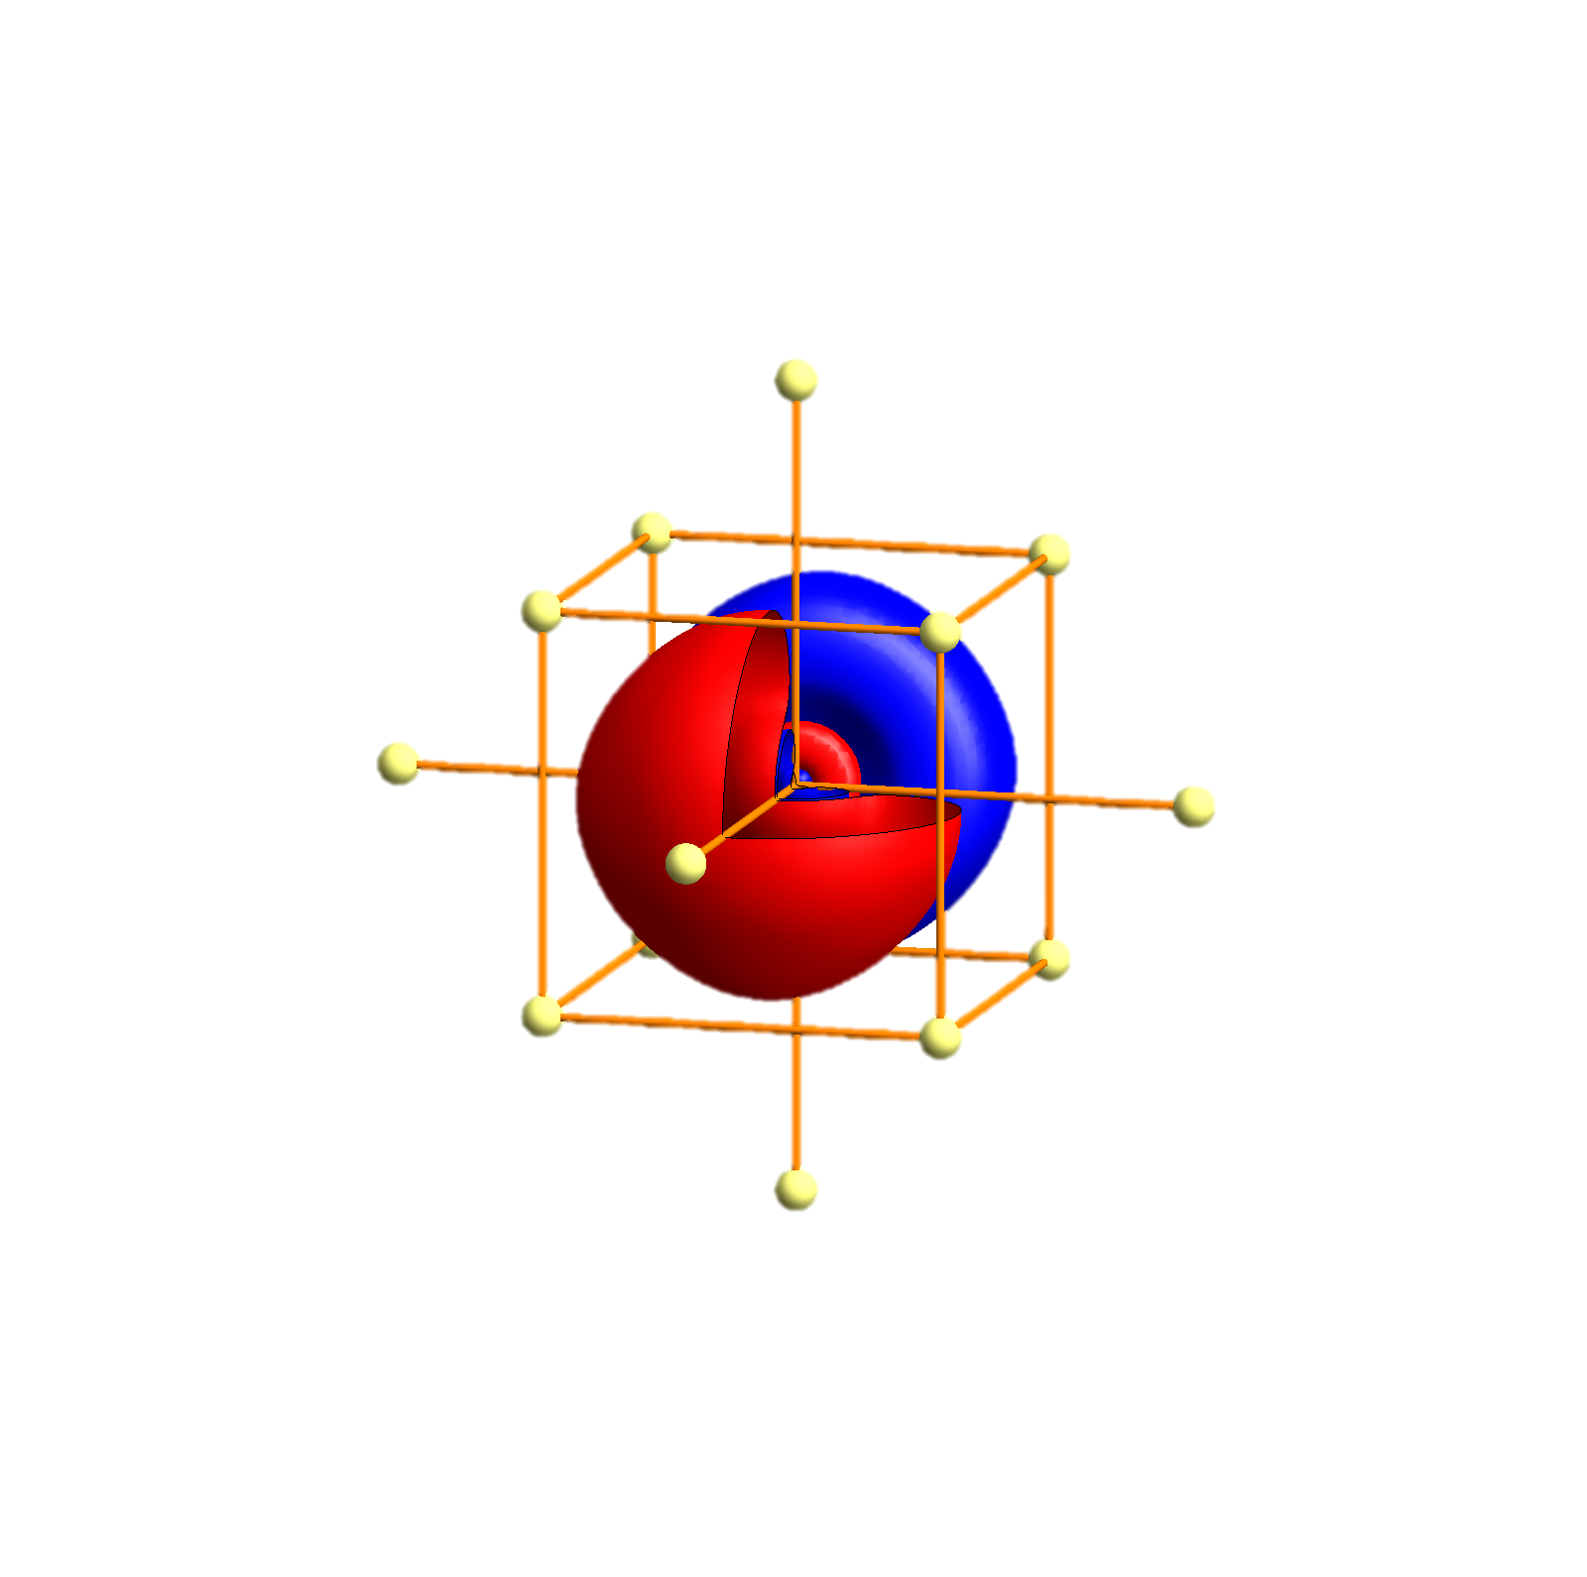
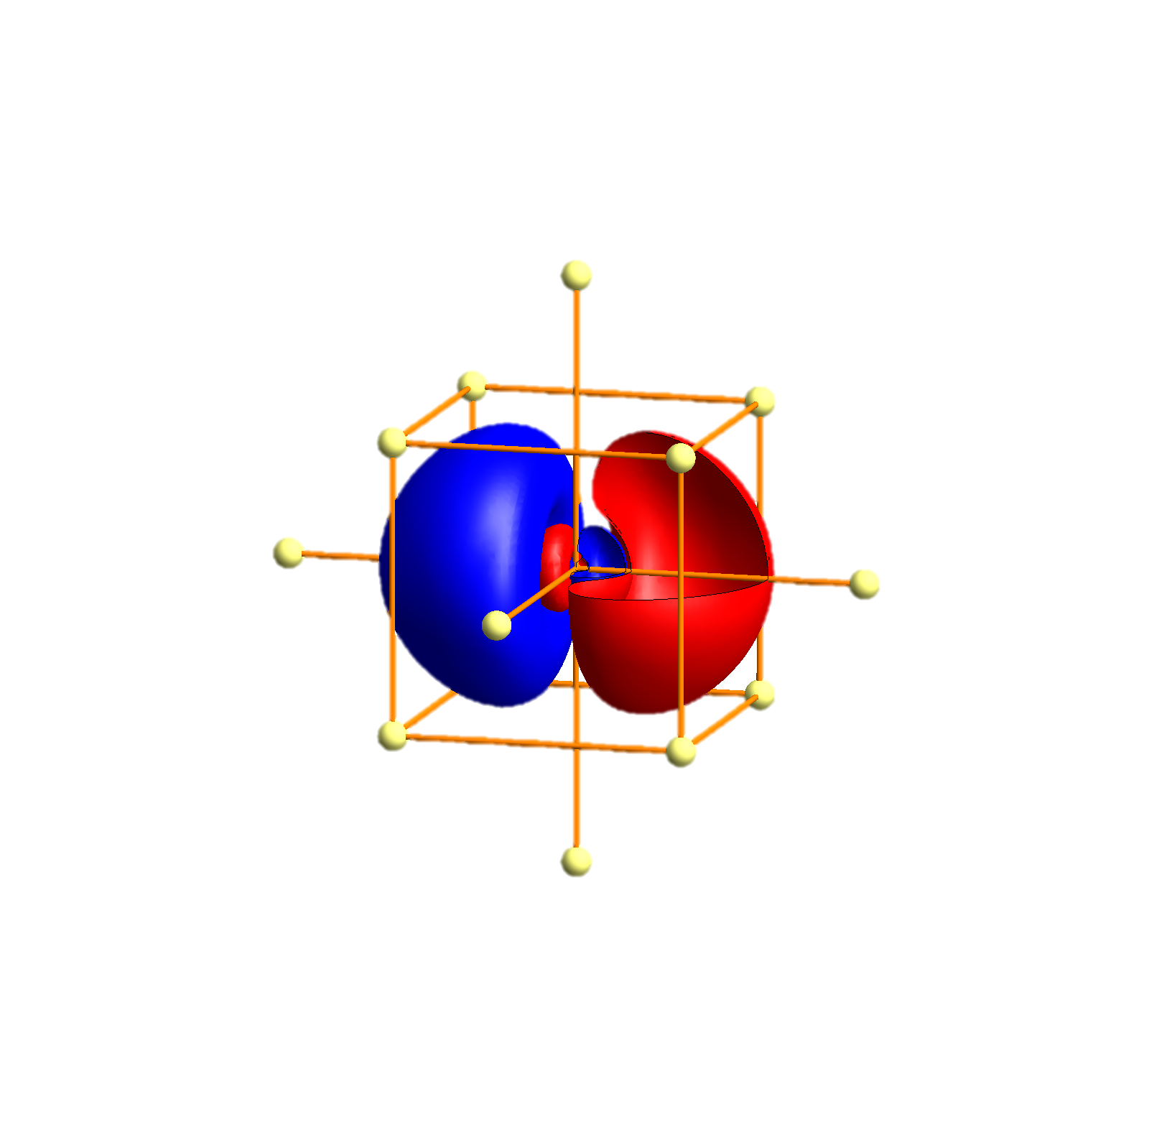
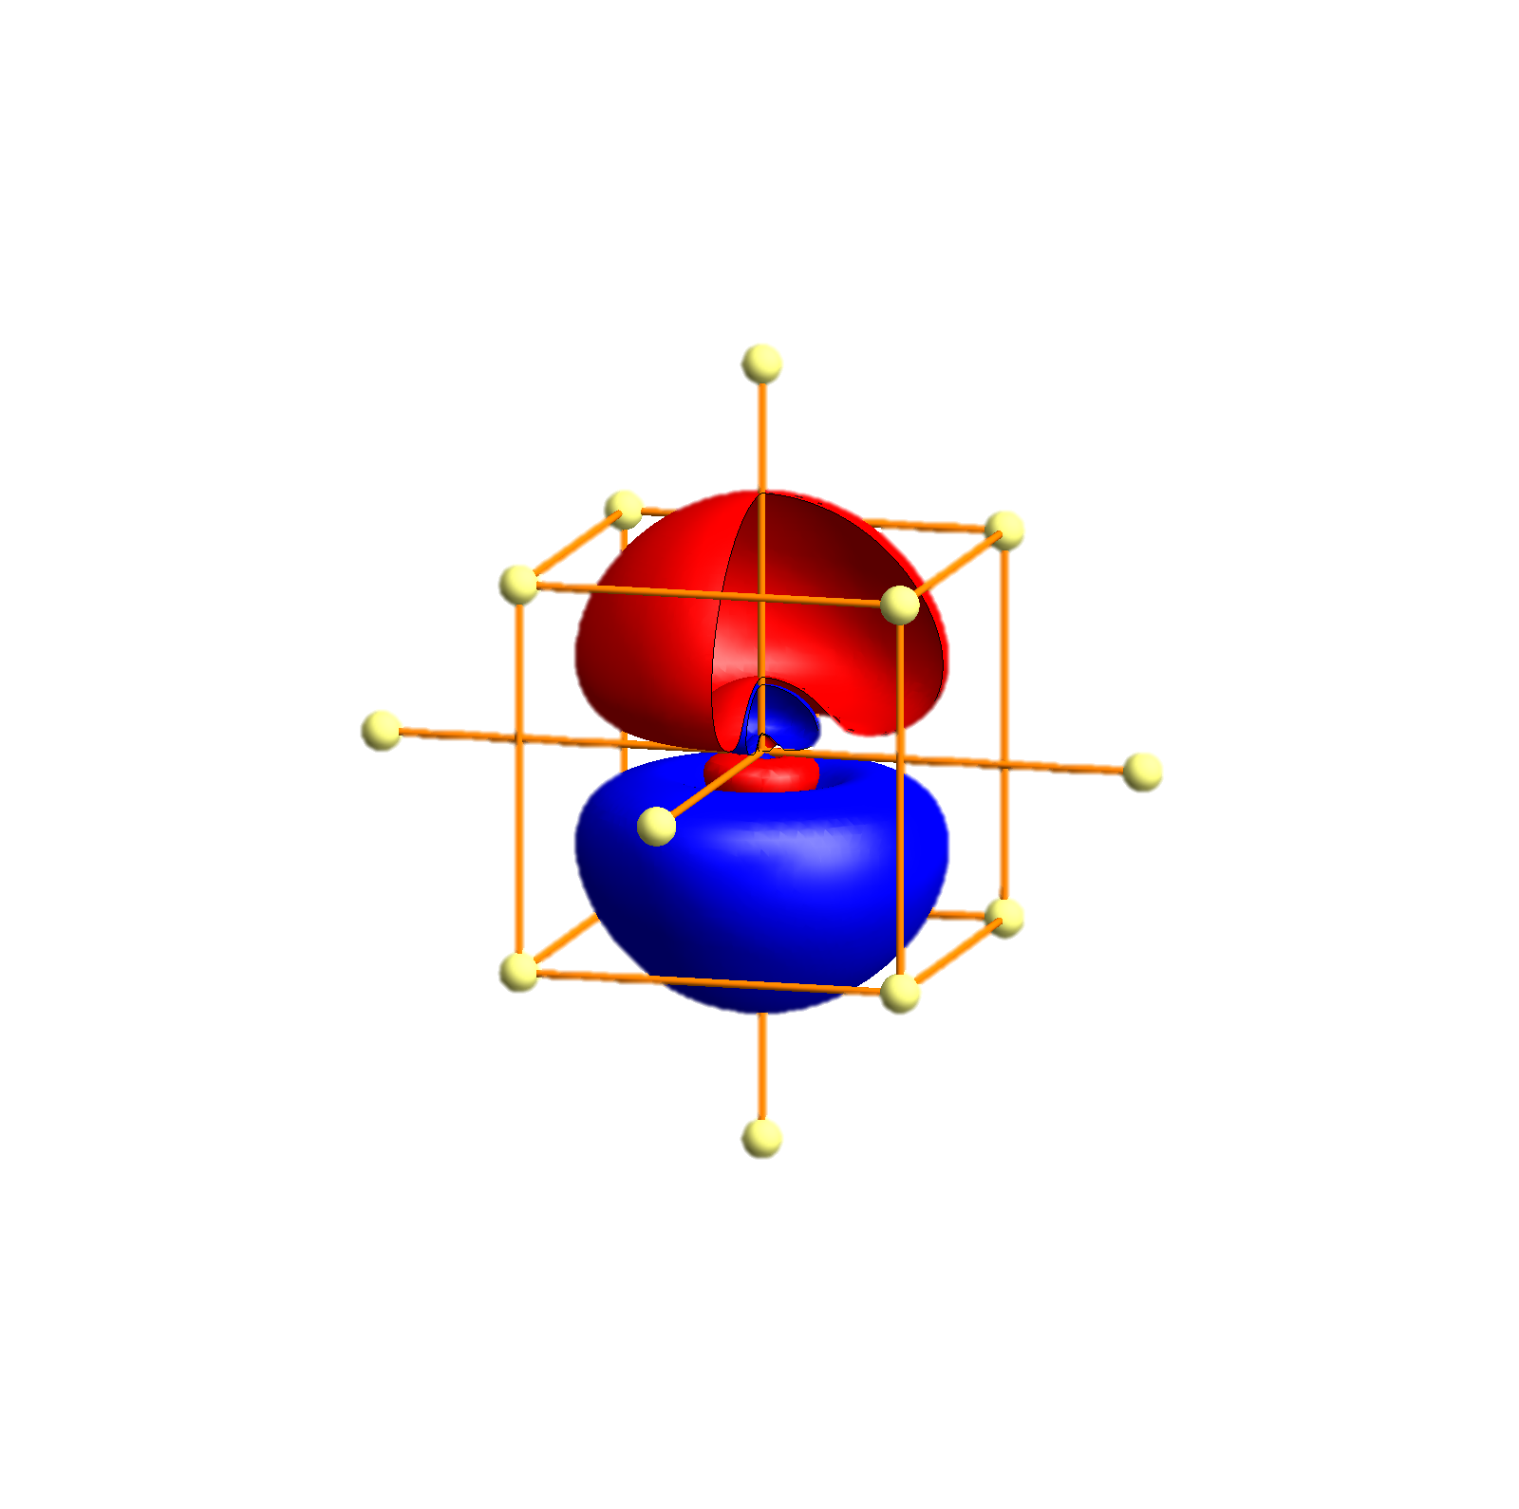
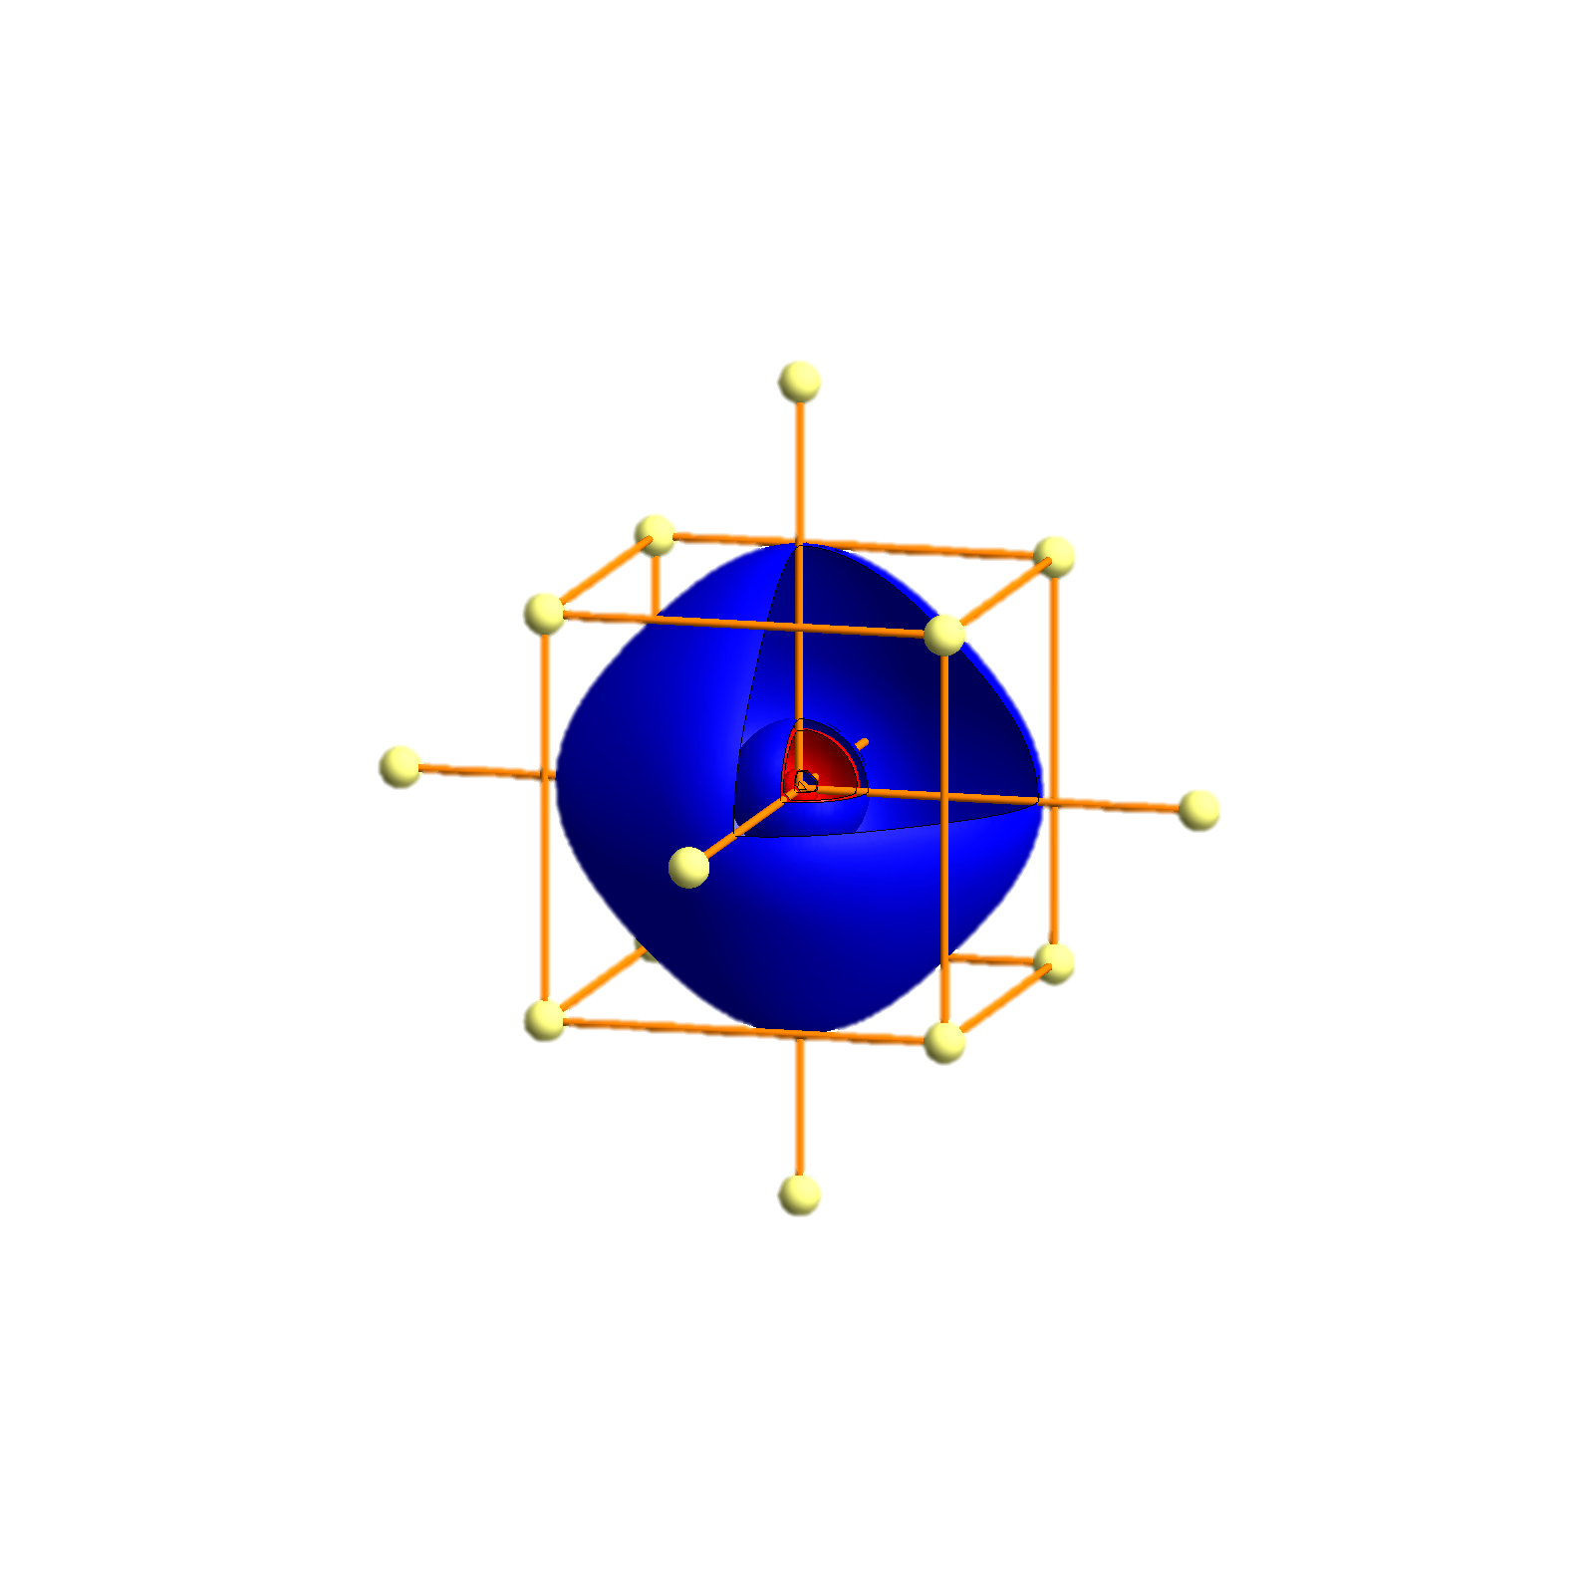
K- Tigth binding description – atomic orbitals
p_{x}
p_{y}
p_{z}
s
P
Γ
P
H
P
Γ
P
H
P
Γ
P

Slide 65
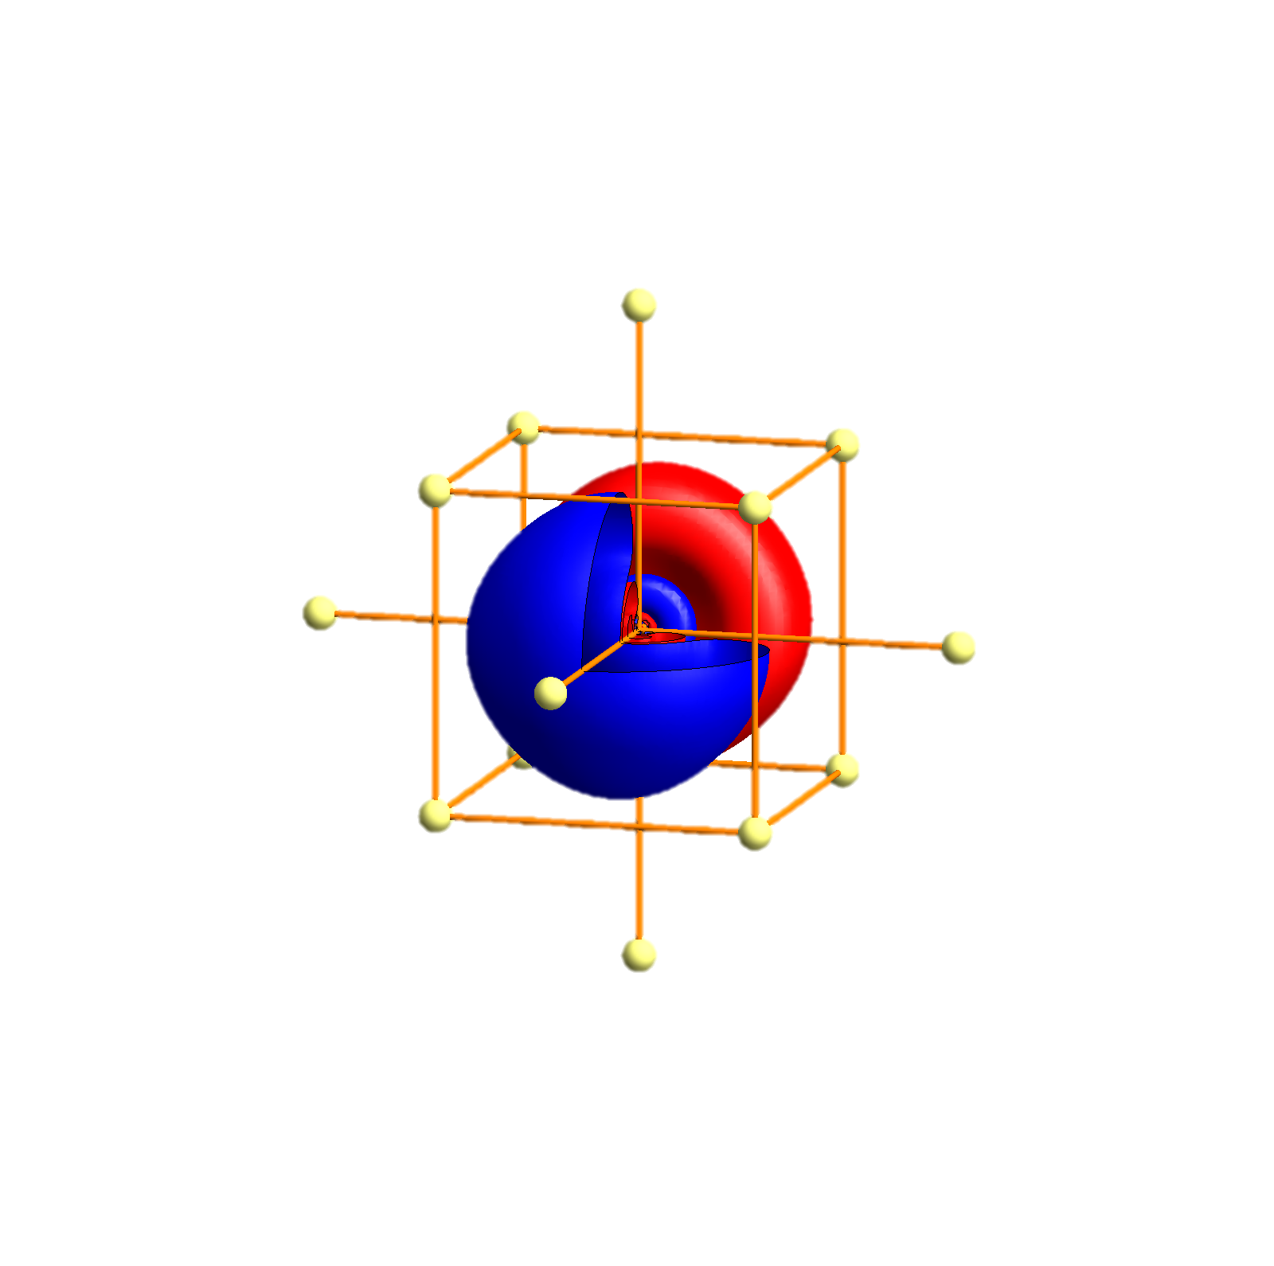
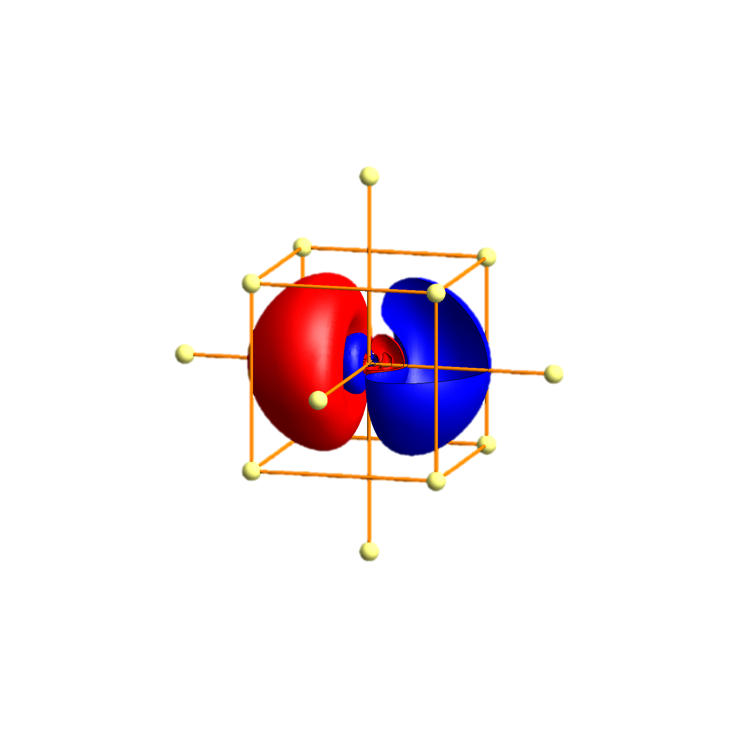
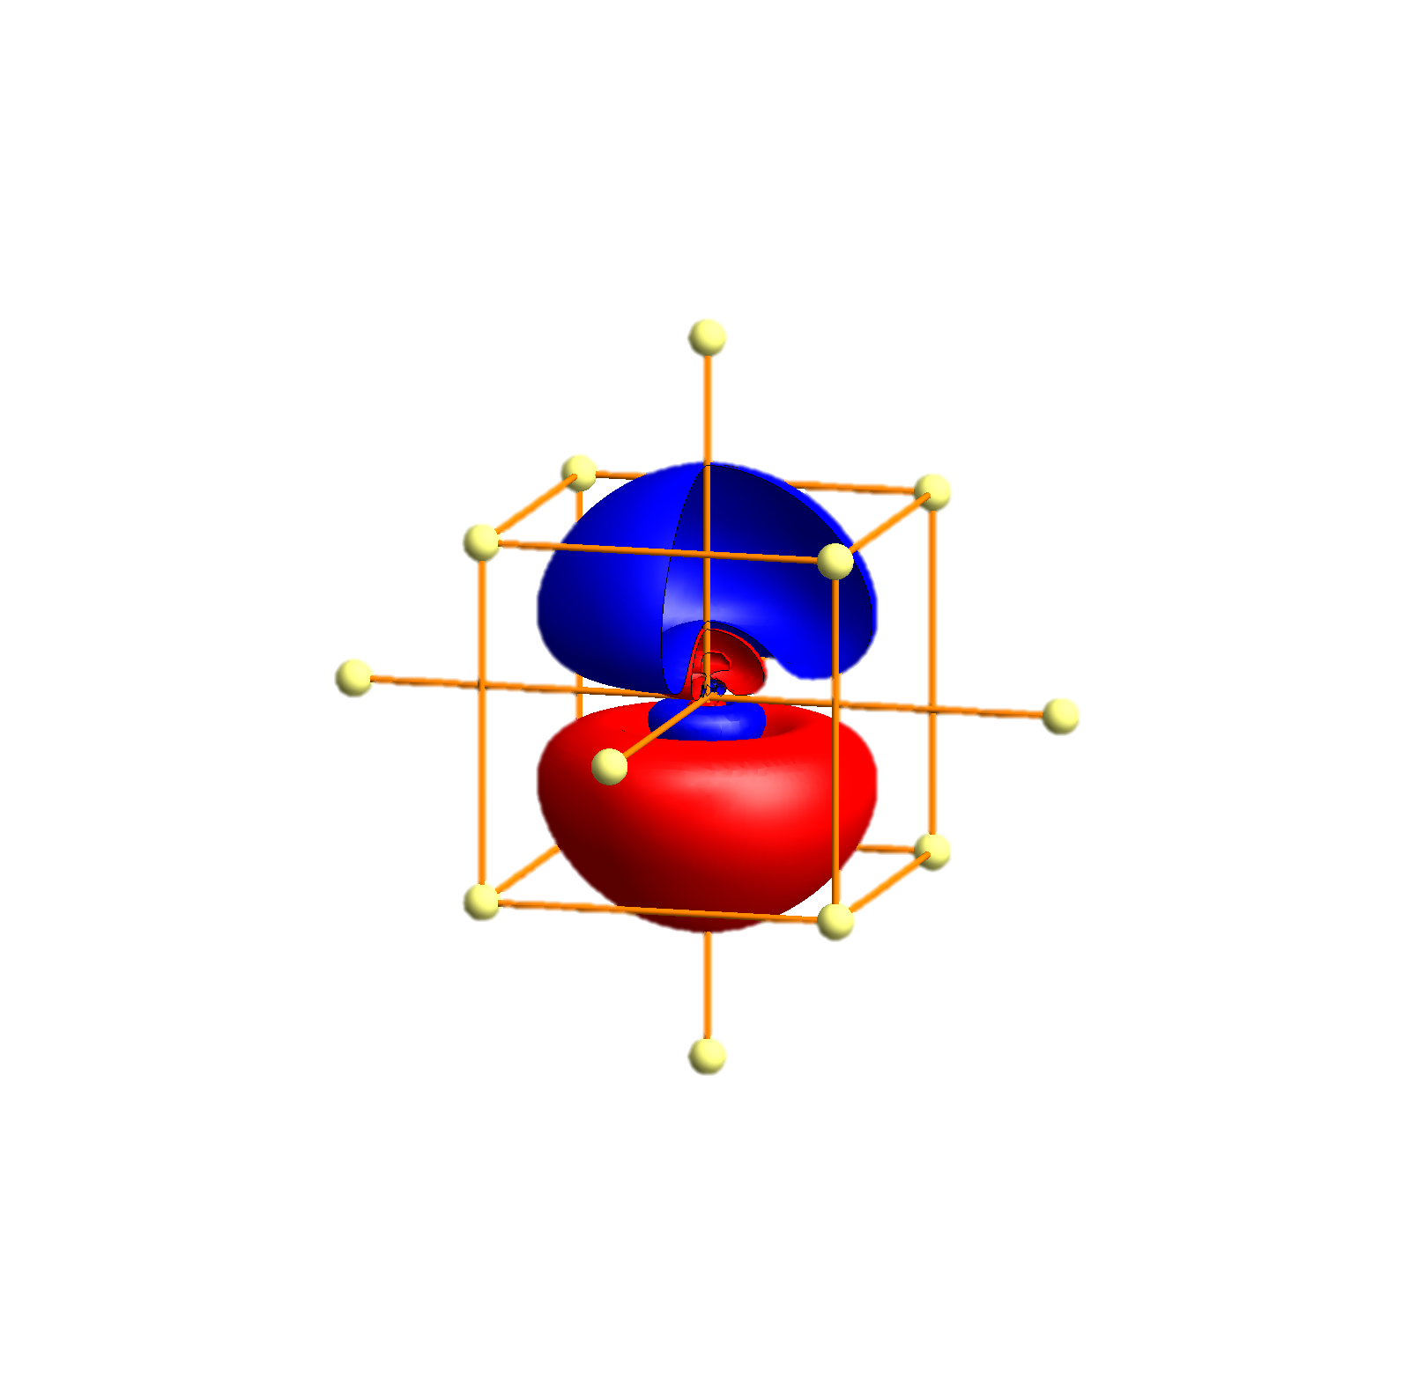
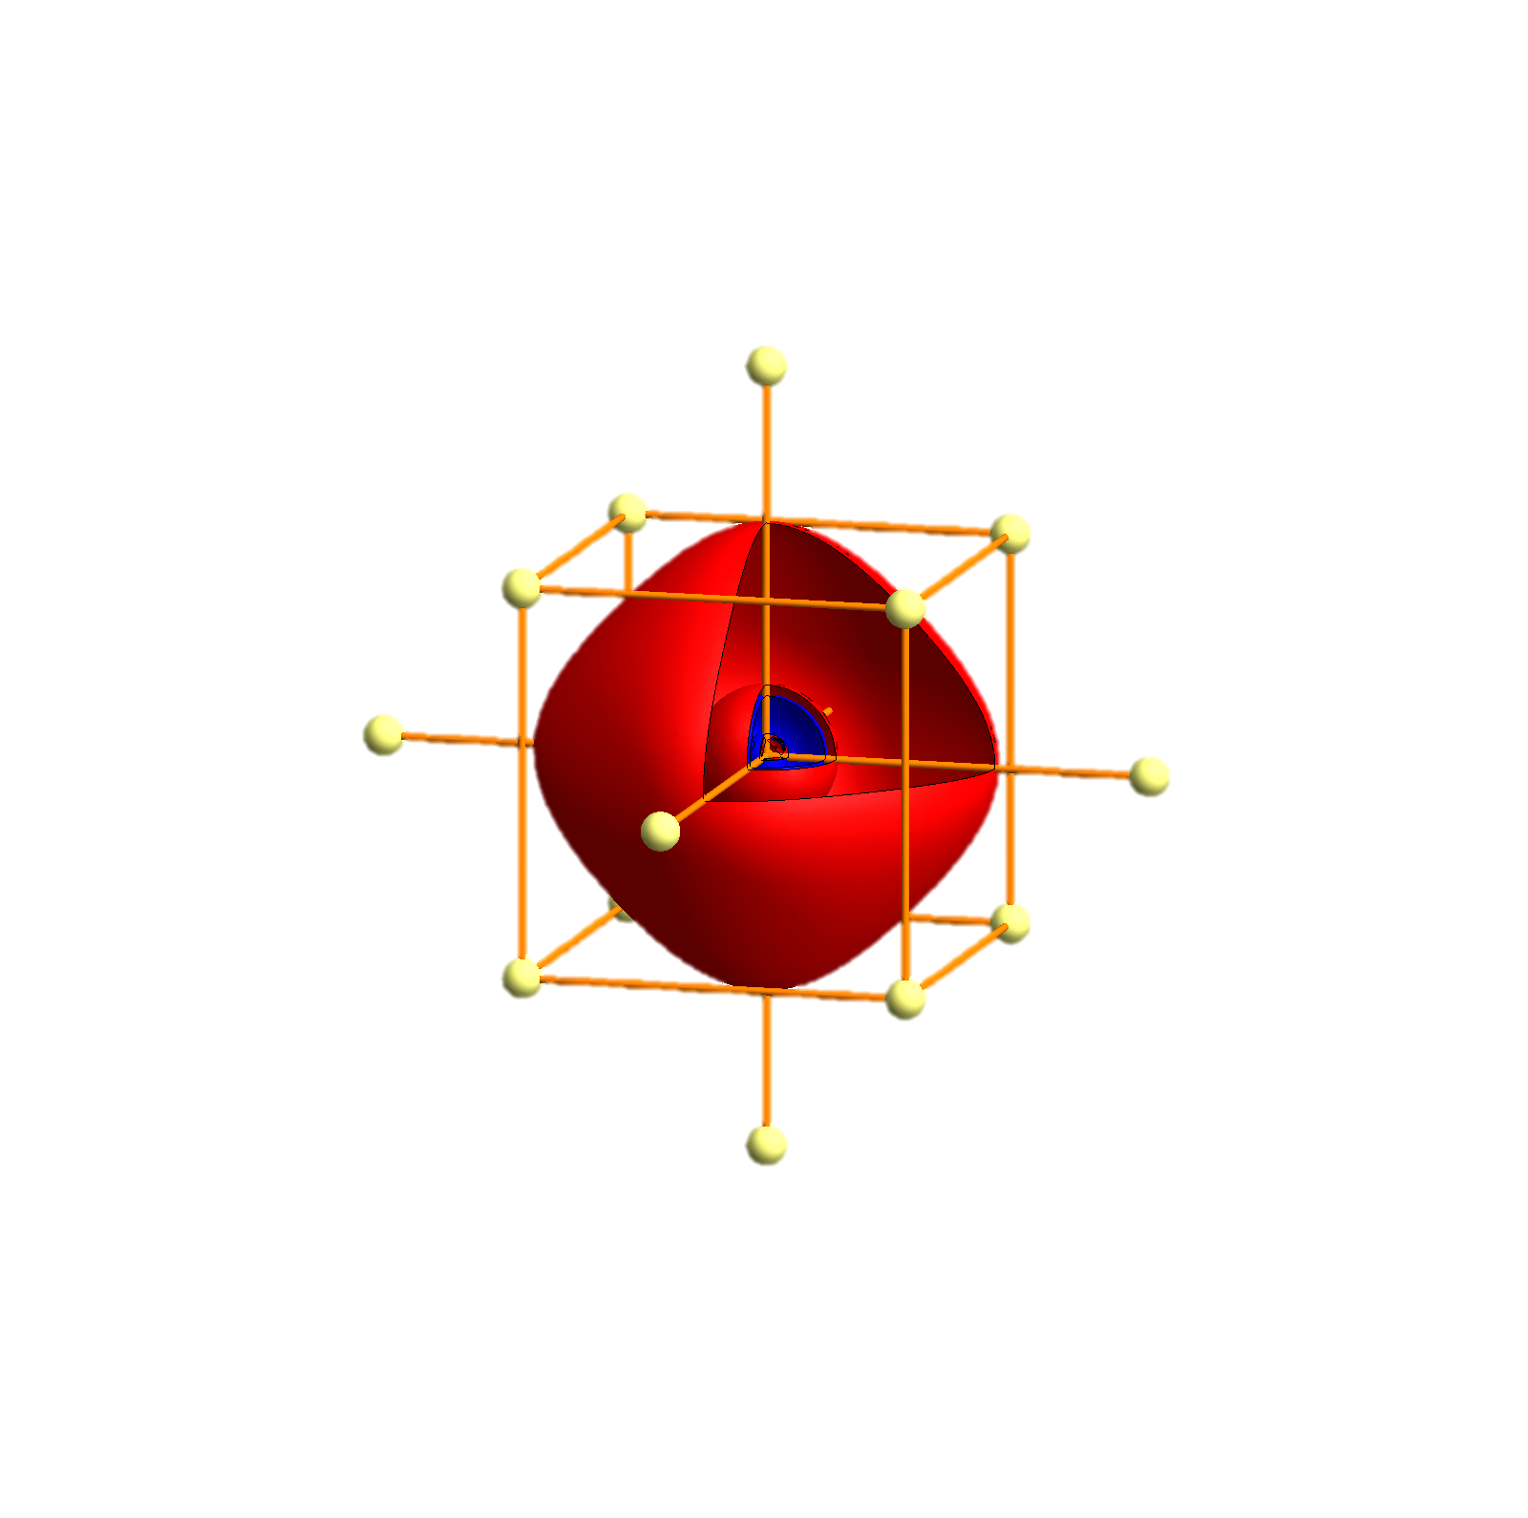
Rb - Tigth binding description – atomic orbitals
p_{x}
p_{y}
p_{z}
s
P
Γ
P
H
P
Γ
P
H
P
Γ
P

Slide 66


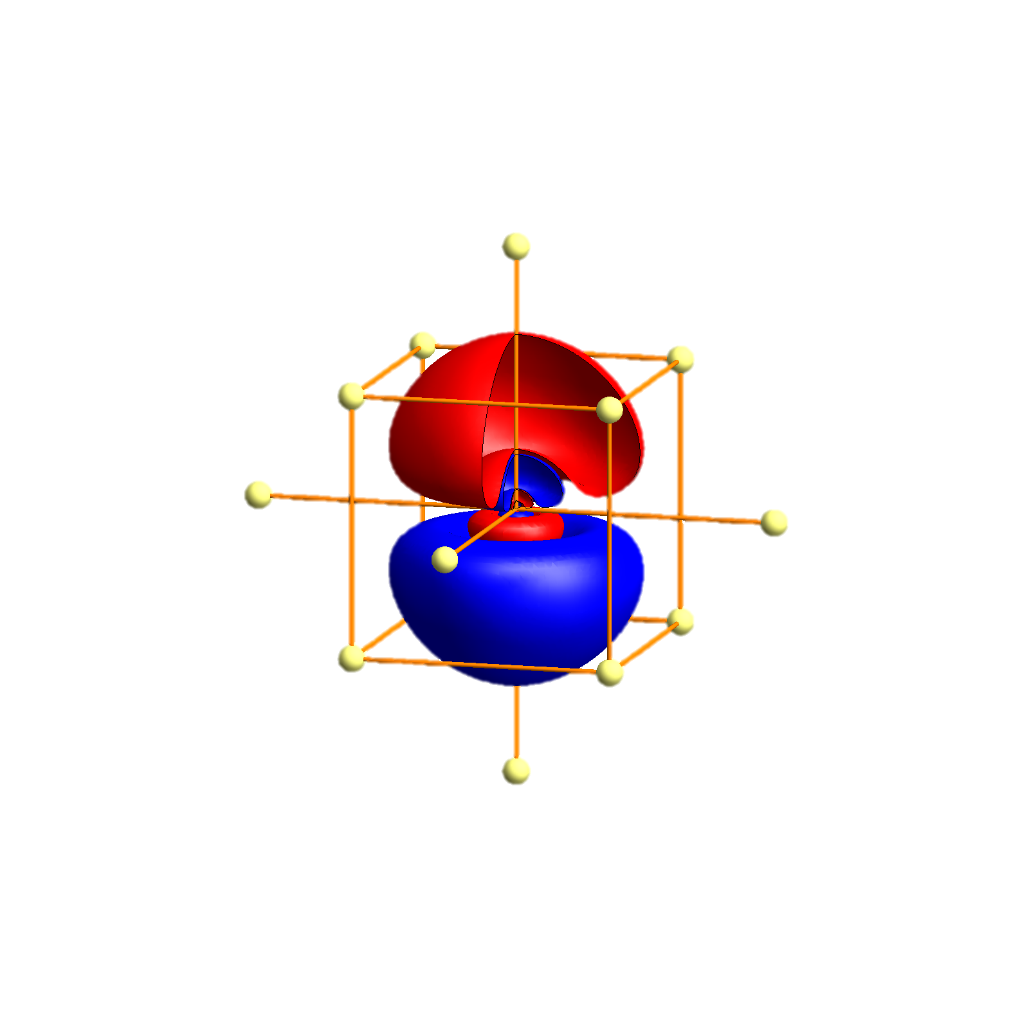
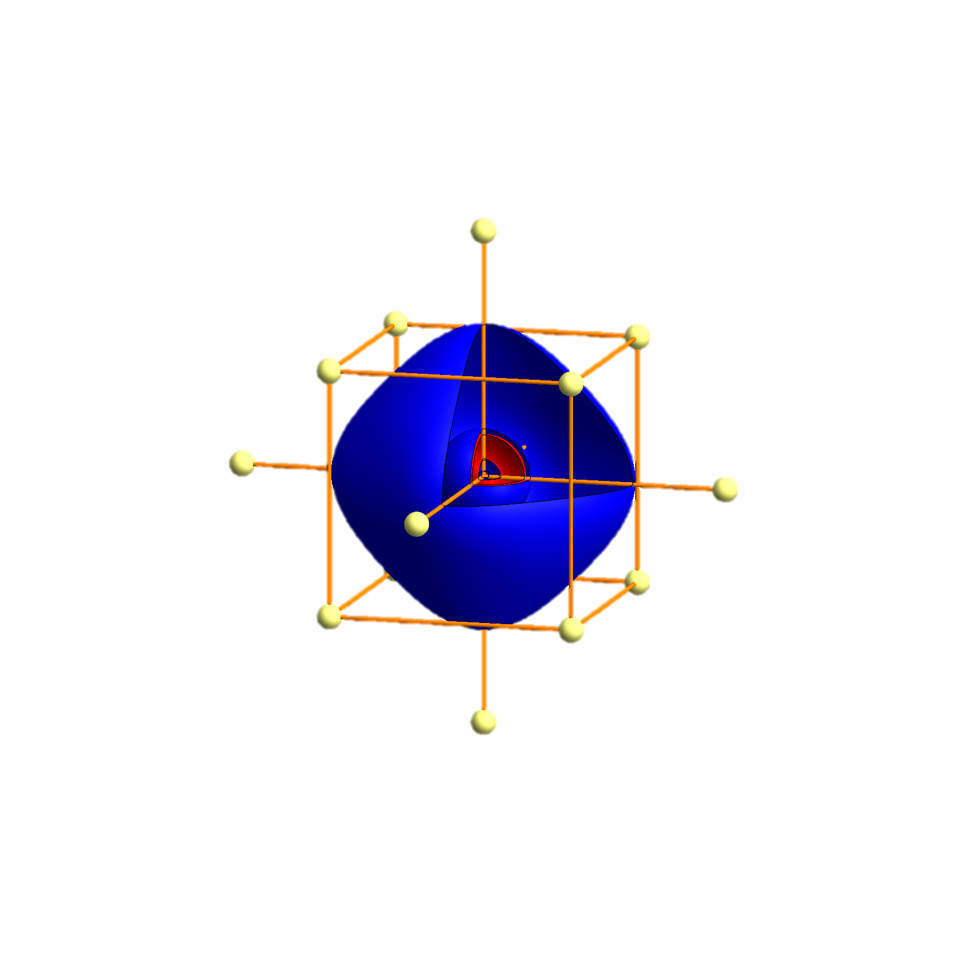
Cs - Tigth binding description – atomic orbitals
p_{x}
p_{y}
p_{z}
s
P
Γ
P
H
P
Γ
P
H
P
Γ
P

Slide 67


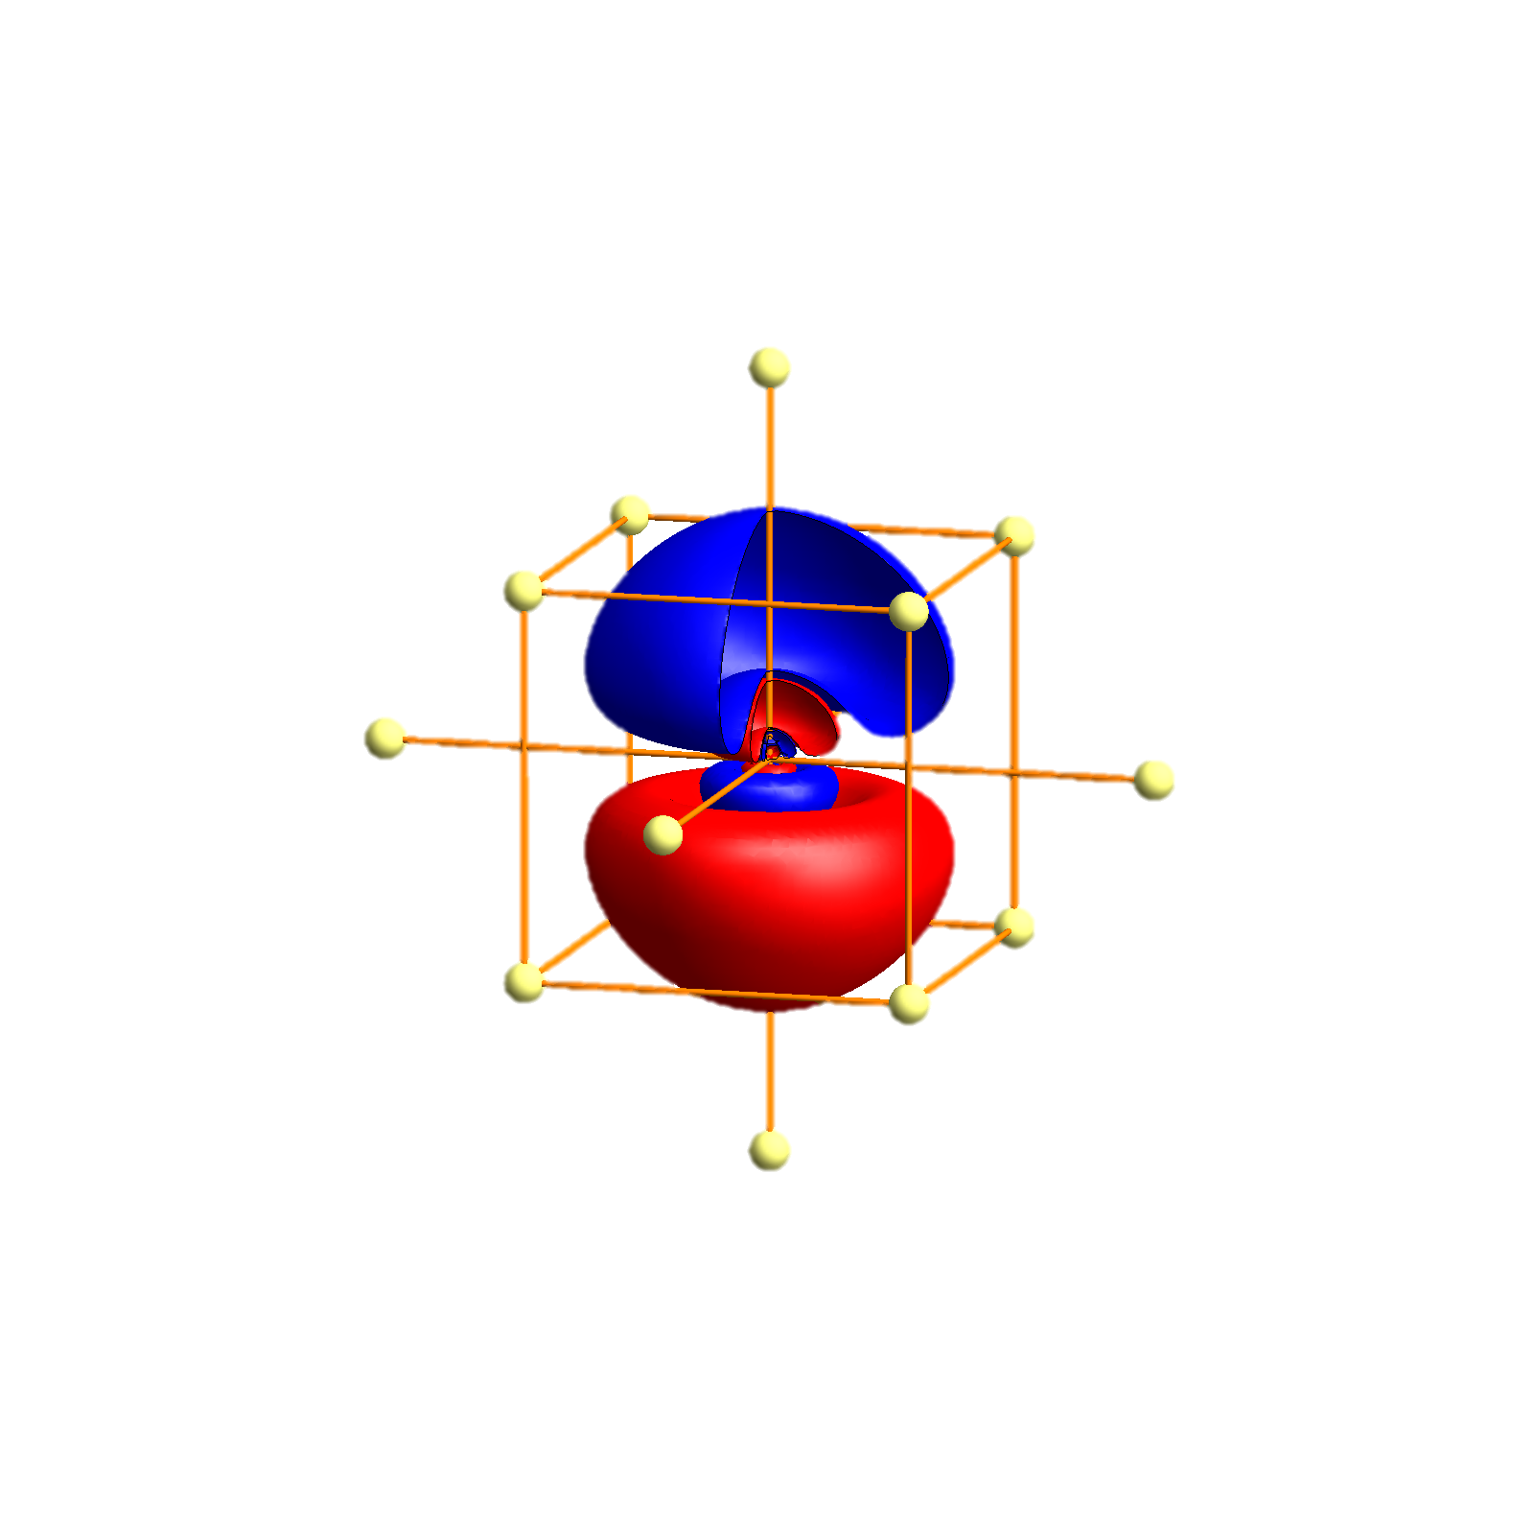
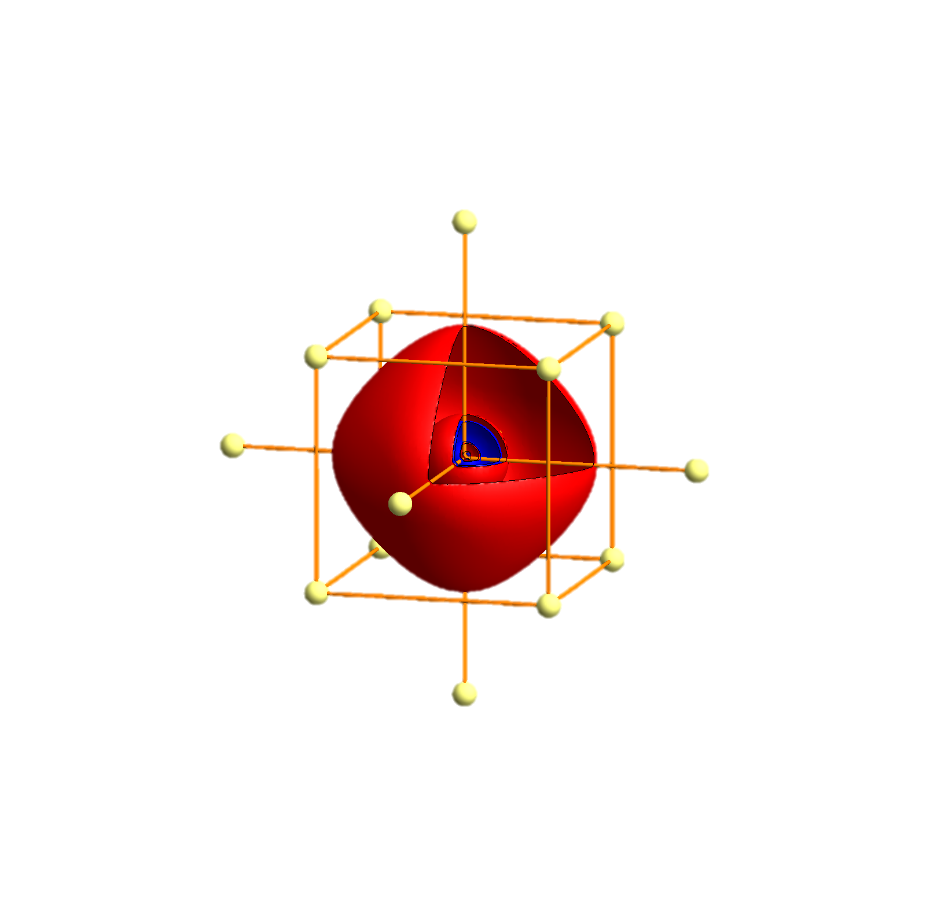
Fr - Tigth binding description – atomic orbitals
p_{x}
p_{y}
p_{z}
s
P
Γ
P
H
P
Γ
P
H
P
Γ
P

Slide 68
Modified atomic orbitals
Large component
Small component
Li
Na
K
Rb
Cs
Fr
r (a₀)
r (a₀)

Slide 69
Modified atomic orbitals
Large component
Small component
Small component
Li
Na
K
Rb
Cs
Fr
r (a₀)
r (a₀)
r (a₀)

Slide 70
Small component is still rather small – perturbation theory
becomes

Slide 71
Two component Dirac equation (perturbation theory)
Kinetic energy with mass correction term
Spin orbit interaction
Potential energy and Darwin term
Coulomb energy

Slide 72
Relation to Lorentz force
Spin orbit interaction

Slide 73
One new term in the Hamiltonian
Spin orbit interaction
Calculating the spin-orbit energy for different orbitals yields
The interaction is determined by the wave function close to the nucleus
Close to the nucleus the potential is spherical so we can write for the one electron orbitals:

Slide 74
One new term in the Hamiltonian
Spin orbit interaction
Calculating the spin-orbit energy for different orbitals yields

Slide 75
One new term in the Hamiltonian
Spin orbit interaction
Calculating the spin-orbit energy for different orbitals yields

Slide 76
One new term in the Hamiltonian
Spin orbit interaction
The interaction can thus be simplified by
with an atom dependent parameter independent of the material or chemical environment.

Slide 77
One new term in the Hamiltonian
Spin orbit interaction
and not
For a given multiplet one can approximate by
with
and depends on the multiplet.
There is no need to make this approximation! (it does not simplify things)

Slide 78
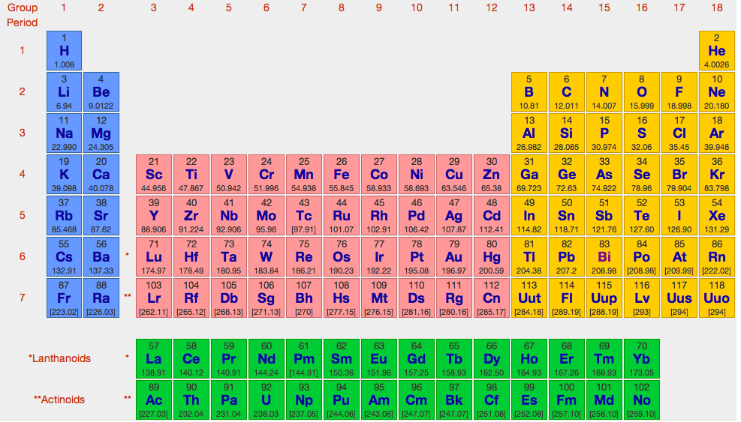
Size of spin-orbit coupling constant
ξ in units of meV
10
36
124
255
122
260
717
1318
36
93
345
672

Slide 79
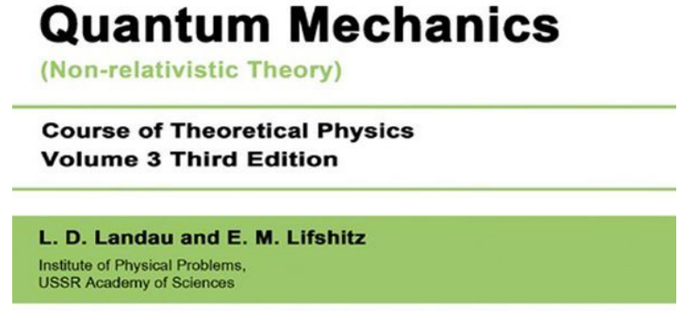
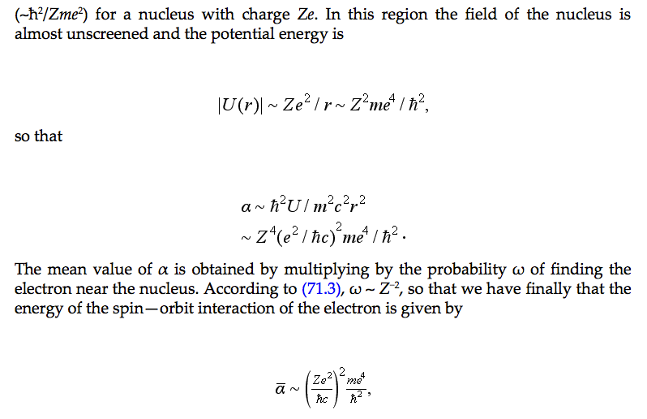
Size of spin-orbit coupling constant

Slide 80
Size of spin-orbit coupling constant
5d
5f
4f
4d
3d

Slide 81
One electron eigen-states of spin-orbit coupling Hamiltonian
Eigen-states of j are eigen states of spin-orbit coupling
How to plot:

Slide 82
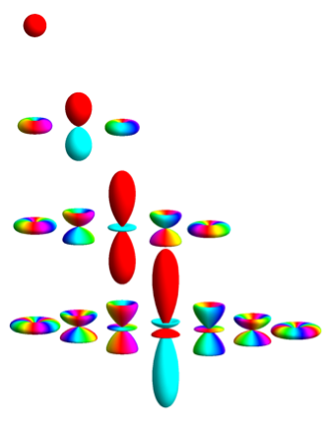
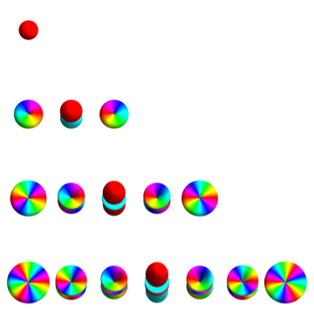
Atomic orbitals – Spherical Harmonics

Slide 83
Atomic orbitals – vectors of two spherical harmonics
Plot contours in the charge density
For atomic functions plot
Color according to spin (depends on quantization axes!!! i.e. not a direct observable)

Slide 84
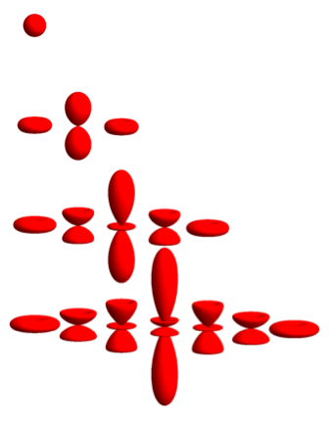
Atomic orbitals – charge density plots – spin down

Slide 85
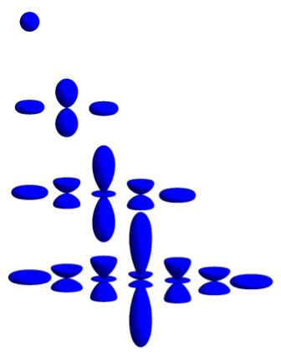
Atomic orbitals – charge density plots – spin up

Slide 86


Atomic orbitals – j j_{z} basis

Slide 87
Atomic orbitals – l=0 – s – j j_{z} basis

Slide 88
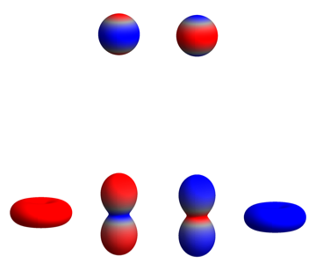

Atomic orbitals – j j_{z} basis

Slide 89
Atomic orbitals – l=1 – p – j j_{z} basis

Slide 90
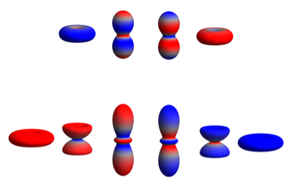
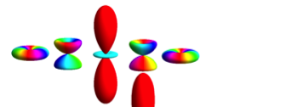
Atomic orbitals – j j_{z} basis

Slide 91
Atomic orbitals – l=2 – d – j j_{z} basis

Slide 92
Atomic orbitals – j j_{z} basis

Slide 93
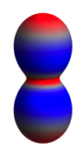
Atomic orbitals – j j_{z} basis

Slide 94
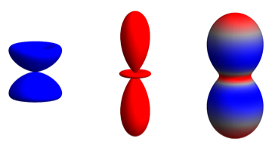
Atomic orbitals – j j_{z} basis

Slide 95
Atomic orbitals – j j_{z} basis

Slide 96
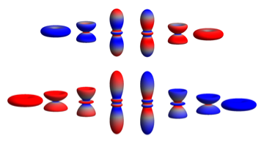
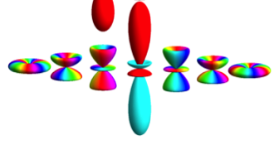
Atomic orbitals – j j_{z} basis

Slide 97
Atomic orbitals – l=3 – f – j j_{z} basis

