Slide 1



DFT calculation of electronic structure: an introduction
Application to K-edge XAS
Amélie Juhin
Sorbonne Université-CNRS (Paris)

Slide 2
About XANES spectroscopy at the K-edge
probe of structural and electronic properties of materials
local probe: up to 5-10 Å around the absorbing element
isotropic spectra
isotropic spectra
polarized spectra (XNLD)
1 eV shift
coordination number fingerprint
tremendous amount of information
needs for calculations

Slide 3
About XANES spectroscopy at the K-edge
probe of structural and electronic properties of materials
selection rules
selective probe of empty states localized on the absorber
K edge: 1s p transitions (mainly)
isotropic spectra
isotropic spectra
polarized spectra (XNLD)
tremendous amount of information with variable core-hole effects

Slide 4
XANES modeling
Basic issue: calculation of the absorption cross section
for a material, i.e., a system of N electrons + N_{at} nuclei
incident x-ray energy
operator of
the interaction between
x-rays and the system
initial state:
ground state of the system
with energy , degenerescence
final state:
excited state of the system
of energy .
weak e⁻ - e⁻ interaction
monoelectronic approach (Density Functional Theory)
ex : K edges
strong e⁻- e⁻ interaction
multielectronic approach
ex : L_{2,3} edges of 3d elements

Slide 5
Part 1
Introduction to electronic structure calculation using DFT

Slide 6
Basic issue
N_{at} atom system :
N electrons, mass m, charge q < 0, position r_{i} (i = 1, …, N)
N_{at} nuclei, mass M_{I}, charge q_{I} , position R_{I} (I = 1, …, N_{at})
+

Slide 7
Born-Oppenheimer approximation
m < M_{I}
(m / m_{proton} ≈ 1836)
Order of magnitude of the velocity ratio
Electron :
≈ 10 eV
Nucleus :
≈ 10 meV
≈ 10³
The nuclear motion is much slower than the electronic motion ➔ separation
The nuclei are considered at fixed positions in the electronic motion study
Positions R_{I} ➔ parameter

Slide 8
Born-Oppenheimer approximation
Electronic Hamiltonian
parameter
constant

Slide 9
Multielectronic Schrödinger equation
antisymmetric (electrons are fermions)

Slide 10
Multielectronic Schrödinger equation
We can solve it for a system of non-interacting electrons !
with
solution
spinorbital
: Slater determinant (SD) - 1929
build from N spinorbital functions

Slide 11
Slater Determinant
Ground state
Properties :
antisymmetric
Pauli exclusion principle satisfied

Slide 12
Multielectronic Schrödinger equation
solution
: Linear combination of an infinite number of Slater determinants
configuration interaction (“brute force”)
α_{max}= 10 ➔ 252 SD
α_{max}= 20 ➔ 15, 504 SD
α_{max}= 50 ➔ 2, 118, 760 SD
N = 5
N = 20 α_{max}= 30 ➔ 3, 004, 015 SD

Slide 13
Mean-field approximation
Non-interacting electrons
Exact solution : SD
Mean-field approximation
Approximative solutions
Interacting electrons
Exact solution : ∞ LC of SD
Exact multilelectronic Hamiltonian
Effective multielectronic Hamiltonian : mean-field Hamiltonian
Solutions :
Slater
determinants
with

Slide 14
Mean-field approximation
Monoelectronic Schrödinger solved self-consistently (SCF)
with
electron density

Slide 15
Mean-field methods: examples
Hartree (H)
Hartree-Fock (HF)
Density Functional Theory (DFT)

Slide 16
Hartree (H) - 1927
Coulomb interaction between one electron and the electron density
includes a self-interaction term (if i = j)
Hartree multielectronic
wave function
product of monoelectronic wave functions
Pauli exclusion principle
exchange not taken into account
=

Slide 17
Hartree-Fock (HF) - 1935
exchange included:
the multielectronic wave function as a (unique) SD
additional term that depends on the spin state and the antisymmetric character of the SD :
strictly compensates the self-interaction term when electrons i and j have the same spin state
BUT no correlation between electrons with opposite spins
Correlation energy:
difference between the exact total energy of N-electrons system and the total energy obtained using HF

Slide 18
Density functional theory (DFT): definition
exact theory
for systems of N interacting electrons
within an external potential

Slide 19
DFT: Hohenberg and Kohn theorems (1964)
The (non-degenerate) ground state electron density uniquely determines (to a constant)
the external potential (and thus all the properties of the system).
basic variable
There is a universal density functional , not depending explicitly on , defined as :
with

Slide 20
DFT: Hohenberg and Kohn (1964)
Total energy
E[ρ]
Variational principle
E_{gs}
ρ_{gs}
ρ
Exact theory but
question 1

Slide 21
DFT: Kohn and Sham (1965)
Hohenberg - Kohn theorems valid
for any N-electrons system
also valid for N non-interacting electrons (V_{e-e}= 0)
Kohn – Sham ansatz
We can find an external potential V_{KS}(r)
for a fictitious system of non-interacting electrons,
giving the same ground state electron density
as the real system
Exact theory BUT
question 2

Slide 22
DFT: Kohn and Sham (1965)
Kohn-Sham fictitious
system:
system of N non-interacting electrons, in an external potential V_{KS}(r),
which gives the same gs electron density as the real system
Ground state : SD build from N orbitals (monoelectronic)
Kohn-Sham orbitals solutions of:
(1)
Kinetic energy of the fictitious system
electron density
(indice s : « single particle »)

Slide 23
DFT: Kohn and Sham (1965)
What we can write as a functional of the electron density in V_{e-e} :
Hartree energy:
exchange and correlation energy
we partially answered question 1 !

Slide 24
DFT: Kohn and Sham (1965)
Total energy
minimization
Ground state total energy
variational principle applied to E[ρ] with respect to KS orbitals with the constraint:
(2)
exchange and correlation potential

Slide 25
DFT: Kohn and Sham (1965)
Kohn-Sham equations
(2)
Schrödinger equations of the fictitious system
(1)
Kohn – Sham potential
We partially answered question 2 !

Slide 26
DFT: Kohn and Sham (1965)
ground state : self-consistent field (SCF) resolution of the Kohn – Sham equations
Exact theory:
A V_{xc} potential that compensates the approximations
introduced by the mean-field approaches
necessarily exist !
In practice:
different forms of exchange-correlation functionals
DFT exact theory
useless
approximate theory widely used

Slide 27
DFT: exchange and correlation functionals
The Local Density Approximation (LDA)
the simplest
exchange - correlation energy for a particle in a homogeneous electron gas (with density ρ)
known analytically
(Dirac exchange energy)
calculated
using Ceperley-Alder Monte-Carlo method,
or other parametrization (ex: Hedin-Lundqvist)
In the LDA, DFT is still exact for an homogeneous electron gas.

Slide 28
DFT: exchange and correlation functionals
Generalized Gardient Approximation (GGA)
the density gradient at r is taken into account
Various parameterizations
example: the PBE functional
J.P. Perdew, K. Burke & M. Ernzerhof « Generalized Gradient Approximation Made Simple » Phys. Rev. Lett., 77:3865‎ (1996).

Slide 29
DFT: exchange and correlation functionals
Hybrid functionals (H-GGA)
combine the exchange and the correlation obtained by using GGA methods with a given proportion of the exchange described by Hartree-Fock
(Becke - 3 parameters - Lee, Yang, Parr)
The most used: B3LYP

Slide 30
DFT: SCF cycle
1st step
Crystal structure
atomic calculation
➔ atomic ρ
Superimposition of atomic ρ
ρ crystal= ρ _{in}

Slide 31
DFT: SCF cycle
ρ_{in}(r)
Potential calculation
Poisson equation
mixing
ρ _{in}(r) & ρ _{out}(r)
KS orbitals calculation
Kohn and Sham equations
Calculation of ρ _{out}(r)
NO
YES
Convergence?
STOP

Slide 32
DFT: softwares
Solid state physics and quantum chemistry
Abinit
ADF
AIMPRO
Augmented Spherical Wave
Atomistix Toolkit
CADPAC
CASTEP
CP2K
CPMD
CRYSTAL
DACAPO
DALTON
deMon2K
DFT++
DMol3
EXCITING
Fireball
FLEUR
GAMESS (UK)
GAMESS (US)
GAUSSIAN
GPAW
JAGUAR
MOLCAS
MOLPRO
MPQC
NWChem
OpenMX
ORCA
ParaGauss
PARATEC
PARSEC
PC GAMESS
PLATO
Parallel Quantum Solutions
PWscf (Quantum Espresso)
Q-Chem
SIESTA
Socorro
Spartan
SPR-KKR
TURBOMOLE
VASP
WIEN2k
non-exhaustive list

Slide 33
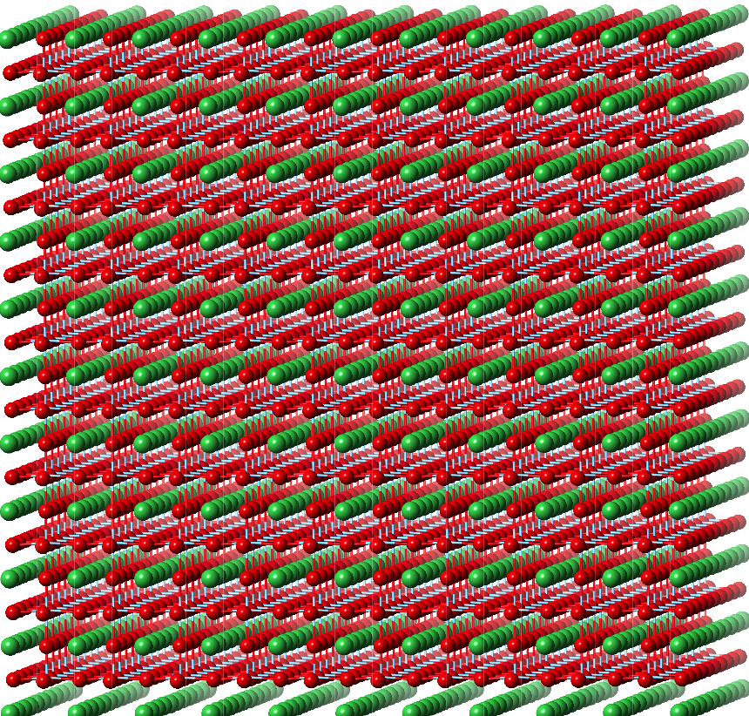
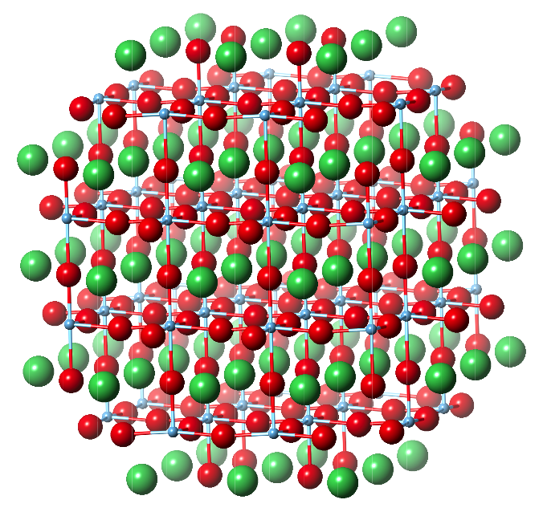
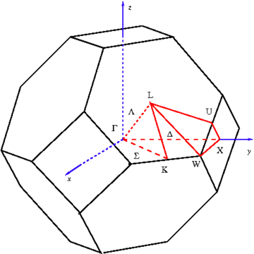
DFT: softwares
the main differences between them
periodic boundary conditions
real space
cluster
infinite
number
of atoms
or
1st Brillouin zone
no periodicity constraint (amorphous and crystalline materials)
suited to molecules
suited to cristals supercell

Slide 34




DFT: sofwares
the main differences between them
Basis to expand the Kohn-Sham orbitals
Plane waves
Pseudopotentials
Atomic orbitals
Gaussians
LCAO
Mixed basis
atomic spheres: LC of radial functions × spherical harmonics
interstitial region: plane waves
Muffin-tin orbitals
spherical waves
LMTO,multiple scattering
LAPW

Slide 35
DFT: sofwares
the main differences between them
Solid state physics and quantum chemistry
Abinit
ADF
AIMPRO
Augmented Spherical Wave
Atomistix Toolkit
CADPAC
CASTEP
CP2K
CPMD
CRYSTAL
DACAPO
DALTON
deMon2K
DFT++
DMol3
EXCITING
Fireball
FLEUR
GAMESS (UK)
GAMESS (US)
GAUSSIAN
GPAW
JAGUAR
MOLCAS
MOLPRO
MPQC
NWChem
OpenMX
ORCA
ParaGauss
PARATEC
PARSEC
PC GAMESS
PLATO
Parallel Quantum Solutions
PWscf (Quantum Espresso)
Q-Chem
SIESTA
Socorro
Spartan
SPR-KKR
TURBOMOLE
VASP
WIEN2k
non-exhaustive list
http://en.wikipedia.org/wiki/List_of_quantum_chemistry_and_solid-state_physics_software

Slide 36
Part 2
Introduction to the calculation of X-ray absorption spectra
X-ray Absorption Near-Edge Structure
Near-Edge X-ray Absorption Fine Structure

Slide 37
XANES modeling
Basic issue: calculation of the absorption cross section
for a material, i.e., a system of N electrons + N_{at} nuclei
incident x-ray energy
operator of
the interaction between
x-rays and the system
initial state:
ground state of the system
with energy , degenerescence
final state:
excited state of the system
of energy .
weak e⁻ - e⁻ interaction
monoelectronic approach (Density Functional Theory)
ex : K edges
strong e⁻- e⁻ interaction
multielectronic approach
ex : L_{2,3} edges of 3d elements

Slide 38
Interaction operator between x-rays and electrons
incident X-ray beam: electromagnetic wave treated as a plane-wave
k: wave vector
: polarization direction
electric dipole transitions (E1)
electric quadrupole transitions (E2)
observable in the K pre-edge of 3d transition elements
majority electronic transitions

Slide 39
Interaction operator between x-rays and electrons
Electric dipole (E1) transitions :
K or L₁
Initial State quantum numbers |  | Edge | final state symmetry
1 | 0 | K | p
2 | 0 | L₁ | p
2 | 1 | L_{2,3} | s+d
3 | 0 | M₁ | p
3 | 1 | M_{2,3} | s+d
3 | 2 | M_{4,5} | p+f
photon energy
L₃
L₂
photon energy
M₅
delocalised final state (weak electron repulsion) : p
monoelectronic theories (DFT)
M₄
localized final state (strong electron repulsion) : 3d, 4f
multielectronic theories (multiplets)
photon energy

Slide 40
XANES and DFT
For K edges:
1s atomic orbital
monoelectronic empty state (KS)
calculated with a 1s core-hole in the electronic configuration of the absorbing atom

Slide 41
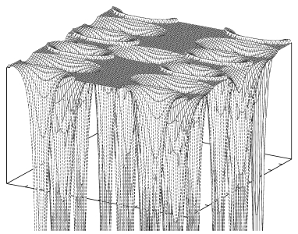
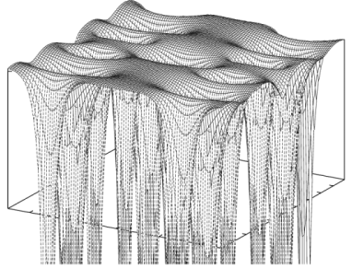
Note: muffin-tin (MT) potential
MT
ZONE I
ZONE II
ZONE I: atomic spheres
spherical symmetry potentials
ZONE II: interstitial region
constant potential
Full Potential

Slide 42
XANES and DFT: the calculation codes
2 types
1- Those written to calculate core-level spectra
cluster, real space
at the beginning: multiple scattering (no self-consistency, muffin-tin potential)
continuum, feff, icxanes,….
at the end of the 90’s: finite differences method with fdmnes
currently: fdmnes, feff
2- The electronic structure codes, in which a post SCF-process code was added to calculate core-level spectra
periodic boundary conditions, reciprocal space
Wien2k, CASTEP, Quantum-Espresso (XSpectra), …

Slide 43
XANES and DFT: periodic boundary conditions and core hole
With codes using periodic boundary conditions (for crystals), we have to avoid spurious interaction of the excited atom with its periodically repeated images.
Large interaction
Weak interaction
2x2
supercell
To restore neutrality :
Negative background charge
Excited electron in conduction band
atom with a core-hole
atom without a core-hole

Slide 44
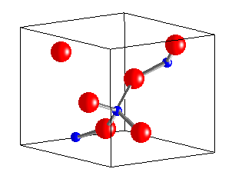
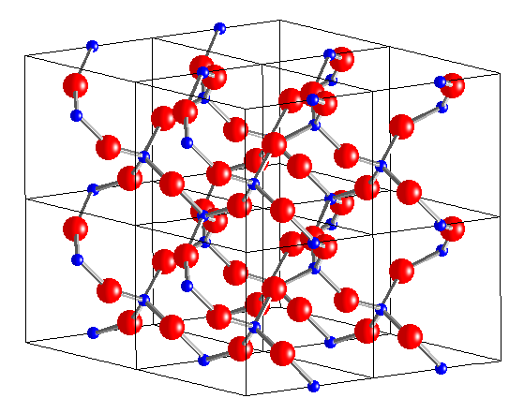
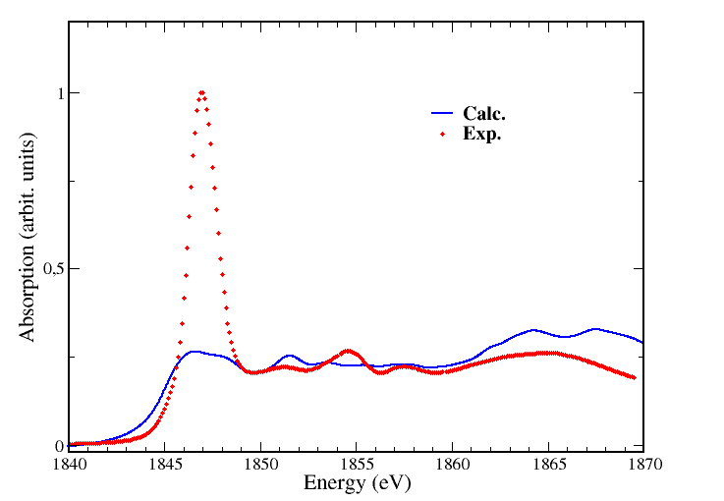
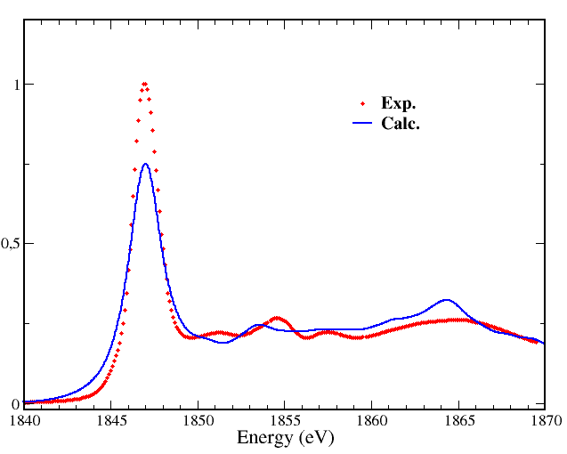
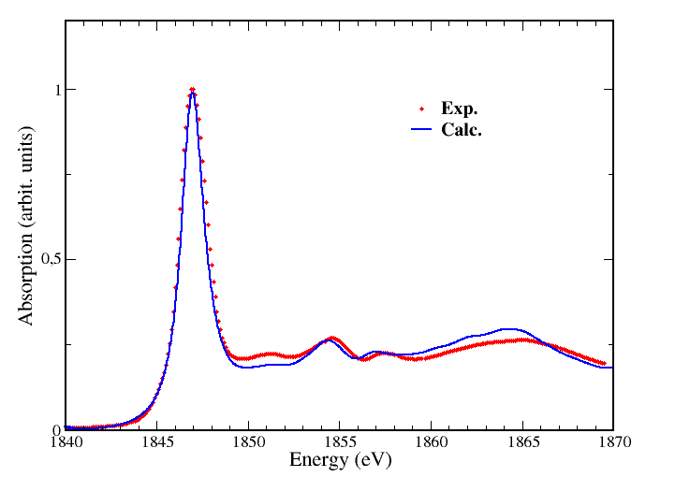
XANES and DFT: periodic boundary conditions and core hole
Si K edge in α-quartz
unit cell
a = 4.91Å, c = 5.40Å
3 Si 6 O
1×1×1 supercell
= unit cell with 1 core-hole
1 Si* 2 Si 6 O
2×2×2 supercell
a = 9.82Å, c = 10.80Å
1 Si* 23 Si 48 O
without core-hole
interaction between core-holes
convergence
44

Slide 45
XANES and DFT: the drawbacks
well identified
DFT is dedicated to the calculation of ground state properties
but used here for the modeling of excited states…
possible underestimation of the excitation energies
Static modeling of the core-hole-electron interaction
through the supercell approach or within a cluster of atoms
Exchange and correlation functional is not energy-dependent
inelastic losses not calculated, the convolution factor is a parameter

Slide 46
XANES and beyond DFT
GW + Bethe-Salpeter equation (BSE)
Shirley and coll.
OCEAN interface
Olovsson, Puschnig, Ambrosch-Draxl, Lakowski : LAPW
TD-DFT (real-space approaches)
FDMNES
Quantum-Chemistry codes: Orca, ADF, Q-chem, …

Slide 47
3d elements in octahedral site
single-particle picture
Cabaret et al. PCCP (2010)
3d⁰
Ti⁴⁺
e_{g}
t_{2g}
TiO₂ rutile, anatase
t_{2g}, e_{g} empty
favorable case
3d⁶
LS
e_{g}
Fe²⁺
t_{2g}
FeS₂ pyrite
MbCO protein
e_{g} empty
acceptable case
3d³
e_{g}
Cr³⁺
e_{g} empty
ruby, emerald, spinel:Cr, pyrope:Cr
acceptable case
t_{2g}
t_{2g}, e_{g} empty
3d²
e_{g}
V³⁺
t_{2g} partially empty e_{g} empty
grossular:V
critical case
t_{2g}
t_{2g}, e_{g} empty
3d⁵
LS
Fe³⁺
e_{g} empty
e_{g}
t_{2g} partially empty
e_{g} empty
critical case
MbCN protein
t_{2g}

Slide 48
Ti⁴⁺ in octahedral site
single-particle picture
TiO₂ rutile, Ti site: centrosymmetric
3d⁰
e_{g}
pre-edge : E2 + non local E1
t_{2g}
peak A1
local E2 transition 1s 3d t_{2g}
peak A2
local E2 transition 1s 3d e_{g}
+
non-local E1 transition 1s p hybrid. 3d t_{2g} (neighb.)
peak A3
non-local E1 transition 1s p hybrid. 3d e_{g} (neighb.)
Cabaret et al. Phys. Chem. Chem. Phys. 12:5619 (2010)

Slide 49
Ti⁴⁺ in octahedral site
single-particle picture
TiO₂ rutile, Ti site: centrosymmetric
3d⁰
e_{g}
pre-edge : E2 + non local E1
t_{2g}
A1 calc. at too high energy !
WHY?
0.5 eV
Cabaret et al. Phys. Chem. Chem. Phys. 12:5619 (2010)

Slide 50
Ti⁴⁺ in octahedral site
single-particle picture
TiO₂ rutile, Ti site: centrosymmetric
3d⁰
e_{g}
pre-edge : E2 + non local E1
t_{2g}
A1 calc. at too high energy !
The 1s core-hole is not attractive enough…
How to improve ?
dashed: no core-hole

Slide 51
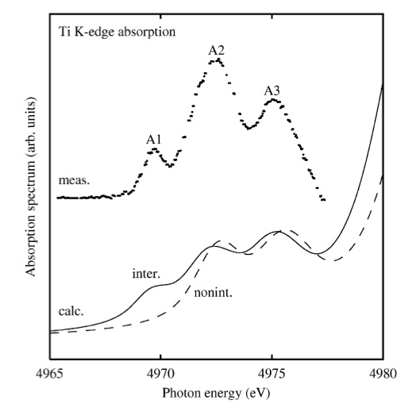
Ti⁴⁺ in octahedral site
TiO₂ rutile, Ti site: centrosymmetric
pre-edge : E2 + non local E1
Bethe-Salpeter equation
dashed: no core-hole
Shirley, J. Electr. Spectr. Rel. Phenom. 136:77 (2004)

Slide 52
Cr³⁺ in octahedral site
MgAl₂O₄:Cr³⁺, Cr site: centrosymmetric
single-particle picture
3d³
e_{g}
pre-edge : E2
t_{2g}
two E2 peaks (at too high energy…)
Origin?
e_{g}
A2
e_{g}
occupied
states
t_{2g}
e_{g}
t_{2g}
A1
t_{2g}
e_{g}
Cabaret et al. Phys. Chem. Chem. Phys. 12:5619 (2010)

Slide 53
V³⁺ in octahedral site
single-particle picture
Ca₃Al₂(SiO₄)₃:V³⁺, V site: centrosymmetric
3d²
pre-edge : E2
e_{g}
t_{2g}
Three E2 peaks (at 2eV too high energy…)
Origin?
e_{g}
A3
t_{2g}
e_{g}
occupied
states
e_{g}
t_{2g}
e_{g}
A2
t_{2g}
A1
t_{2g}
Cabaret et al. Phys. Chem. Chem. Phys. 12:5619 (2010)

Slide 54
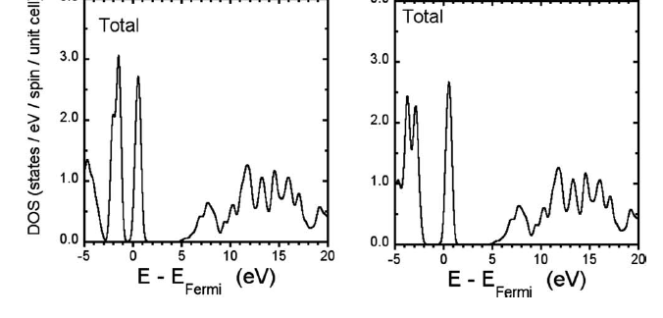
Angular dependence of core hole screening in LiCoO₂
DFT-GGA
DFT-GGA +U
Gap = 1.7 eV
Gap =2.3eV
Electronic structure poorly described in GGA
Better described using Hubbard parameter (U) on Co 3d states
Juhin et al. PRB 81 (2010)

Slide 55
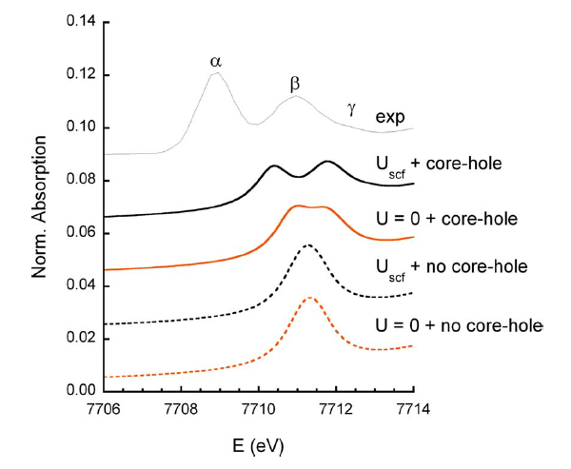
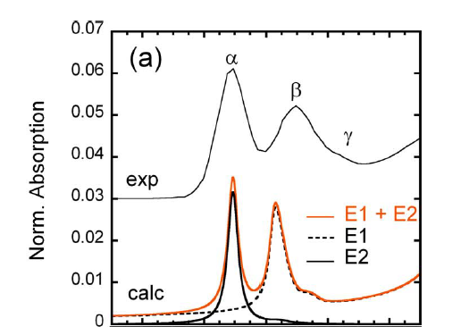
LiCoO₂ : the Co K pre-edge
Best agreement is obtained when including U and the 1s core hole

Slide 56
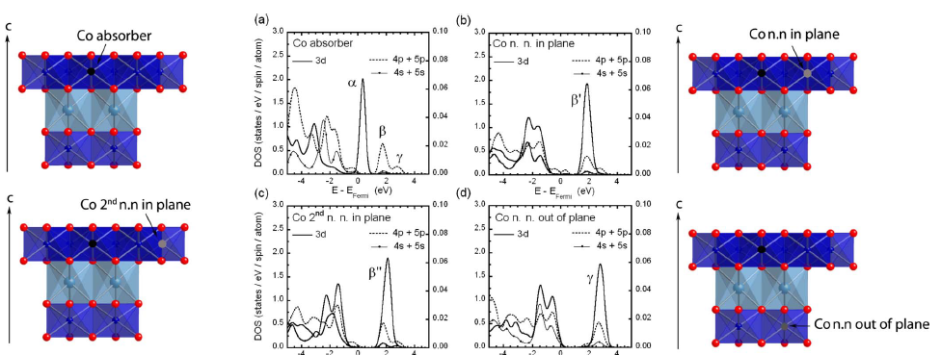
LiCoO₂ : the Co K pre-edge
pre-edge : E2 + nonlocal E1
Peak α : 1s→3d (Co*)
Peak β : 1s→4p + O(2p) + Co (3d) n.n. in plane
Peak γ : 1s→4p + O(2p) + Li (2p)+Co (3d) n.n. out of plane

Slide 57
Summary
Inherent drawbacks of DFT-LDA/GGA for XANES calculation
electronic repulsion modeling
core hole-electron interaction modeling
E2 and E1 transitions toward 3d (abs) systematically at too high energy
3d⁰ (TiO₂) ~ 0.5 eV reduced to 0 using BSE of E. Shirley
3d⁶ LS (MbCO, FeS₂) ~ 0.8 eV
3d³ (Cr-spinel, emerald) 1 ~eV
3d⁵ LS (MbCN) ~ 1.7 eV
3d³ (ruby) and 3d² (V-grossular) 2 ~eV
GGA+U reduces 2 eV 1 eV for 3d⁸ (NiO) Gougoussis et al. PRB 79:045118 (2008)
2.4 eV 1.7 eV for 3d⁶ LS (LiCoO₂) Juhin et al. PRB 81:115115 (2010)
TDDFT+hybrid functionals in Fe complexes : DeBeer et al. J.Phys.Chem.A 112:12936 (2008)

Slide 58
Summary
Inherent drawbacks of DFT-LDA/GGA for XANES calculation
electronic repulsion modeling
core hole-electron interaction modeling
E2 and E1 transitions toward 3d (abs) systematically at too high energy
However, DFT in LDA/GGA is useful !
number of pre-edge peaks well reproduced
relative intensities and positions in rather good agreement with experiment
single-particle description of transitions with
E1/E2 character
degree of local and non-local hybridization
spin polarization
improved with adding U (NiO, LiCoO₂, …)

Slide 59
Thank you for your attention.
Thanks to Delphine Cabaret for slide courtesy

