Slide 1
Tutorial on Quanty
Spectrosocpy
Maurits W. Haverkort
Institute for theoretical physics – Heidelberg University
M.W.Haverkort@thphys.uni-heidelberg.de

Slide 2
Transitions, spectroscopy and Green’s functions

Slide 3
Quiz: what happens when a photon hits an atom?
For example an H atom with one electron in the s-shell
A) At some point in time the photon gets absorbed, the photon disappears and the electron in the s-shell is excited to the p-shell
B) Photons are electromagnetic waves. The electron starts to oscillate around the nucleus with the photon frequency
C) Electrons are particles. The photon bounces like a ball of the electron, thereby transferring part of its energy to the electron
Notes:
I know that the 1s to 2p excitation of H is not in the x-ray range ( ¾ Rydberg, 10.2 eV) but all our theories are conveniently rather independent from the actual energy scale. (Linear response does not depend on the value of omega) For the purist replace H by Fe25+ (also a single electron around a nucleus, but as Z=26 in this case the excitation energy is 26^2 * ¾ = 507 Rydberg or 6898 eV)

Slide 4
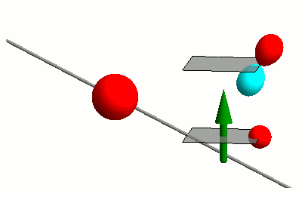
Interaction of photons with matter
RIXS
nIXS

Slide 5

Interaction of photons with matter
RIXS
nIXS

Slide 6
Time dependent perturbation theory
Fermi’s golden rule

Slide 7
Time dependent perturbation theory
Fermi’s golden rule
Green’s function – spectral representation (energy domain)

Slide 8
Time dependent perturbation theory
Fermi’s golden rule
Green’s function – spectral representation (energy domain)
Green’s function – (time domain)

Slide 9


Slide 10
Time dependent perturbation theory
Fermi’s golden rule
Green’s function – spectral representation (energy domain)
Green’s function – (time domain)

Slide 11
Time dependent perturbation theory
Green’s function – (time domain)
At time t=0 an excitation is created
In spectroscopy one probes if at time t the excitation is still at the same place, or if it moved away.
Spectroscopy probes the dynamics of the system

Slide 12
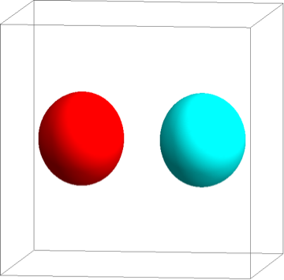



Example on an H₂ molecule
1s
1s

Slide 13
Example on an H₂ molecule
1s
1s

Slide 14

Example on an H₂ molecule
1s
1s

Slide 15

Example on an H₂ molecule
Intensity
Excitation energy

Slide 16

Example on an H₂ molecule – with correlations

Slide 17

Example on an H₂ molecule – with correlations

Slide 18

Example on an H₂ molecule – with correlations

Slide 19
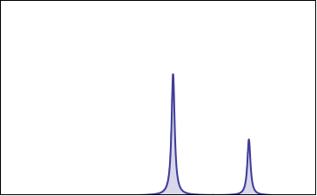
Example on an H₂ molecule – with correlations
Intensity
Excitation energy

Slide 20
Example on an H₂ molecule – with correlations
1s
1s
Intensity
Excitation energy

Slide 21
The problem is (almost) never in the transition operator
Fermi’s golden rule

Slide 22
The problem is (almost) never in the transition operator
Fermi’s golden rule
Green’s function – spectral representation (energy domain)

Slide 23
The problem is (almost) never in the transition operator
Fermi’s golden rule
Green’s function – spectral representation (energy domain)
Green’s function – (time domain)

Slide 24
The description of all the eigenstates can be hard
Fermi’s golden rule
Green’s function – spectral representation (energy domain)
Green’s function – (time domain)

Slide 25
The calculation of the resolvent of the Hamiltonian
Fermi’s golden rule
Green’s function – spectral representation (energy domain)
Green’s function – (time domain)

Slide 26
The time evolution of the excited state can be hard
Fermi’s golden rule
Green’s function – spectral representation (energy domain)
Green’s function – (time domain)

Slide 27
Spectroscopy – different T, same equations
PES
Optics

Slide 28
X-ray spectroscopy – different T, same equations
PES
XAS
RXD
RIXS
nIXS
cPES
NEXAFS
XES
X-Raman
XPS
XAFS
FY

Slide 29
Non-linear Spectroscopy – different T, same equations
Pump Probe
XAS
PES
XAS
RXD
RIXS
cPES
NEXAFS
XES
XPS
XAFS
FY

Slide 30
Three classes of excitations – different approximations on H
Band excitations
Resonances
Excitons

