Slide 1
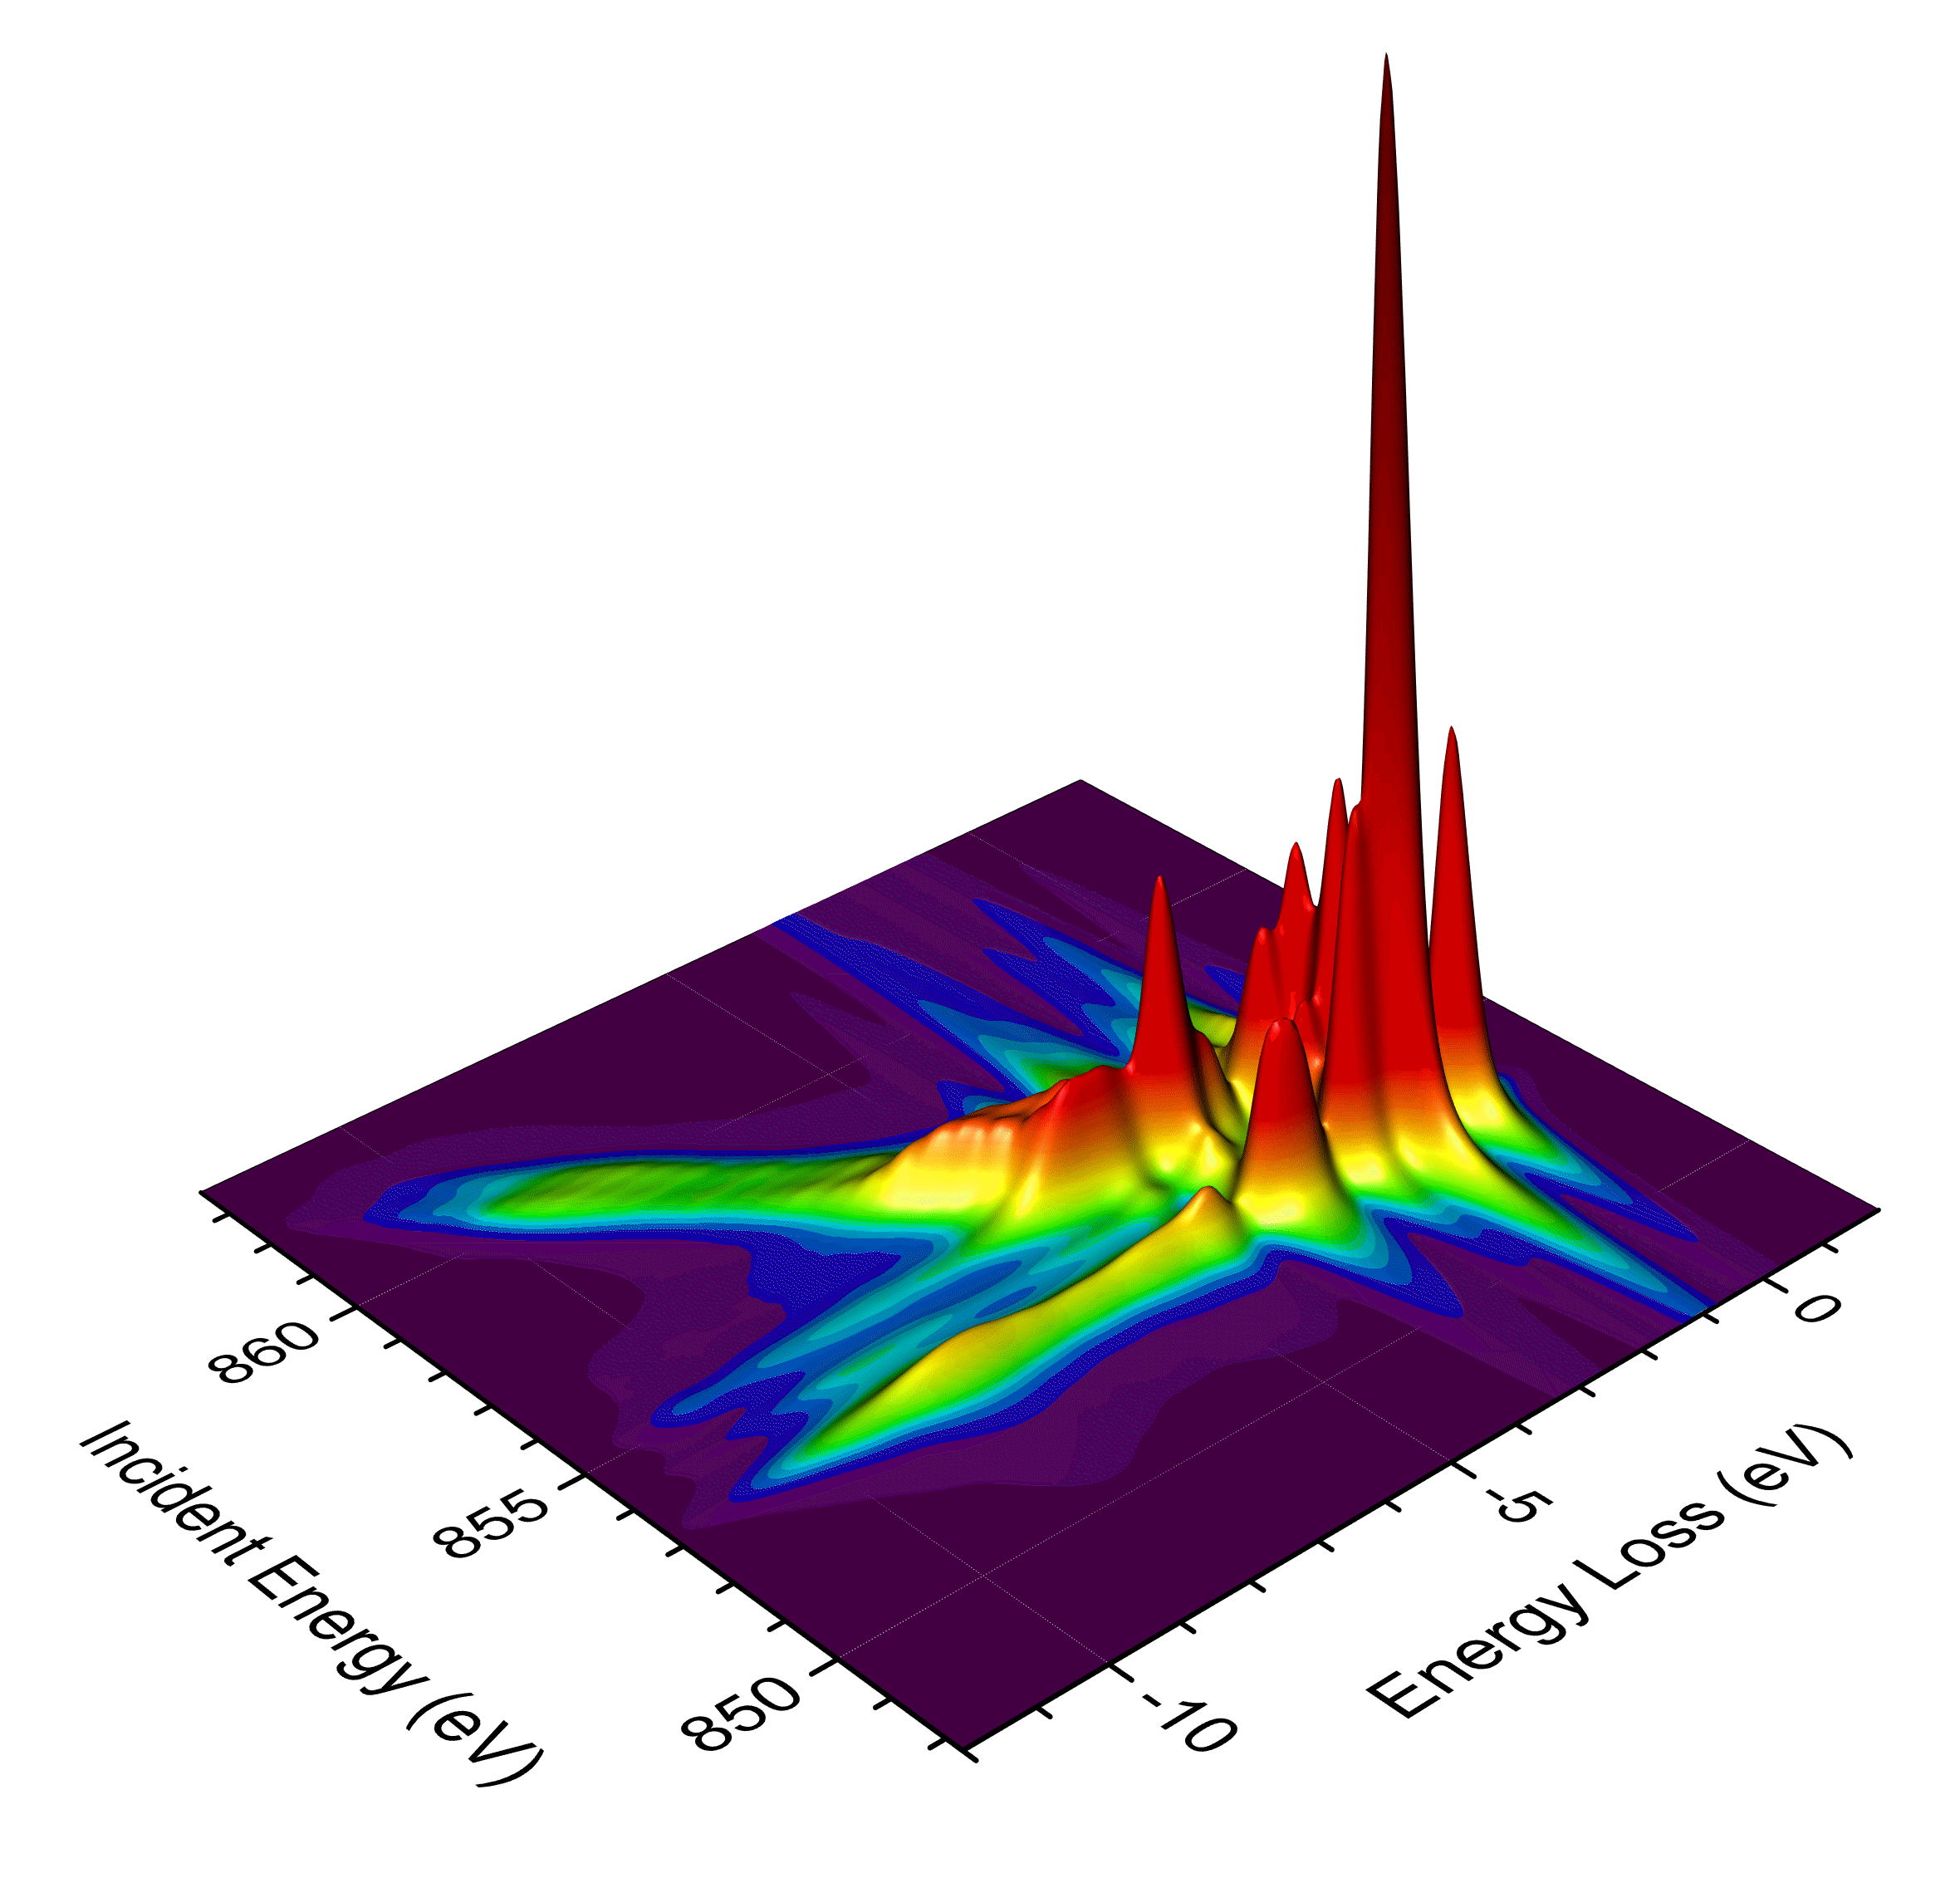
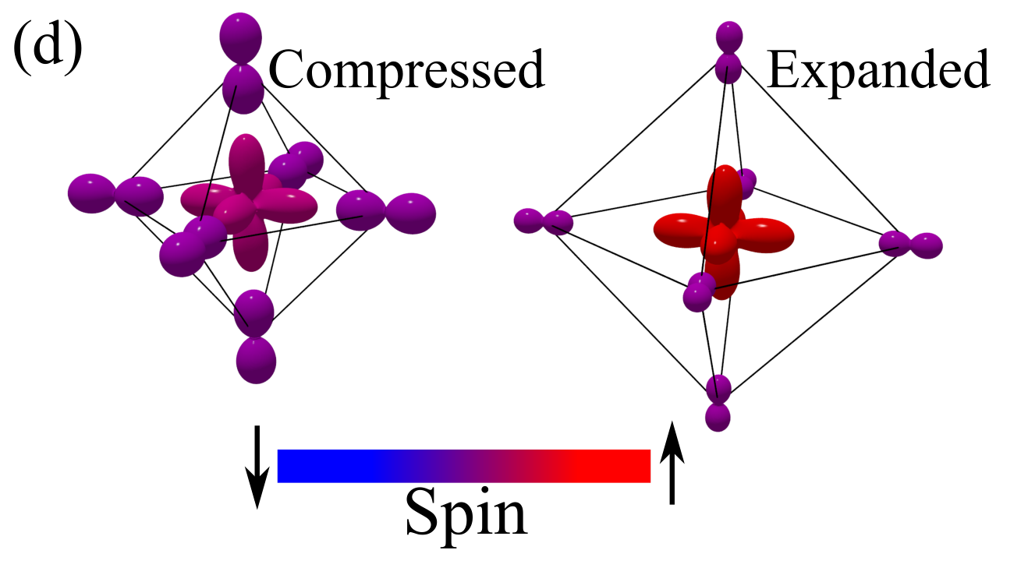
Models Beyond Ligand Field Theory
Robert Green
Quanty Workshop 2019

Slide 2
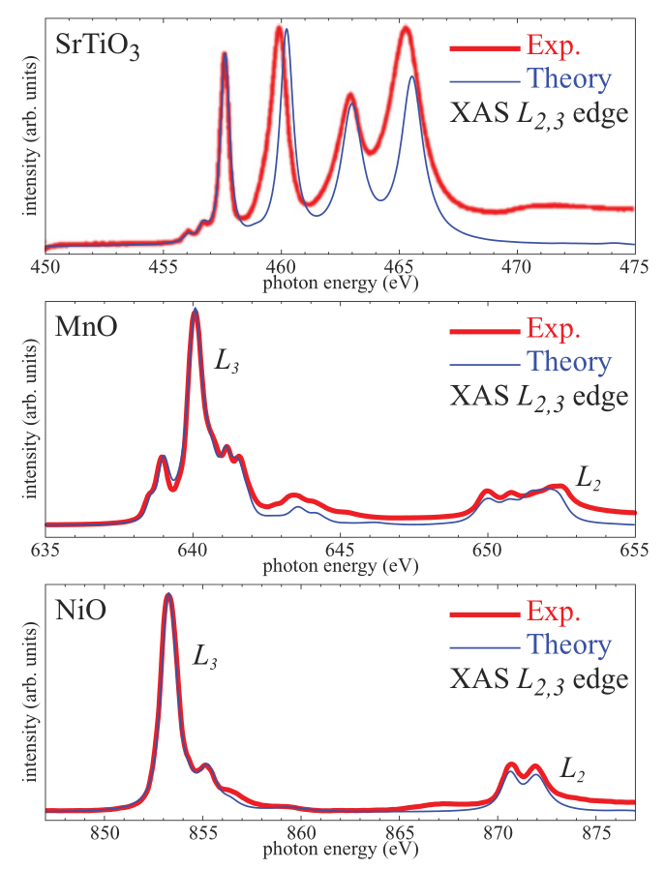
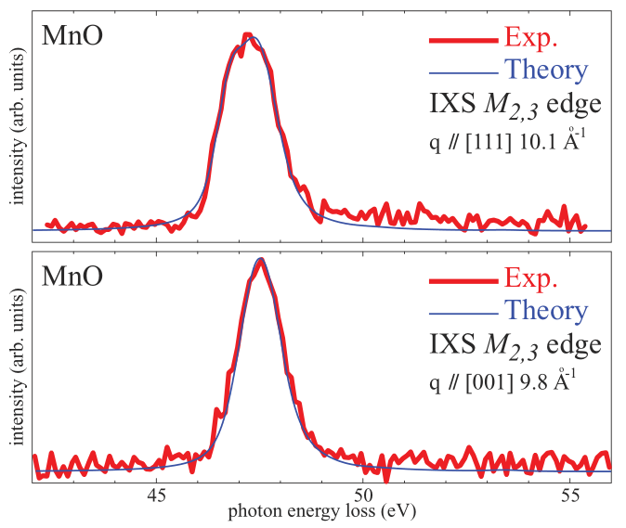
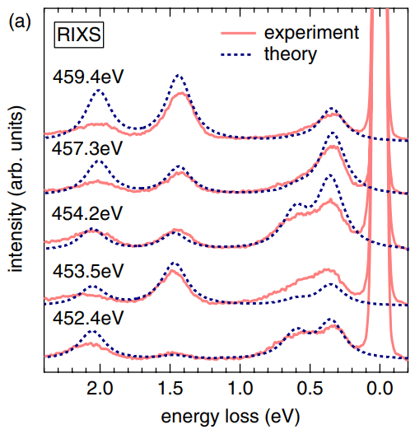
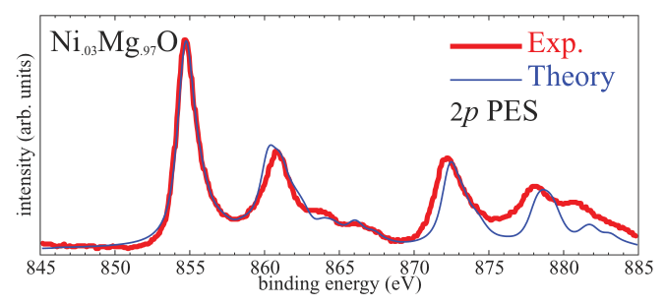
Recap: The success of crystal and ligand field theories

Slide 3
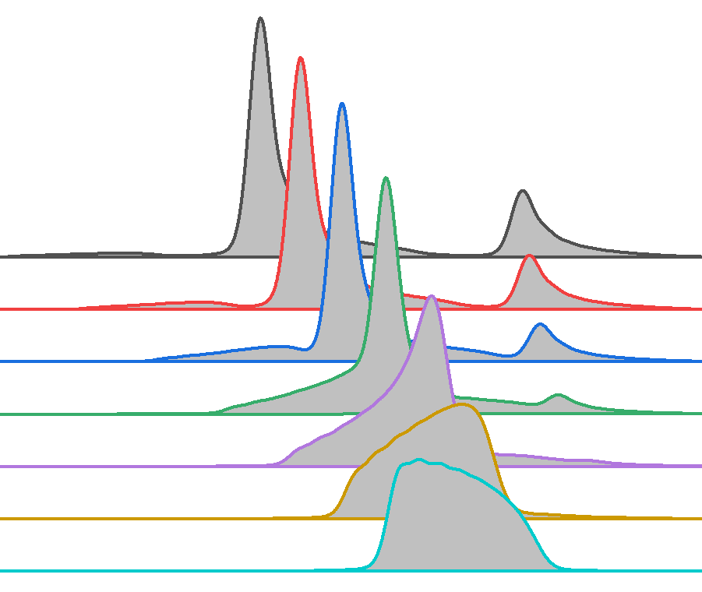
For some material + experiment combinations, LFT is insufficient
1. Perovskite nickelate XAS
2. Rocksalt 3d oxide RIXS
3. Impurity in/on a non-correlated metal

Slide 4
Case 1: Perovskite Nickelate XAS
Double Clusters for Highly Covalent Oxides

Slide 5
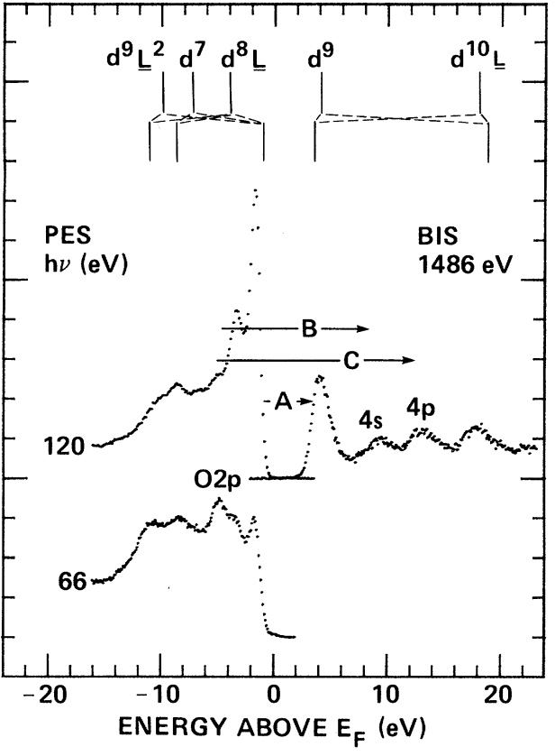
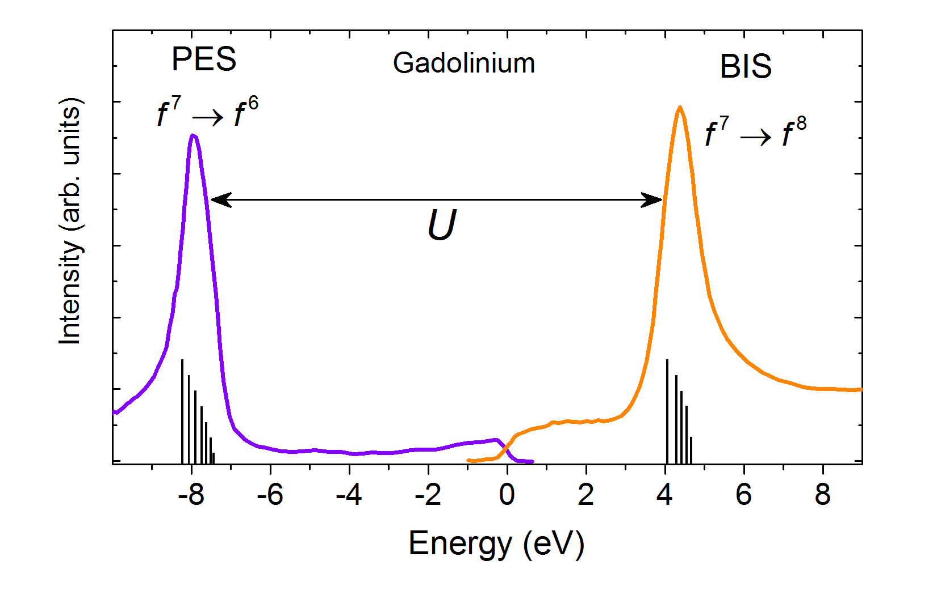


3d transition metal oxides
Δ
$$p^{6}d^{n}→p^{5}d^{n+1}$$
U
U
$$d^{n}d^{n}→d^{n−1}d^{n+1}$$
Δ
J. Phys. F: Metal Phys. 11, 121 (1981)
PRL 53, 2339 (1985)

Slide 6
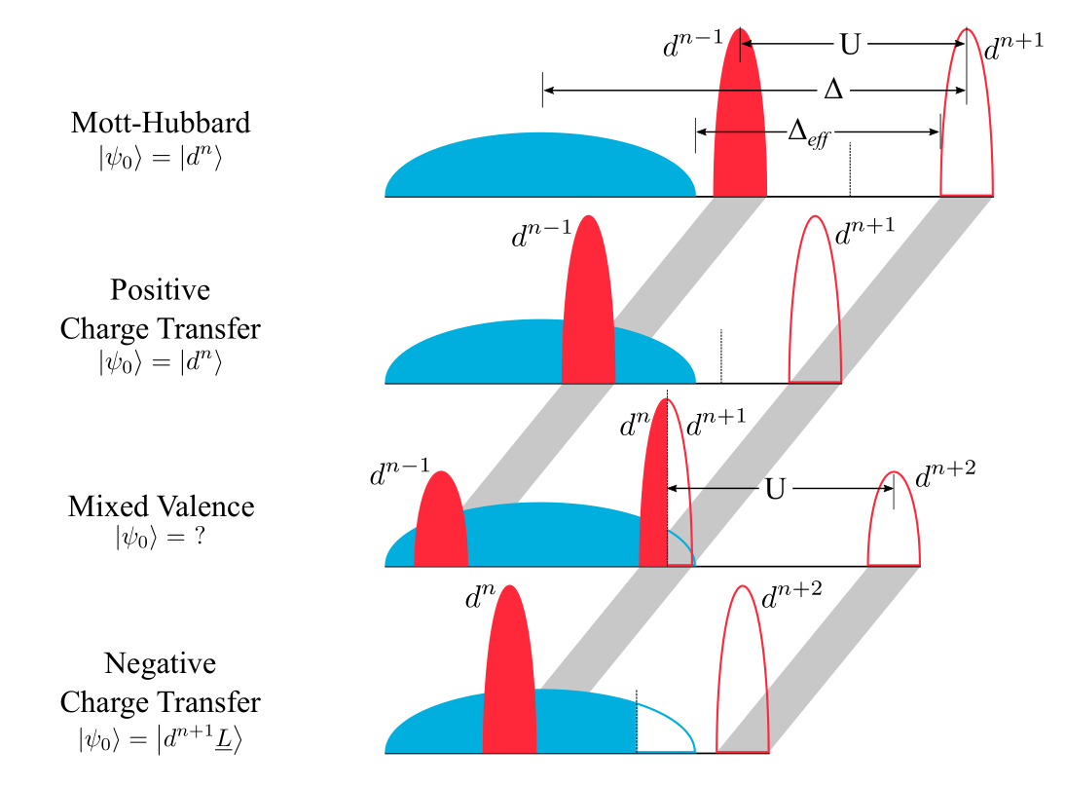
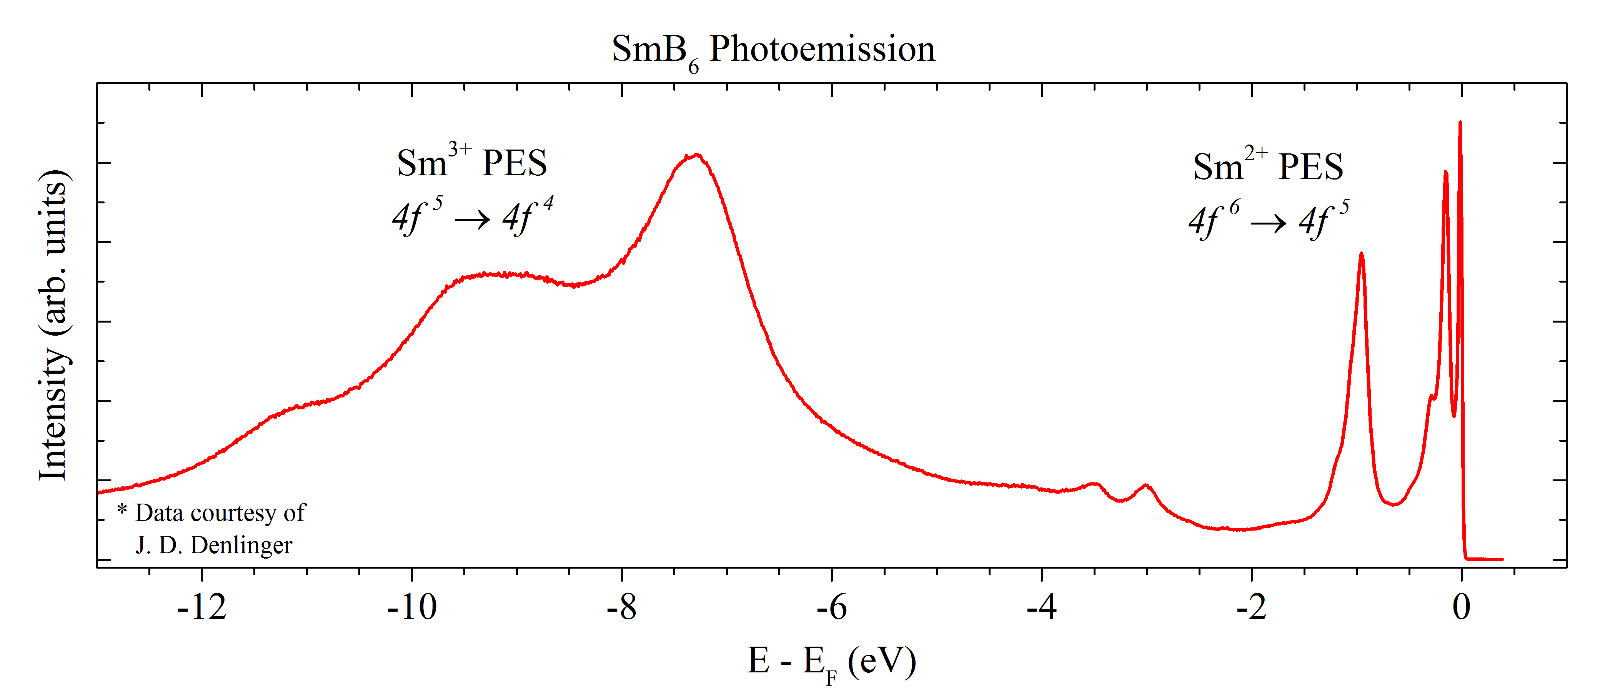
Classification of Correlated Compounds
Sawatzky and Green, cond-mat.de/events/correl16/manuscripts/

Slide 7
Classification of Correlated Compounds
Sawatzky and Green, cond-mat.de/events/correl16/manuscripts/

Slide 8
Charge Transfer Trends
+
-
Mn Fe Co Ni Cu
N | O | F
P | S | Cl
As | Se | Br
Sb | Te | I
 |  |  | R³⁺NiO₃ | NaCuO₂
 | SrFeO₃ | SrCoO₃
2+
3+
4+
Oxide Trends
Anion Trends

Slide 9
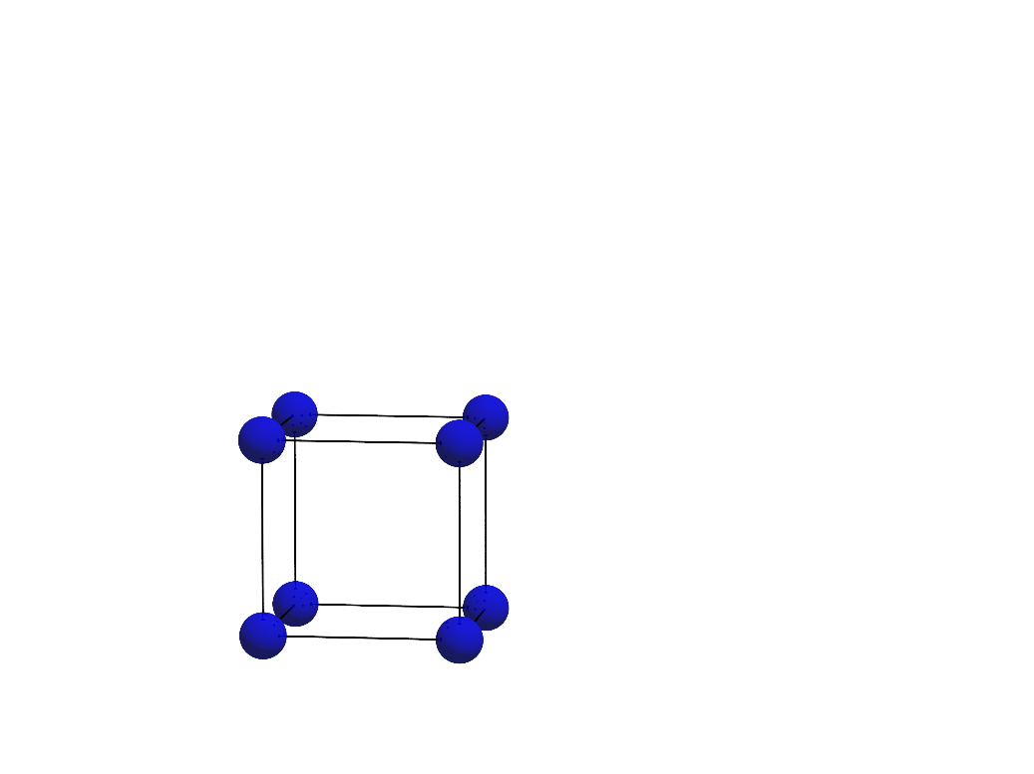
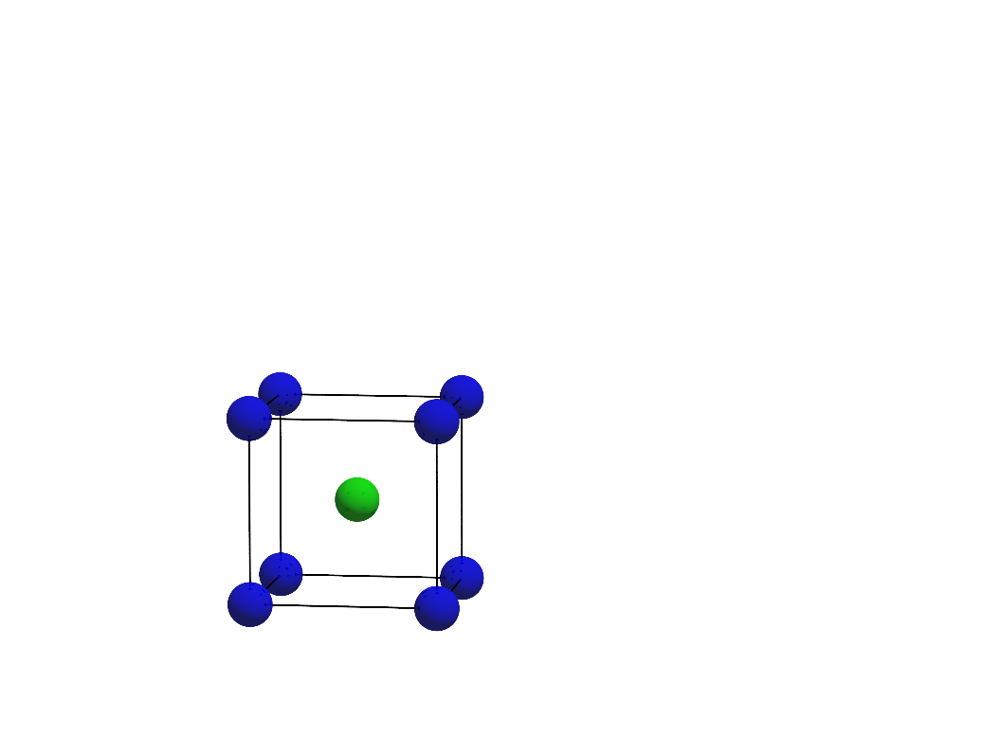
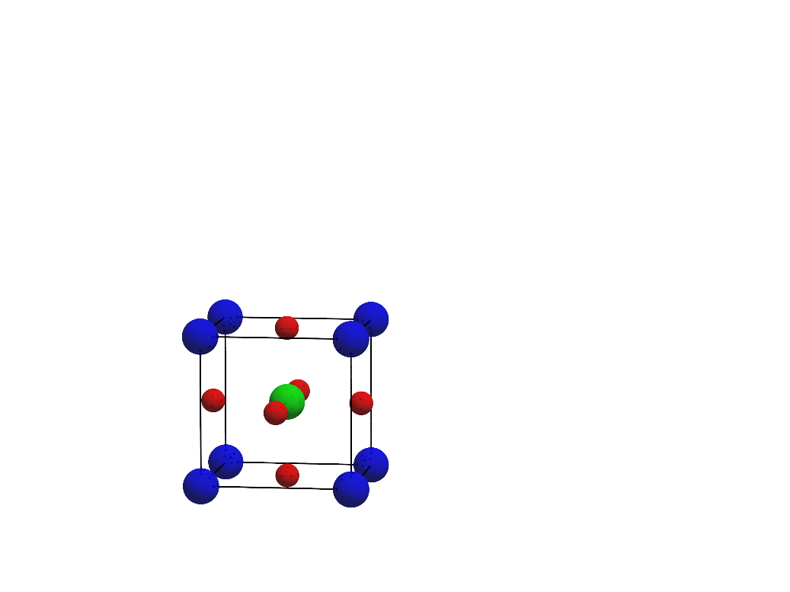
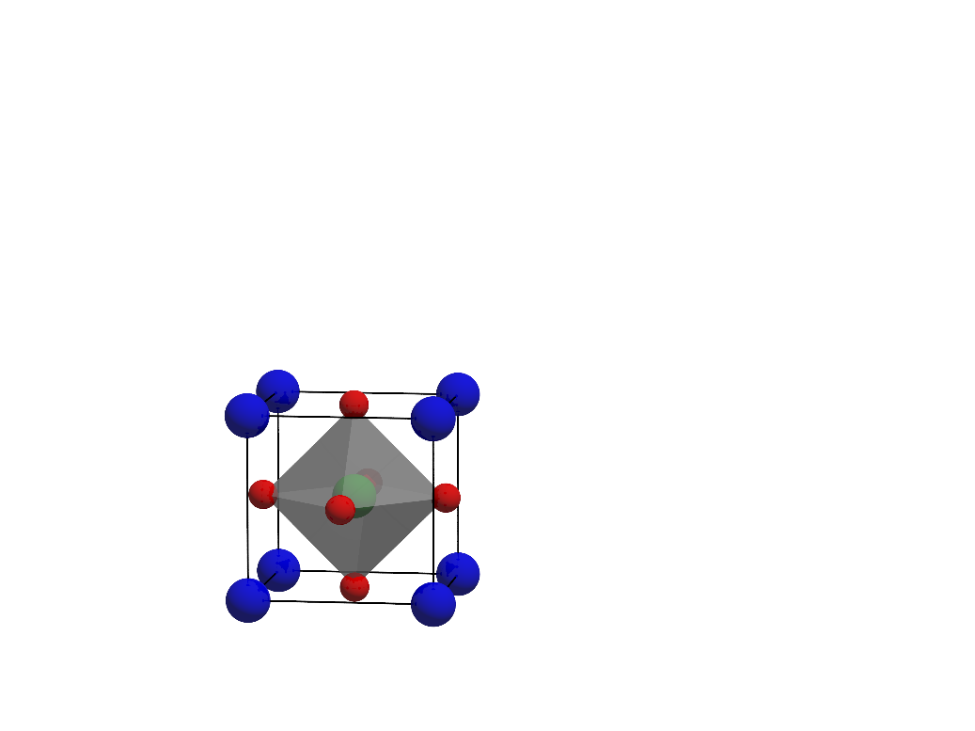
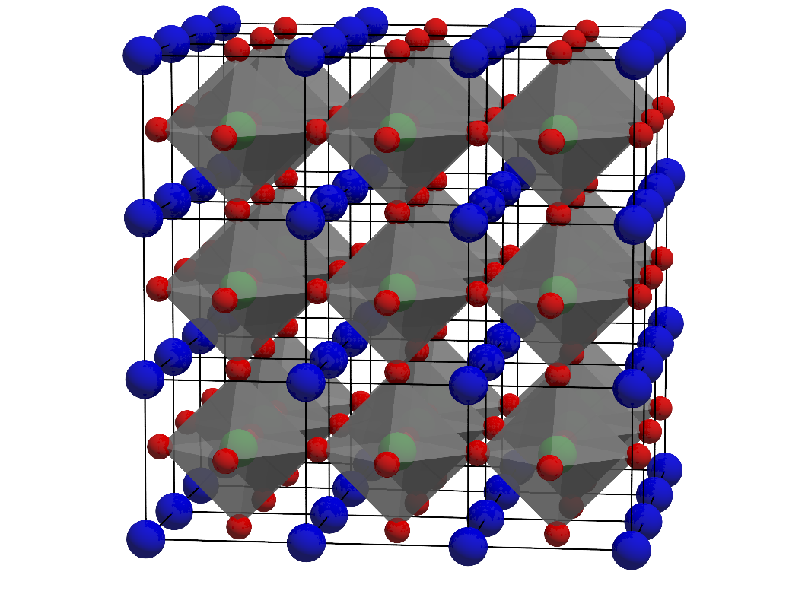
Review of the Perovskite Oxide Crystal Structure
Many different combinations of A and B possible
 |  |  |  |  |  |  |  |  |  |  |  |  |  |  | O
 | Ca | Sc | Ti | V | Cr | Mn | Fe | Co | Ni | Cu
 | Sr
 | Ba
 |  |  | La | Ce | Pr | Nd | Pm | Sm | Eu | Gd | Tb | Dy | Ho | Er | Tm | Yb | Lu

Slide 10
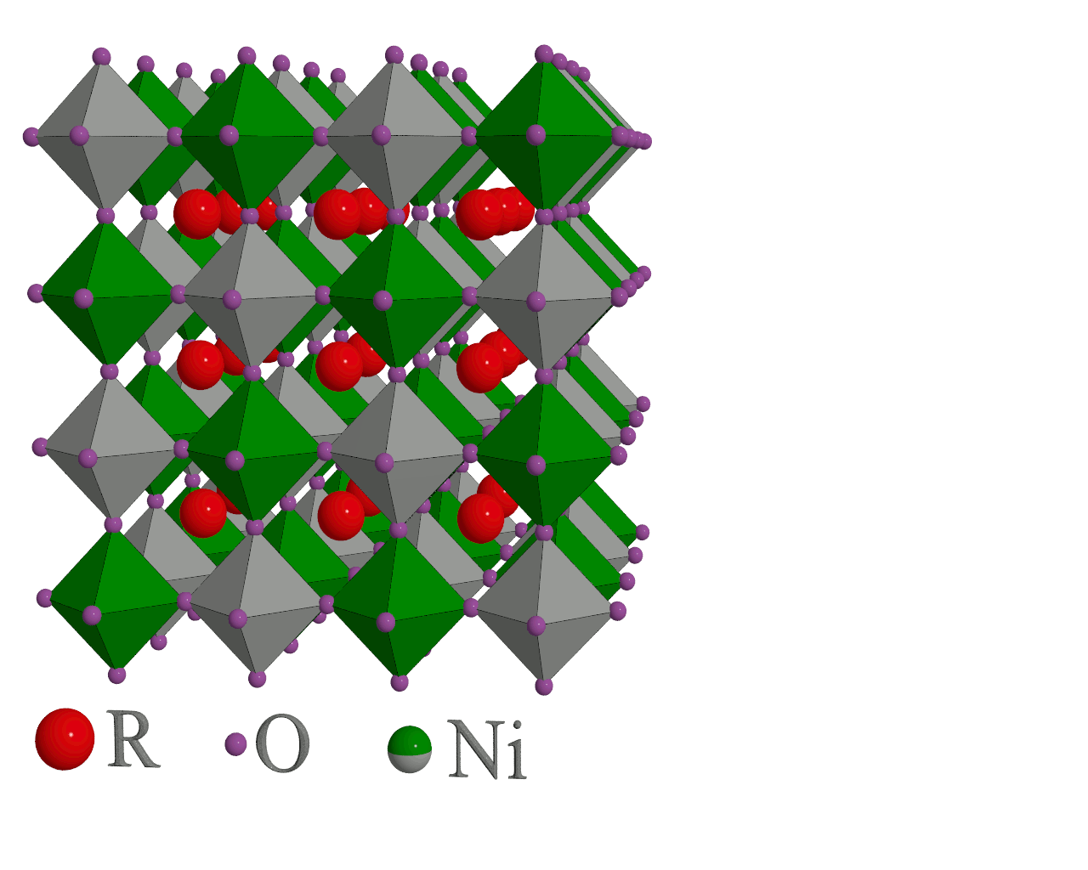
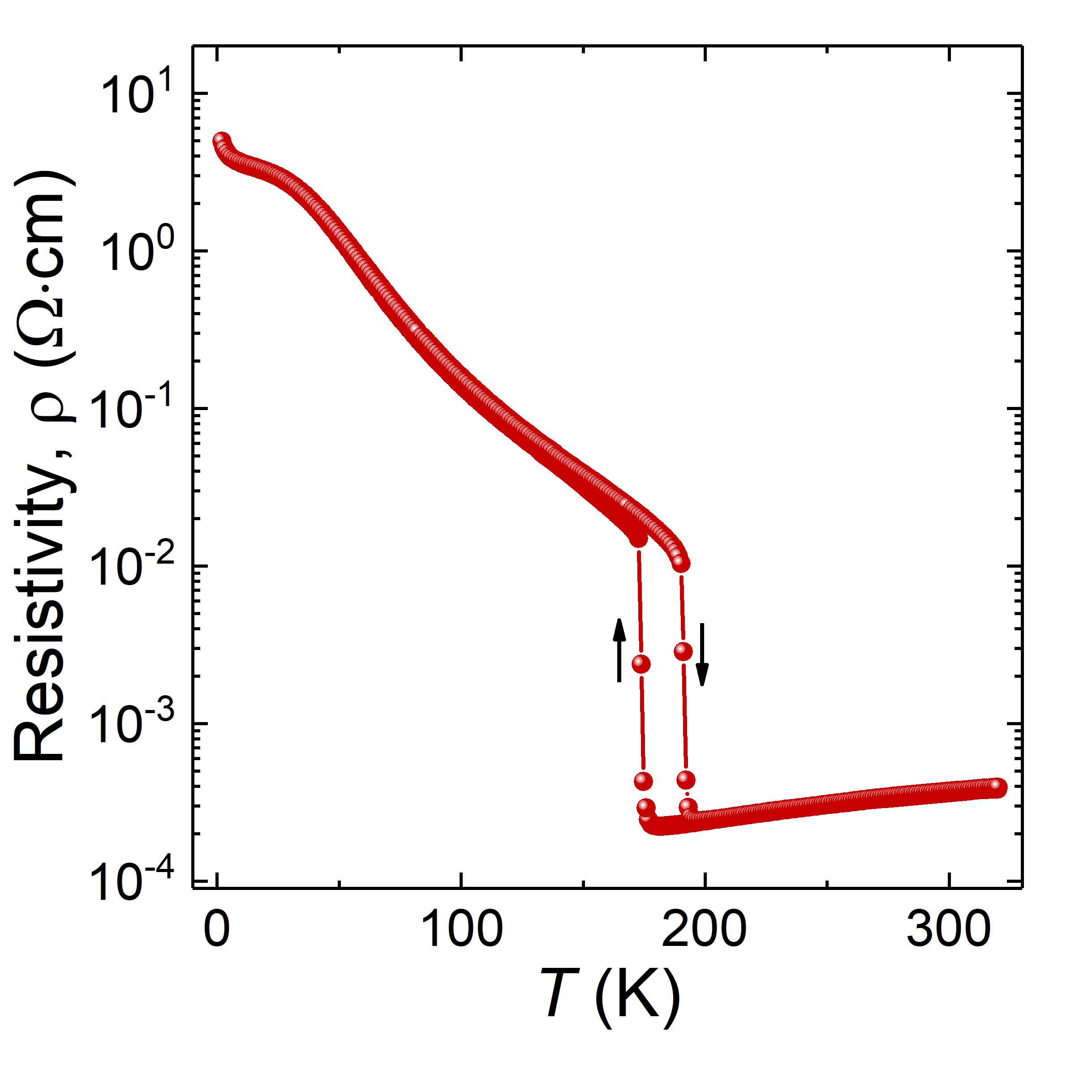
Perovskite Nickelates: RNiO₃
Temperature-dependent metal-insulator transition
“Breathing distortion” in low temperature insulating phase
NdNiO₃

Slide 11
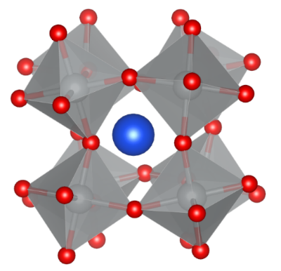
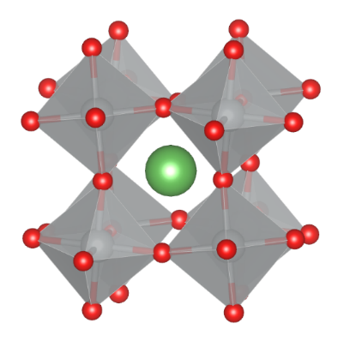
Perovskite Nickelates: RNiO₃
Phase diagram for metal-insulator transition and magnetic order

Slide 12
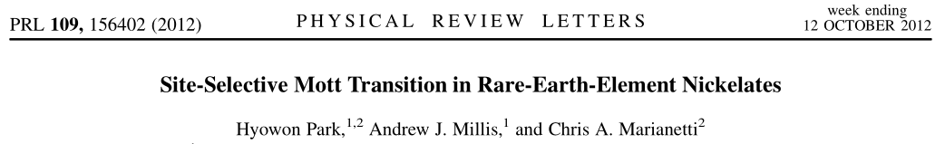
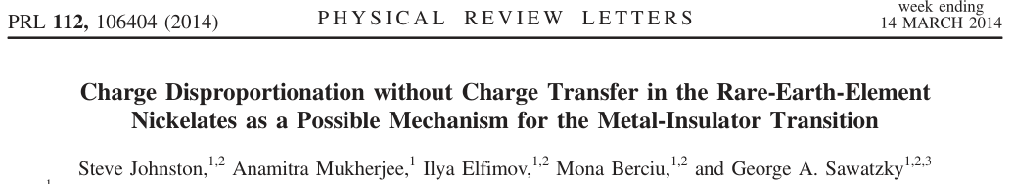
Perovskite Nickelates: RNiO₃
Thought to be a negative charge transfer system – disobeys formal oxidation state rules
R³⁺Ni³⁺(O₃)⁶⁻ → R³⁺Ni²⁺(O₃)⁵⁻
Nickel prefers to be 2+ (3d⁸ occupation), and there are corresponding “self-doped” holes in oxygen band
MIT can then be understood as “bond disproportionation”:
d⁸L¹ (S=1/2) + d⁸L¹ (S=1/2) → d⁸L⁰ (S=1) + d⁸L² (S=0)

Slide 13
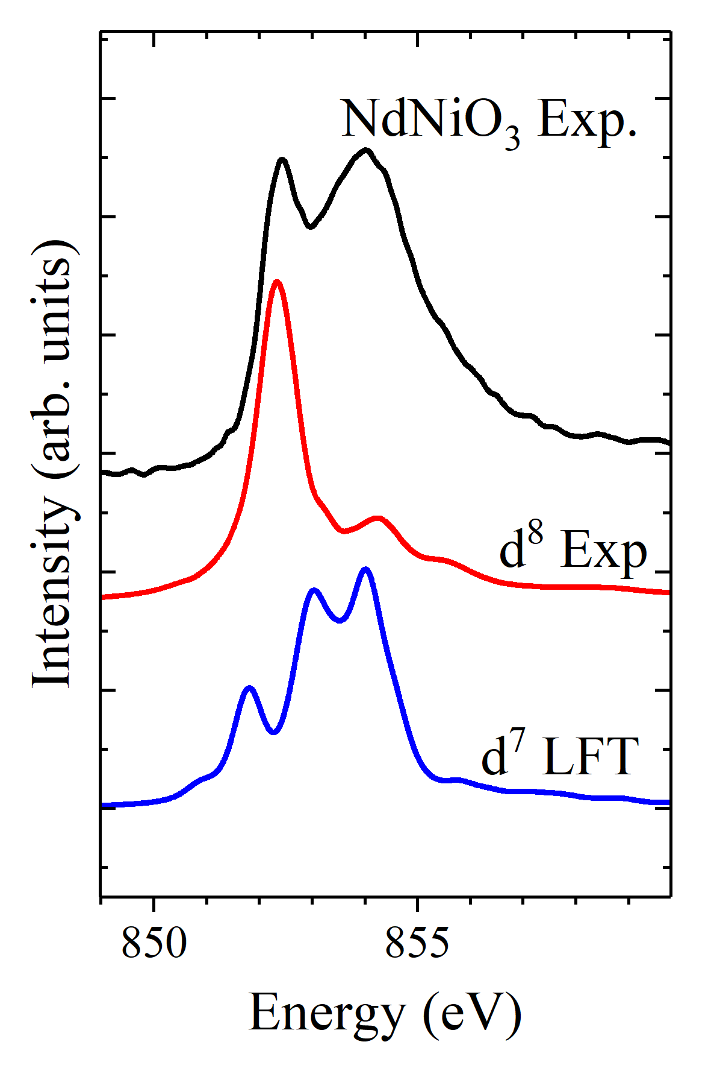
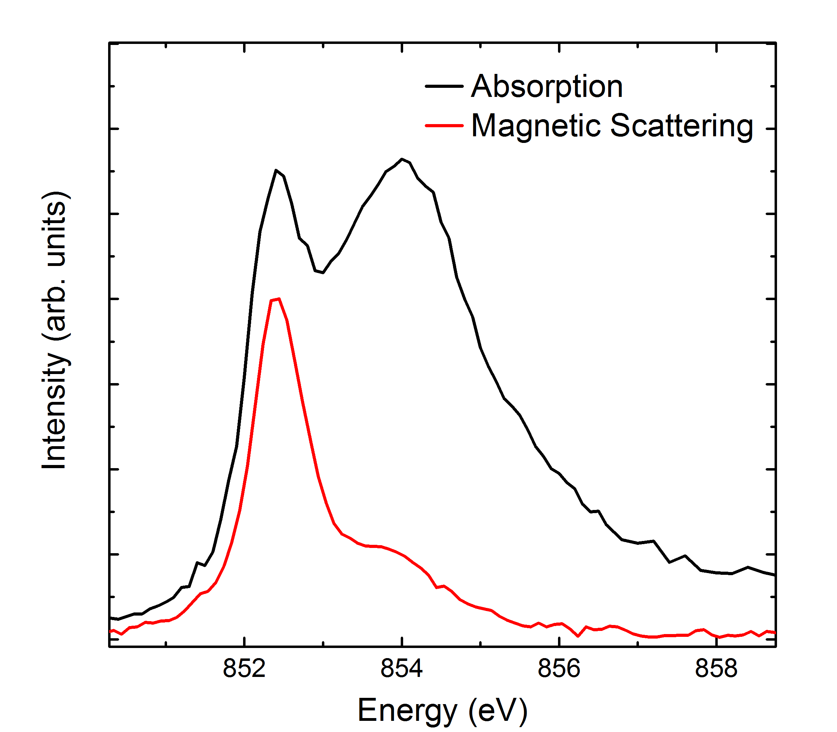
Perovskite Nickelates: RNiO₃
Experimental absorption and magnetic diffraction data should provide insight on the electron occupation and charge transfer energy
NdNiO₃ Experiment
One can use creative broadening for d⁷ LFT to get reasonable XAS, but then the magnetic scattering fails

Slide 14
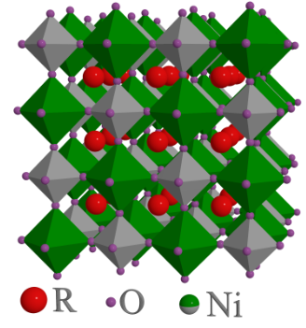
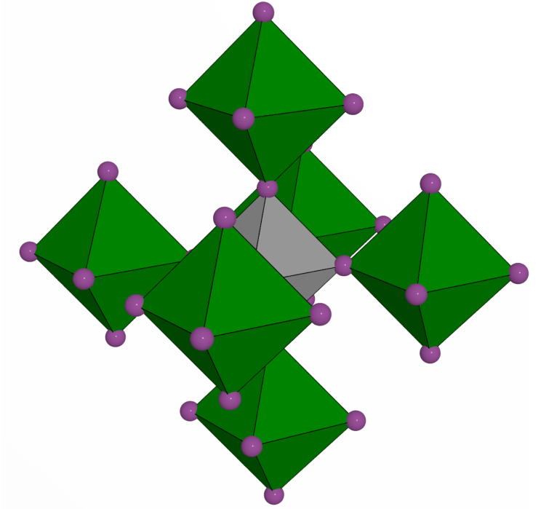
Can we improve on ligand field theory? What might be missing?

Slide 15



Double Cluster Model
Ligand field theory: NiO₆ cluster, exact diagonalization
Coulomb
Spin-orbit
$$Δ, 10Dq, T_{pp}$$
$$V_{eg},V_{t2g}$$
Two of these clusters, coupled via $O_{h}$ symmetric hybridization operator
Phys. Rev. B 94, 195127 (2016)

Slide 16
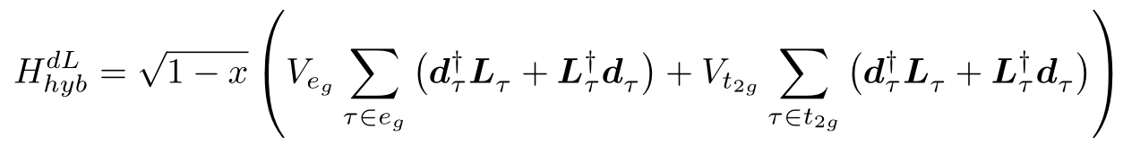
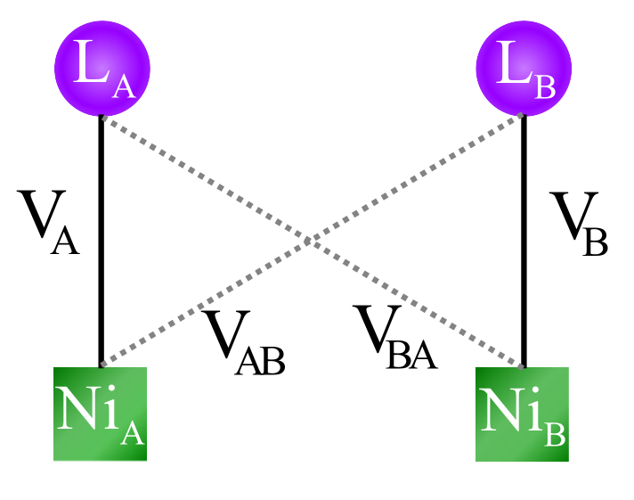
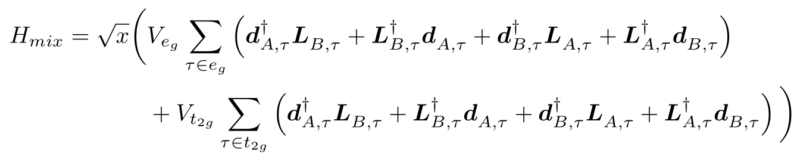
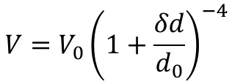
Double Cluster Model
$\sqrt{x}$ and $\sqrt{1−x}$ prefactors allow one to gradually turn on coupling between clusters
For perovskite, where two Ni share 1 out of 6 oxygens, we expect $x≈1/6$
Variations of bond lengths via Harrison’s rules
$$V=V_{0}{\left(1+\frac{δd}{d_{0}}\right)}^{−4}$$
Phys. Rev. B 94, 195127 (2016)

Slide 17
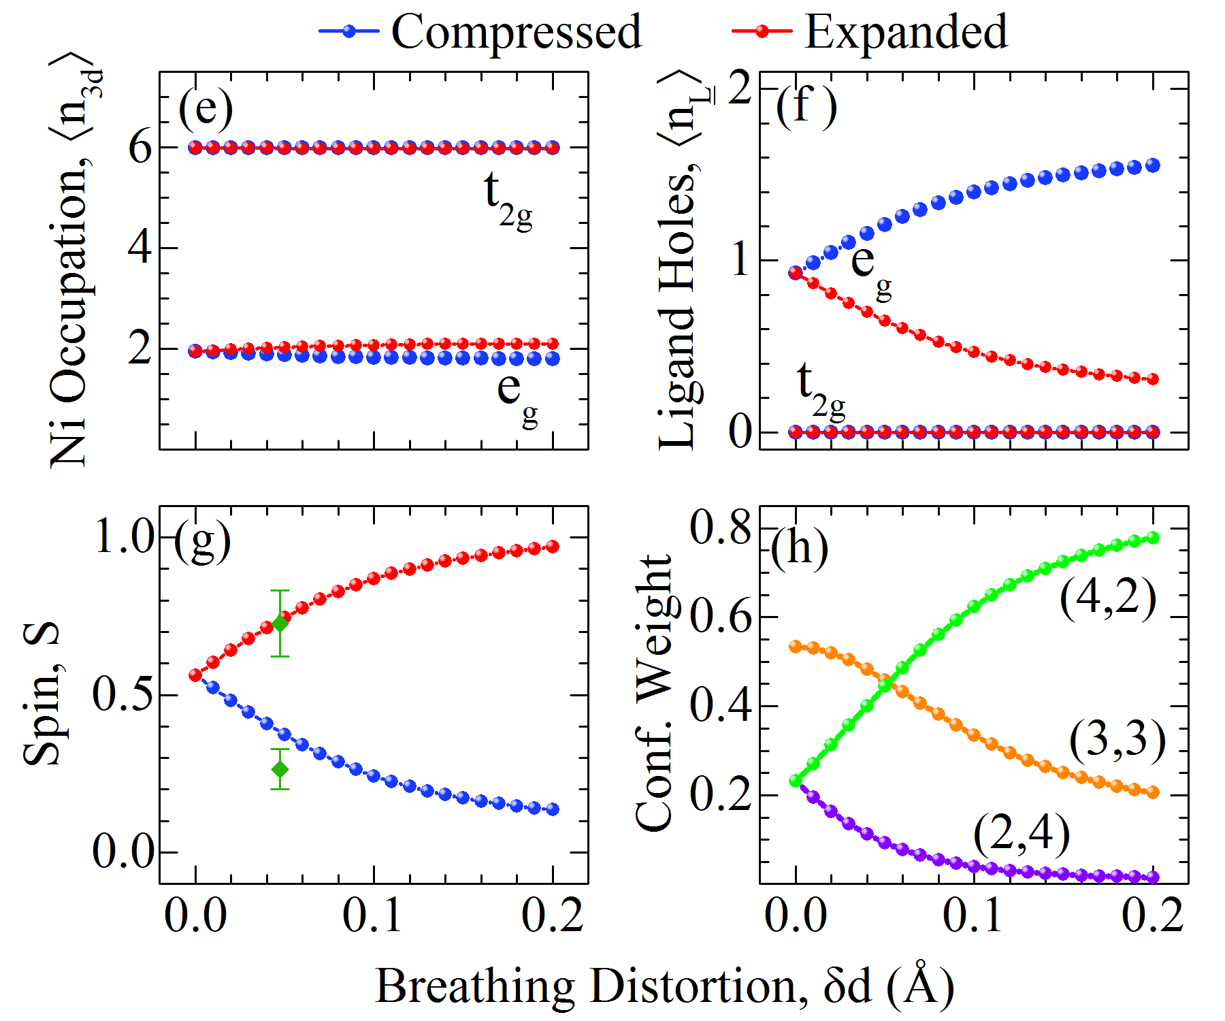
Double Cluster Model
Phys. Rev. B 94, 195127 (2016)

Slide 18
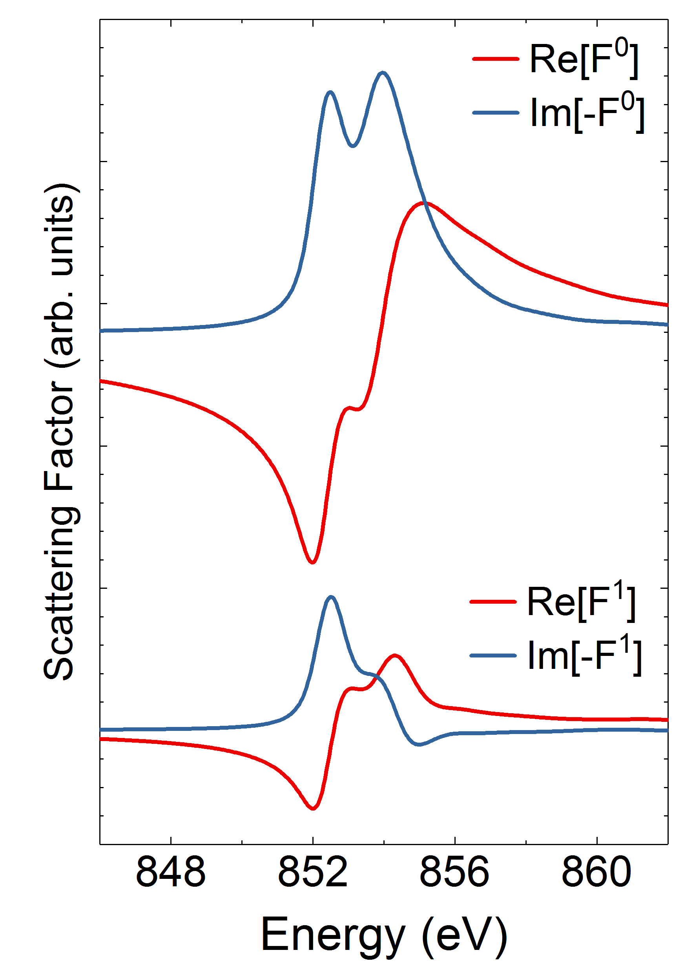
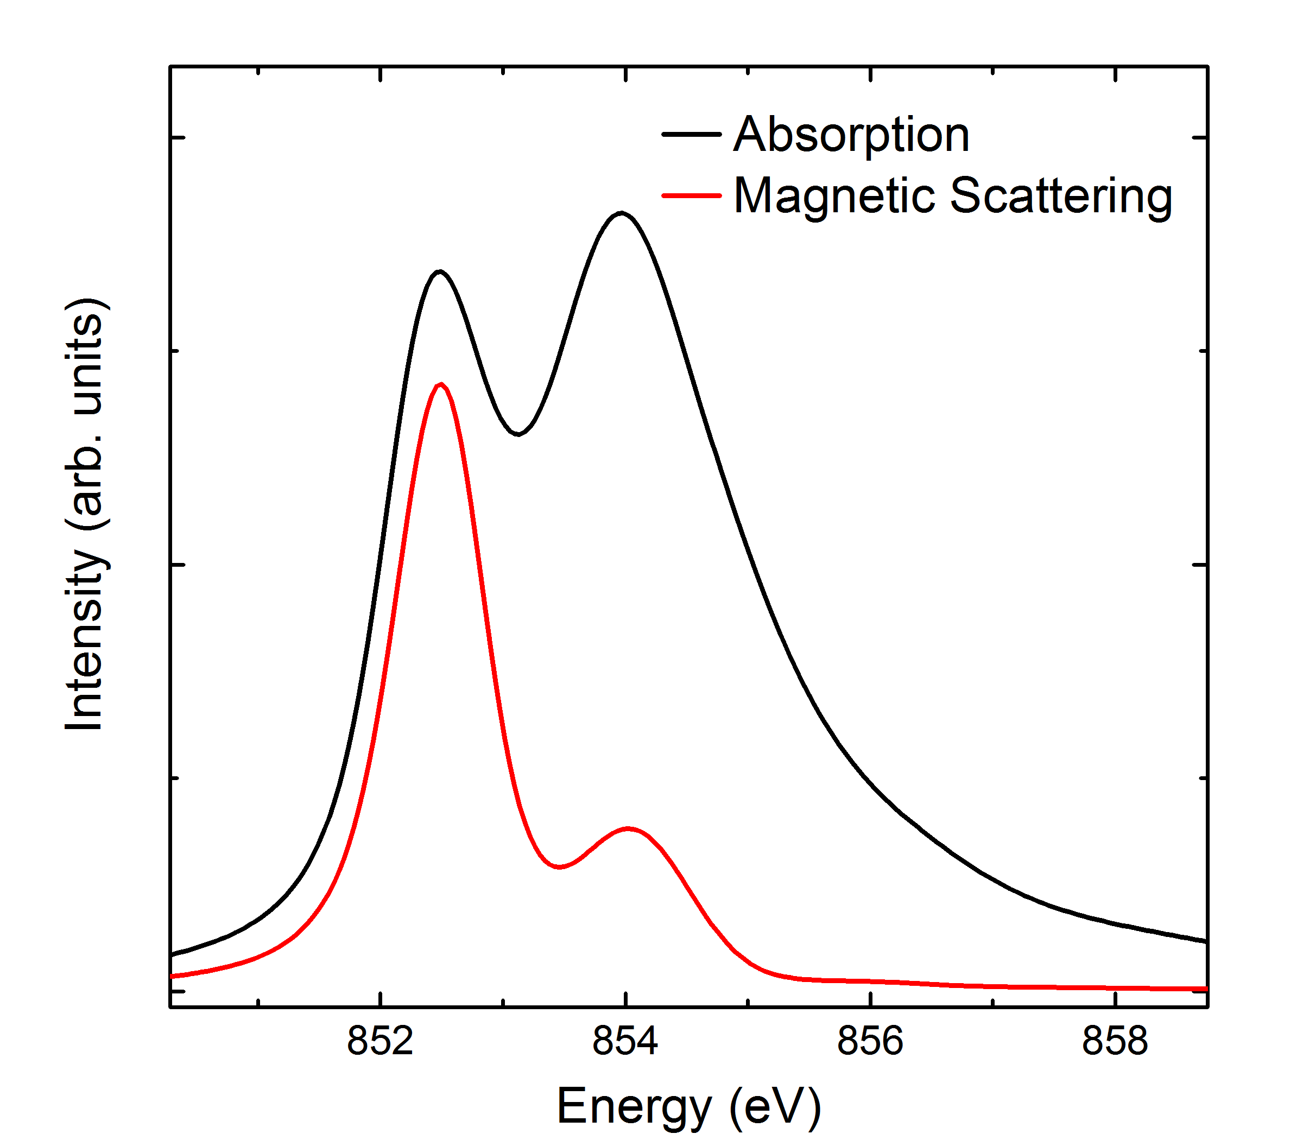


Double Cluster Model
We can use the model to compute the isotropic and MCD components of the scattering tensor
From these, we can calculate the XAS and magnetic scattering energy dependence, and find excellent agreement with experiment
Theory
NdNiO₃ Experiment
$$XAS∝−Im\left(F_{A}^{0}+F_{B}^{0}\right)$$
$$RMD∝{\left|F_{A}^{1}+iF_{B}^{1}\right|}^{2}$$
Phys. Rev. B 94, 195127 (2016)

Slide 19
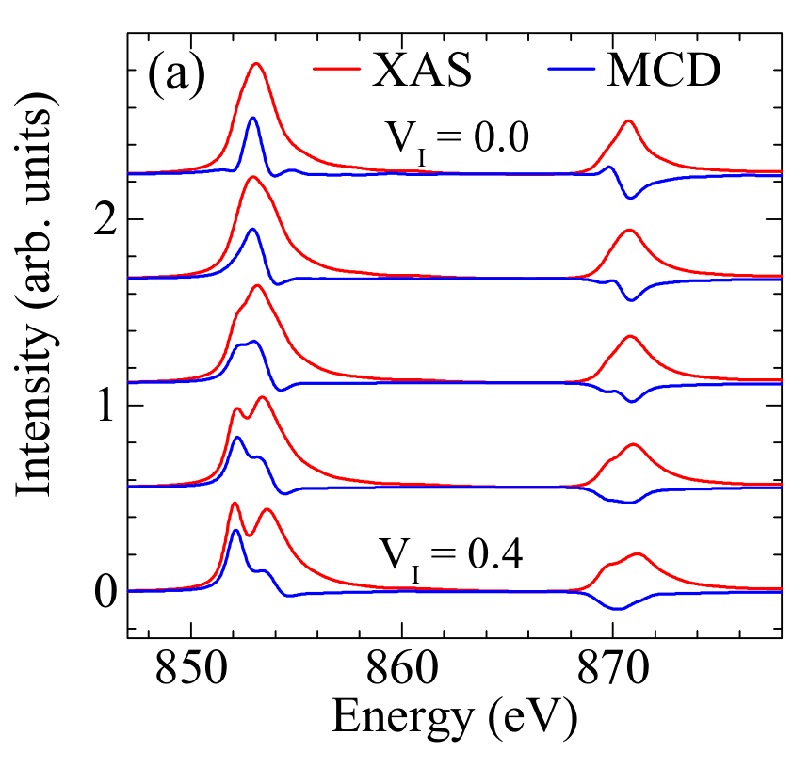
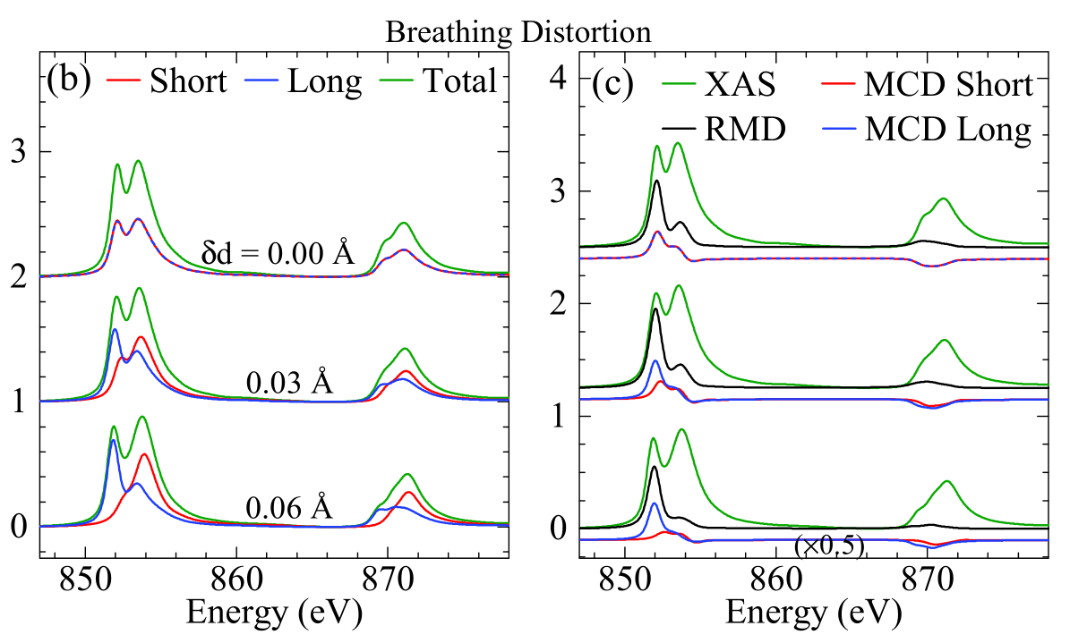
Double Cluster Model
The main spectral features are captured by the double cluster model without any breathing distortion
The most important thing is to capture inter-cluster charge fluctuations
Breathing distortion leads to unique spectra at each site, which sum to yield a spectrum exhibiting weak (but important) changes with breathing distortion

Slide 20
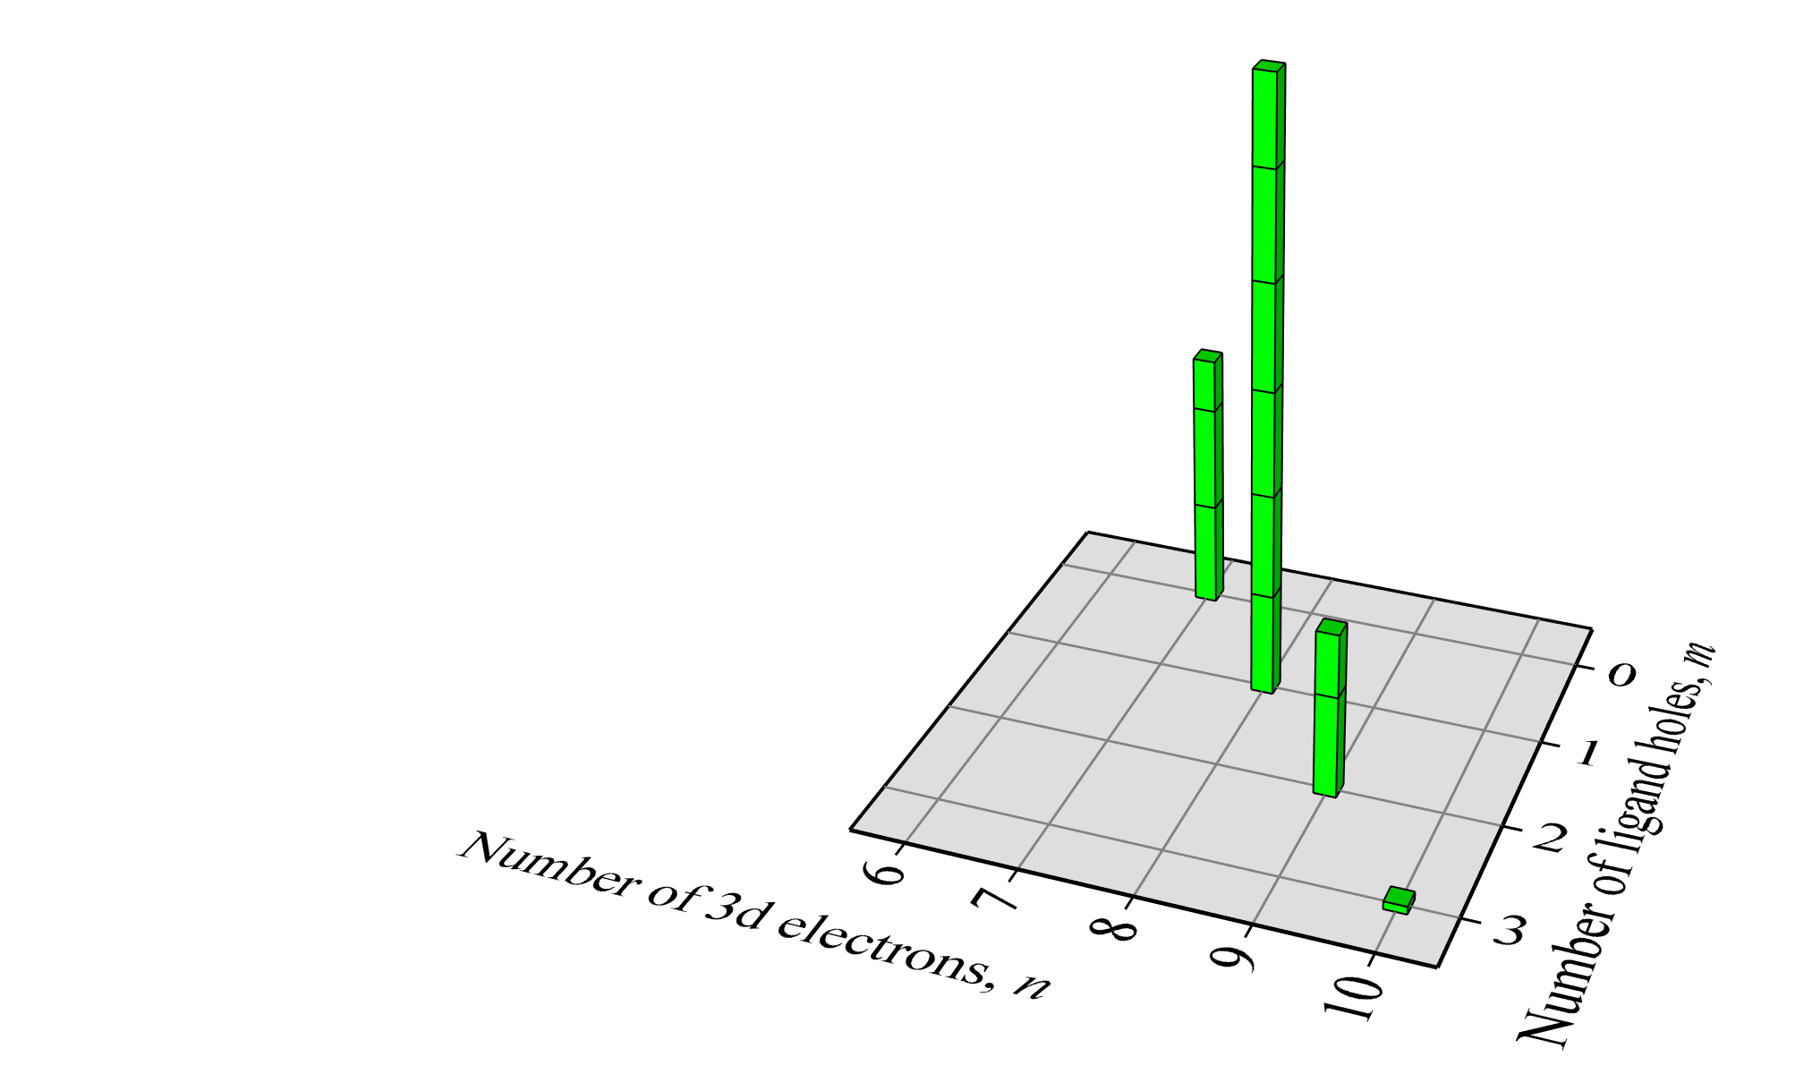
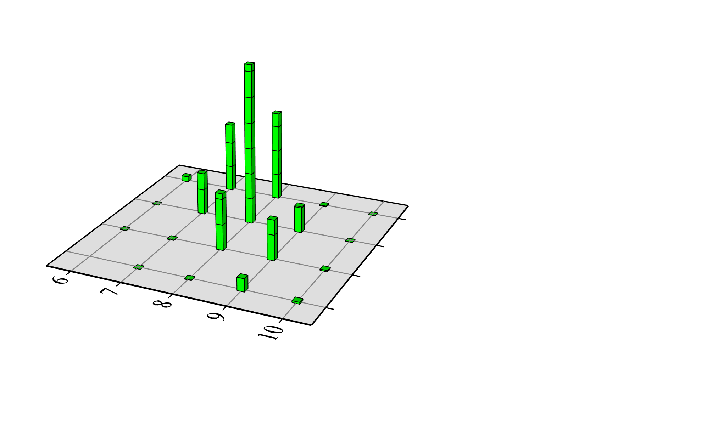
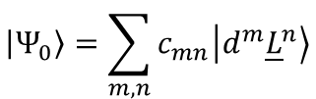
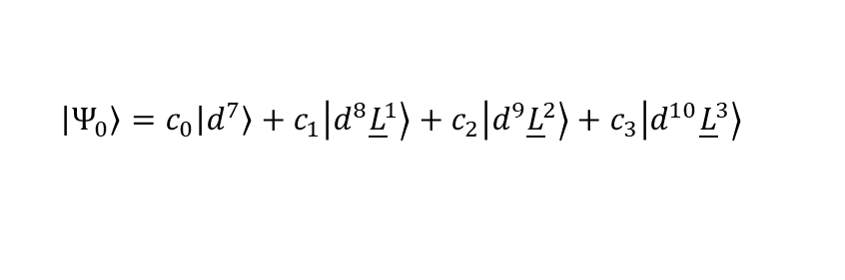
Highly Covalent Ground State
$$\left|\left.Ψ_{0}\right\rangle \right.=\sum_{m,n}{c_{mn}\left|\left.d^{m}{\underline{L}}^{n}\right\rangle \right.}$$
$$\left|\left.Ψ_{0}\right\rangle \right.=c_{0}\left|\left.d^{7}\right\rangle \right.+c_{1}\left|\left.d^{8}{\underline{L}}^{1}\right\rangle \right.+c_{2}\left|\left.d^{9}{\underline{L}}^{2}\right\rangle \right.+c_{3}\left|\left.d^{10}{\underline{L}}^{3}\right\rangle \right.$$
Single Cluster
Double Cluster

Slide 21


A Note on Complexity
With single cluster ligand field theory, our basis size is
d^{n} | Single | Double
0 | 1.8E+05 | 1.4E+11
1 | 1.7E+05 | 1.1E+11
2 | 1.3E+05 | 6.3E+10
3 | 7.8E+04 | 2.3E+10
4 | 3.9E+04 | 5.6E+09
5 | 1.6E+04 | 8.5E+08
6 | 4.8E+03 | 7.7E+07
7 | 1.1E+03 | 3.8E+06
8 | 1.9E+02 | 9.1E+04
9 | 2.0E+01 | 7.8E+02
10 | 1.0E+00 | 1.0E+00
$$\left(\begin{matrix}20 \\ 10+n\end{matrix}\right)=\frac{20!}{\left(10+n\right)!\left(10−n\right)!}$$
With double cluster ligand field theory, our basis size is
$$\left(\begin{matrix}40 \\ 20+2n\end{matrix}\right)=\frac{40!}{\left(20+2n\right)!\left(20−2n\right)!}$$

Slide 22
Case 2: 2p3d RIXS of Oxides
Impurity models to capture ligand band effects

Slide 23
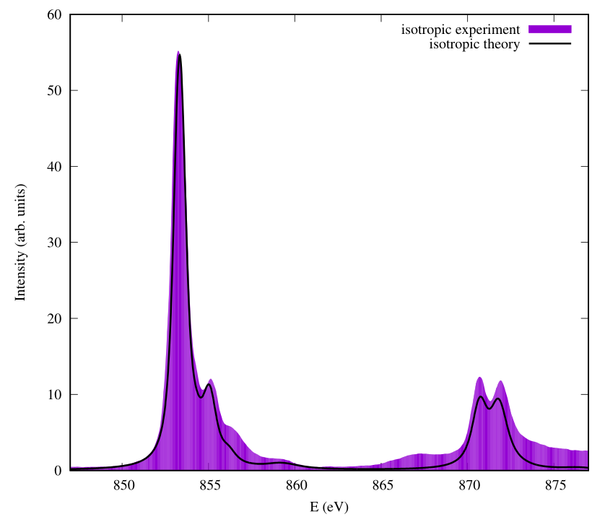
Case 2: Anderson Impurity Model for 2p3d RIXS in Oxides
Back to NiO example
During Tuesday tutorial, we saw that ligand field theory gives good agreement with XAS
We added extra broadening in charge transfer region to improve agreement
But for some experiments which directly probe these charge transfer states, we find that ligand field theory fails

Slide 24
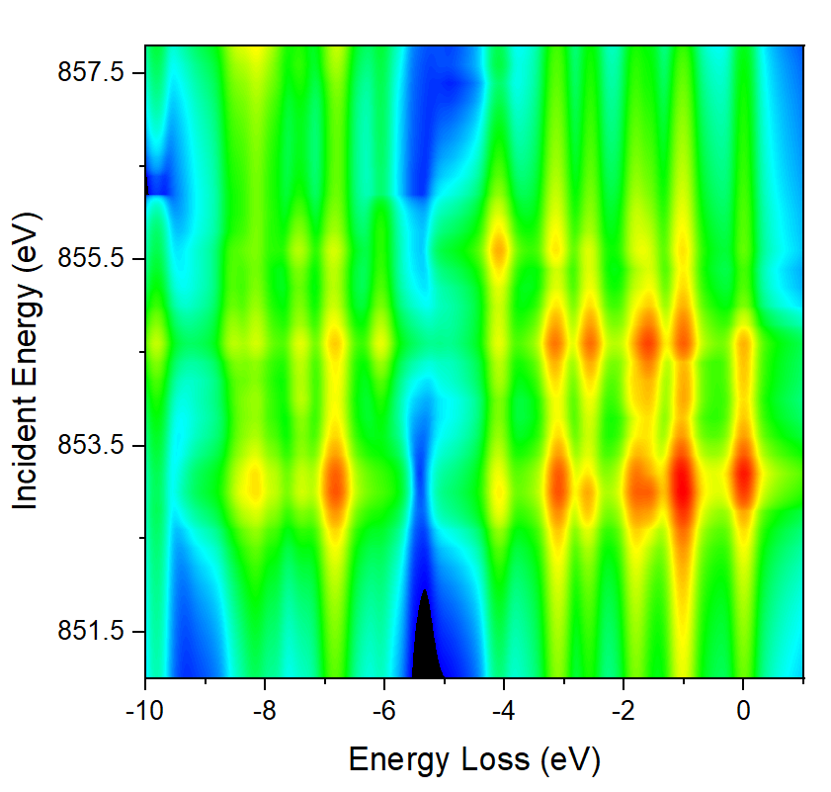
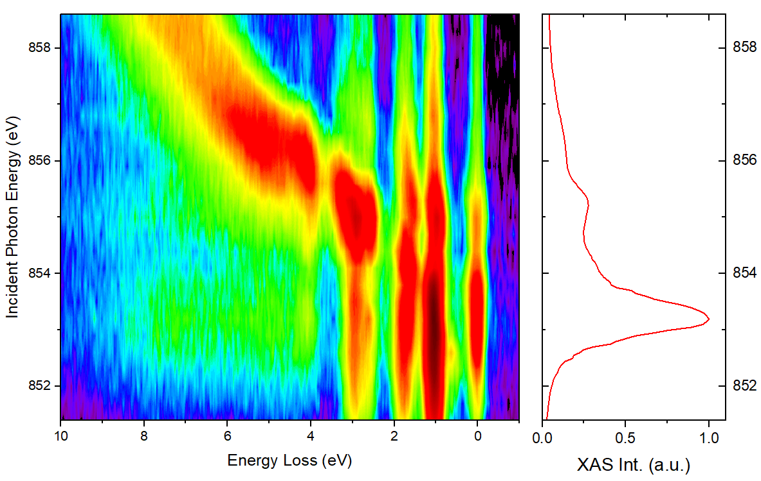
Nickel Oxide 2p3d RIXS
Ligand Field Theory
Experimental Data
Ligand field theory is missing the dispersing nature of the charge transfer excitations
Experimental data from PRL 102, 027401 (2009), courtesy G. Ghiringhelli

Slide 25
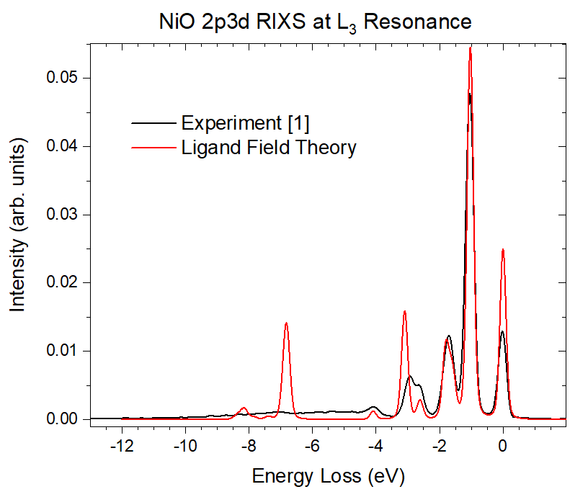
Nickel Oxide 2p3d RIXS
Ligand field theory also shows sharp charge transfer excitations, instead of a band when exciting at resonance
To understand these deficiencies, let’s consider the RIXS process, first from the ligand field theory point of view
[1] PRL 102, 027401 (2009), data courtesy G. Ghiringhelli

Slide 26
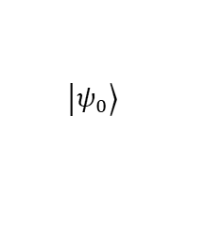
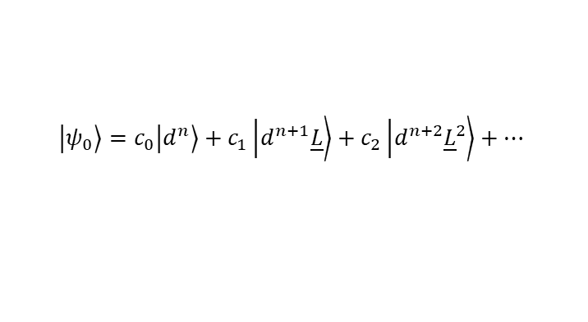
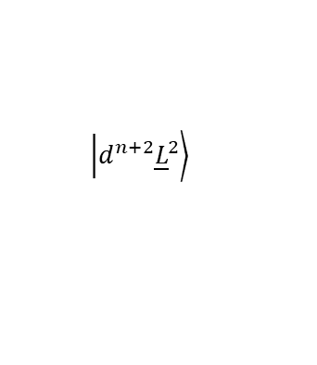
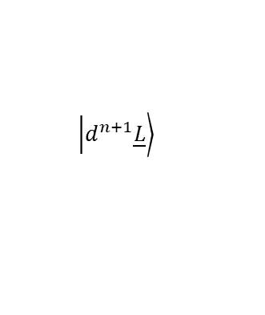
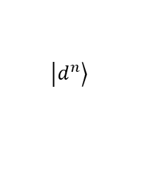
Ligand Field Theory Review
$$\left.\left|d^{n+2}{\underline{L}}^{2}\right.\right\rangle$$
Δ + U
$$\left.\left|d^{n+1}\underline{L}\right.\right\rangle$$
Δ
$$\left.\left|d^{n}\right.\right\rangle$$
$$\left.\left|ψ_{0}\right.\right\rangle$$
$$\left.\left|ψ_{0}\right.\right\rangle =c_{0}\left.\left|d^{n}\right.\right\rangle +c_{1}\left.\left|d^{n+1}\underline{L}\right.\right\rangle +c_{2}\left.\left|d^{n+2}{\underline{L}}^{2}\right.\right\rangle +…$$

Slide 27

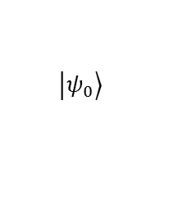




Ligand Field Theory Review
XPS
XAS
Δ + U - Q
Δ + 2U - Q
Δ - Q
Δ + U - Q
NiBr₂
$$\underline{c}d^{9}\underline{L}$$
NiO
$$\underline{c}d^{9}$$
$$\underline{c}d^{10}{\underline{L}}^{2}$$
$$\left.\left|ψ_{0}\right.\right\rangle$$
$$\underline{c}d^{10}\underline{L}$$
$$\underline{c}d^{8}$$

Slide 28
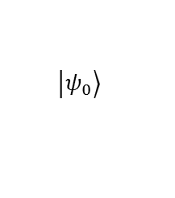
Ligand Field Theory Review
XAS
RIXS
Δ + U
Δ
$$\left.\left|ψ_{0}\right.\right\rangle$$

Slide 29

Impurity Model
Recall that our ligand states actually form a broad band
So our $d^{n+1}\underline{L}$ configurations will have a different energy depending on where the ligand electron came from within the band

Slide 30





Impurity Model
$$|\left.d^{n+2}{\underline{L}}^{2}\right\rangle$$
$$Δ+U$$
$$|\left.d^{n+1}\underline{L}\right\rangle$$
$$Δ$$
$$|\left.d^{n}\right\rangle$$
LFT
Impurity

Slide 31
RIXS from the Impurity Model Perspective
$$\left.\left|ψ_{0}\right.\right\rangle$$
The dispersing “fluorescence” spectra arise from resonantly exciting different parts of the charge transfer band

Slide 32







Implementation of impurity model – “Anderson geometry”
$$ε_{N}$$
$$V_{N}$$
...
$L$ shells
$d$ shell
$$V_{1}$$
$$ε_{1}$$
We “distribute” our total LFT hopping $V_{c}$ over our set of ligand sites:
$$\sum_{i=1}^{N}{V_{i}^{2}}=V_{c}^{2}$$
The specific $V_{i}$ and/or $ε_{i}$ set the shape of our band (a.k.a. hybridization function)

Slide 33


Implementation
In our calculation, we need to include an additional ligand shell (with 10 fermions), for EACH ligand site we want to include (i.e. how finely we want to discretize the band)
$$ε_{N}$$
$$V_{N}$$
...
$L$ shells
$d$ shell
Once we have included the shells in Quanty, we simply have to define hopping operators and set onsite energies to form a band
$$V_{1}$$
$$ε_{1}$$
E.g., for a rectangular band of width $W$ discretized by $N$ points, and total hopping integral $V_{T}$,
$$ε_{i}=\left\{−\frac{W}{2},−\frac{W}{2}+\frac{W}{N−1},−\frac{W}{2}+\frac{2W}{N−1},…,\frac{W}{2}\right\}$$
$$V_{i}=\frac{V_{T}}{\sqrt{N}}$$

Slide 34


A Note on Complexity
With single cluster ligand field theory, our basis size is
d^{n} | N=1 (LFT) | N=20 | N=100
0 | 1.8E+05 | 3.7E+16 | 2.9E+23
1 | 1.7E+05 | 1.8E+15 | 2.9E+21
2 | 1.3E+05 | 8.2E+13 | 2.6E+19
3 | 7.8E+04 | 3.2E+12 | 2.1E+17
4 | 3.9E+04 | 1.1E+11 | 1.5E+15
5 | 1.6E+04 | 3.2E+09 | 8.7E+12
6 | 4.8E+03 | 7.9E+07 | 4.3E+10
7 | 1.1E+03 | 1.5E+06 | 1.7E+08
8 | 1.9E+02 | 2.2E+04 | 5.1E+05
9 | 2.0E+01 | 2.1E+02 | 1.0E+03
10 | 1.0E+00 | 1.0E+00 | 1.0E+00
$$\left(\begin{matrix}20 \\ 10+n\end{matrix}\right)=\frac{20!}{\left(10+n\right)!\left(10−n\right)!}$$
With an impurity model having $N$ (full) ligand sites, our basis size is
$$\left(\begin{matrix}10N+10 \\ 10N+n\end{matrix}\right)=\frac{\left(10N+10\right)!}{\left(10N+n\right)!\left(10−n\right)!}$$

Slide 35

Impurity model RIXS for NiO
XAS
Using similar parameters as LFT, but now add a band
Captures both $dd$ excitations and dispersing charge transfer excitations
RIXS

Slide 36



Comparison to Experiment
Impurity Model
Experiment
Ghiringhelli et al., JP:CM, 17, 5397 (2005)

Slide 37








Improvements in Efficiency
With the Anderson impurity model in the traditional hybridization geometry, the impurity couples directly to each ligand site
The ground state wavefunction then has weight distributed over all ligand sites, leading to a complicated (large) wavefunction
We can transform to a more efficient bath geometry
$$V_{A,N}$$
$$ε_{A,N}$$
$$V_{C,1}$$
$$V_{C,N}$$
...
...
$$ε_{C,1}$$
$$ε_{C,N}$$
$$V_{A,1}$$
$$ε_{A,1}$$
Anderson Geometry
Chain Geometry

Slide 38
Hybridization Operator Layout
Anderson geometry
Chain geometry
Impurity couples to all ligands
Impurity couples to one ligand
Ligands couple to form chain
Examples and comparisons in tutorial session

Slide 39


Many-body Hamiltonian
Two different basis choices for same 3d impurity Hamiltonian.
Which is better for computing the ground state (iteratively)?

Slide 40
Case 3: Correlated impurity in/on a non-correlated Metal
Impurity model with metallic bath & natural orbital geometry

Slide 41
Case 3: Impurity in/on a Metal
From earlier in the week – in spectroscopy we might see bands, excitons, and resonances
Band
Resonance
Exciton
K-edges, DFT
?
L-edges, MCFT/MLFT/AIM

Slide 42

Case 3: Impurity in/on a Metal
A key property of the oxide impurity model was that the bath of oxygen ligands was completely full (before hybridization)
...
The oxides are insulators, so any charge fluctuations from the metal to the conduction band are at a higher energy scale and can (usually) be neglected
For an impurity coupled to a metallic bath the problem becomes much more complex (historically called the infrared divergence problem)
...
If our starting configuration is $d^{n}$, we have many, many low energy configurations of the form $d^{n}\underline{v}c$ which mix into our groundstate.
...

Slide 43
Case 3: Impurity in/on a Metal
We can do a bit better by transforming to a full chain + empty chain representation
...
...
...
...

Slide 44
Case 3: Impurity in/on a Metal
We can do much better by transforming to a natural impurity orbital representation
...
...
...
...

Slide 45


Case 3: Impurity in/on a Metal
We can do much better by transforming to a natural impurity orbital representation
Many-body Hamiltonian
(Nbath=5)

Slide 46
With our impurity coupled to a metallic bath on a natural impurity orbital basis, we can study band, resonance, and exciton formation in spectra
More details in tutorial session this afternoon
W=1
U=20
Q=2.0
W=1
U=20
Q=0.25
W=1
U=20
Q=0.5
W=1
U=20
Q=1.0
W=1
U=20
Q=1.25
W=1
U=20
Q=1.5
W=1
U=20
Q=1.75
W=1
U=20
Q=0
Intensity
Intensity
Intensity
Intensity
Intensity
Intensity
Intensity
Intensity
Energy (eV)
Energy (eV)
Energy (eV)
Energy (eV)
Energy (eV)
Energy (eV)
Energy (eV)
Energy (eV)
Figure from M. Haverkort

