Slide 1



A Multiscale approach to dispersive excitations in RIXS
Institute for
Theoretical Physics

Slide 2
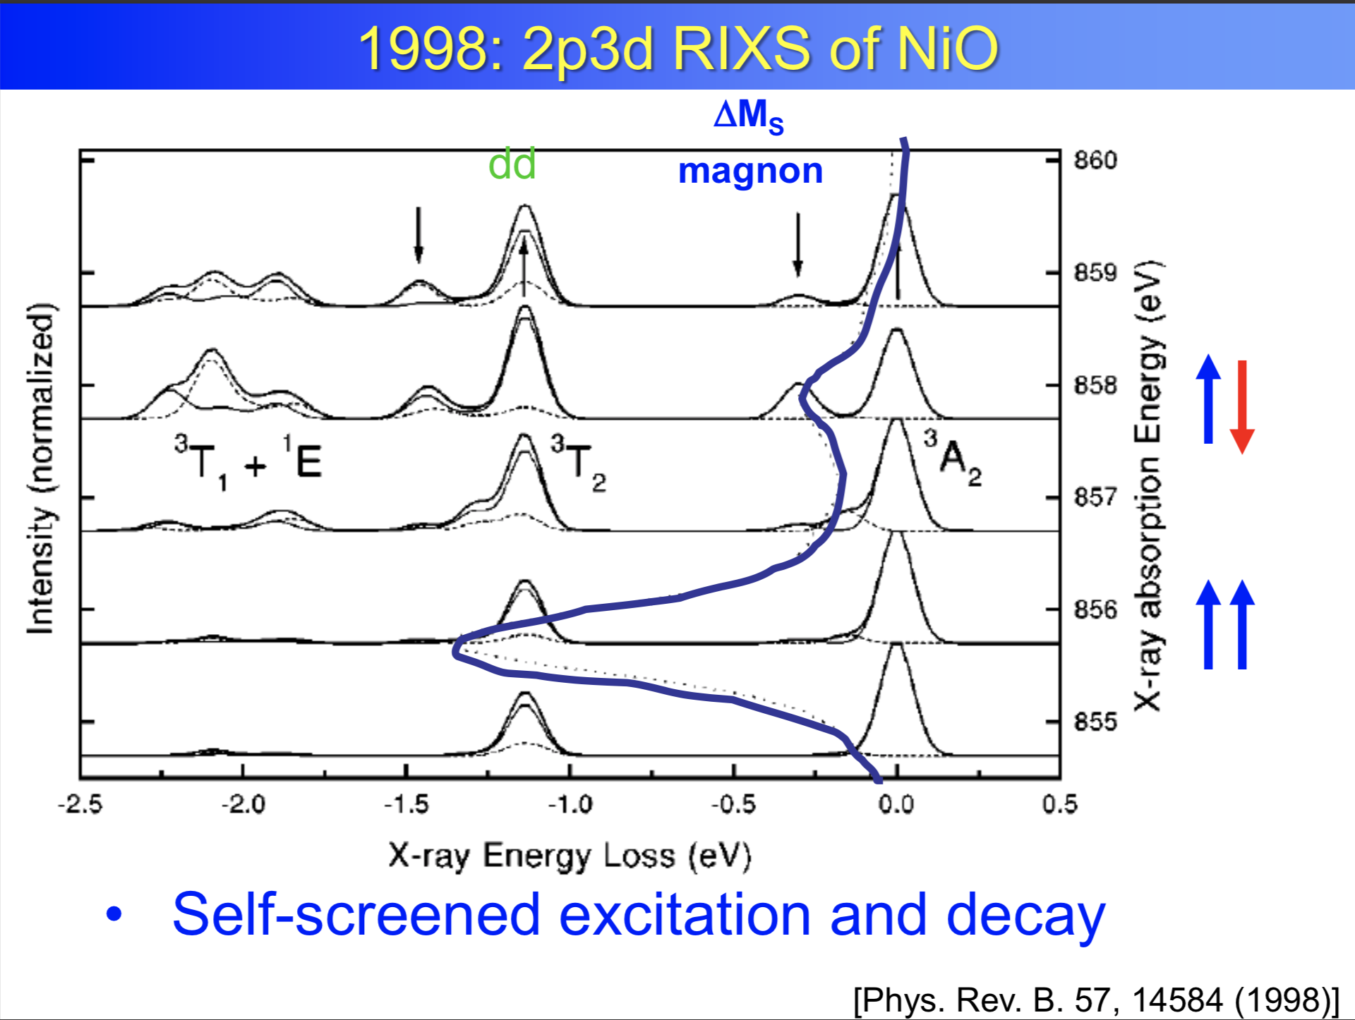
Frank de Groot: You can use RIXS to measure magnons

Slide 3
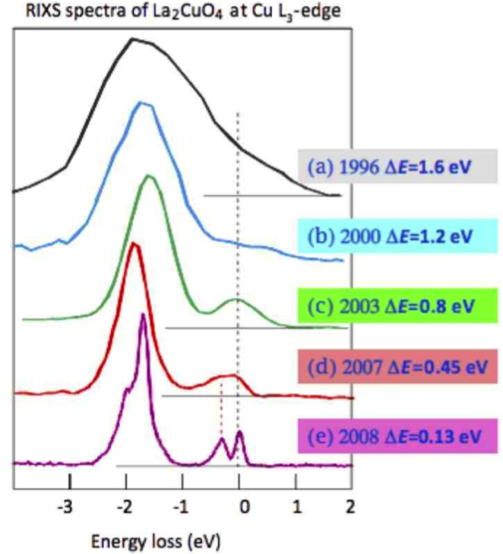
But the resolution is a challange
Picture by G. Ghiringhelli and L. Braicovich

Slide 4
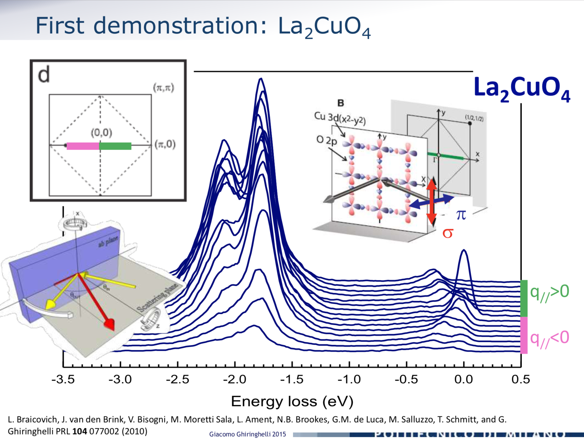
Giacomo Ghiringhelli, but possible

Slide 5
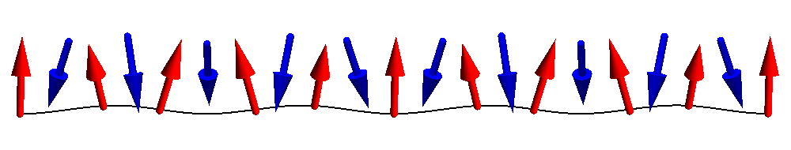
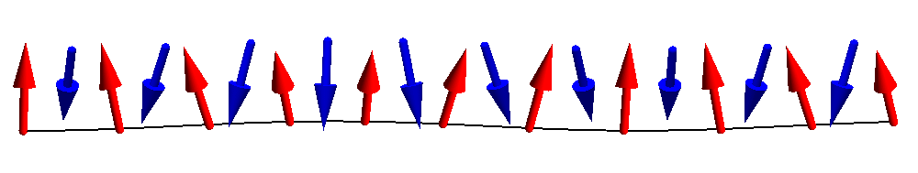
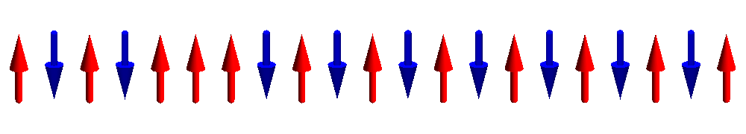
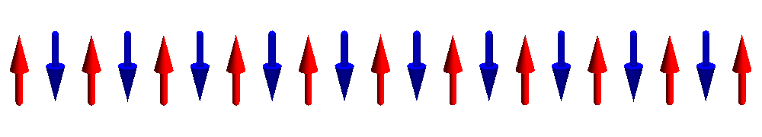
Dispersing magnons

Slide 6
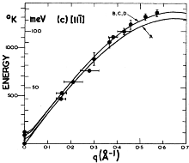
Dispersing magnons – Neutron scattering
Interaction of Neutrons with matter is well understood (magnetic dipole),
single magnon intensity
q-dispersion
M. T. Hutchings and E. J. Samuelsen,
Phys. Rev. B 6, 3447 (1972)

Slide 7
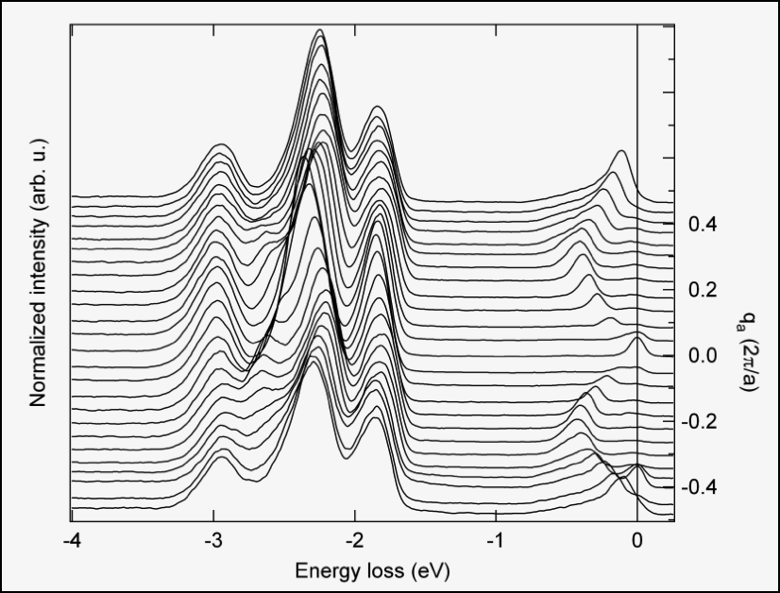
Justina Schlappa: Dispersing orbitals in Sr₂CuO₃
spinons

Slide 8
Spin excitations in 1-dimension

Slide 9
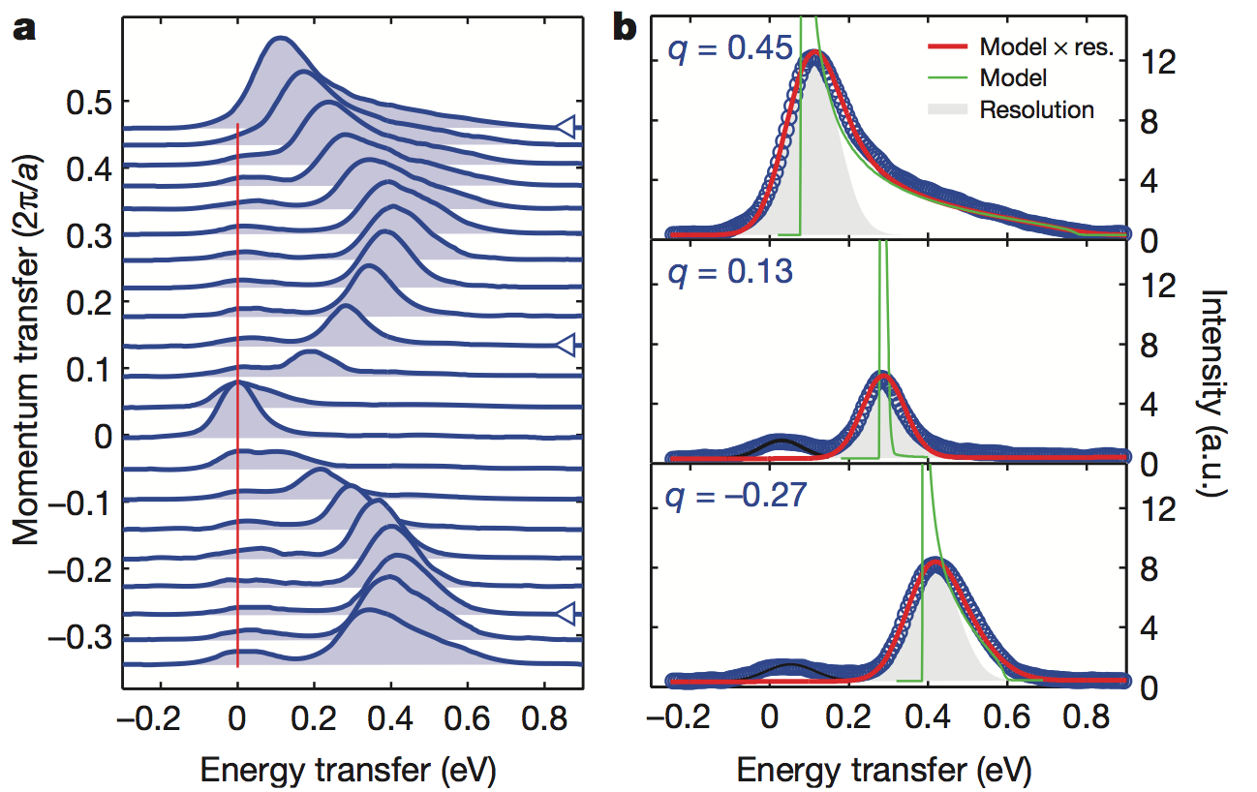
Spin excitations in 1 dimension – Sr₂CuO₃

Slide 10
Dispersing orbitals
orbitons
spinons

Slide 11
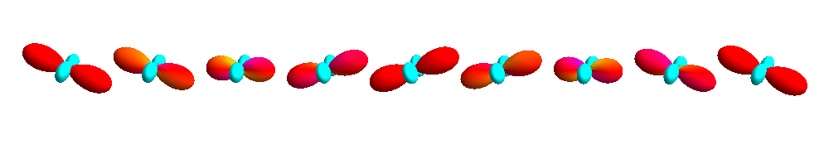
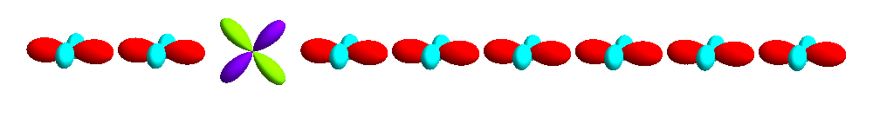
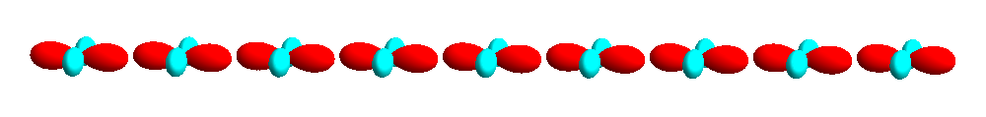
Dispersing orbitals

Slide 12
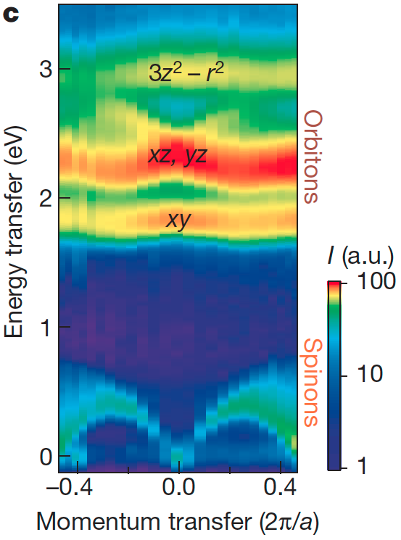
Dispersing orbitals

Slide 13
How can we understand these dispersing modes
Dispersing magnons, “quasi” particles traveling in the solid. Responsible for transport of heat and magnetism, need the periodic crystal
RIXS, a process involving a local core hole and all many-body multiplet interactions (at least at these L₂₃ edges)

Slide 14
Relation between XAS, RXD and RIXS
X-ray Absorption
Spectroscopy
Resonant X-ray
Diffraction
Resonant Inelastic
X-ray scattering
2p
2p
2p

Slide 15
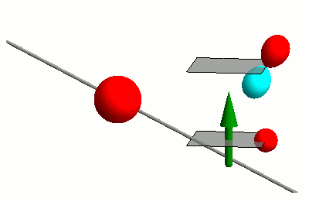
Interaction of photons with matter
RIXS
nIXS

Slide 16
Response theory (linear)
Fermi’s golden rule
Energy conservation
Initial state
Final state

Slide 17
Absorption and diffraction – two sides of the same coin
Crystalline sollid
Each site gets polarized by the photon field and the local charge density starts to oscillate.
Absorption
Scattering
σ_{i}
σ_{i}
σ_{i}
σ_{i}

Slide 18
Relation between resonant x-ray diffraction and absorption
2p
2p

Slide 19
Absorption and diffraction – two sides of the same coin
Crystalline sollid
Each site gets polarized by the photon field and the local charge density starts to oscillate.
Absorption
Scattering
σ_{i}
σ_{i}
σ_{i}
σ_{i}
Diffraction at given momentum determined by the sum of local scattering with correct phase:

Slide 20
An example magnetic Bragg reflection of Ho metal film

Slide 21
Fundamental spectra from the literature

Slide 22
Fundamental spectra from the literature

Slide 23
Fundamental spectra from the literature

Slide 24
Fundamental spectra from the literature

Slide 25
An example magnetic Bragg reflection of Ho metal film

Slide 26
Relation between XAS, RXD and RIXS
X-ray Absorption
Spectroscopy
Resonant X-ray
Diffraction
Resonant Inelastic
X-ray scattering
2p
2p
2p

Slide 27
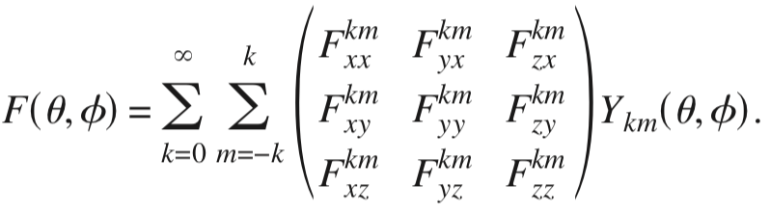
How does XAS depends on the magnetization
For a system with high crystal symmetry (Oh), but a magnetic field in a low symmetry direction, the local point-group is C1
We can think of the local conductivity tensor as a function of the magnetization direction with all 9 components possible non-zero.
If we expand this tensor function on spherical harmonics representing the direction of the magnetization we can still use symmetry arguments relating different components to each other

Slide 28
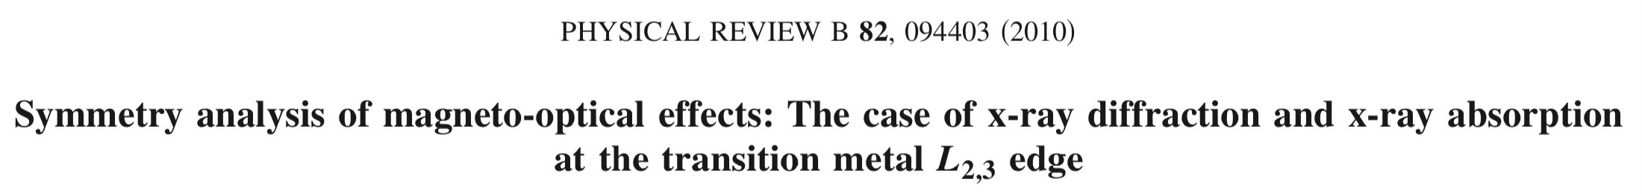
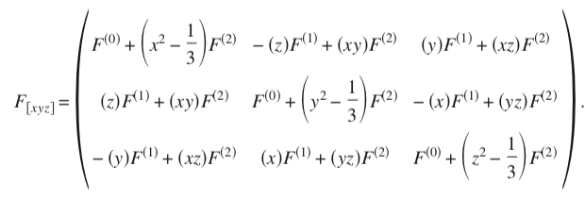
In spherical crystal symmetry

Slide 29
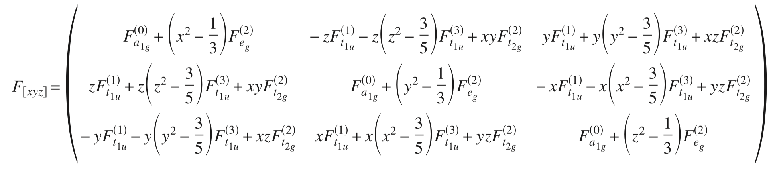
In cubic symmetry truncated at k=3

Slide 30
Relation between XAS, RXD and RIXS
X-ray Absorption
Spectroscopy
Resonant X-ray
Diffraction
Resonant Inelastic
X-ray scattering
2p
2p
2p

Slide 31
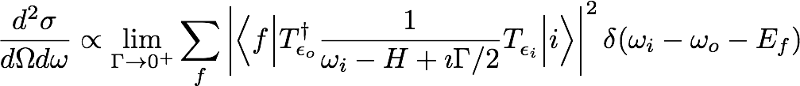
RIXS – the search for a low energy effective operator
Interaction of Neutrons with matter is easy (magnetic dipole),
but for resonant inelastic x-ray scattering nothing is obvious.
A lot is known though…

Slide 32
RIXS – what does one measure
Interaction of Neutrons with matter is easy (magnetic dipole),
but for resonant inelastic x-ray scattering nothing is obvious.
A lot is known though…

Slide 33
RIXS – what is the cross section
Interaction of Neutrons with matter is easy (magnetic dipole),
but for resonant inelastic x-ray scattering nothing is obvious.
A lot is known though…

Slide 34
RIXS – what does one measure
Interaction of Neutrons with matter is easy (magnetic dipole),
but for resonant inelastic x-ray scattering nothing is obvious.
A lot is known though…

Slide 35
RIXS – what does one measure
Interaction of Neutrons with matter is easy (magnetic dipole),
but for resonant inelastic x-ray scattering nothing is obvious.
A lot is known though…

Slide 36
RIXS – what does one measure
Interaction of Neutrons with matter is easy (magnetic dipole),
but for resonant inelastic x-ray scattering nothing is obvious.
A lot is known though…

Slide 37
RIXS – what does one measure
Interaction of Neutrons with matter is easy (magnetic dipole),
but for resonant inelastic x-ray scattering nothing is obvious.
A lot is known though…

Slide 38
RIXS – what does one measure
Interaction of Neutrons with matter is easy (magnetic dipole),
but for resonant inelastic x-ray scattering nothing is obvious.
A lot is known though…

Slide 39
RIXS – what does one measure
Interaction of Neutrons with matter is easy (magnetic dipole),
but for resonant inelastic x-ray scattering nothing is obvious.
A lot is known though…

Slide 40
XAS – XRD – RIXS – a time dependent picture

Slide 41

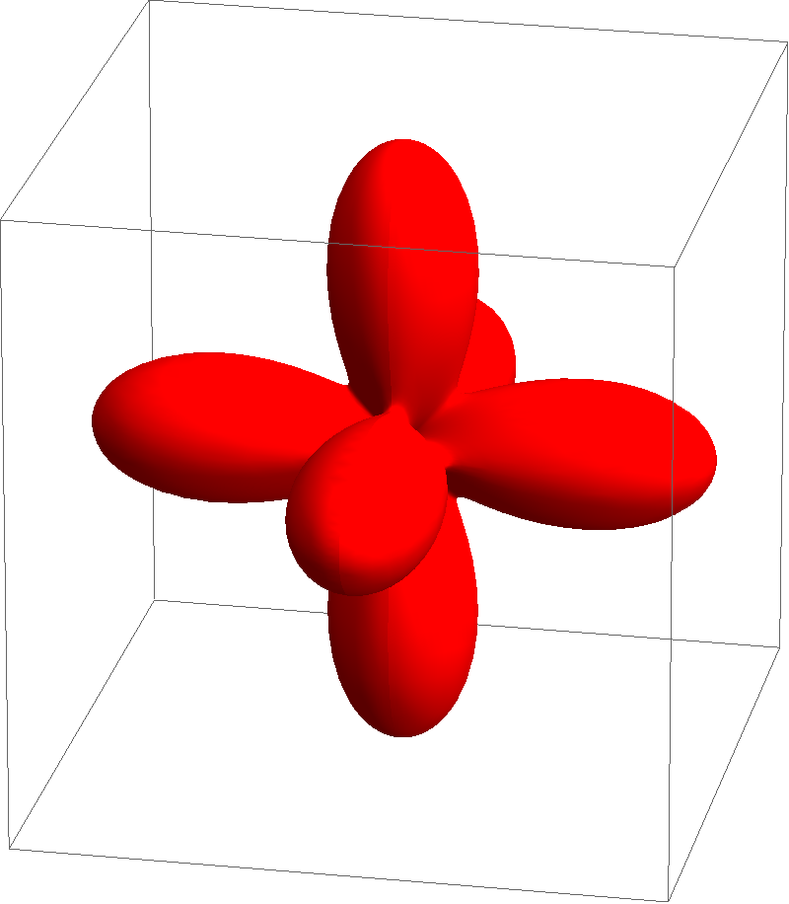
XAS – XRD – RIXS – a time dependent picture in NiO
e_{g}
t_{2g}

Slide 42
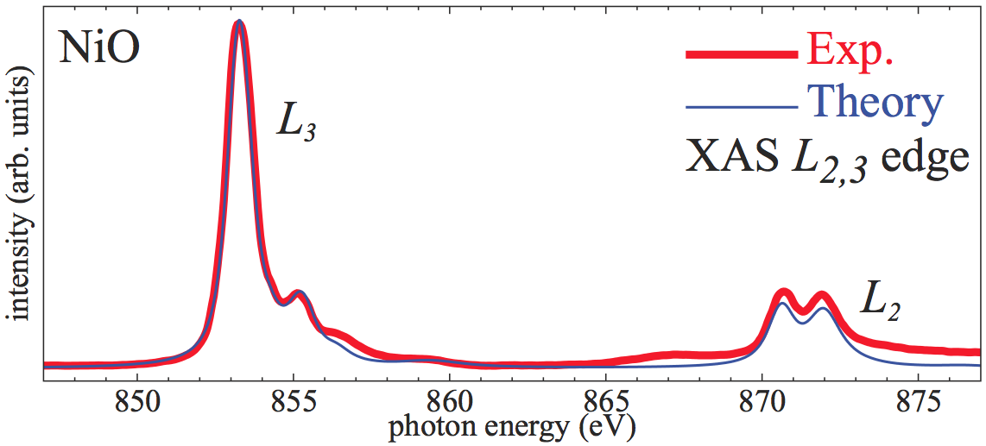
NiO – Ni 2p to Ni 3d excitation
X-ray absorption of NiO (L₂₃ edge) is well described.
How does the wave-function (charge density) evolve as a function of time when the sample is hit by an x-ray pulse?

Slide 43
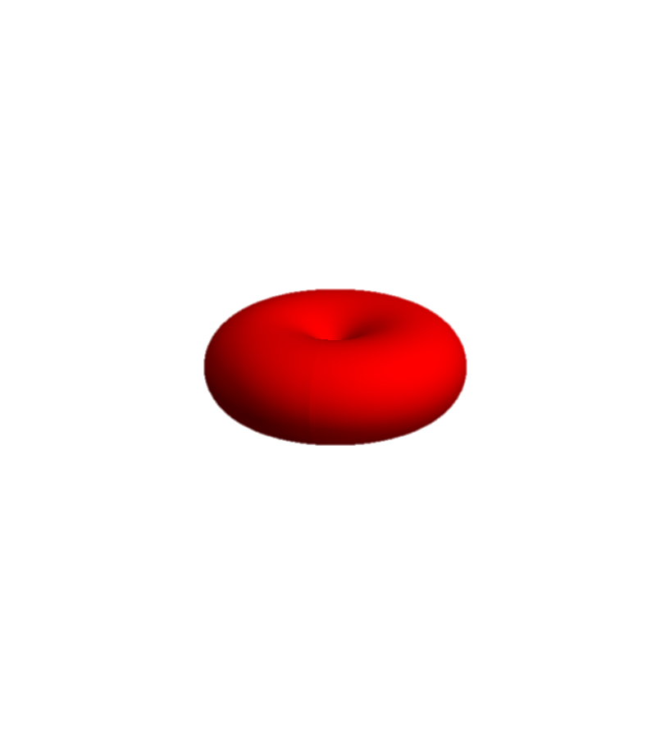
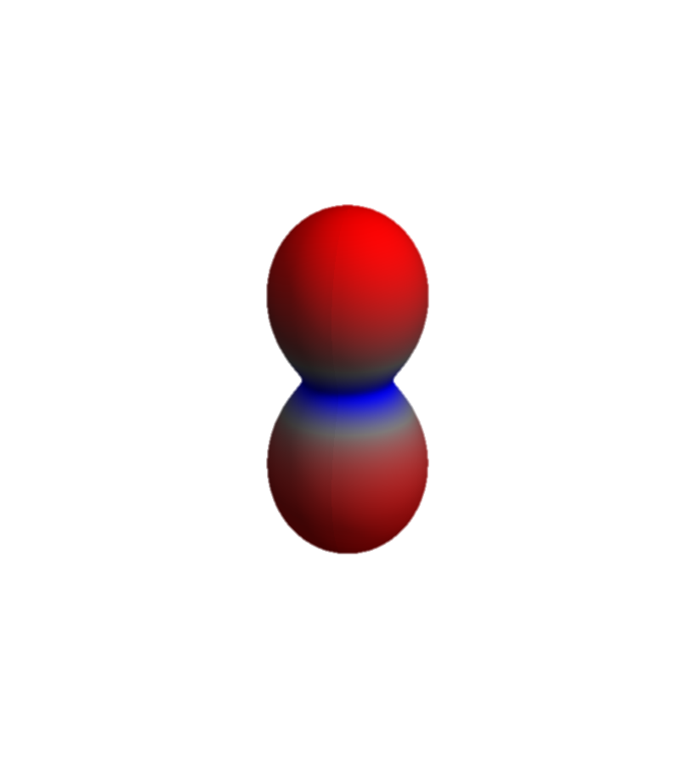
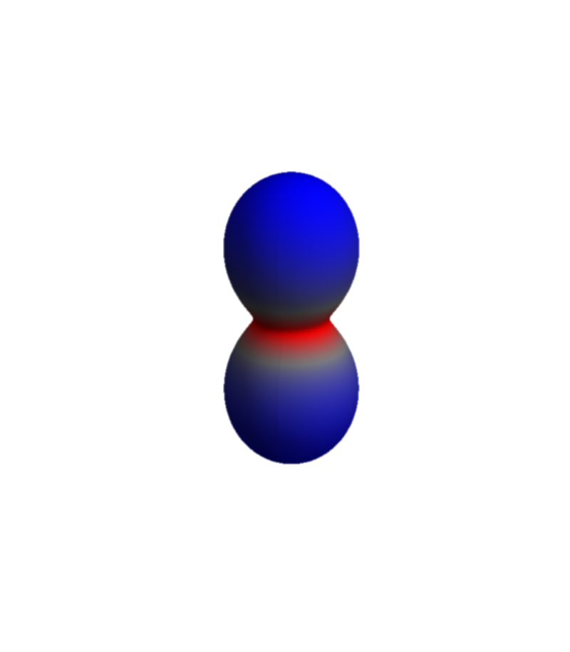
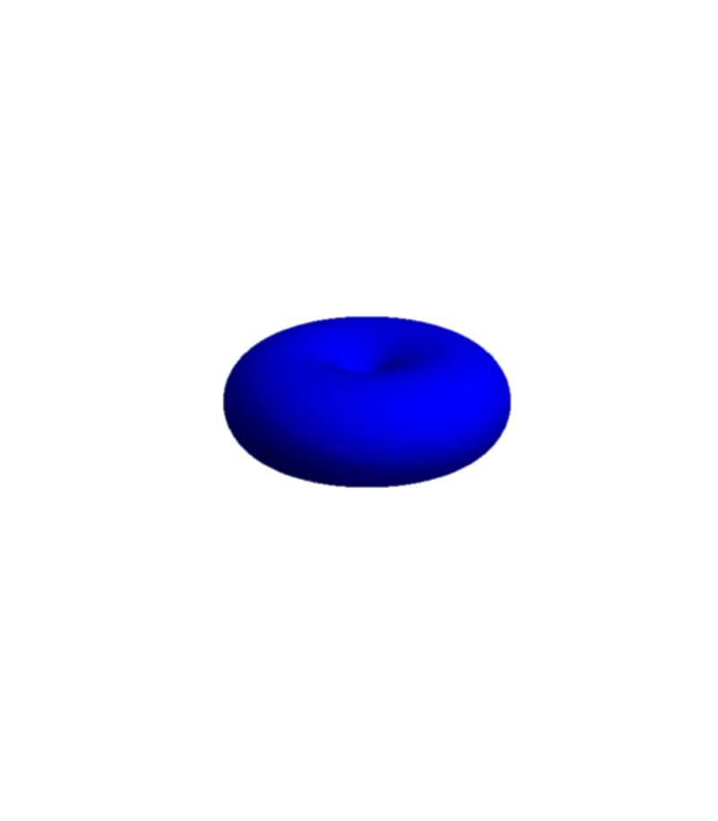
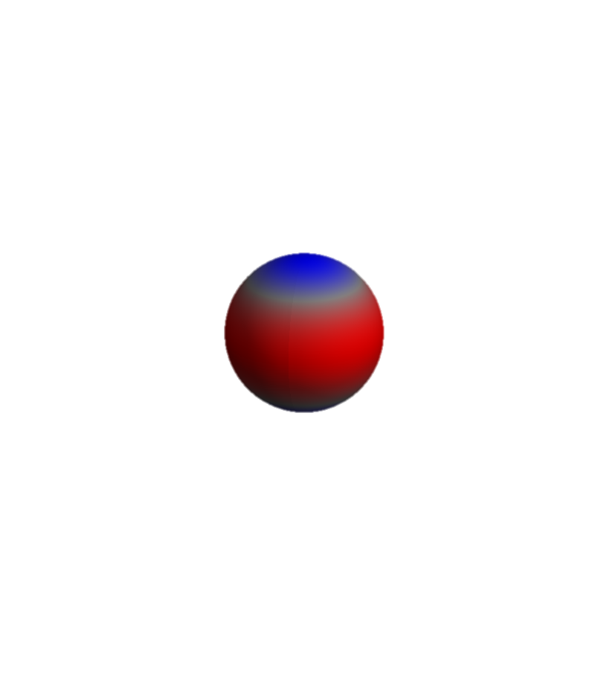
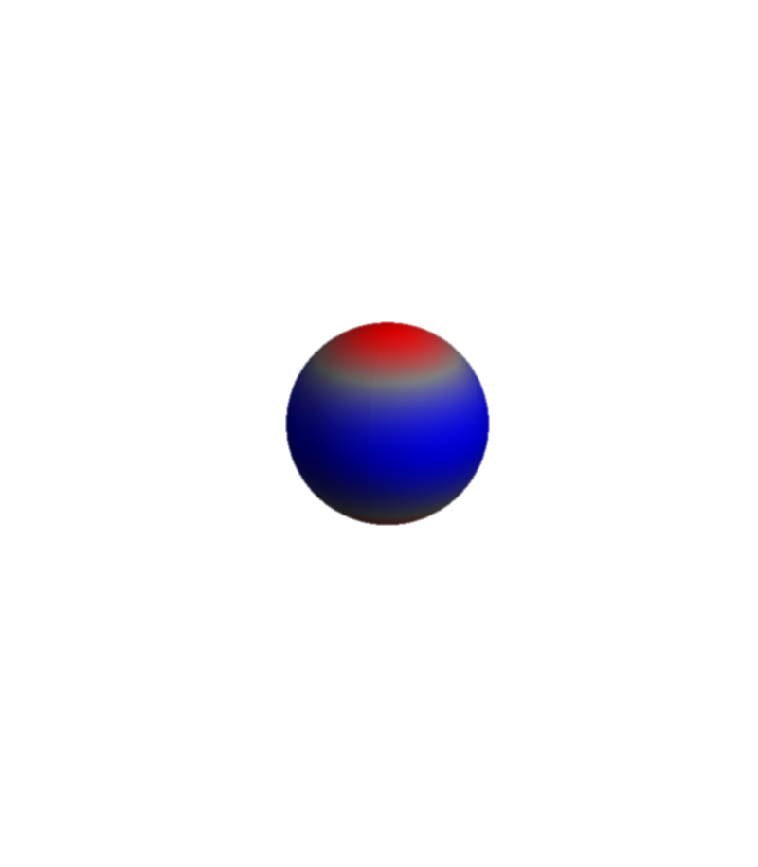
NiO – Ni 2p to Ni 3d excitation
We include a light field of 1 kV per Angstrom (possible at SLAC) at an energy of 852 eV.
e_{g}
t_{2g}
Pulse duration is 100 atto seconds

Slide 44
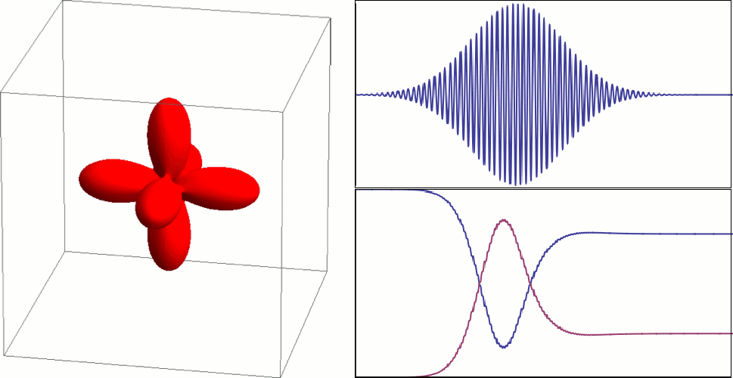
NiO 2p to 3d excitation in the time domain
Energy of pulse 852 eV
FWHM 100 as
41 eV
1 kV Å⁻¹
holes in Ni 3d-shell
holes in Ni 2p-shell
350 attosecond

Slide 45
RIXS – what does one measure
Interaction of Neutrons with matter is easy (magnetic dipole),
but for resonant inelastic x-ray scattering nothing is obvious.
A lot is known though…

Slide 46
RIXS – what does one measure
Interaction of Neutrons with matter is easy (magnetic dipole),
but for resonant inelastic x-ray scattering nothing is obvious.
A lot is known though…
BOOM

Slide 47


RIXS – what does one measure
Interaction of Neutrons with matter is easy (magnetic dipole),
but for resonant inelastic x-ray scattering nothing is obvious.
A lot is known though…

Slide 48
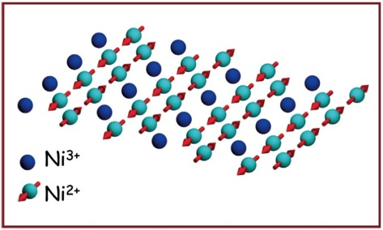
RIXS – what does one measure
Intermediate state
Initial state
Final state

Slide 49

Relations between absorption, elastic- and inelastic scattering
The elastic scattering tensor is related to the absorption by the optical theorem (Conservation of energy)
Elastic scattering is a limiting case of inelastic scattering:
If one restricts the inelastic scattering operator R to the ground-state one describes the elastic scattering
For the description of magnetic excitations:
Expand the scattering operator on spin operators

Slide 50


RIXS – effective operator – spin excitations
Effective operator for spin excitations only

Slide 51
RIXS – effective operator – spin excitations
Need to calculate x-ray absorption spectra
… and spin susceptibilities

Slide 52
RIXS – effective operator – spin excitations
Theory
Experiment
Need to calculate x-ray absorption spectra
σ⁽⁰⁾=

Slide 53
Predicted RIXS spectra with cross polarized light
spin susceptibility, same as neutron scattering

Slide 54
General polarization: RIXS is a mixture of 1 and 2 spin flips

Slide 55
The anatomy of RIXS,
What do we measure
Yi Lu
Maurits W. Haverkort
Heidelberg University
A non-perturbative absolute converging series expansion as alternative to traditional (diagrammatic) methods

Slide 56
Understand RIXS by numerical solving a model
The equation to solve
with,
and

Slide 57
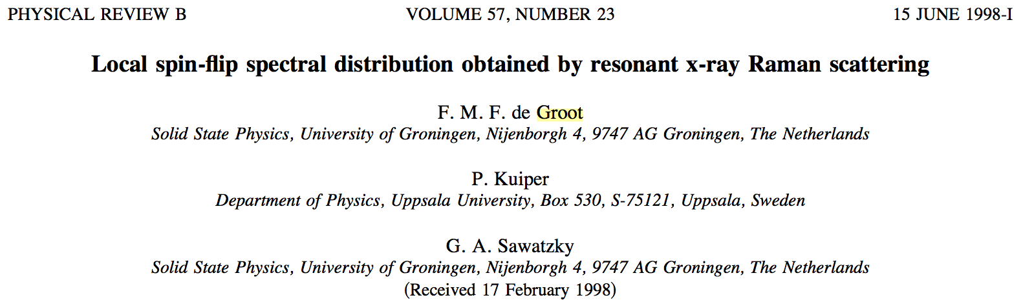
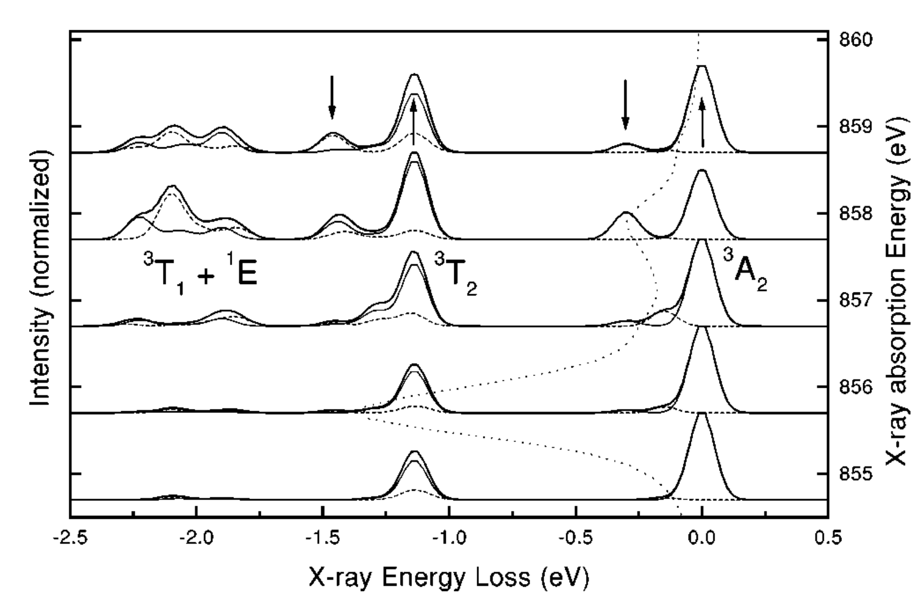
Single Ni atom in crystal-field theory

Slide 58
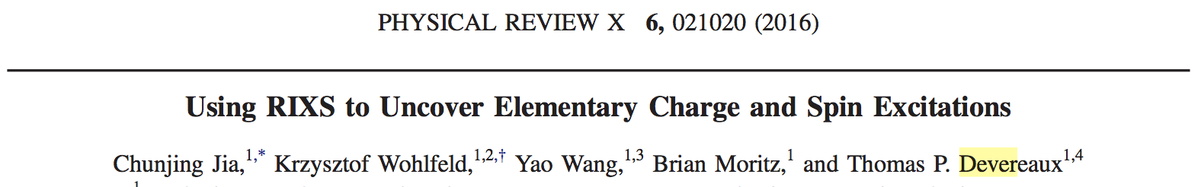
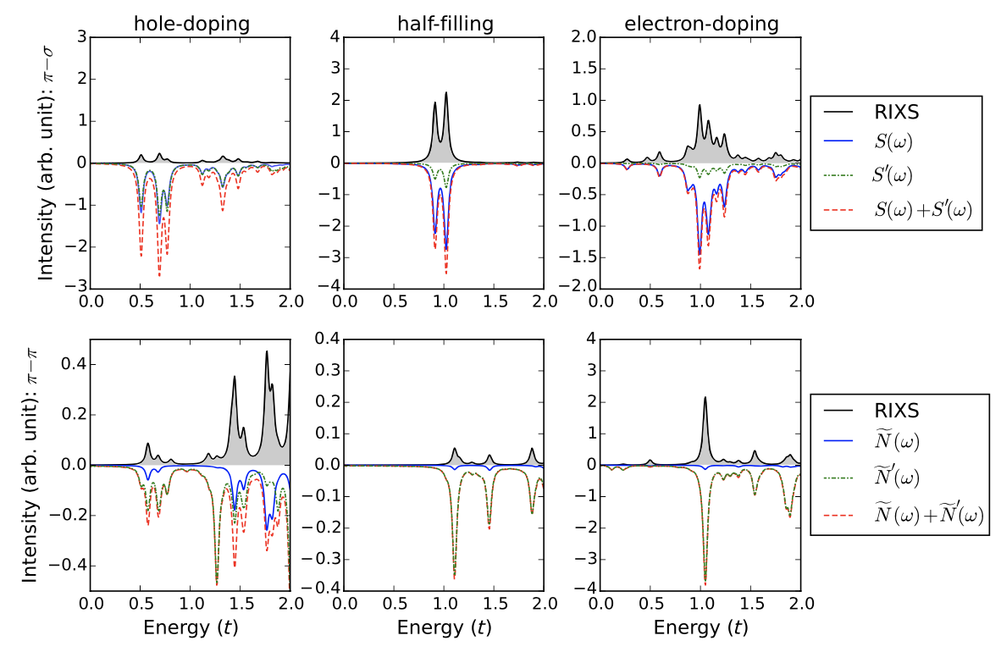
Hubbard model on finite (12) size cluster

Slide 59
Understand RIXS as effective operator
Replace the exact RIXS operator by a low energy effective operator
Write the exact RIXS operator as a series
Possible operators in the series could be
Task: find all operators
and all coefficients

Slide 60
Challenge – No small parameter – perturbation theory fails
Different interactions are of similar scale
Perturbation theory leads to divergent series
i.e. summing part of the series gives a different result from the full solution!

Slide 61
Divergent series – example from functions
The following function is smooth, continues and infinite differentiable on the real axis
We can write the function as an expansion on powers of x:

Slide 62
Divergent series – example from functions
The following function is smooth, continues and infinite differentiable on the real axis
We can write the function as an expansion on powers of x:
Truncate at i=2

Slide 63
Divergent series – example from functions
The following function is smooth, continues and infinite differentiable on the real axis
We can write the function as an expansion on powers of x:
Truncate at i=4

Slide 64
Divergent series – example from functions
The following function is smooth, continues and infinite differentiable on the real axis
We can write the function as an expansion on powers of x:
Truncate at i=10

Slide 65
Divergent series – example from functions
The following function is smooth, continues and infinite differentiable on the real axis
We can write the function as an expansion on powers of x:
Truncate at i=20

Slide 66
Divergent series – example from functions
The following function is smooth, continues and infinite differentiable on the real axis
We can write the function as an expansion on powers of x:
Truncate at i=50

Slide 67
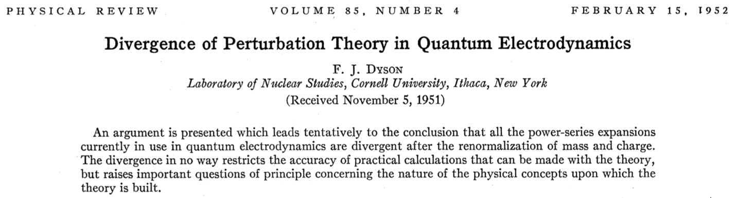
General problem in many particle physics

Slide 68
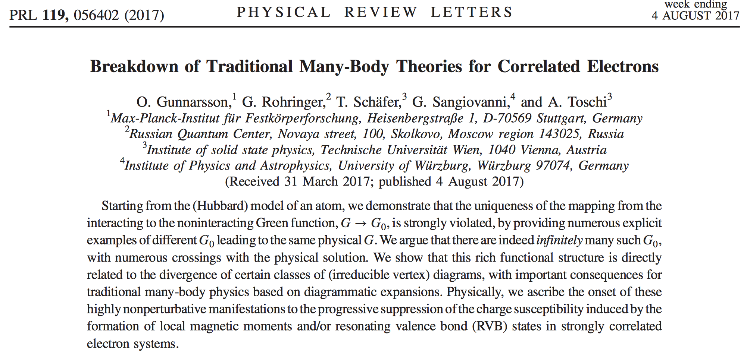
General problem in many particle physics
Need for a non-divergent (non perturbative) series expansion

Slide 69
Fourier v.s. Taylor – example from functions
The following function is smooth, continues and infinite differentiable on the real axis
We can write the function as a sum of orthonormal functions:

Slide 70
Fourier v.s. Taylor – example from functions
The following function is smooth, continues and infinite differentiable on the real axis
We can write the function as a sum of orthonormal functions:
Truncate at n=1

Slide 71
Fourier v.s. Taylor – example from functions
The following function is smooth, continues and infinite differentiable on the real axis
We can write the function as a sum of orthonormal functions:
Truncate at n=2

Slide 72
Fourier v.s. Taylor – example from functions
The following function is smooth, continues and infinite differentiable on the real axis
We can write the function as a sum of orthonormal functions:
Truncate at n=3

Slide 73
Fourier v.s. Taylor – example from functions
The following function is smooth, continues and infinite differentiable on the real axis
We can write the function as a sum of orthonormal functions:
Truncate at n=4

Slide 74
Fourier v.s. Taylor – example from functions
The following function is smooth, continues and infinite differentiable on the real axis
We can write the function as a sum of orthonormal functions:
Truncate at n=5

Slide 75
An alternative expansion for operators
Projection expansions for functions
with
if
Projection expansions for operators
with
if

Slide 76
An alternative expansion for operators
Trivial example
with
and
an orthonormal complete set
we have
The trivial example needs exponentially many weird operators
Alternative:
O^{m,n} an operator that transforms exponentially many states that share property n into states that share property m

Slide 77
Expansion of the RIXS operator
Create a local (j) expansion
Lattice model

Slide 78
Expansion of the RIXS operator
Create a local (j) expansion
Lattice model
Site j
Level L=0 only include operators acting on site j

Slide 79
Expansion of the RIXS operator
Create a local (j) expansion
Lattice model
j
Level L=1 include operators acting on site j and n.n.

Slide 80
Expansion of the RIXS operator
Create a local (j) expansion
Lattice model
j
Level L=2 include operators acting on site j, n.n. and n.n.n.

Slide 81
Expansion of the RIXS operator
Create a local (j) expansion
Lattice model
j
Level L=3 include operators acting on site j, n.n., n.n.n. and n.n.n.n.
etc.

Slide 82
Expansion of the RIXS operator
Convergence of this series is guaranteed by linear algebra!
define

Slide 83
Expansion of the RIXS operator
Convergence of this series is guaranteed by linear algebra!
As RIXS intensity is bounded:
Sufficient condition to guarantee absolute convergence of series

Slide 84
Example for doped Hubbard model
with
As a first step we need to create all possible O_{m,n}
For L=0 we only look at local operators
The local Fock space is given by 4 states
Operators on that basis as
4 by 4 matrices

Slide 85
Example for doped Hubbard model
For L=1 we look at two sites
The Fock space is given by 16 states
Resulting in 16²=256 operators

Slide 86
Example for doped Hubbard model
We can get back to more familiar representations by linear combing these operators (unitary transformation)
For L=0 (only keeping the particle number conserving operators)

Slide 87
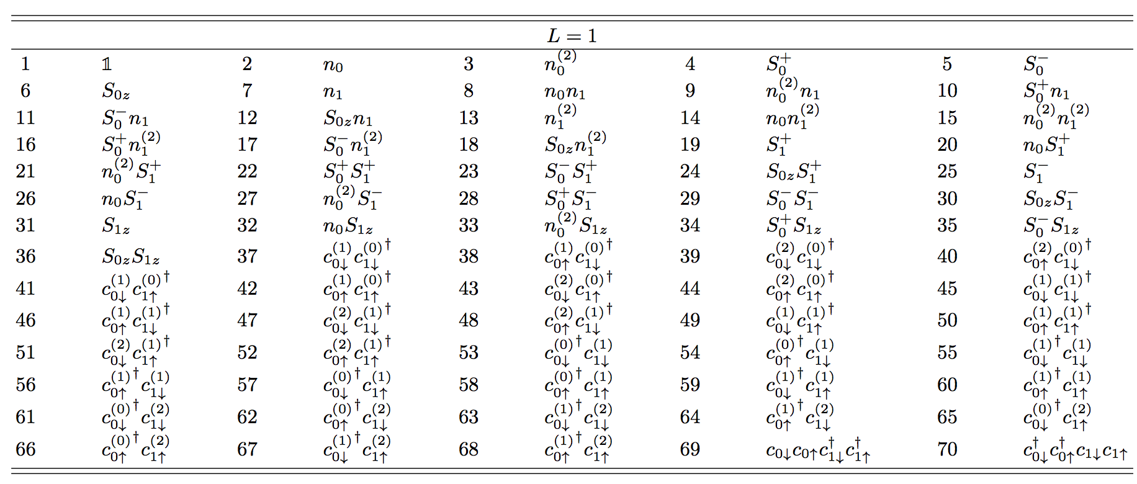
Example for doped Hubbard model
We can get back to more familiar representations by linear combing these operators (unitary transformation)
For L=1 (only keeping the particle number conserving operators)

Slide 88
Convergence rate for doped Hubbard model

Slide 89
Convergence rate for doped Hubbard model
Coefficient of operator for cross polarized light (xy)
1D, 17% hole doping U=2t, t=0.4, t’=-0.2t, U_{c}=1.2U, ζ=13.5

Slide 90
Convergence rate for doped Hubbard model
Coefficient of operator for parallel polarized light (zz)
1D, 17% hole doping U=2t, t=0.4, t’=-0.2t, U_{c}=1.2U, ζ=13.5

Slide 91
Convergence rate for doped Hubbard model
2D, cross polarized light, L=0
17% hole doping U=4t, t=0.4, t’=-0.2t, U_{c}=1.2U, ζ=13.5

Slide 92
Convergence rate for doped Hubbard model
1D, cross polarized light, L=0, L=1, L=2
17% hole doping U=2t, t=0.4, t’=-0.2t, U_{c}=1.2U, ζ=13.5

Slide 93
Convergence rate for doped Hubbard model
1D, parallel polarized light, L=0, L=1, L=2
17% hole doping U=2t, t=0.4, t’=-0.2t, U_{c}=1.2U, ζ=13.5

Slide 94
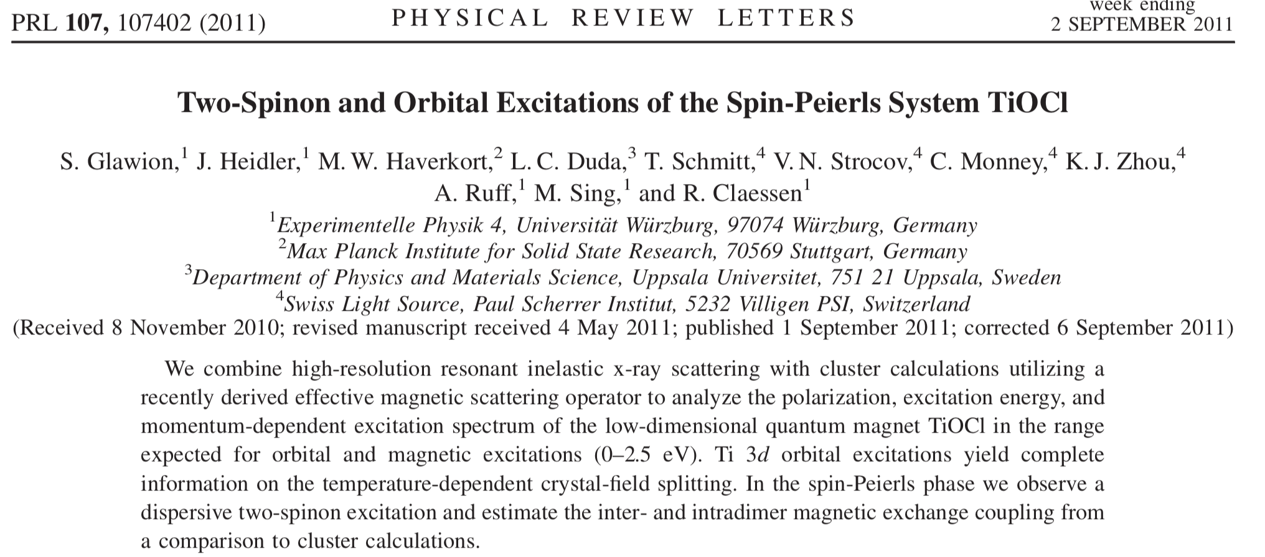
RIXS in TiOCl

Slide 95
Spin excitations in 1 Dimension

Slide 96
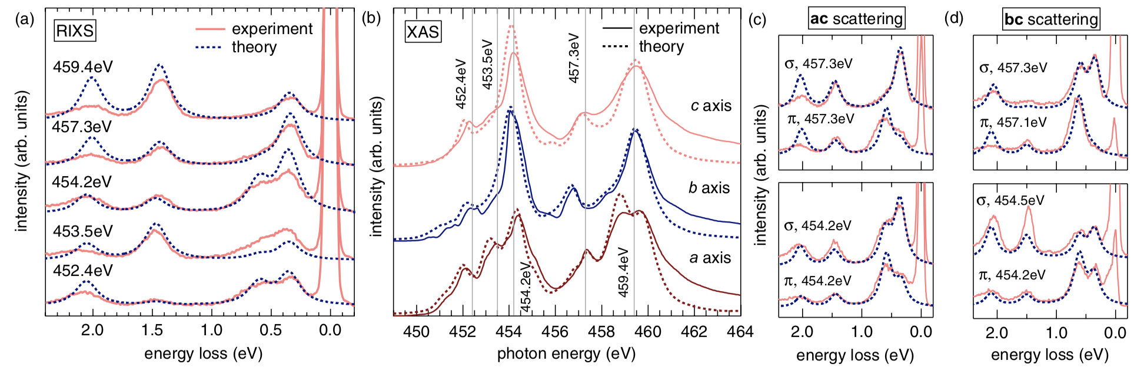
RIXS in TiOCl

Slide 97
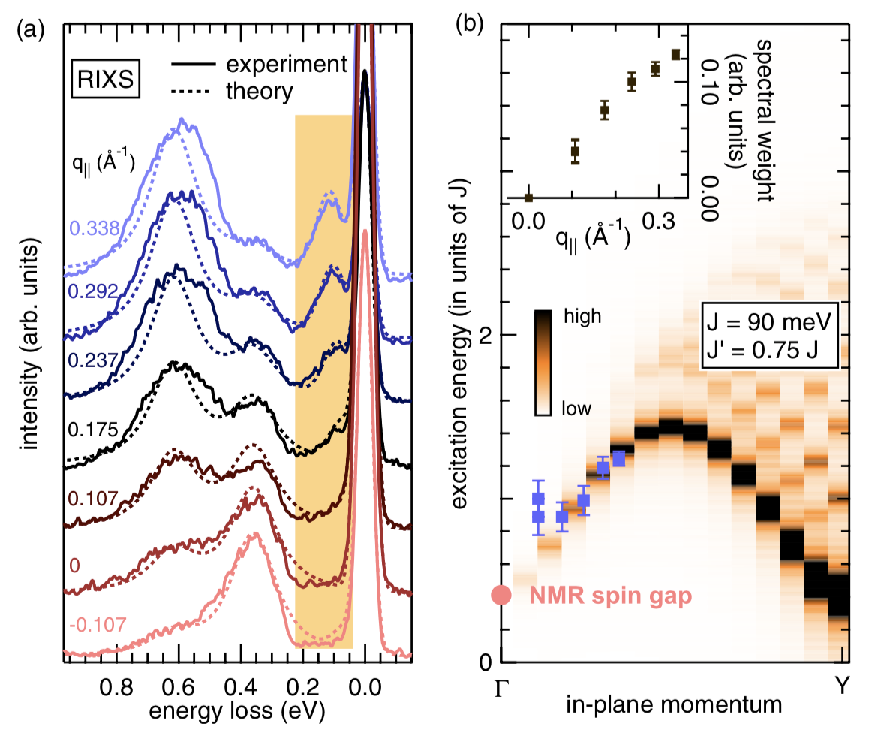
RIXS in TiOCl

Slide 98
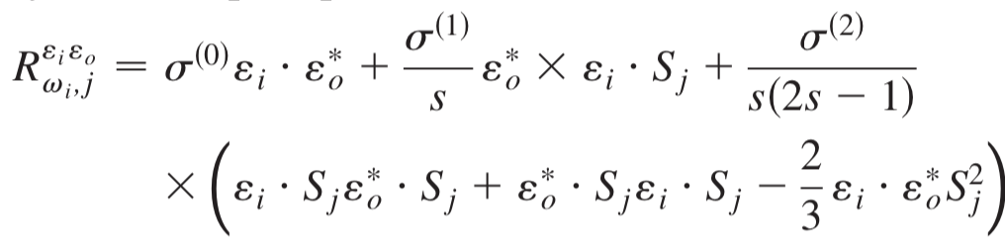
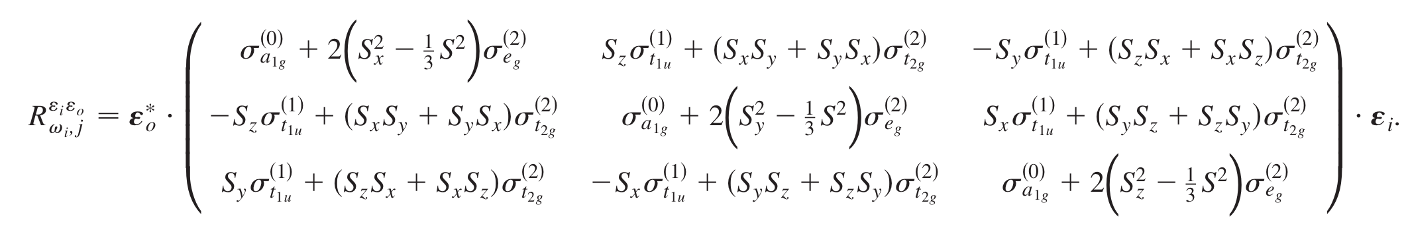
Is a single magnon given by: e cross e dot S
Effective operator in spherical symmetry
Effective operator in Cubic (Oh) symmetry (s=1)

