Slide 1
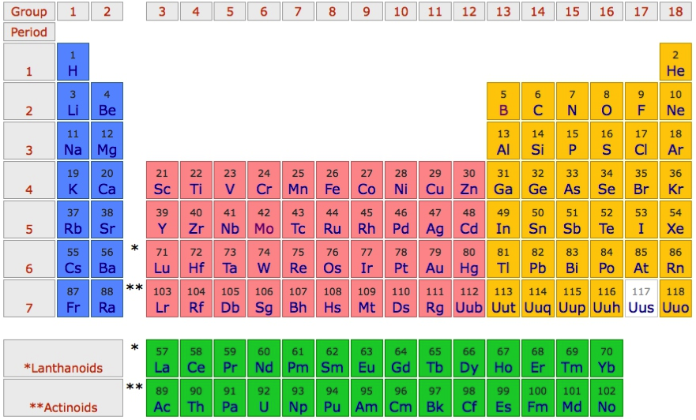
Tight binding description of Alkali metals
Alkali metals are close to free electron like

Slide 2
Free electron like description
Energy momentum relation of a free electron
Maximal velocity is given by the Fermi momentum

Slide 3
Free electron like description – Brillouin zone folding

Slide 4
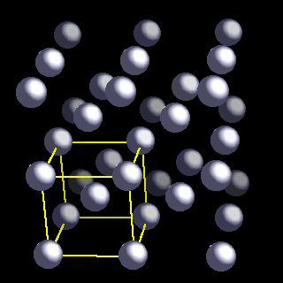
Brillion zone of Li (bcc)

Slide 5
Brillion zone of Li

Slide 6
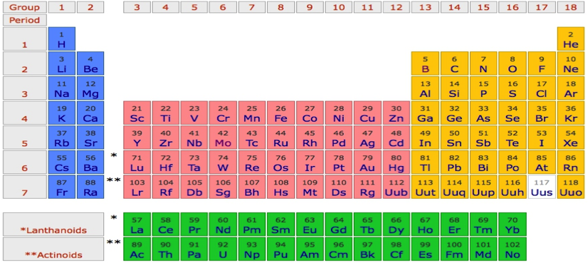
Li
P
Γ
P
H
P
Γ
P
H
P
Γ
P

Slide 7
Na
P
Γ
P
H
P
Γ
P
H
P
Γ
P

Slide 8
K
P
Γ
P
H
P
Γ
P
H
P
Γ
P

Slide 9
Rb
P
Γ
P
H
P
Γ
P
H
P
Γ
P

Slide 10
Cs
P
Γ
P
H
P
Γ
P
H
P
Γ
P

Slide 11
Fr
P
Γ
P
H
P
Γ
P
H
P
Γ
P

Slide 12
Li - Tigth binding description – “atomic” orbitals
φ_{2s}(r)
Li-atom
neighbor
Li-atom
neighbor
Li-atom

Slide 13
Li - Tigth binding description – “atomic” orbitals

Slide 14
Li - Tigth binding description – “atomic” orbitals
Non-orthogonal
Basis, but that is ok.

Slide 15
Li - Tigth binding description – “atomic” orbitals
Tight binding description of free electron like state

Slide 16
Li - Tigth binding description – “atomic” orbitals

Slide 17
Li - Tigth binding description – “atomic” orbitals

Slide 18
Li - Tigth binding description – “atomic” orbitals

Slide 19
Li - Tigth binding description – “atomic” orbitals

Slide 20
Li - Tigth binding description – “atomic” orbitals

Slide 21
Li - Tigth binding description – “atomic” orbitals

Slide 22
Li - Tigth binding description – “atomic” orbitals

Slide 23
Li - Tigth binding description – “atomic” orbitals

Slide 24
Li - Tigth binding description – “atomic” orbitals
p_{x}
s

Slide 25
Li - Tigth binding description – “atomic” orbitals
p_{z}
s
p_{x}
p_{y}

Slide 26
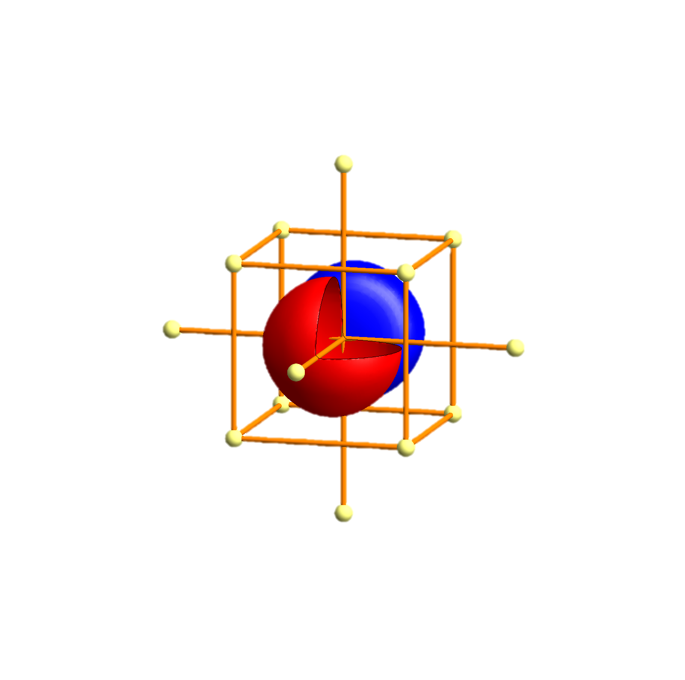
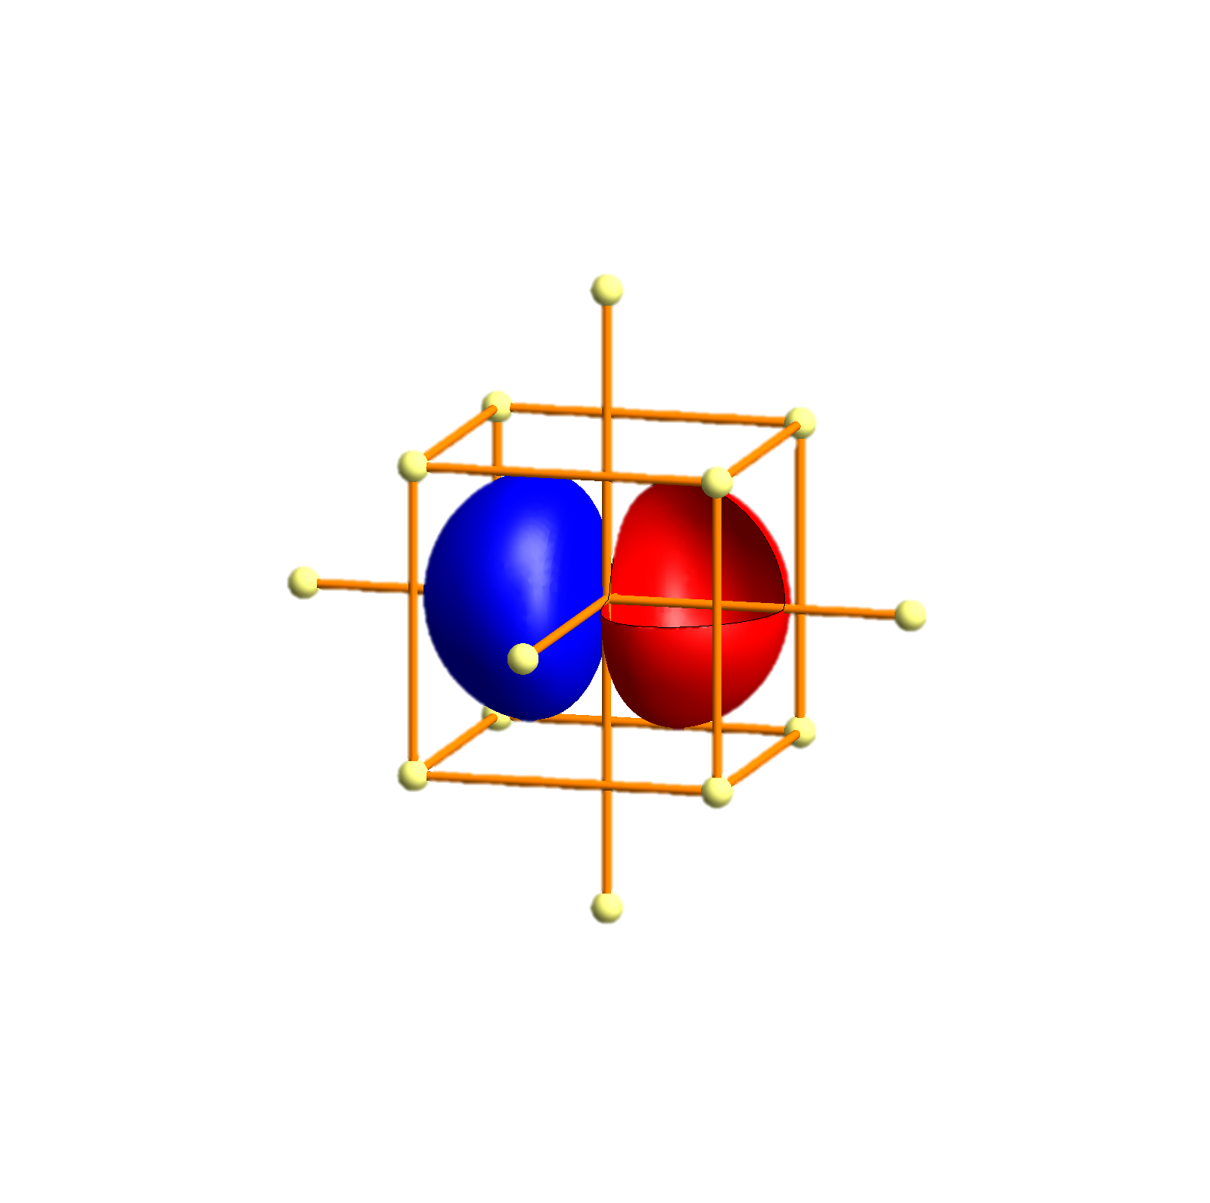
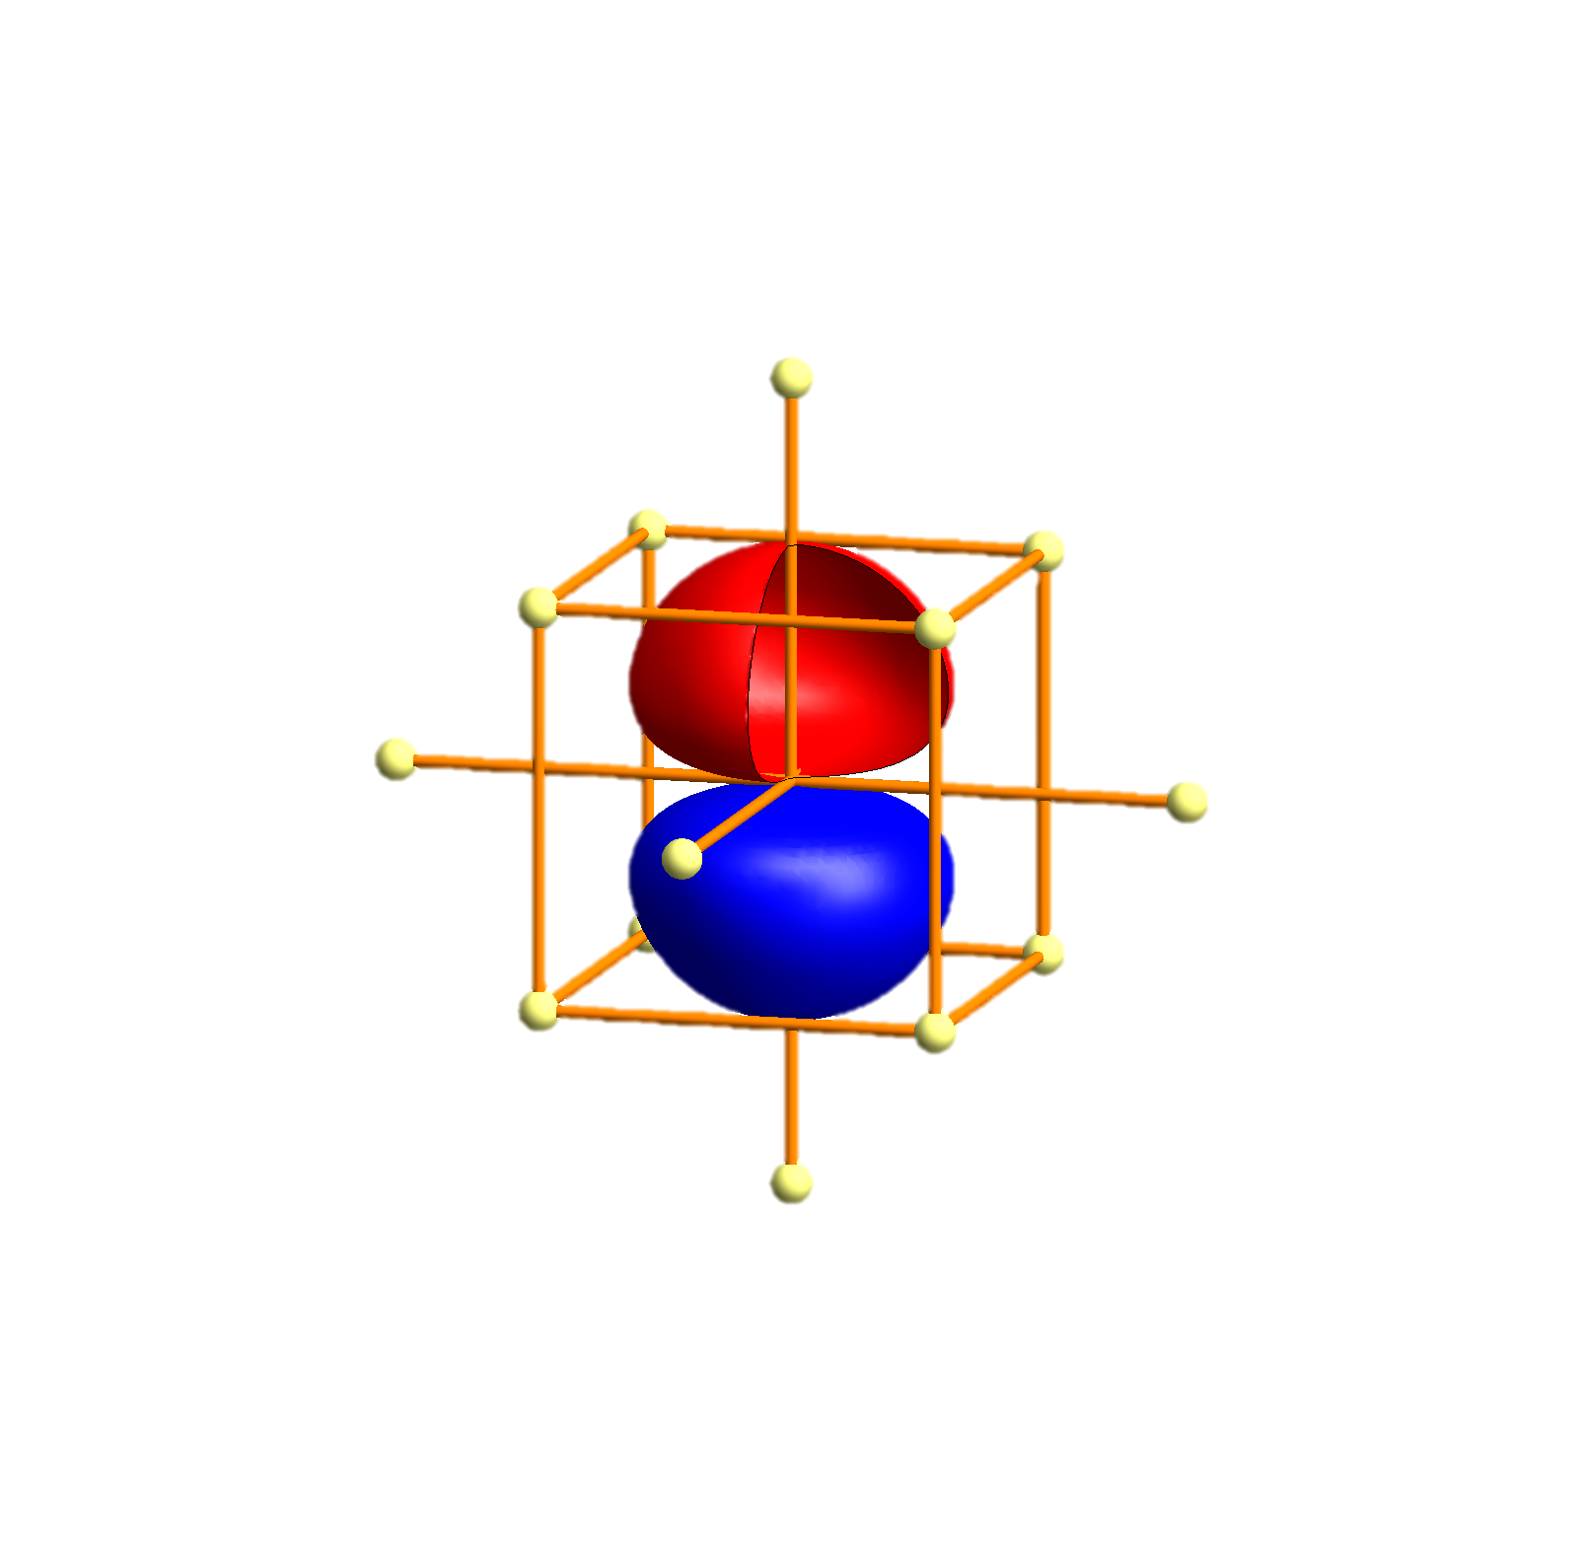
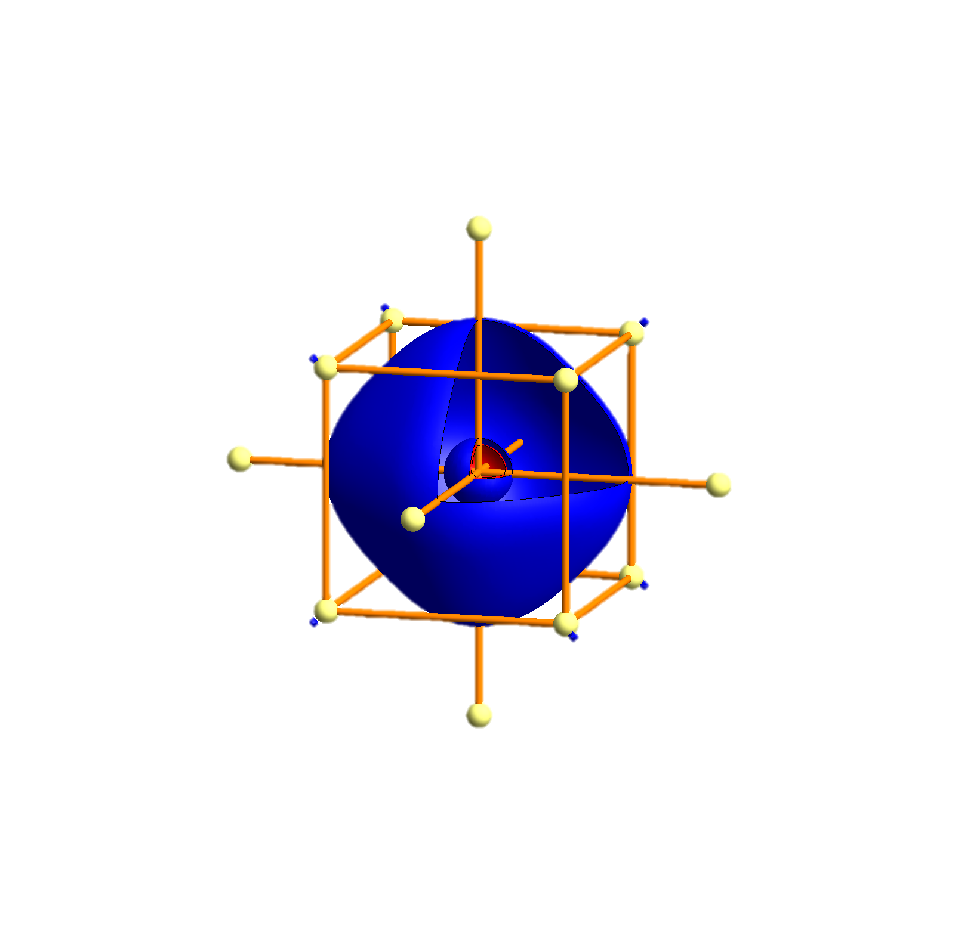
Li - Tigth binding description – atomic orbitals
p_{x}
p_{x}
p_{y}
p_{z}
s
s
P
Γ
P
H
P
Γ
P
H
P
Γ
P

Slide 27
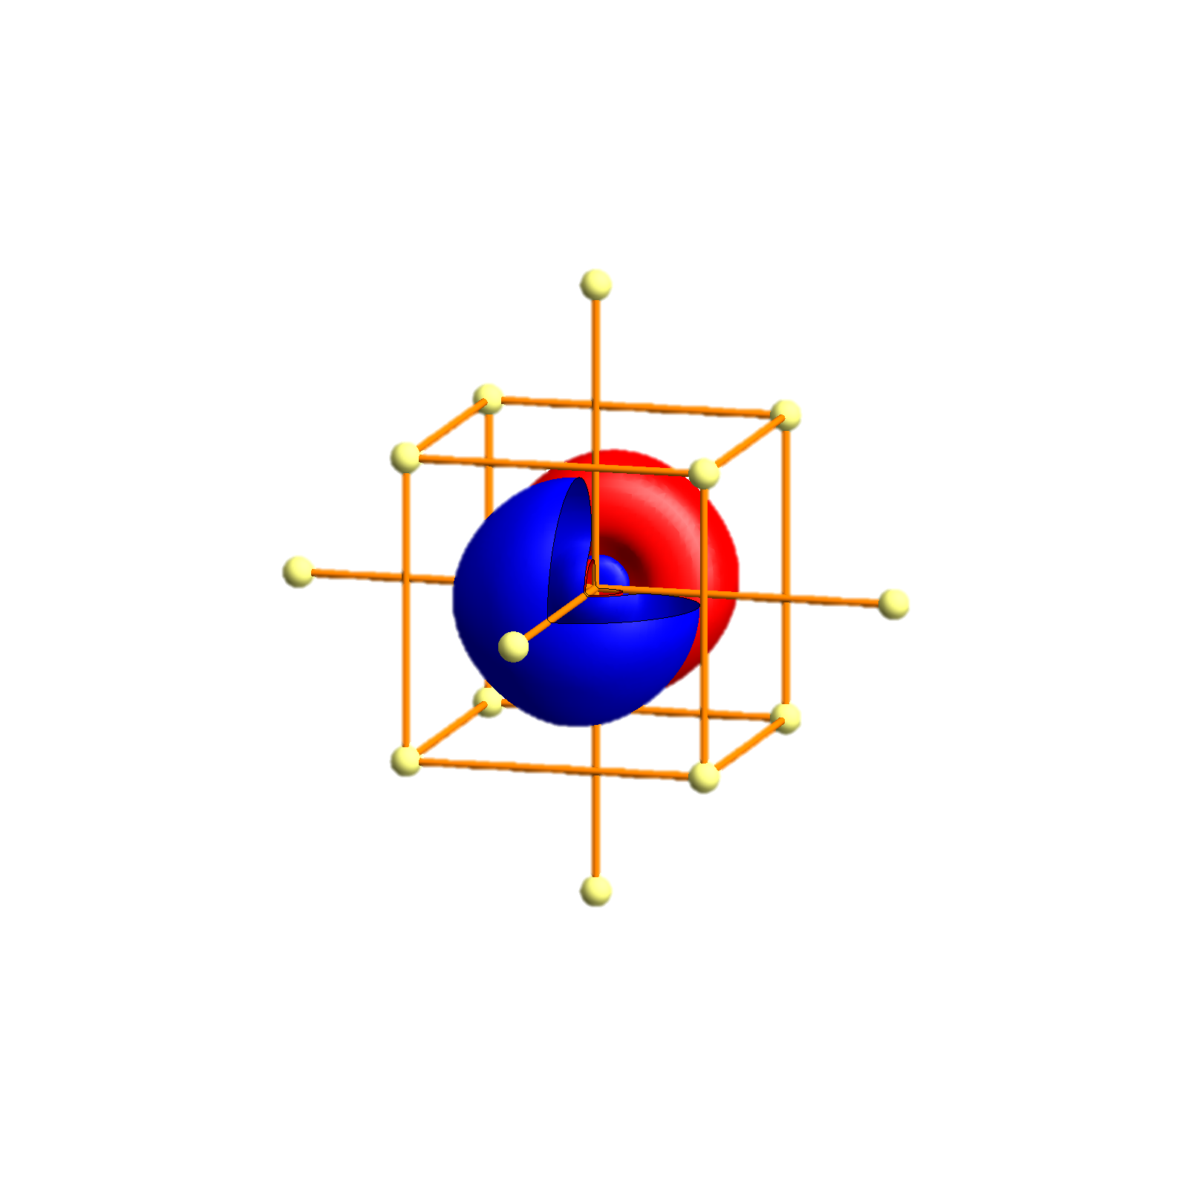
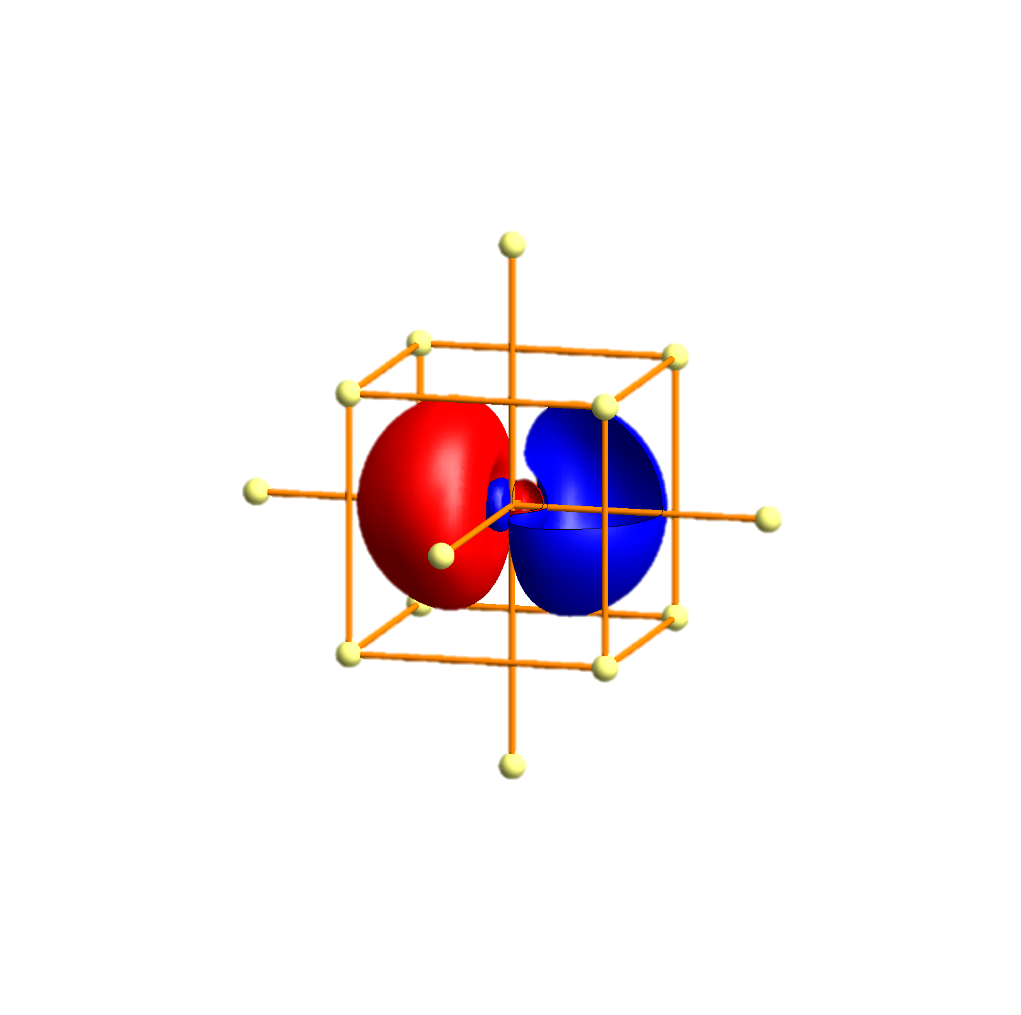
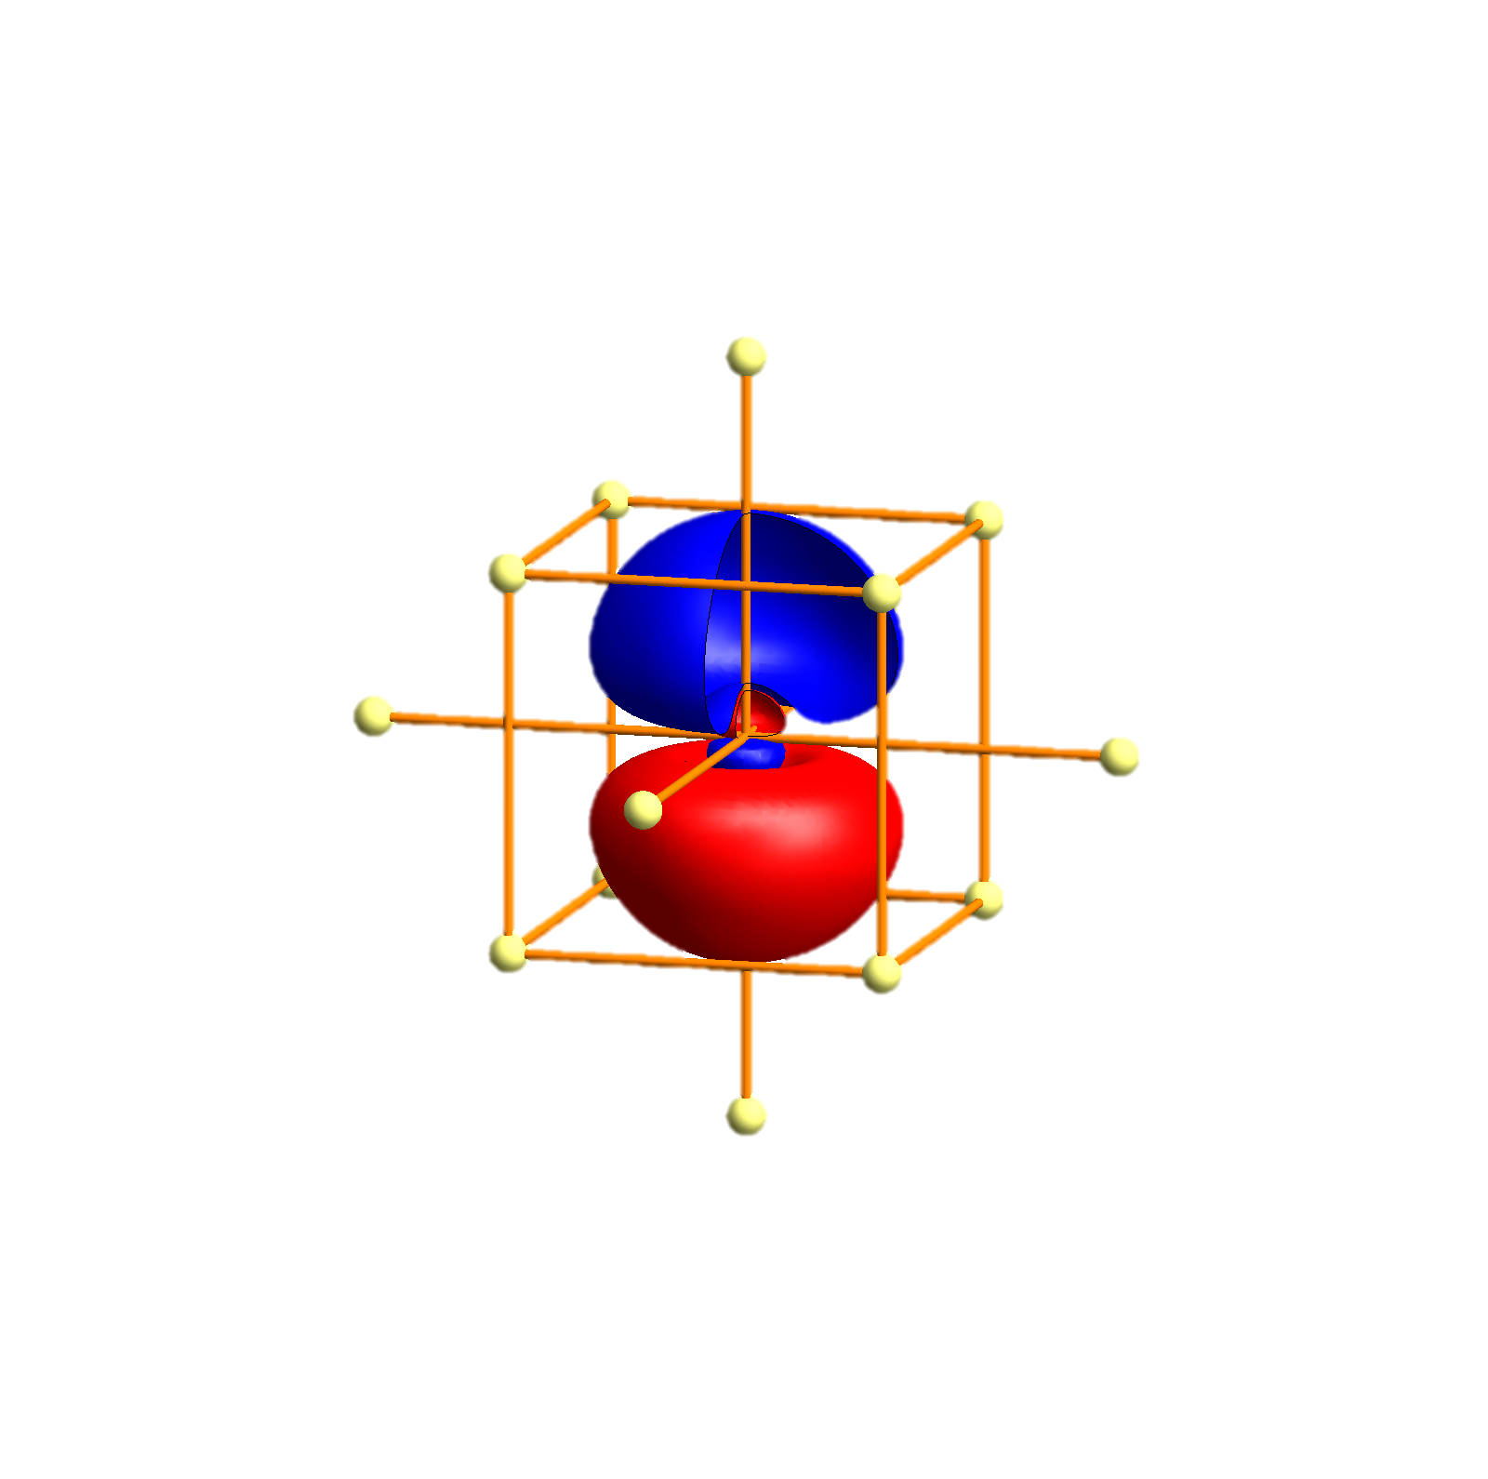
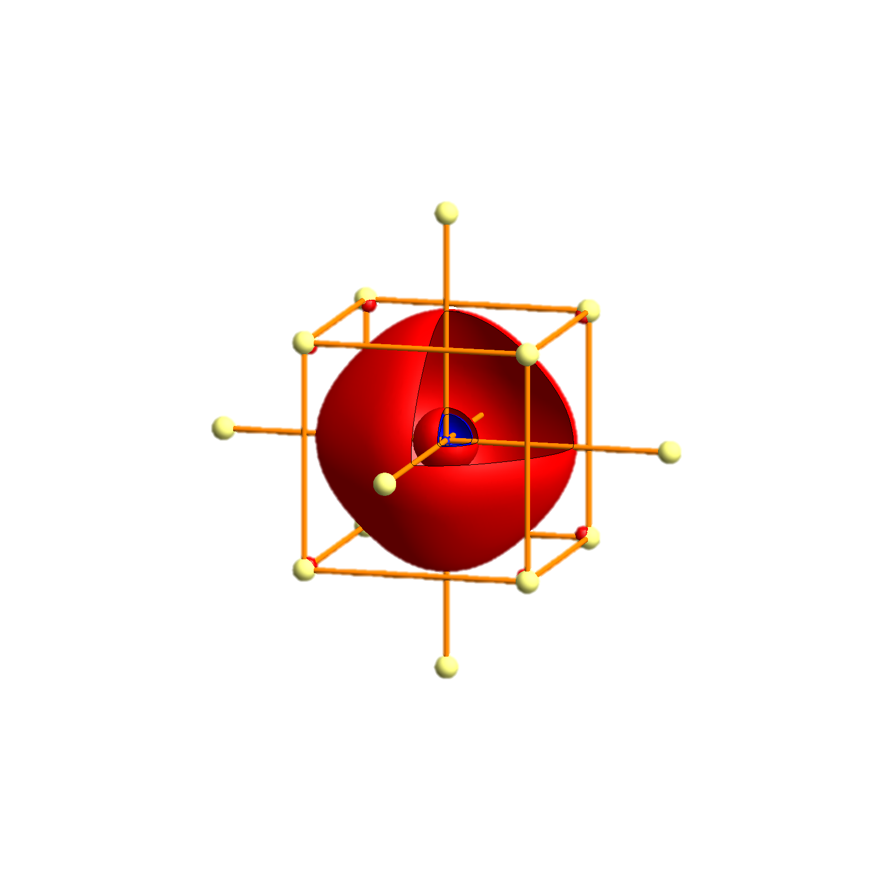
Na - Tigth binding description – atomic orbitals
p_{x}
p_{y}
p_{z}
s

Slide 28
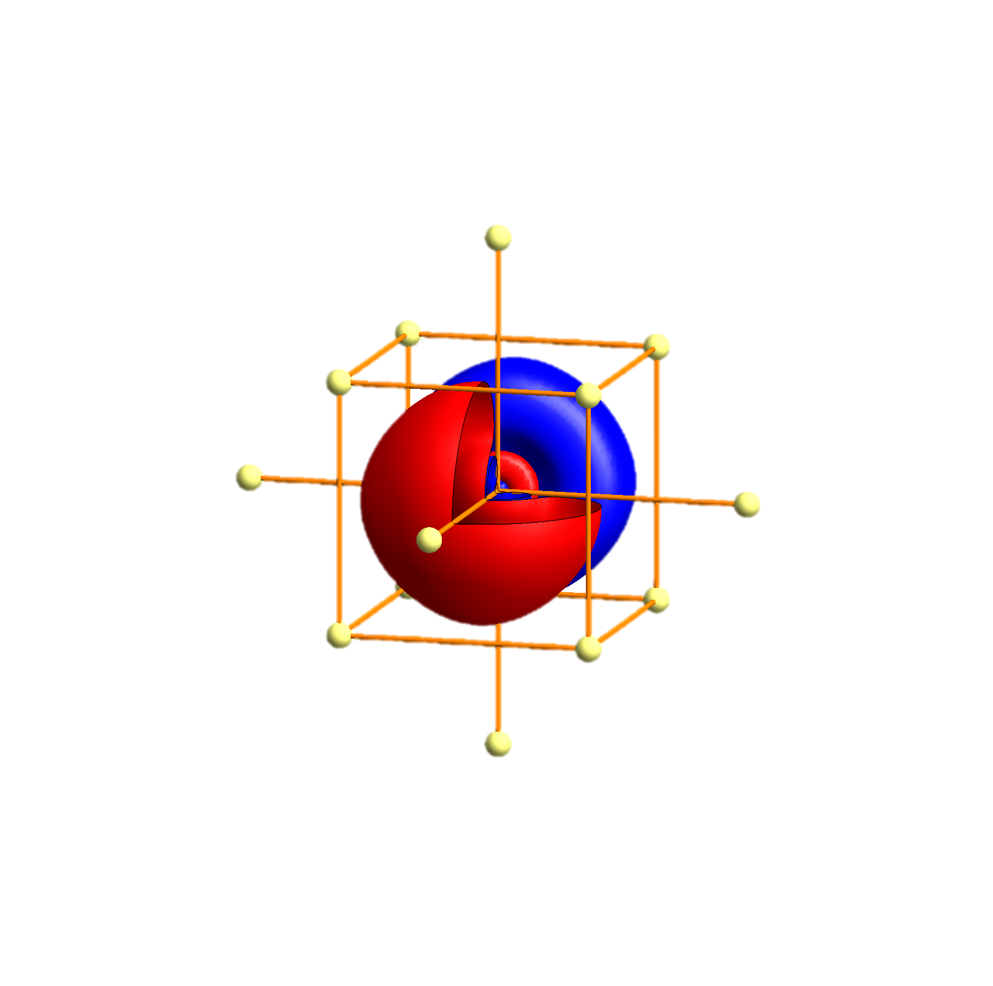
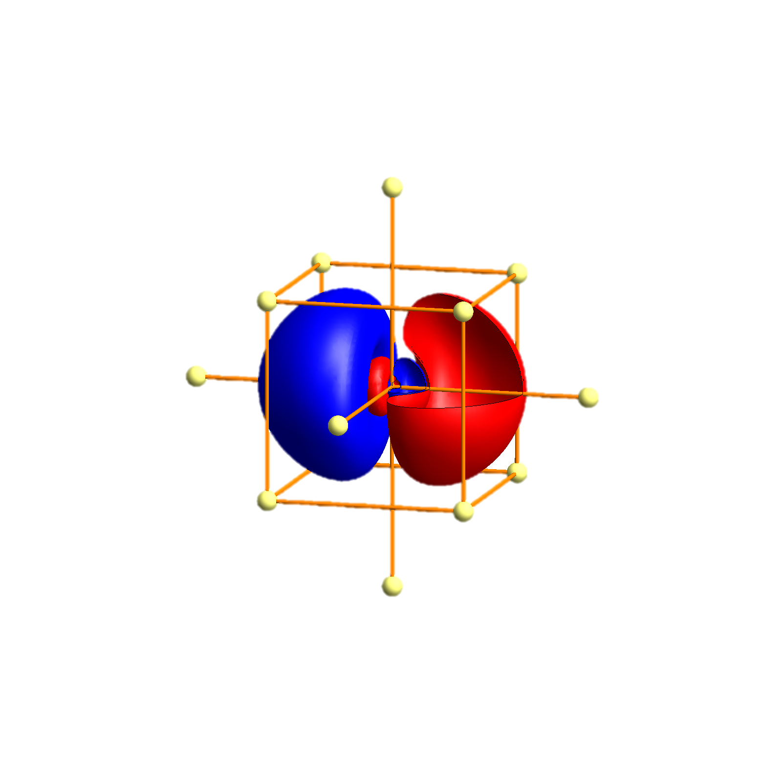
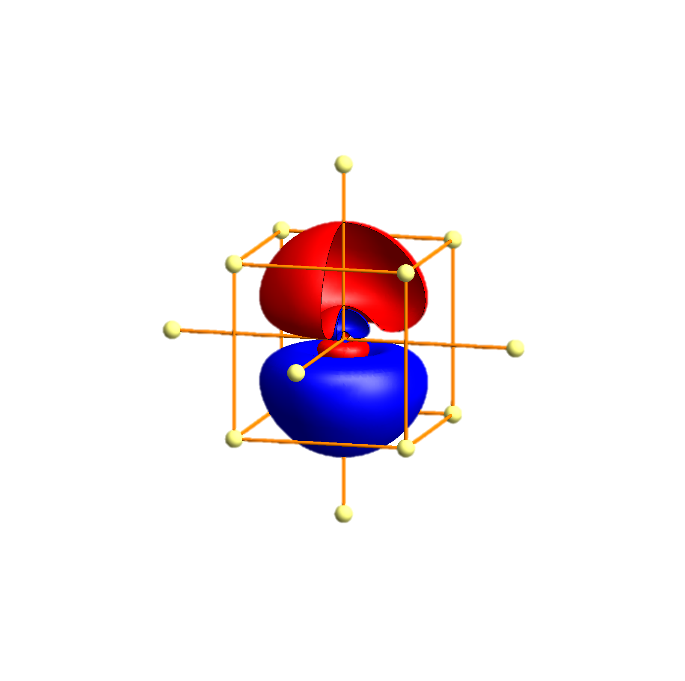
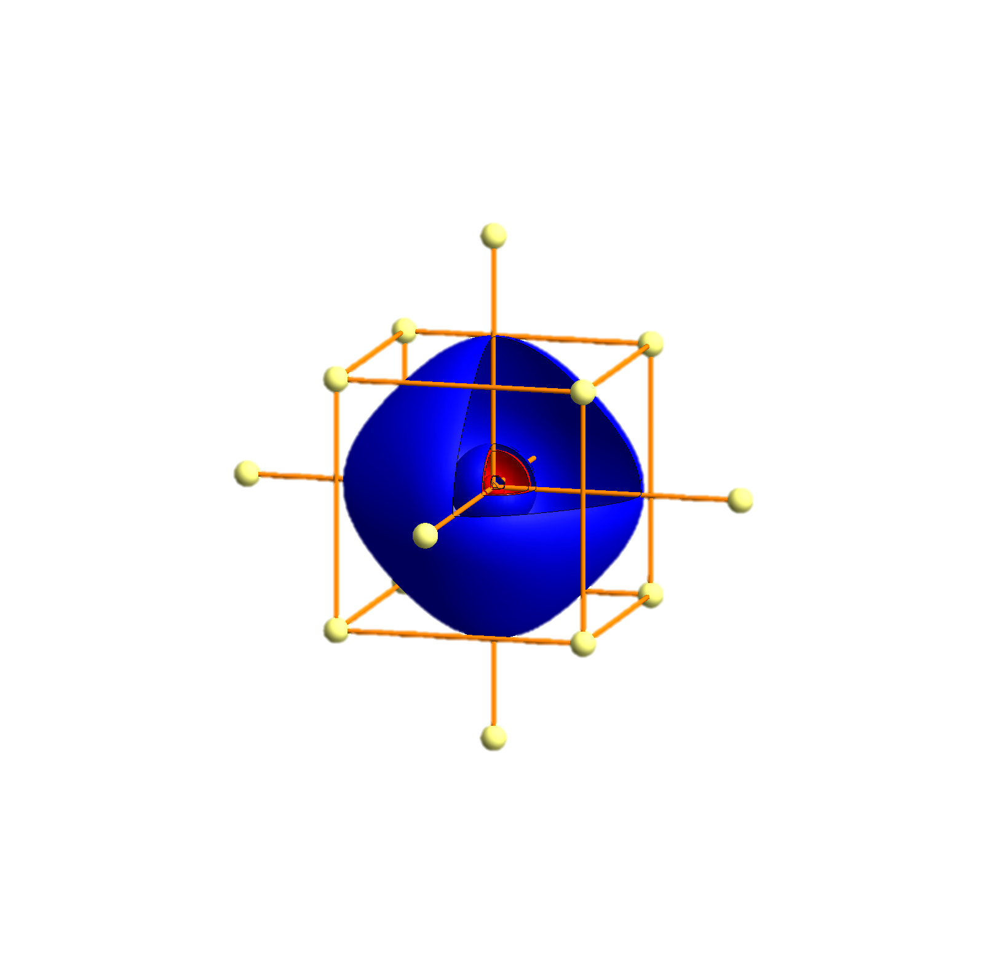
K- Tigth binding description – atomic orbitals
p_{x}
p_{y}
p_{z}
s
P
Γ
P
H
P
Γ
P
H
P
Γ
P

Slide 29
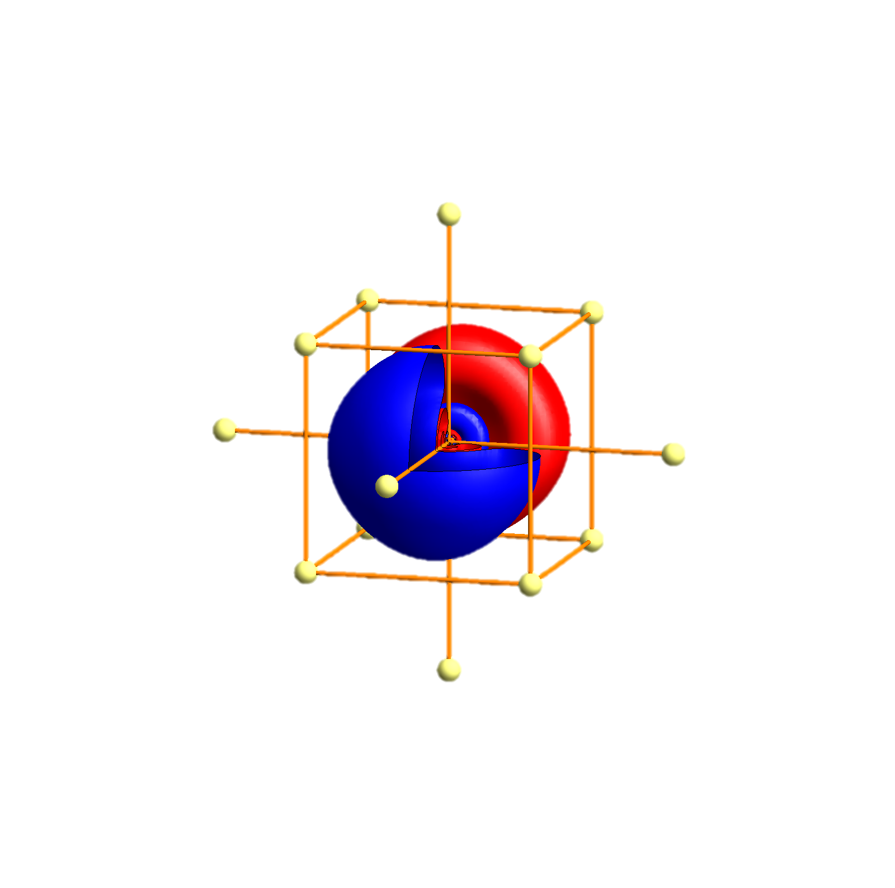
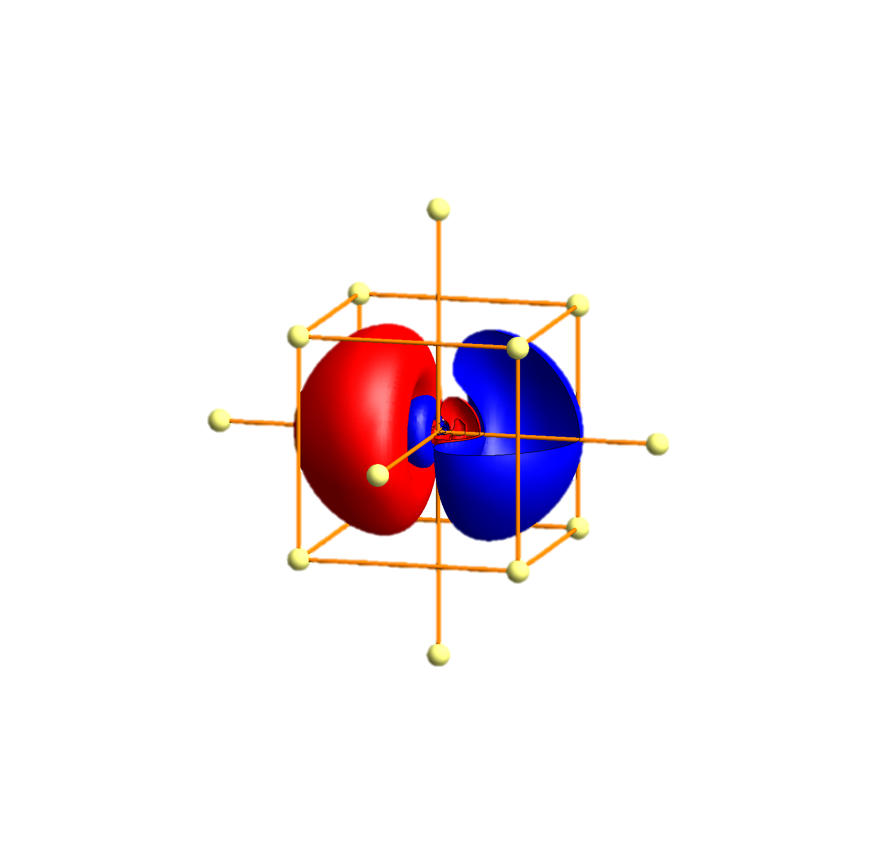
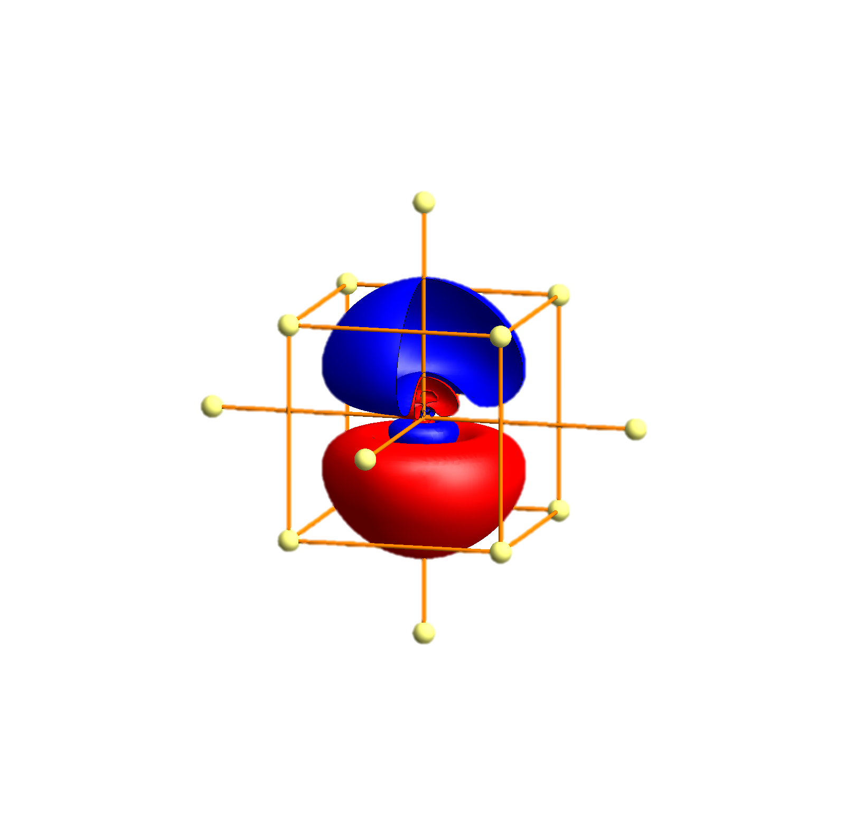
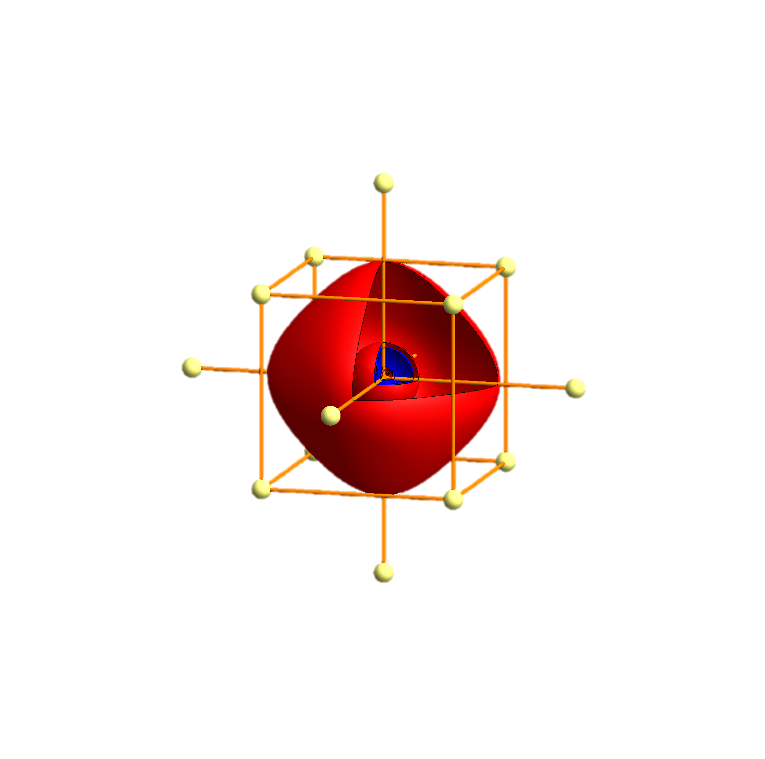
Rb - Tigth binding description – atomic orbitals
p_{x}
p_{y}
p_{z}
s
P
Γ
P
H
P
Γ
P
H
P
Γ
P

Slide 30


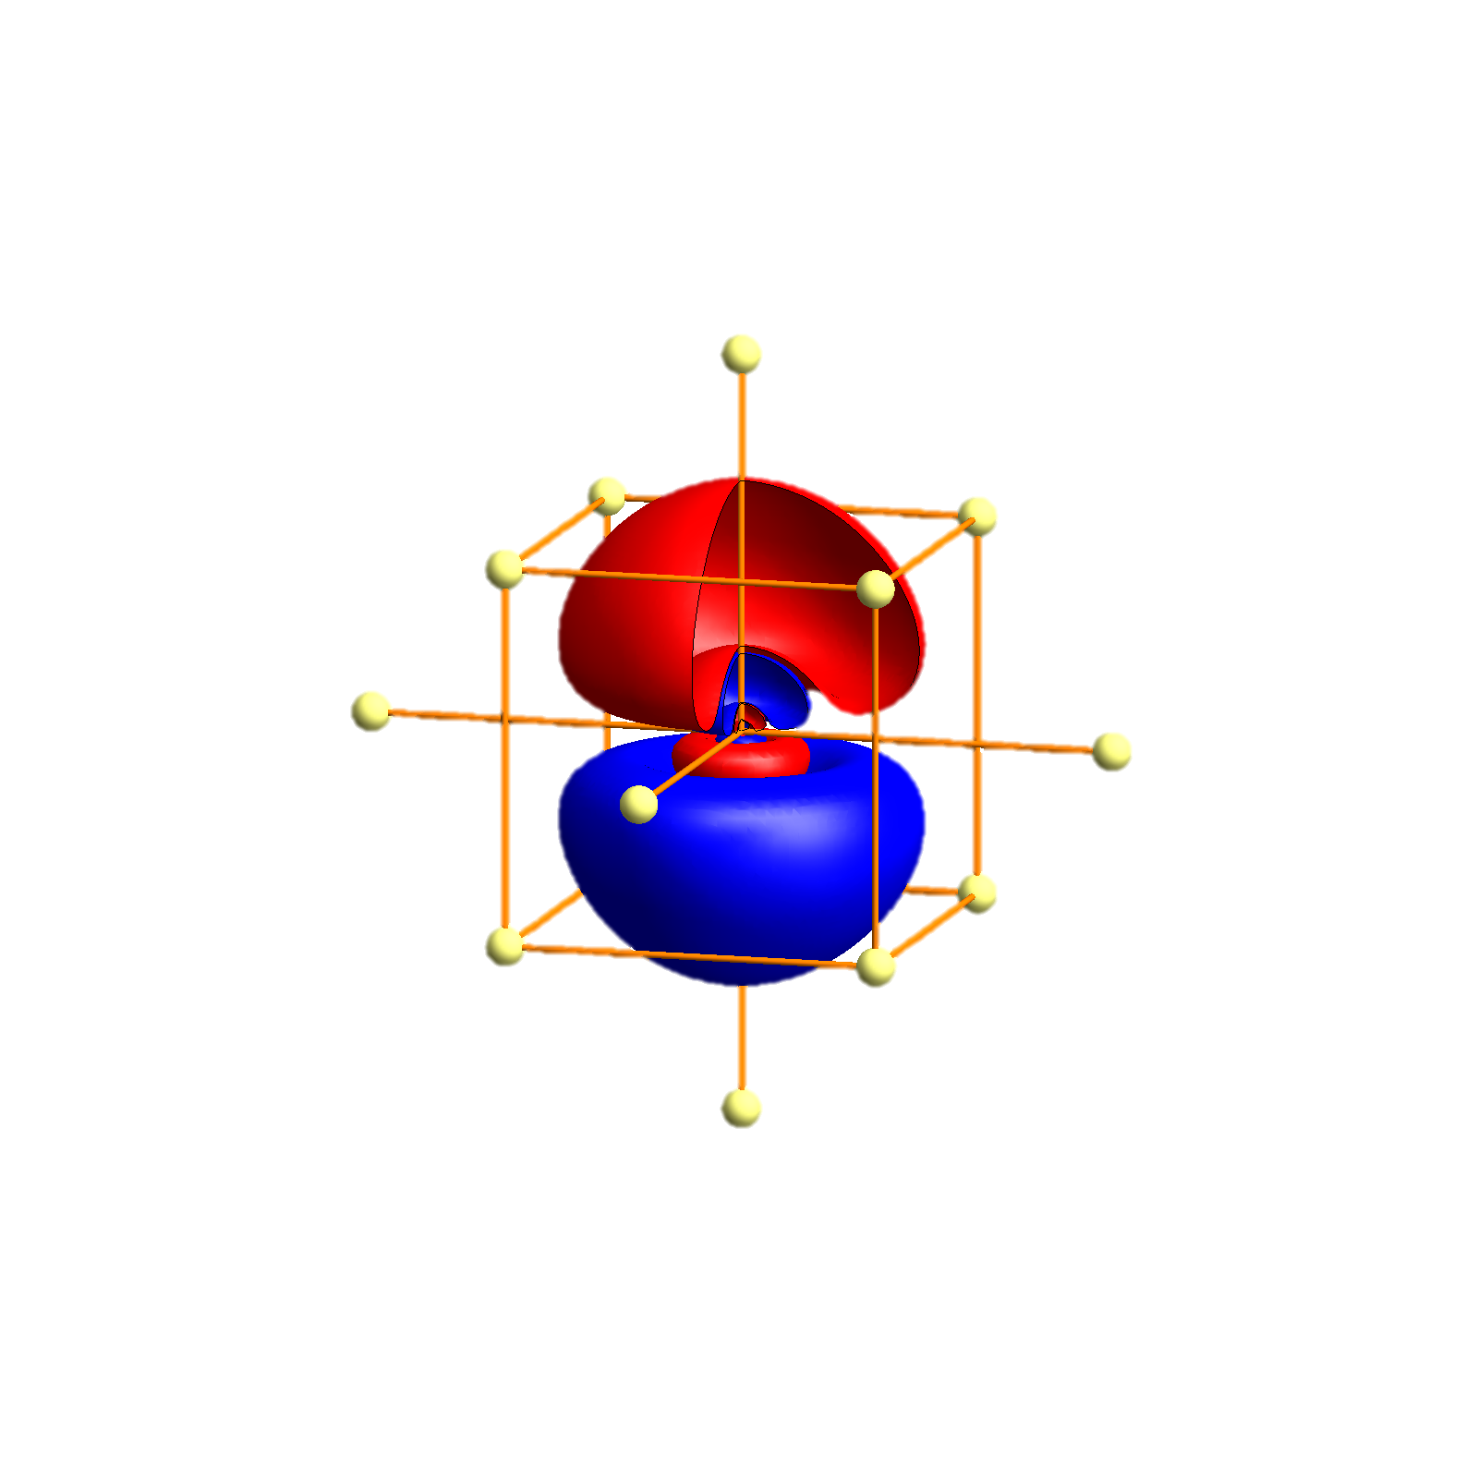
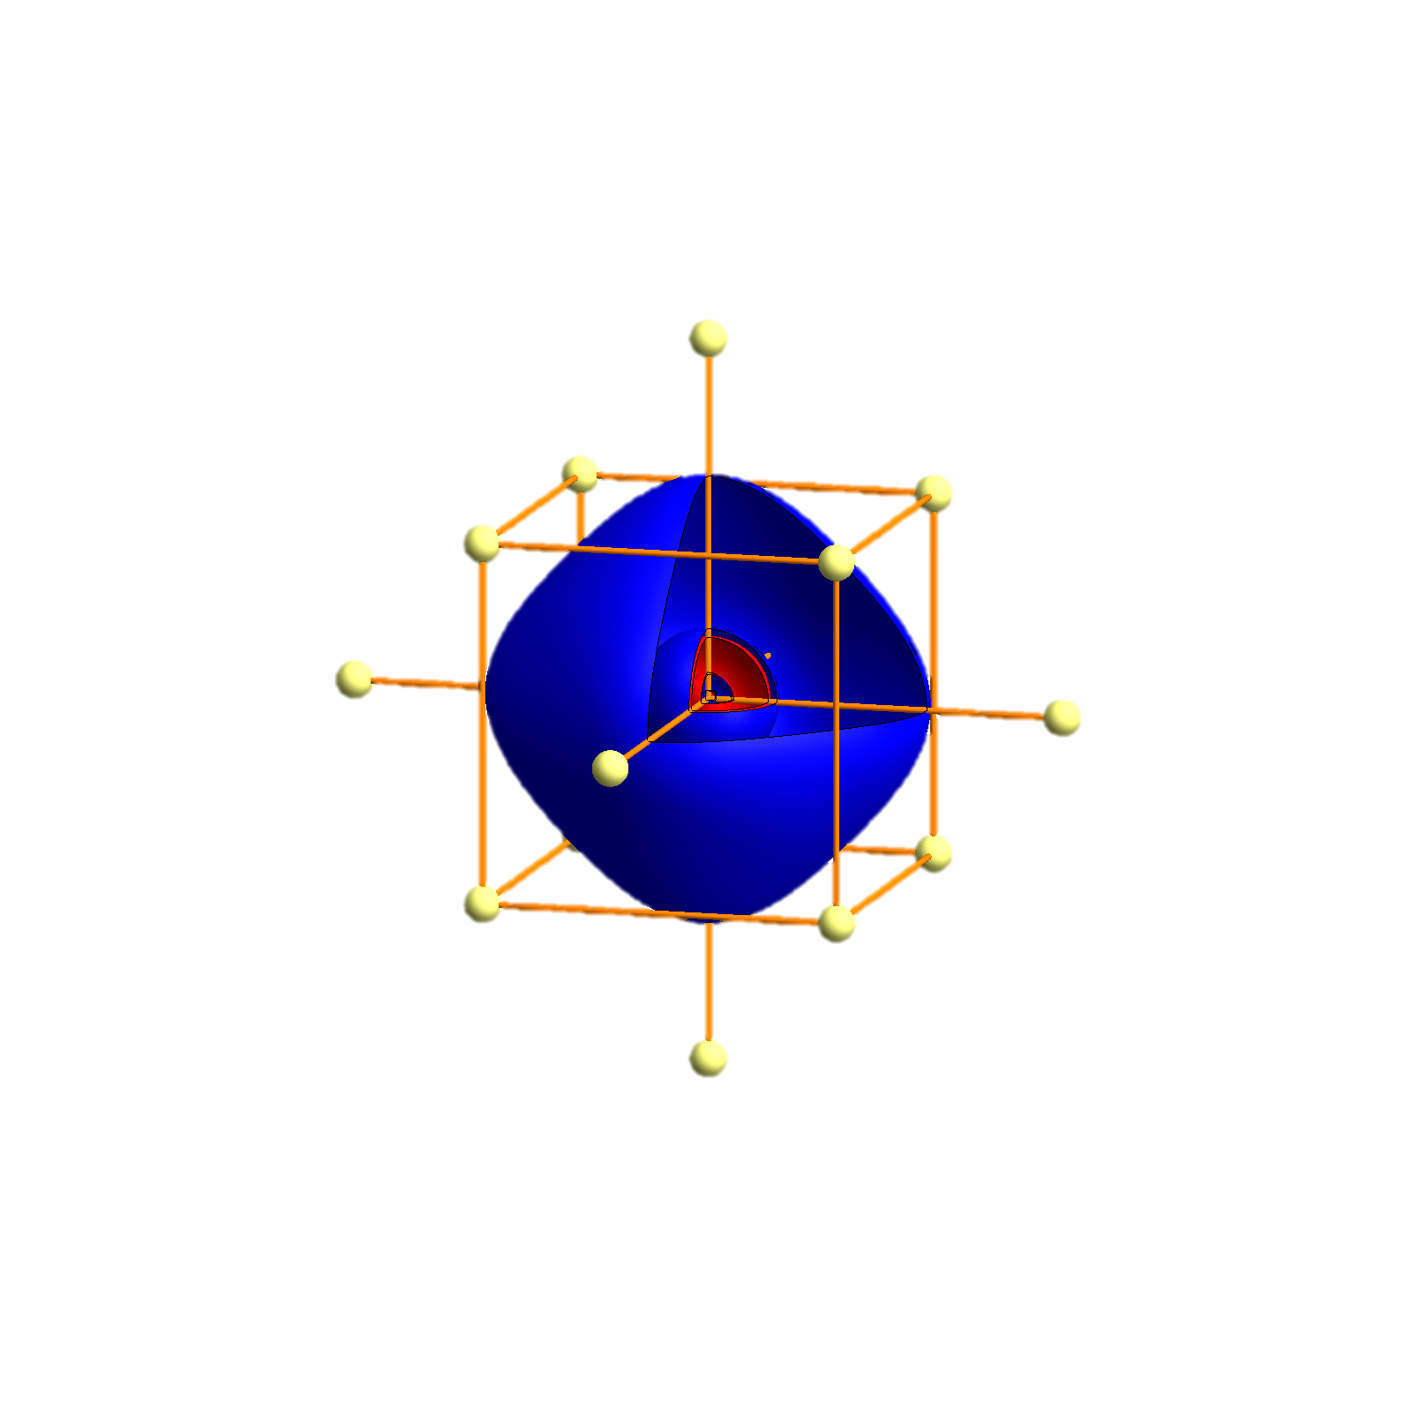
Cs - Tigth binding description – atomic orbitals
p_{x}
p_{y}
p_{z}
s
P
Γ
P
H
P
Γ
P
H
P
Γ
P

Slide 31


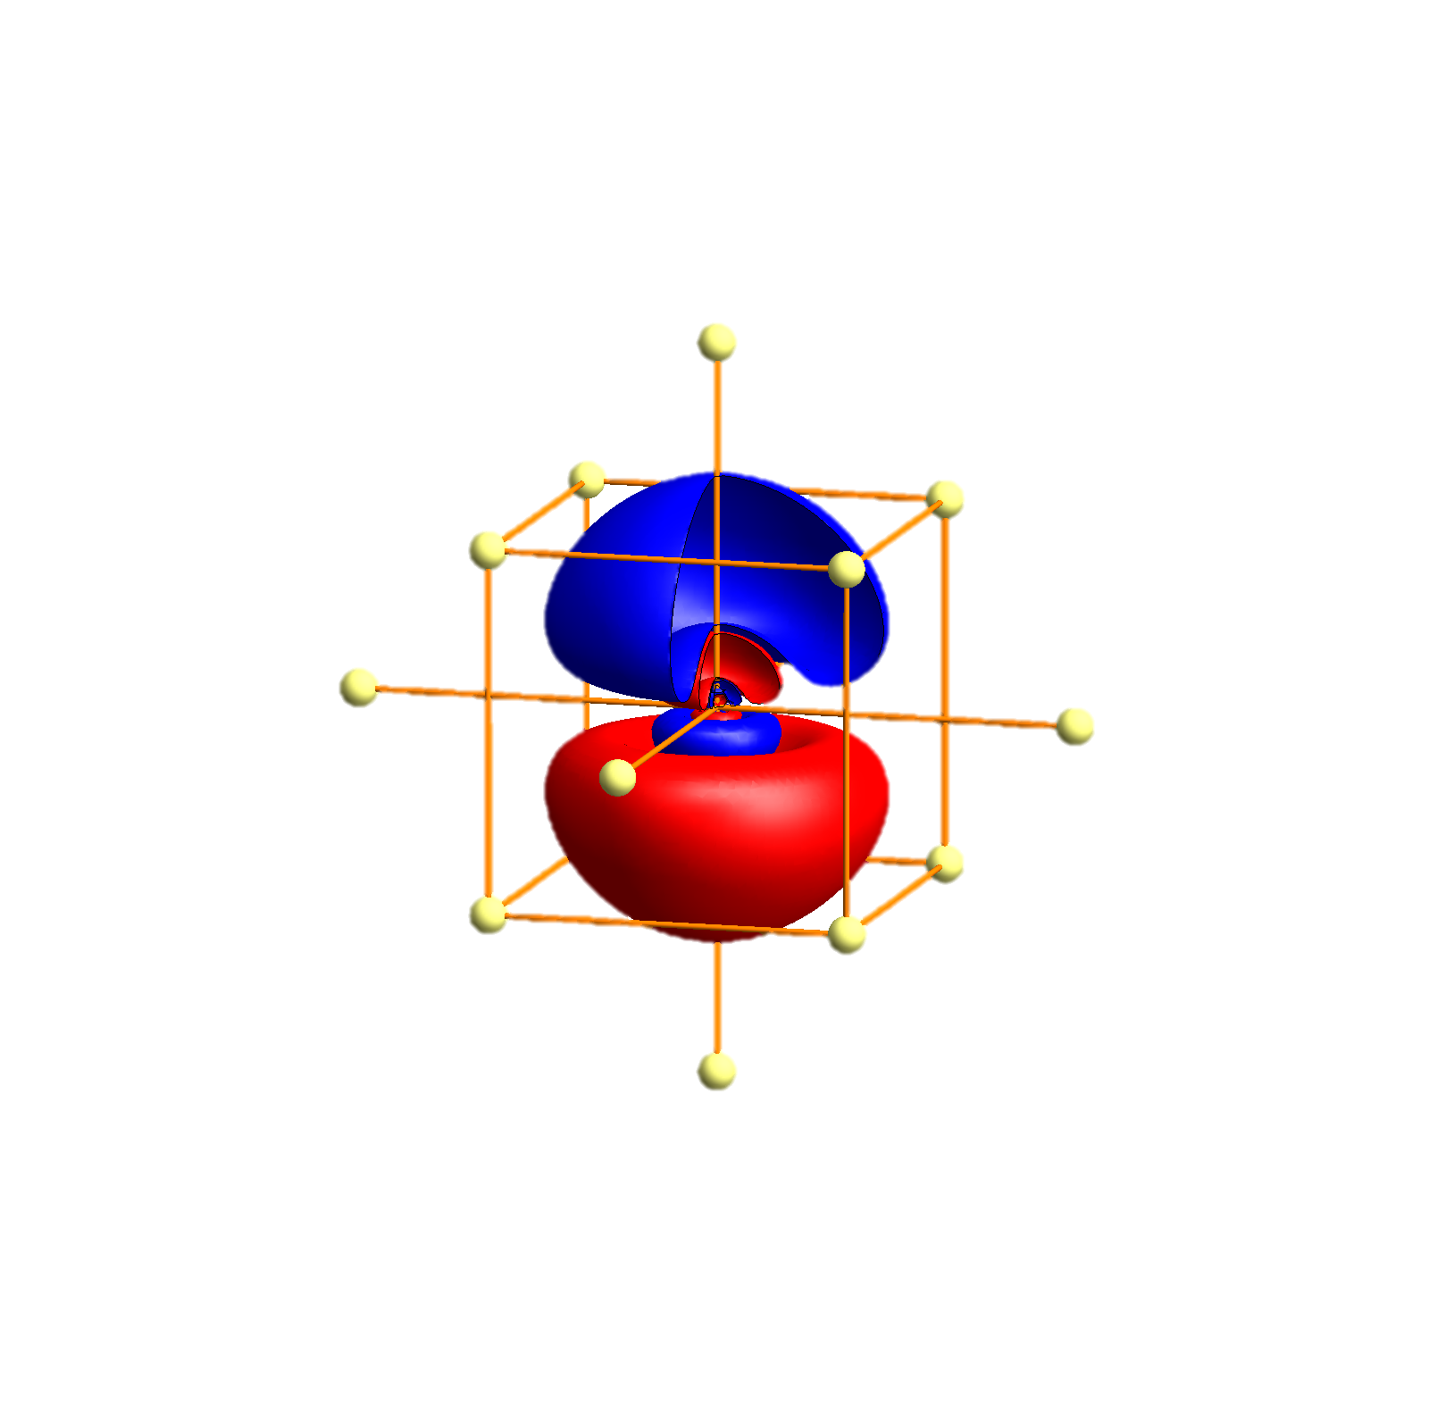
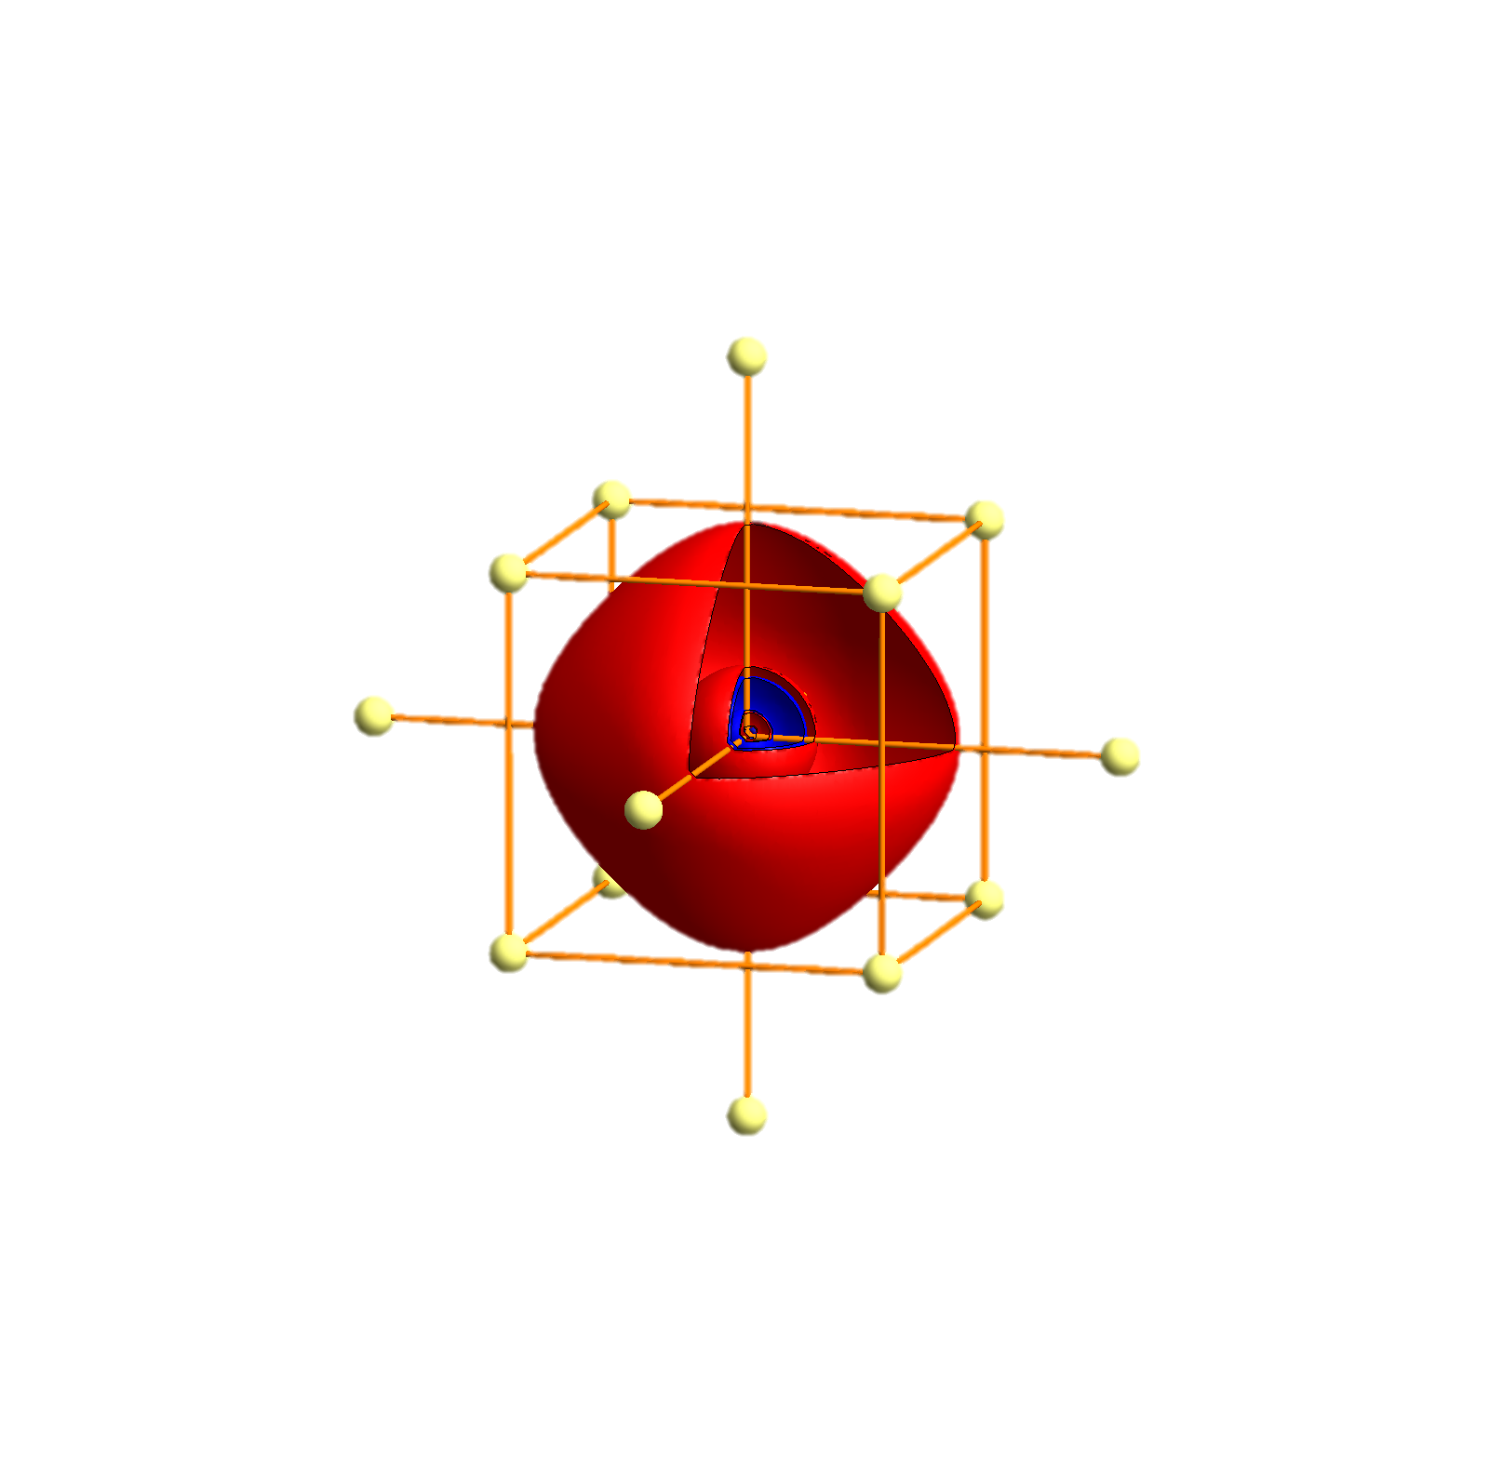
Fr - Tigth binding description – atomic orbitals
p_{x}
p_{y}
p_{z}
s
P
Γ
P
H
P
Γ
P
H
P
Γ
P

Slide 33



A possible realization of a Kitaev model?
In most materials the magnetic interaction is given as
Theoretically one can dream up models whereby the spin direction is related to the hopping direction. In a Kitaev model the x-component of the spin couples in the x direction, the y component in the y direction, the z component in the z direction.
Such exotic models can have all kind of exotic symmetry protected, topological excited state that are thus long lived and can be used for (quantum) spin-tronics.
But these are mathematical models, not descriptions of a material.

Slide 34
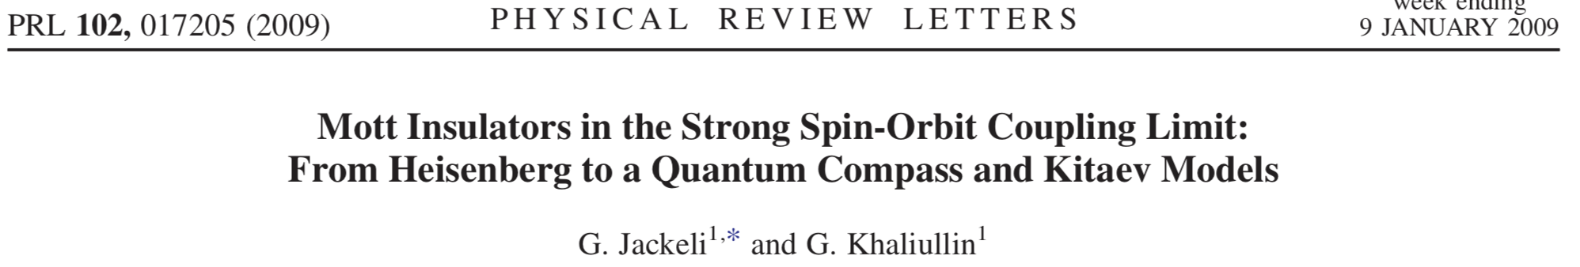
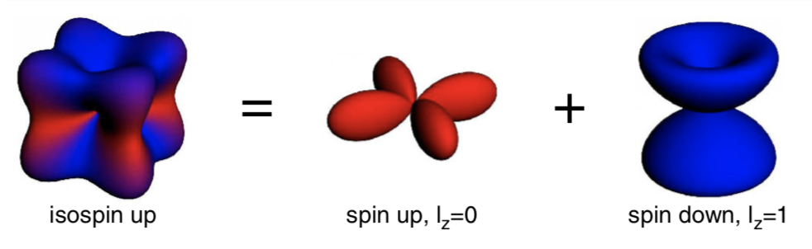
A possible realization of a Kitaev model?
Ir d⁵

Slide 35
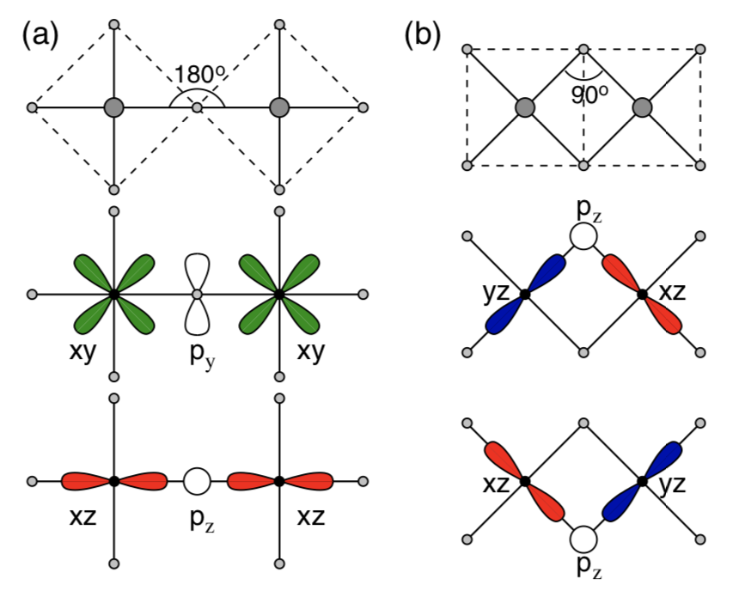
A possible realization of a Kitaev model?

Slide 36
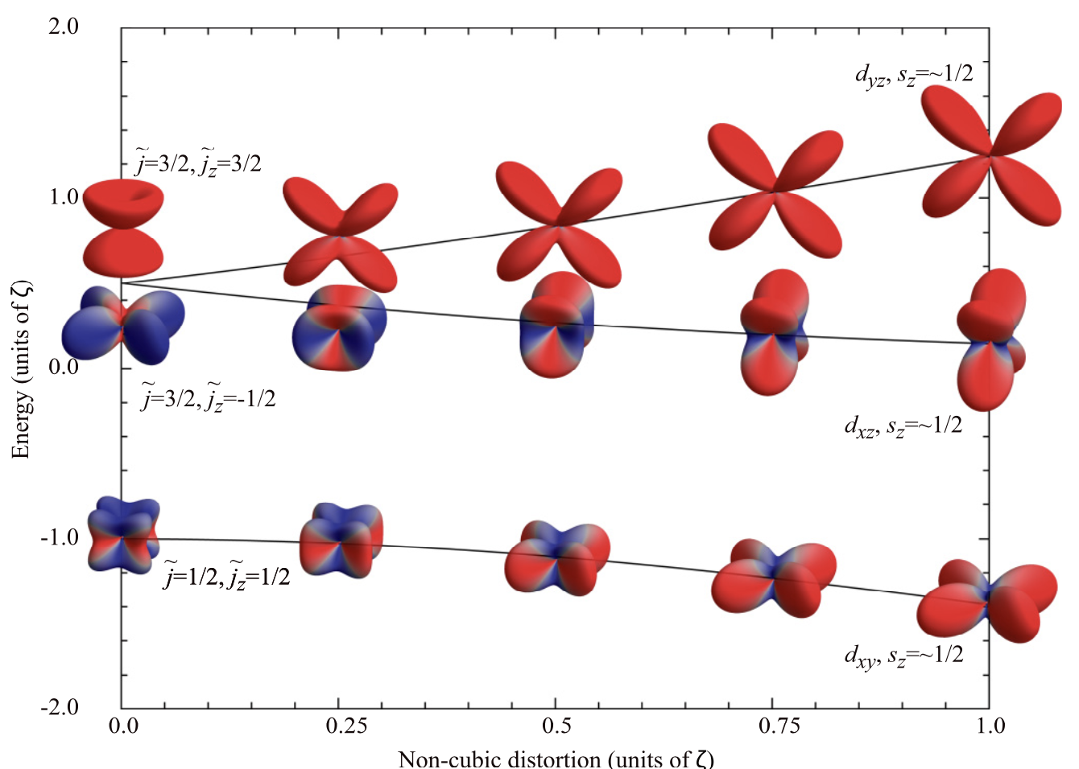
The system needs to be cubic

Slide 37
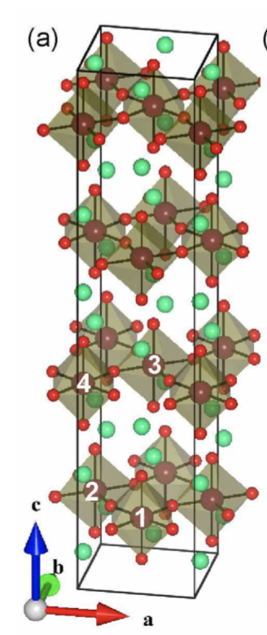
Test the size of the non-cubic distortions in Sr₂IrO₄

Slide 38
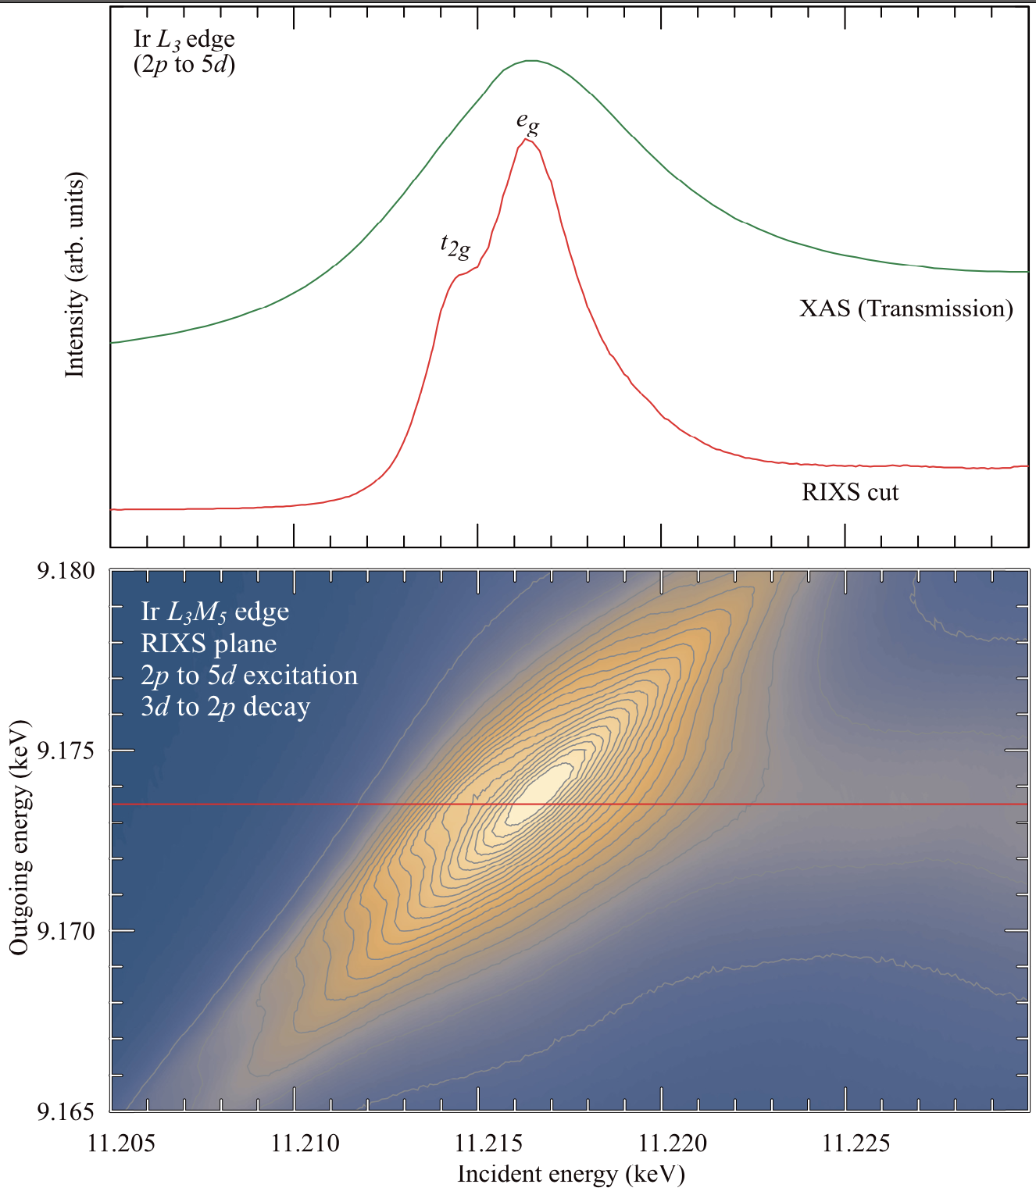
L₃M₄ edge (2p – 5d, 3d – 2p) in Sr₂IrO₄

Slide 39
L₃M₄ edge in Sr₂IrO₄ – resolution enhanced XAS ?

Slide 40
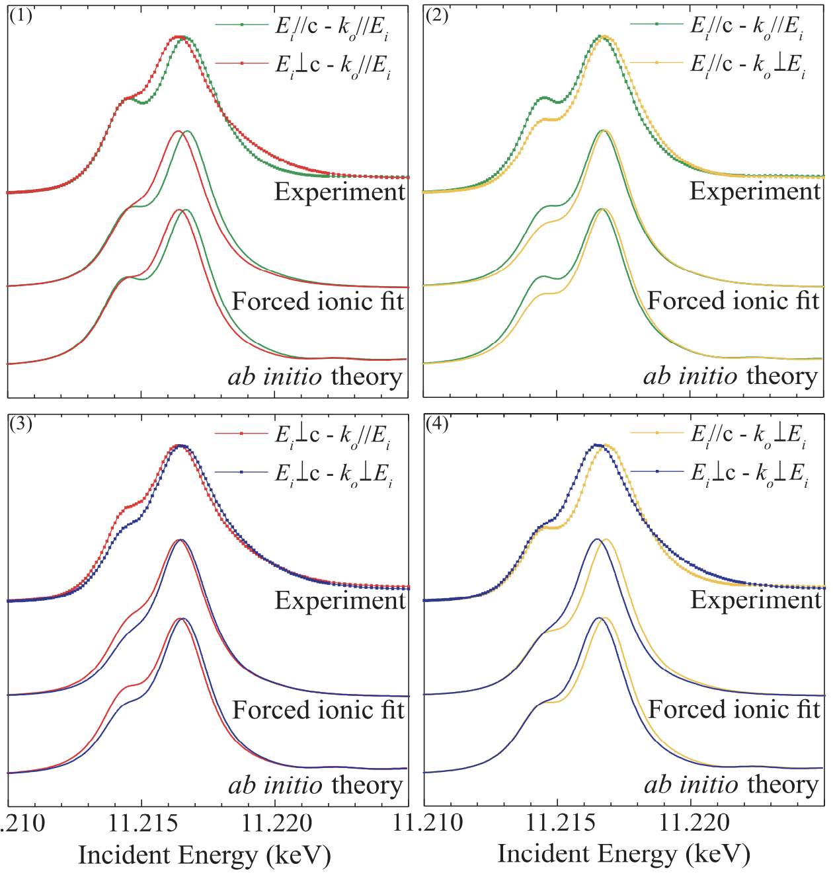
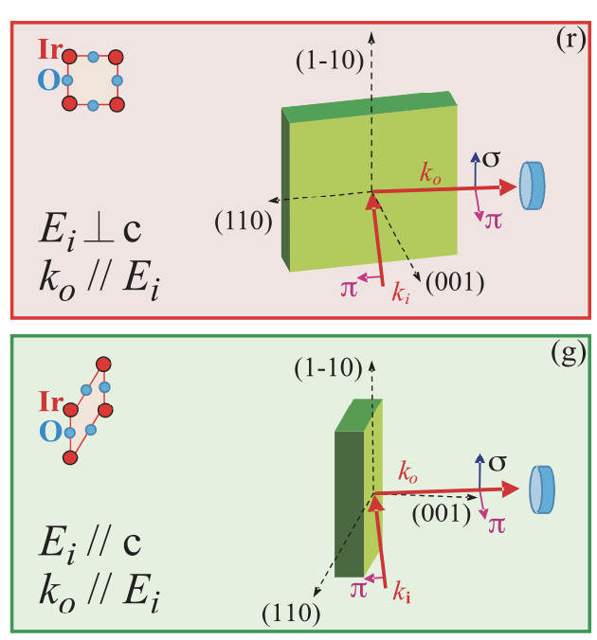
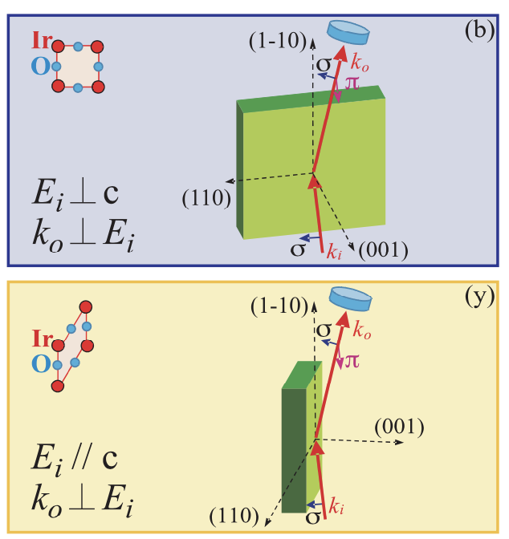
Different measurement geometries yield different spectra

Slide 41
Different measurement geometries yield different spectra

Slide 42
Different measurement geometries yield different spectra

Slide 43
Fit the experiment to a crystal-field theory calculation

Slide 44
Fit the experiment to a crystal-field theory calculation
Delta eg = ~ 0.5 eV
Delta t2g = ~ 150 meV
Spin-orbit atomic value ~ 0.5 eV
Slater integrals reduced to 20% of their atomic value

Slide 45
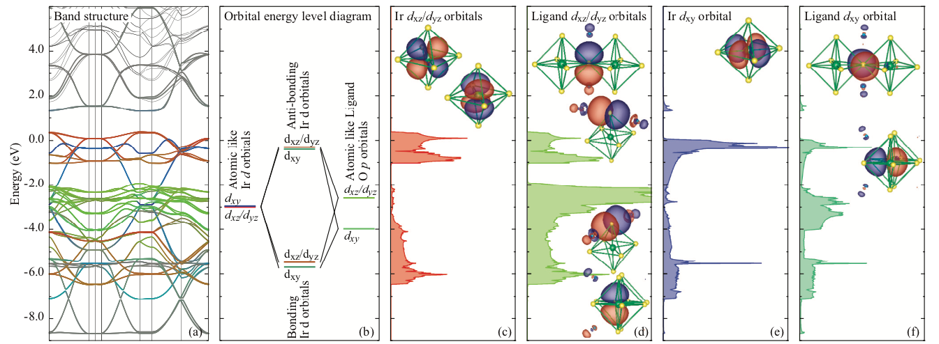
Electronic structure of Sr₂IrO₄

Slide 46
Electronic structure of Sr₂IrO₄

Slide 47
DFT based theory compared to experiment

Slide 48
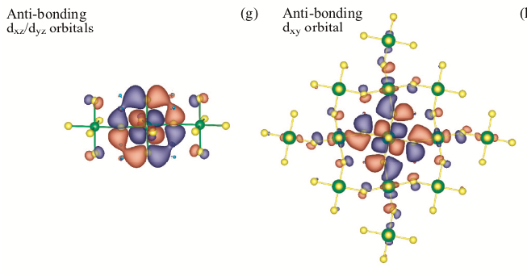
Electronic structure of Sr₂IrO₄

Slide 49
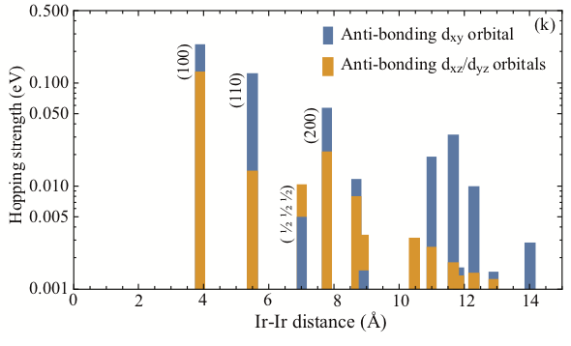
Sr₂IrO₄ – long range anisotropic hopping on t_{2g} basis

Slide 51
Double counting

Slide 53
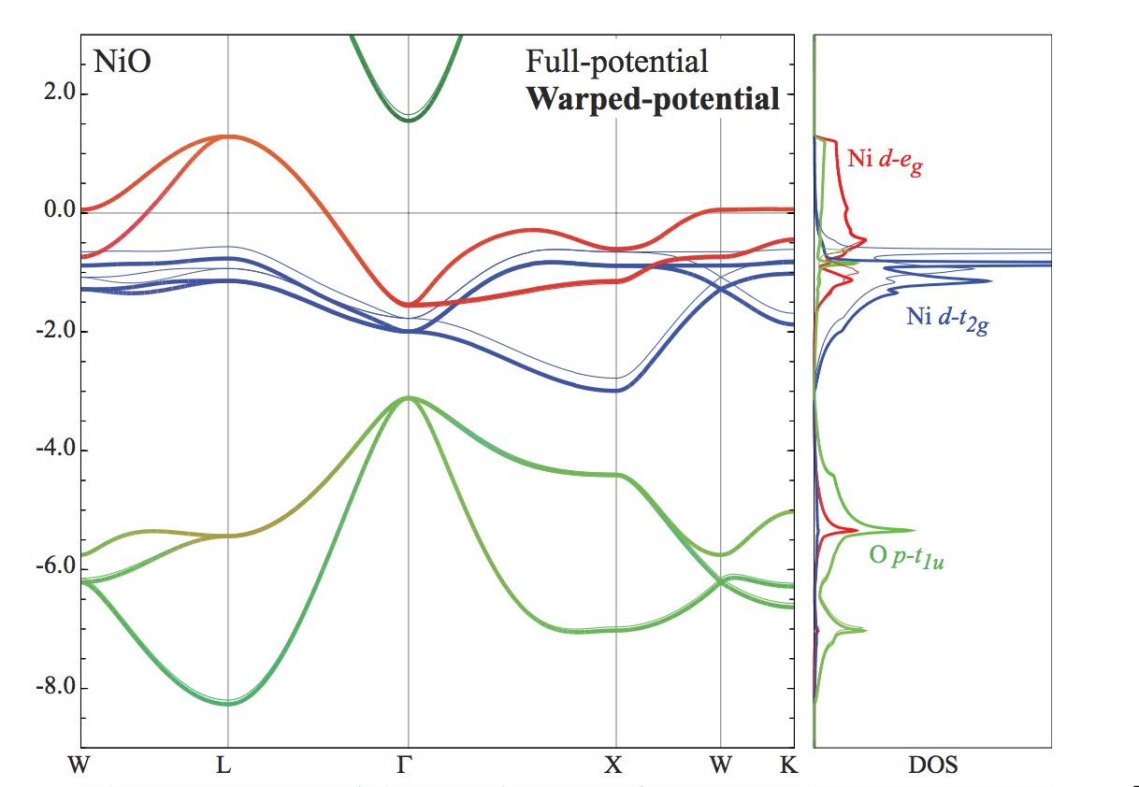
The non-spherical part – effective spurious crystal fields

Slide 55
Creating a cluster Hamiltonian

